Slide 1
KUConnect
Shriharsh Acharya
Rochak Adhikari
Suyog Basnet
Aditya Pokharel
Nerish Shrestha

Slide 2

Introduction
What is KUConnect?

Slide 3
Objective
Centralized Platform for KU News & Announcements
Real-time Notifications
Categorized News & Posts
Interactive Community Features

Slide 4
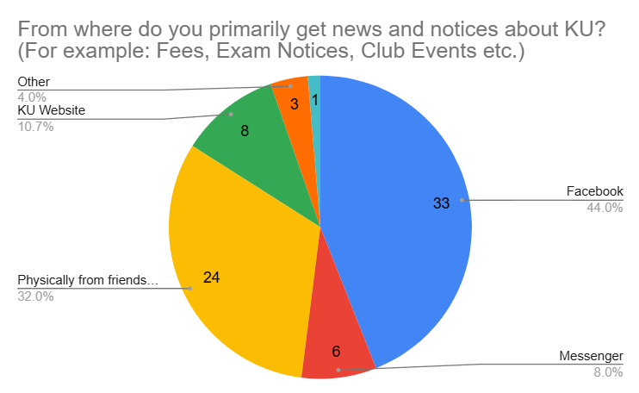
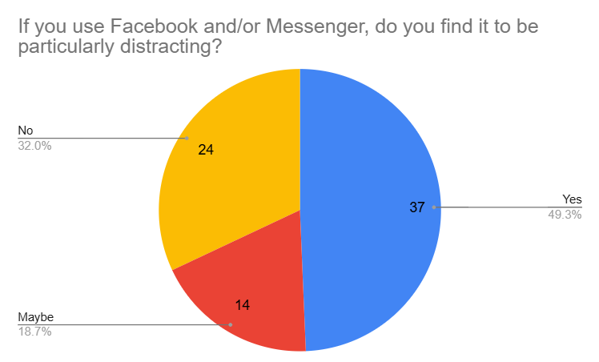
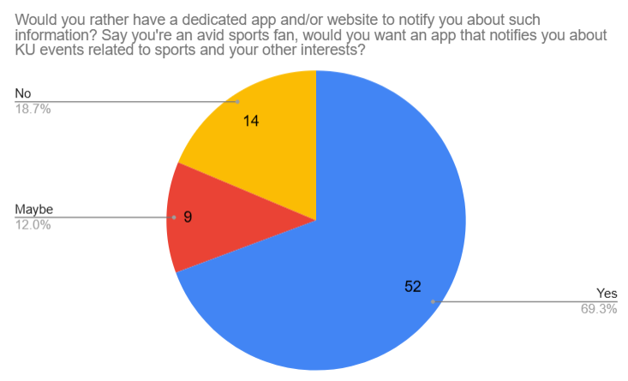
Problem Statement

Slide 5

Technologies Used:
Frontend: React + Tailwind CSS
Backend: Express.js + Node.js
Database: MongoDB

Slide 6
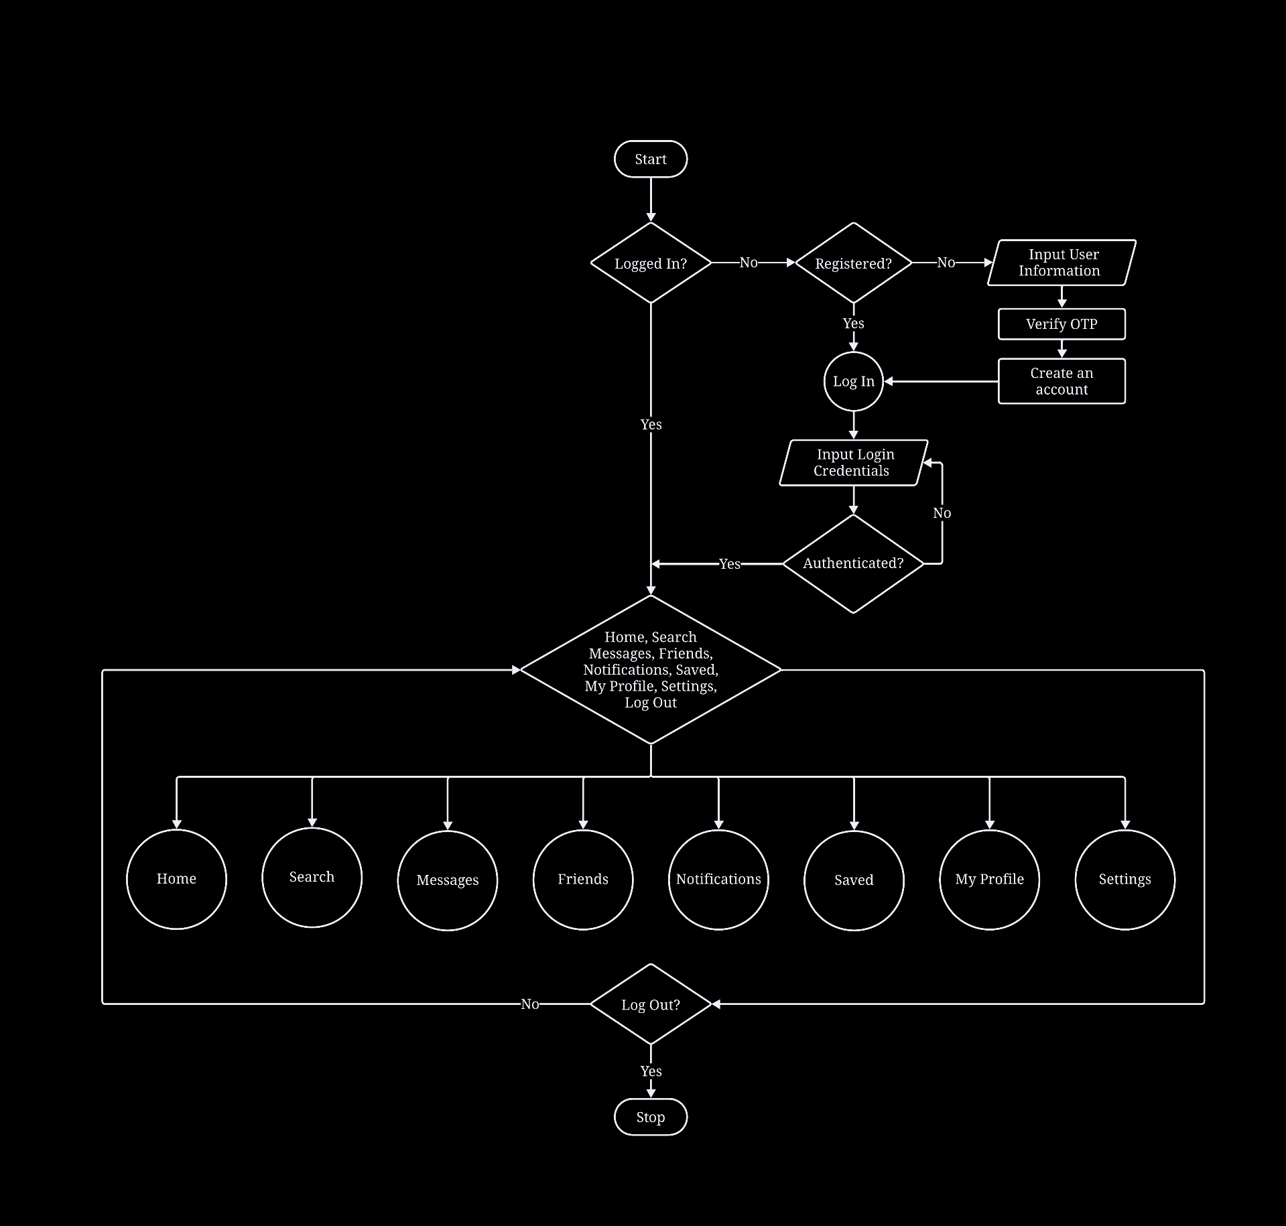
System Flowchart

Slide 7
Video Call
Functional
Search
Component
Login/
Registration
Features
Instant
Messaging
CRUD
Posts
Tags
Subscription

Slide 8




Security Measures
JWT Authentication (Secured user login)
Password Hashing (Using bcrypt)
Input Validation
HTTPS Encryption (For secure communication)

Slide 9
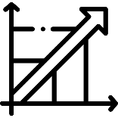



Scalability Constraints
Basic Security Measures
Limitations
Limited Accessibility Features
Absence OF A Mobile APPLICATION

Slide 10



Future Enhancement
Improve scalability and performance
Expand accessibility features
Enhance security and privacy
Develop a mobile application

Slide 11
Thank You! Any Queries?

