Slide 1
Web Communication APIs
adrian.olaru@1and1.ro

Slide 2
Web Communication APIs
Web Messaging
Web Workers
Server Sent Events
Web Sockets

Slide 3
Web Messaging
allows documents from different domains to communicate with each other in a secure way.

Slide 4

5.0+ 3.0+ 10.0+ 4.0+ 8.0+

Slide 5
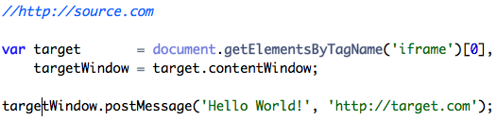

Slide 6
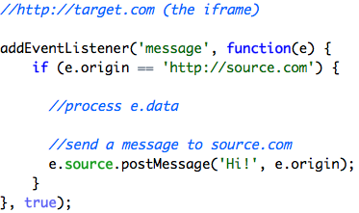

Slide 7
Tips
Check e.origin and e.data
Use JSON.parse and JSON.stringify for sending complex data
Wait for the target to finish loading
Works with documents from same domain too

Slide 8
Web Workers
run JavaScript in parallel on a web page, without blocking the user interface.

Slide 9
5.0+ 3.5+ 10.6+ 4.0+ 9.0

Slide 10
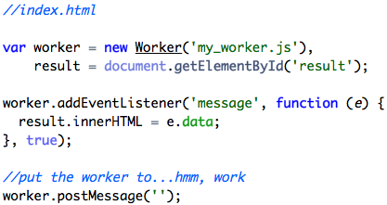

Slide 11
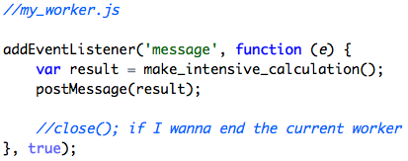

Slide 12
Workers can't
access the DOM.
directly access the 'parent' page.

Slide 13
Workers can
use all core JavaScript functions
use XHR, SSE or Web Sockets
import other libraries with importScript()
use timers (setTimeout, setInterval)
use other workers

Slide 14
Server Sent Events (SSE)
push data from the server to the client over HTTP

Slide 15
6.0+ 4.0 10.7+ 5.0+ 9.0

Slide 16
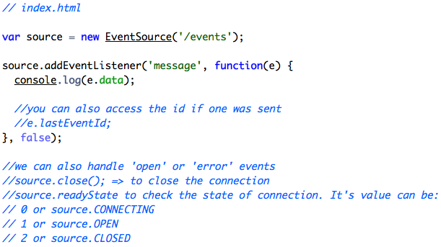

Slide 17
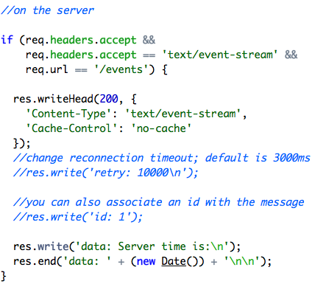

Slide 18
Web Sockets
a bi-directional connection between the server and the client

Slide 19
5.0+ 4.0 11 5.0+ 9.0

Slide 20
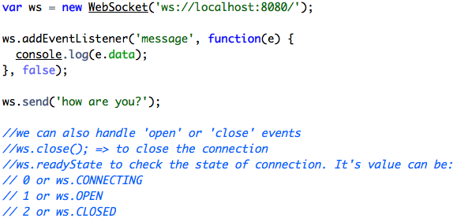

Slide 21
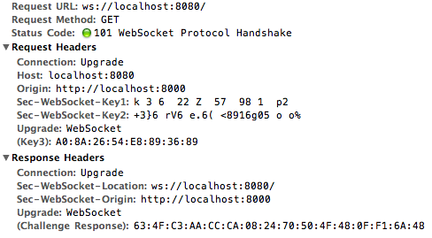

Slide 22
Danke

