Slide 1
control your IoT device through phone
Made Adi Paramartha Putra
STMIK Primakara - 2020

Slide 2

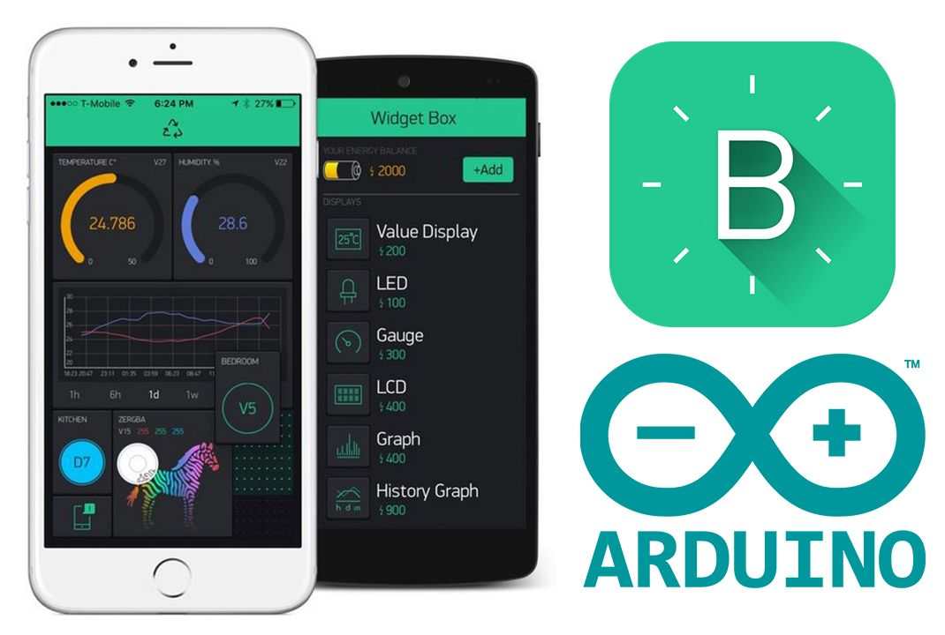
Today outline
Introduction of Mobile Apps
Blynk as IoT Development

Slide 3
1. Iot through mobile apps
Control your IoT device easily

Slide 4
Internet of Things device able to controlled from anywhere and anytime even from a mobile phone application.

Slide 5
how to control the device
End to end connection with device
Platform that used to control the device
Able to do something without worrying abotut the distance

Slide 6
What is actual control
Monitoring
Is a method to simultaneously read the current condition of anything.
Operation
Is a method that able to simultaneously read the current condition as well as controling the device to do something new.

Slide 7
2. Blynk for iot development
Develop your first IoT mobile apps

Slide 8

An iot platform for business development
Blynk providing easy and fast access to controlling your IoT devices through your phone with many customizable control mode.

Slide 9
BLYNK.Io
Providing free access to develop and control your first IoT Project

Slide 10
Few THINGS that you need
Smartphone
• Android OS version 4.2+
• iOS version 9+
Blynk doesn't run on Windows Phones, Blackberries and other dead platforms. Sorry.
You can also run Blynk on emulators
IoT Device
Blynk can run on over 400 hardware modules. The most popular are:
• ESP8266
• ESP32
• NodeMCU
• Arduino (any model)
• Raspberry Pi (any model).
Internet Connection
To connect your hardware to the Internet, you can choose almost any module either built-in, or external shields
Supported connectivity
• WiFi
• Ethernet
• Cellular (GSM, 2g, 3g, 4g, LTE)

Slide 11
how to start using blynk
Download Blynk in your Phone
Installing Blynk Library in Arduino IDE
Connect IoT device with auth token
Enjoy Blynking!

Slide 12
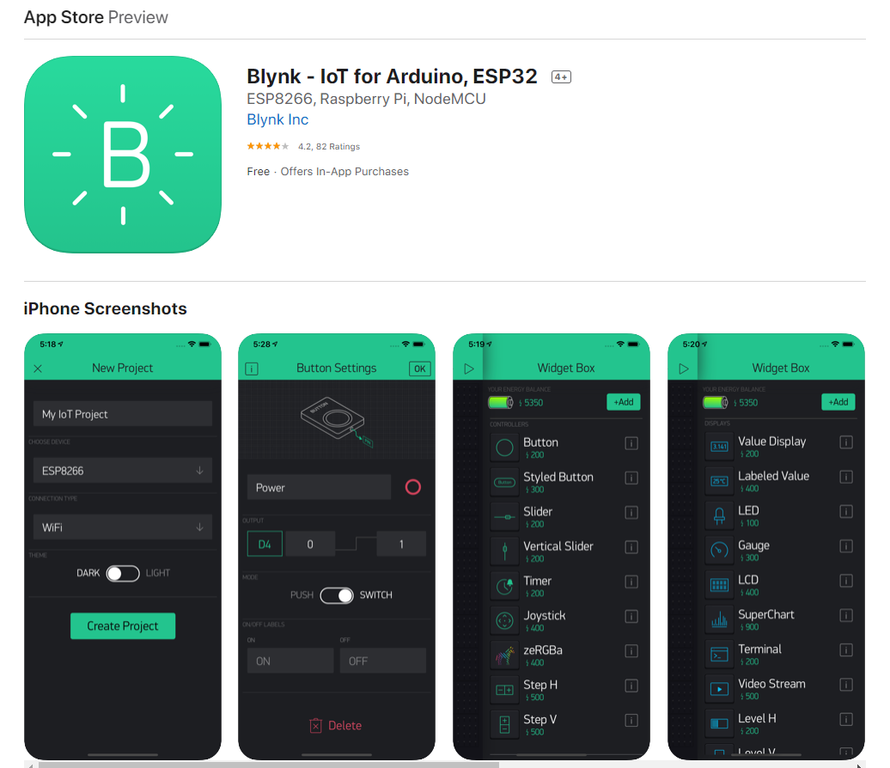
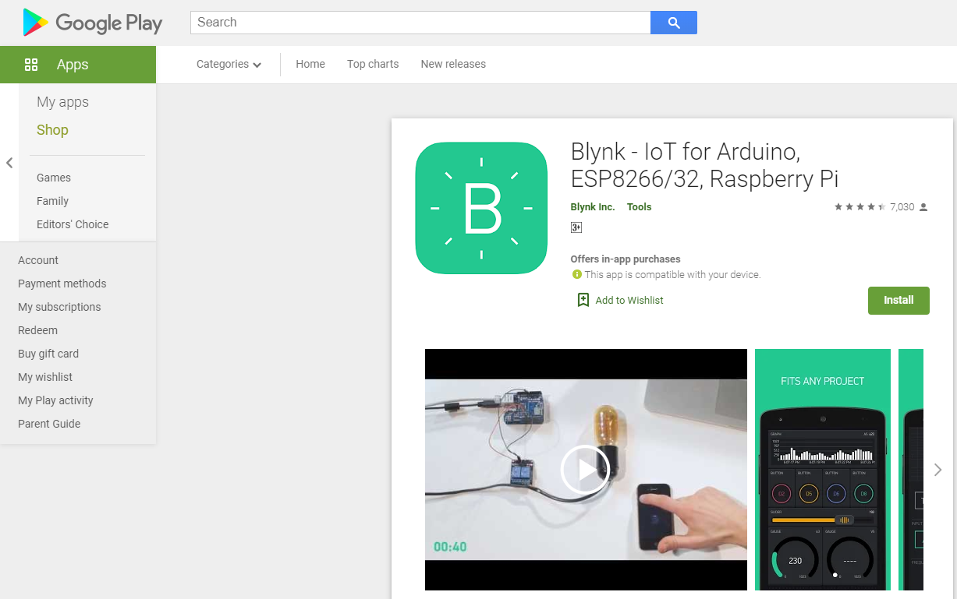
download blynk app @mobile phone
Download Blynk in your Phone

Slide 13
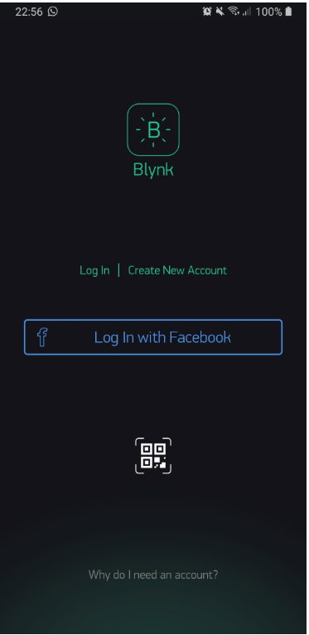
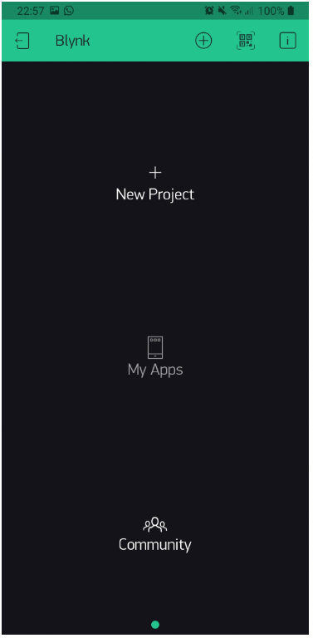
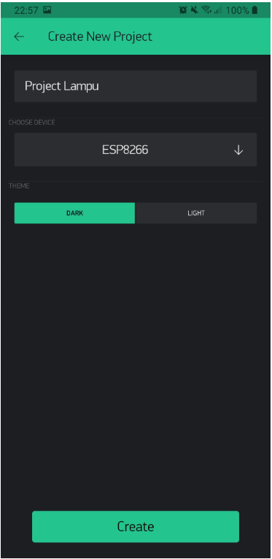
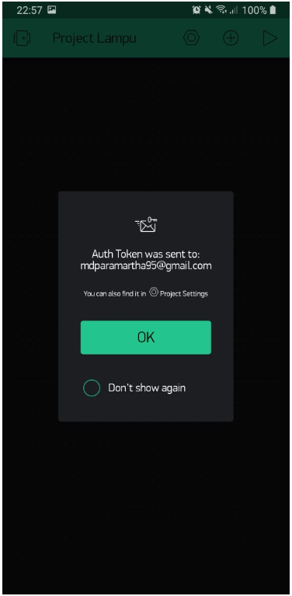
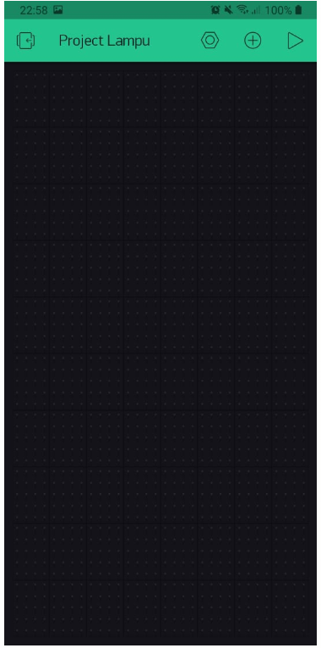
create an account
Create an account and sign in

Slide 14
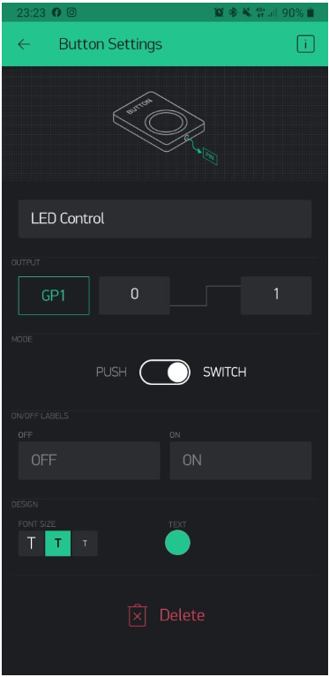
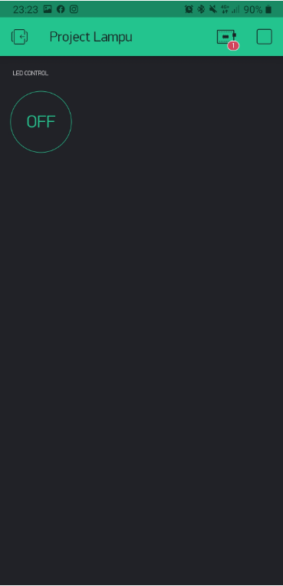
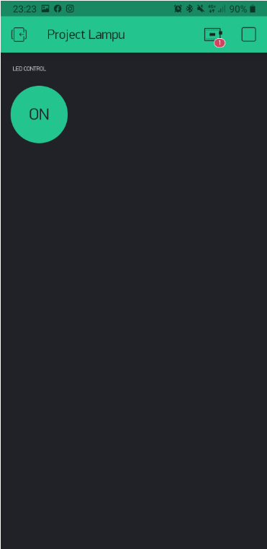
create an project
Create an project with gp1 as selected Pinout (ESP8266)

Slide 15
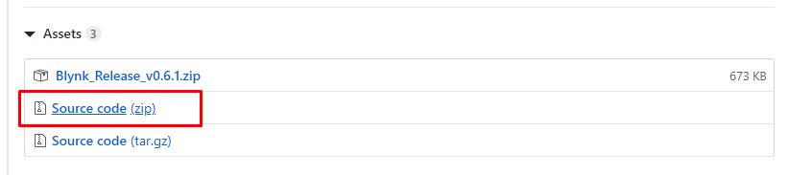
Install blynk app @Arduino ide
Downloading Blynk Library from Website
Download Link:
After downloading, include the library (.zip) in Arduino IDE

Slide 16
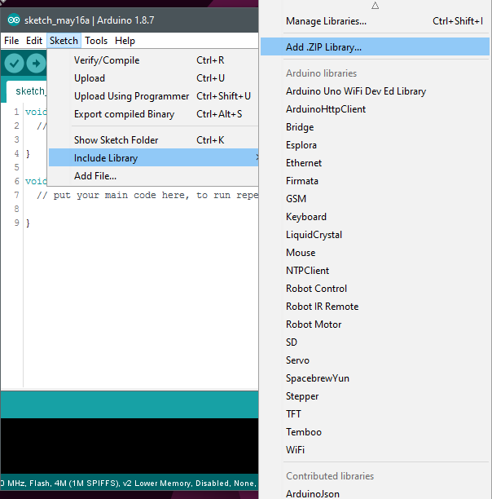
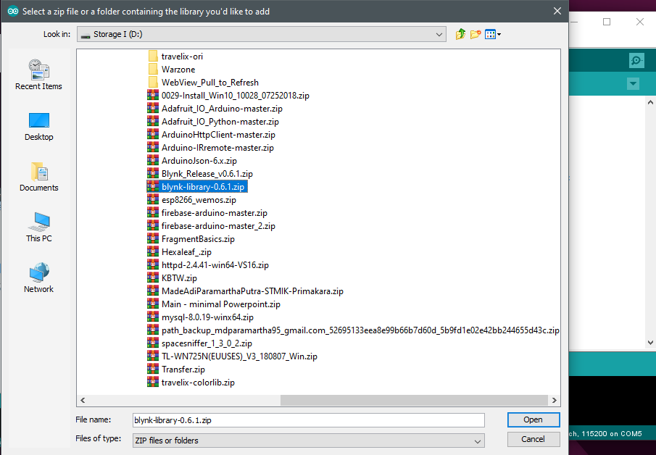
Install blynk app @Arduino ide - 2
Installing Blynk Library in Arduino IDE

Slide 17
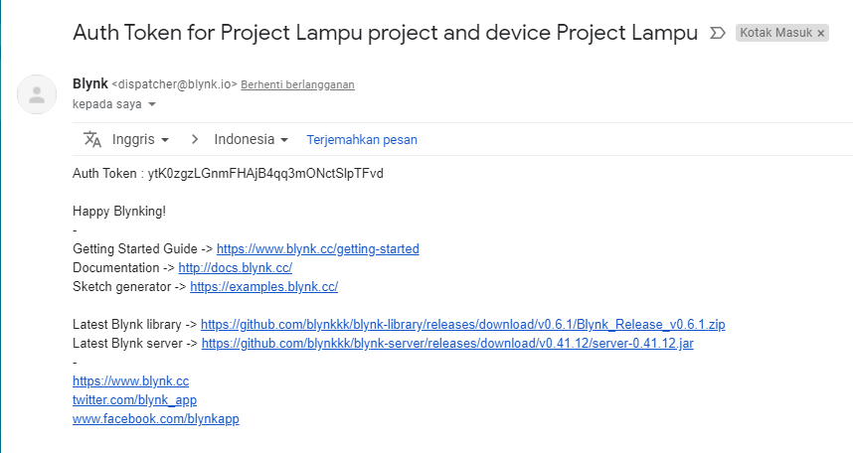
connect iot device w/ auth token
Connect IoT device with auth token
Token: ytK0zgzLGnmFHAjB4qq3mONctSlpTFvd

Slide 18
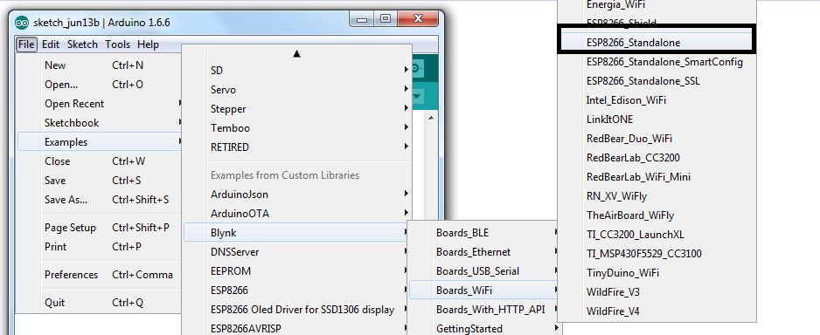
connect iot device w/ auth token - 2
Choose the correct code for your board

Slide 19
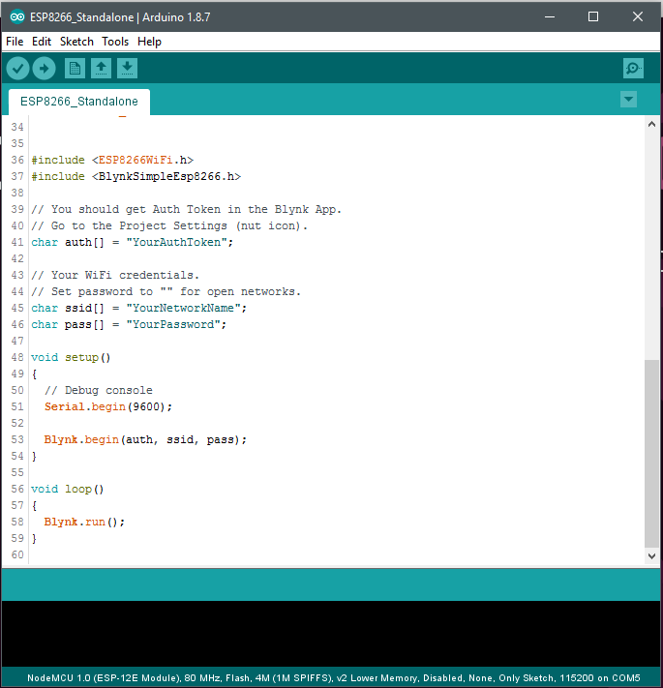
connect iot device w/ auth token - 3
Input the auth token into the code
Remember to input ssid information for internet connection

Slide 20
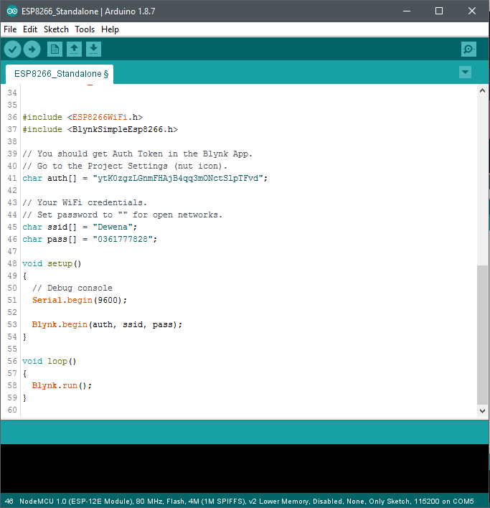
connect iot device w/ auth token - 4

Slide 21
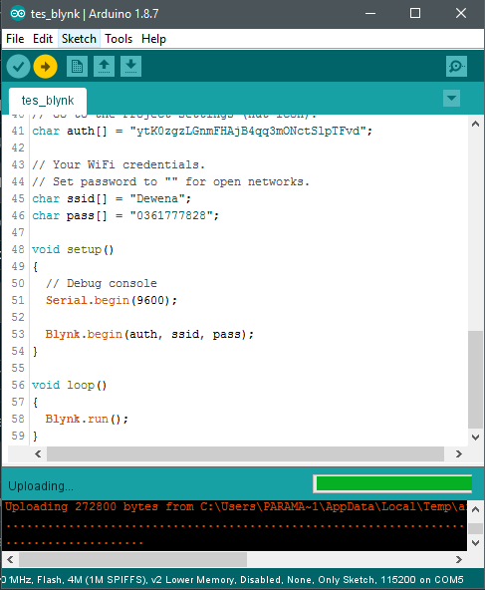
connect iot device w/ auth token - 5

Slide 22
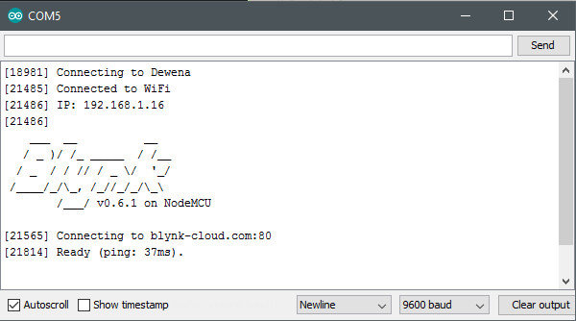
the results (connection)

Slide 23
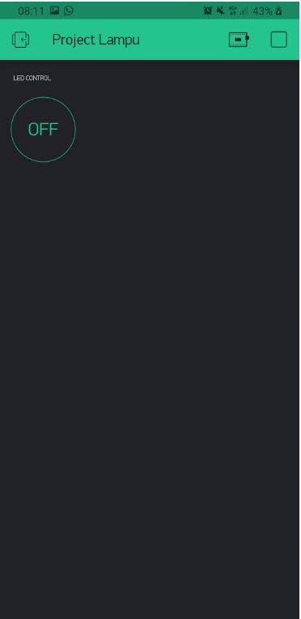
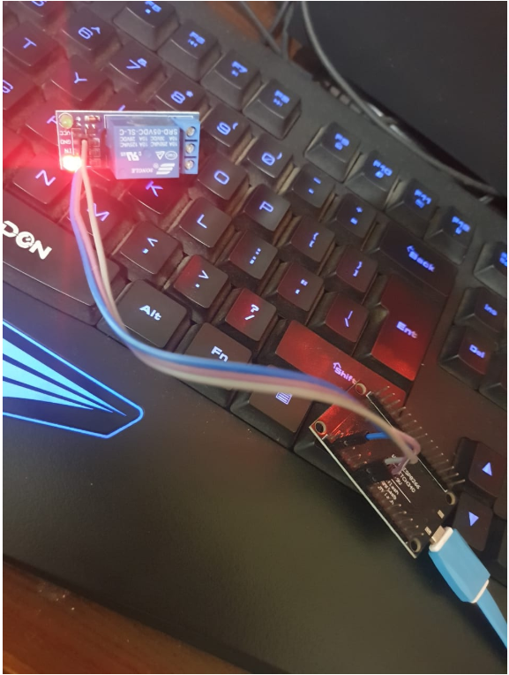
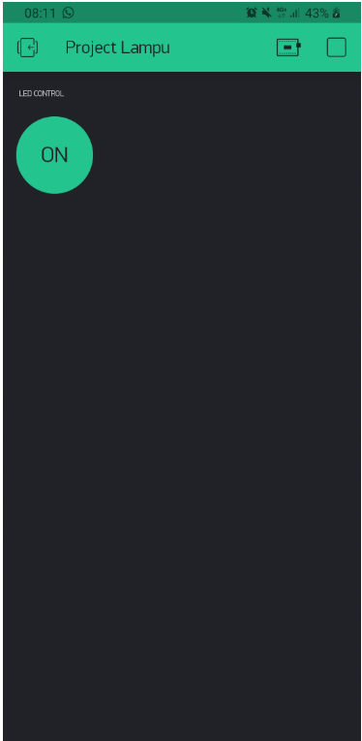
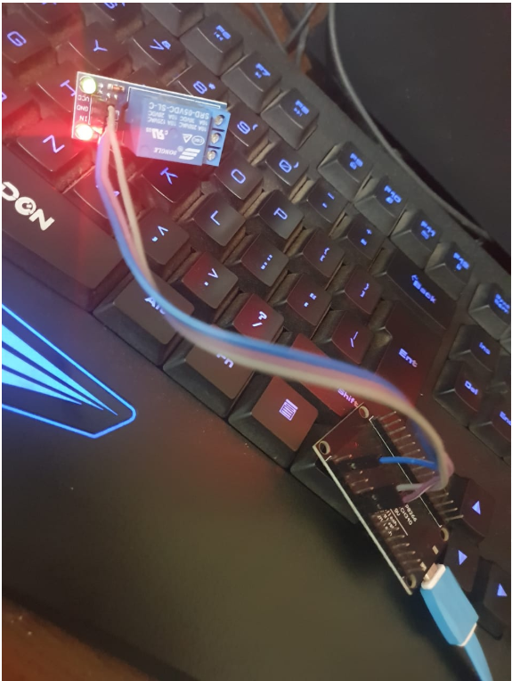
the results - 2

Slide 24
Enjoy the blynk app
Enjoy Blynking!

Slide 25

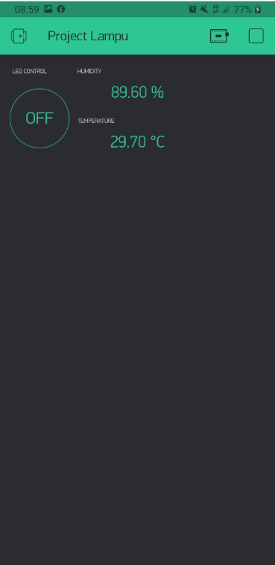
How to show sensor value?
For example dht22 sensor.

Slide 26
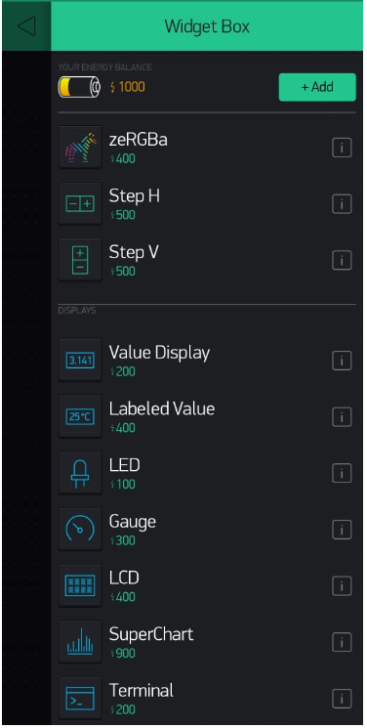
Labeled value
Widget that used to shows sensor value

Slide 27
How to do that ?
Add New Widget
Create two (2) widget to show current sensor value.
1 widget for temperature
1 widget for humidity
Settings up Widget
Modify the widget setting and make it able to receive the sensor value through Virtual Pin (Blynk)
Modify the Code
Add DHT22 Sensor Code into Arduino IDE to read the current sensor value, and send it with virtualWrite(virtualPin, value).
Mobile settings
Arduino settings

Slide 28
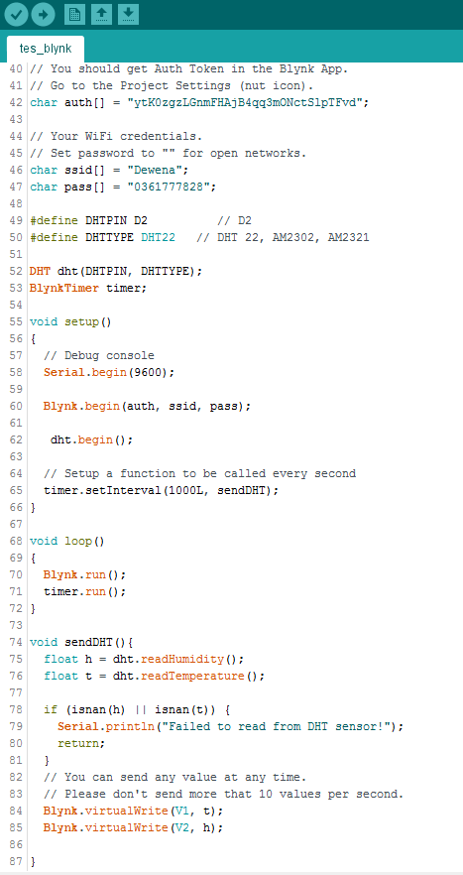
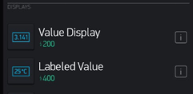
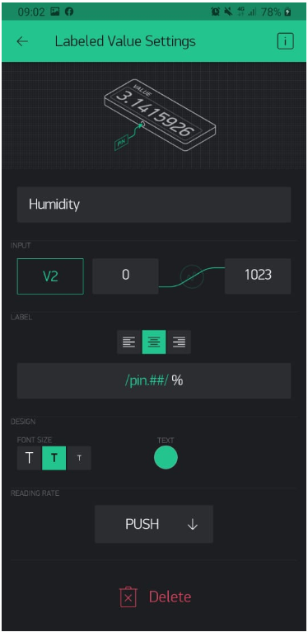
How to do that ? - 2
Add New Widget
Settings up Widget
Modify the Code
Arduino
settings
Mobile settings

Slide 29
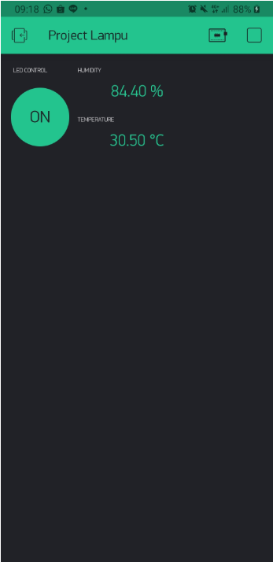
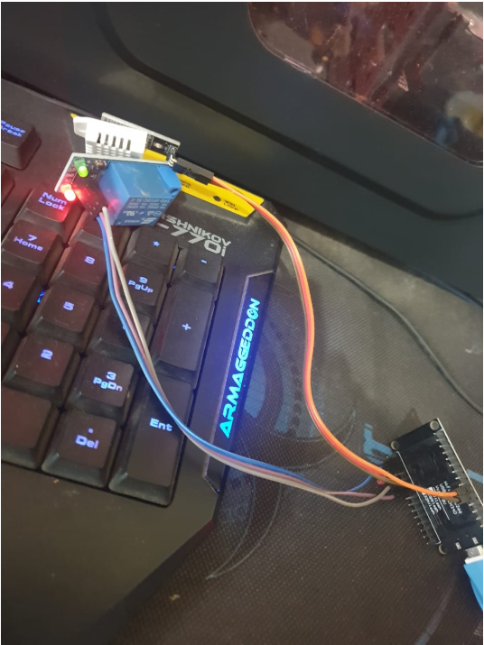
the results - 3

Slide 30

FOR THE PROJECT code
adiparamartha

Slide 31
Task for you
Install Blynk app in your phone and Blynk Library in your Arduino IDE

Slide 32
thanks!
@adiparamartha adi@primakara.ac.id
Any questions?

Slide 33
Credits
Special thanks to all the people who made and released these awesome resources for free:
Presentation template by SlidesCarnival
Photographs by Unsplash

