Slide 1
A review of mazes: generation, solving and usability
Student: Petercă Adrian
Coordinating teacher: Croitoru Eugen

Slide 2
Content
Generation
Using standard approaches
Using trained models
Solving
Simple techniques (a solution)
Complex techniques (the best solution)
Usability
Esoteric language (aMaze(d))
Controllable dataset

Slide 3
Generation – standard approach
Based on established algorithms, such as:
DFS
Kruskal
Hunt & Kill
Aldous Broder
Alternative approaches:
Spiral + Random Carving

Slide 4
Generation – standard approach
Depth First Search with bias
Kruskal Randomized

Slide 5
Generation – standard approach
Spiral (Cinnamon Buns)
Random Carving

Slide 6

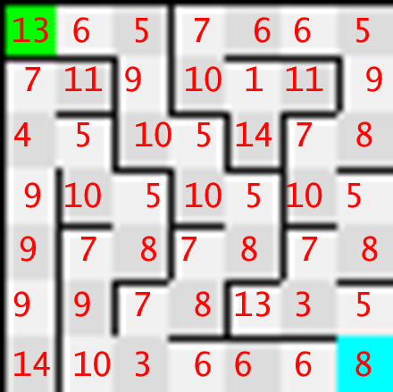
Generation – Trained Models
Based on GANs trained on maze data, not photos
Significant improvement over the last version

Slide 7

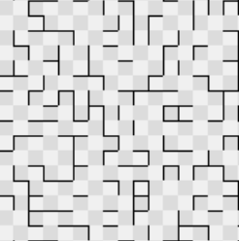
Generation – Trained Models
Maze generated using image GANs
Maze generated using data GANs

Slide 8
SolvinG
Three distinct categories based on paths:
Complete mazes : each pair of (distinct) cells is reachable by one and only one path.
(Complete) Looped mazes : there is at least one pair of cells that has two or more possible paths between them
Incomplete mazes : at least one pair of cells has no path between them.
Two distinct categories based on cell/wall ratio:
Dense mazes
Sparse mazes

Slide 9
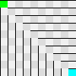
SolvinG
For complete mazes, DFS is almost always the best choice
For looping mazes, one question arises: what to prioritize?
Solution needed only once (for example, for verifying that two cells are reachable) : use DFS
Solution needed multiple times : use A*
Not sure of future uses : use DFS Heuristic
DFS is not the best choice here

Slide 10
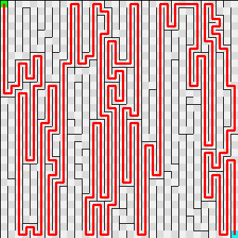
Solving – Single solution
DFS – A* – DFS Heuristic

Slide 11
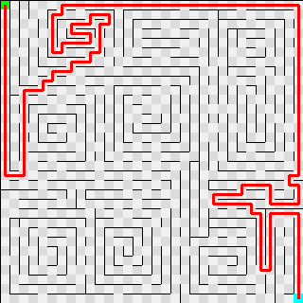
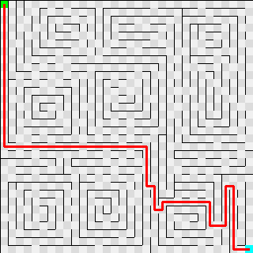
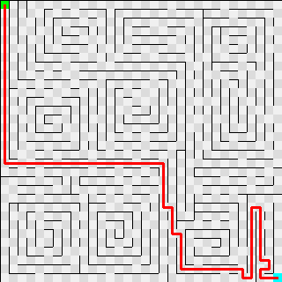
Solving – Multiple solutions
DFS – A* – DFS Heuristic

Slide 12

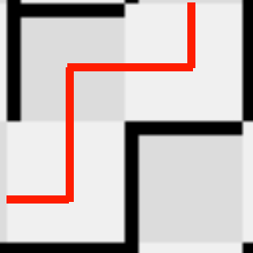
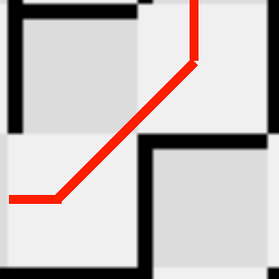
SolvinG – Various Questions
Can we jump from one known cell to another?
Do all cells have the same traverse speed?
For example, is there a difference between corridor travel (where the direction is constant) vs turn travel?
Can we move in 4 or 8 directions?
Is it faster to cut corners?
Is there a limit to how much an agent can see?
Can it see only tiles that are within movable reach? Or can it see tiles which he cannot move to in a single move?

Slide 13
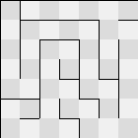
Usability – Esoteric language
Mazes can be used as a form of obfuscation of program execution.
Given a limited set of instructions, create a program by having three parts:
The maze itself, where each cell encodes a specific action
The solution (or executable path)
The input (a binary string/file)
Where is the start/end?

Slide 14
Usability – Esoteric language Rules
Always start at index 0 in the input.
Always start with a standard file opened for output.
The execution can start & end at any cell in the maze.
The movement in the maze is dictated by the solution: a list of directions on how to navigate the maze.
A stored value is always available.

Slide 15
Usability – Esoteric language (Example)
Consider the following actions:
SWITCH FILE: read the current position in the input and expect a number X. The next X cells will describe a path for a file. Open that file for writing.
SKIP: read the current position in the input and expect a number X. Move the indicator for the current position by X cells to the right.
WRITE FILE: write the current stored value to the current opened file.
DEC: decrease by 1 the current stored value
INC: increase by 1 the current stored value
MOVE LEFT: move the indicator for the current position to the left.
MOVE RIGHT: move the indicator for the current position to the right.

Slide 16
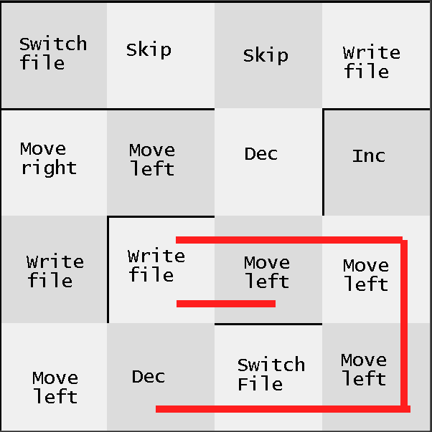
Usability – Esoteric language (EXAMPLE)
First case: simple Hello world
Input: b’16'dlrow_olleh.txt
Solution: 3, 1 > 3, 2 > 3, 3 > 2, 3 > 2, 2 > 2,3 > 2, 2> 2,1 > 2, 2 >2,1 > 2, 2 >2,1 > 2, 2 >2,1 > 2, 2 >2,1 > 2, 2 >2,1 > 2, 2 >2,1 > 2, 2 >2,1 > 2, 2 >2,1 > 2, 2 >2,1 > 2, 2 >2,1 > 2, 2 >2,1 > 2, 2 >2,1 > 2, 2 >2,1 > 2, 2 >2,1 > 2, 2
Output: “hello_world” written in “hello_world.txt”

Slide 17
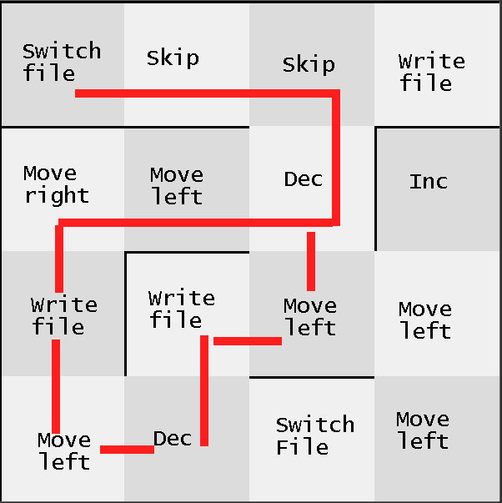
Usability – Esoteric language (EXAMPLE)
Second case: simple Caesar decrypt
Input: b'15'/tmp/caesar.txtb'3'PGOJ
Solution: 0,0 > 0,1 > 0,2 > 1,2 > 1,1 > 1,0 > 2,0 > 3,0 > 3,1 > 2,1 > 2,2 > 1,2 > 1,1 > 1,0 > 2,0 > 3,0 > 3,1 > 2,1 > 2,2 > 1,2
Yields “INFO”

Slide 18
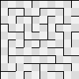
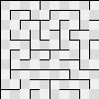
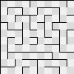
Usability – Controllable Dataset
Using mazes, one can control the differences between each entry more easily (rather than, for example, stock photos).
Original
One modification
Two modifications

Slide 19
Next on improvements
Further improving the esoteric language action list & implementing simple algorithms
Adding the option to generate mazes using the wave-function collapse principle
Reinforcement learning agents for solving sparse mazes
Evolving agents on mazes with diverse challenges (such as the ability to move faster along corridors rather than corners)
Benchmarking known algorithms for solving 3D mazes (2D mazes with ladders)

Slide 20
Q & A

