Slide 1
Maze generation techniques
Author: Petercă Adrian
Coordinator: Lect. Dr. Eugen Croitoru

Slide 2
State of the Art methods
Random methods
Aldous-Broder Algorithm
Kruskal Randomized Algorithm
Hunt and Kill algorithm
Division methods
Recursive Division
Cell traversal methods
Depth First Search
Breath First Search
Cellular Automata approaches
Binary Tree
Eller’s Algorithm
Sidewinder Algorithm

Slide 3
State of the Art methods
Aldous-Broder Algorithm
Kruskal Randomized Algorithm
Hunt and Kill algorithm

Slide 4
State of the Art methods
Binary Tree
Depth First Search

Slide 5
Challenges
How is a maze defined?
Structure
Complexity
Connectivity (very important)
Solvability
What is the smallest part of a maze? What are its building blocks?
Where does it start/end?
Single start/end point
Multiple start/end points
What makes it “hard”?
How quick can it be solved?
How many start/end points does it have?
How many start-end paths between the same start/end points does it have?
Density of walkable areas over number of walls?

Slide 6
New approach: GANs
Multiple tested models, various results to compare
Already used for PCG (Procedural Content Generation)
Can achieve good results even with a smaller size

Slide 7
GANs: Challenges
How to define the discriminator? (again, what defines a maze?)
Let the GAN decide
Provide a standard way (an agent perhaps) to determine solvability
How to prevent mode collapse?
Bigger dataset?
Longer training time?
How to prevent overtraining?
Are bigger models suitable?

Slide 8
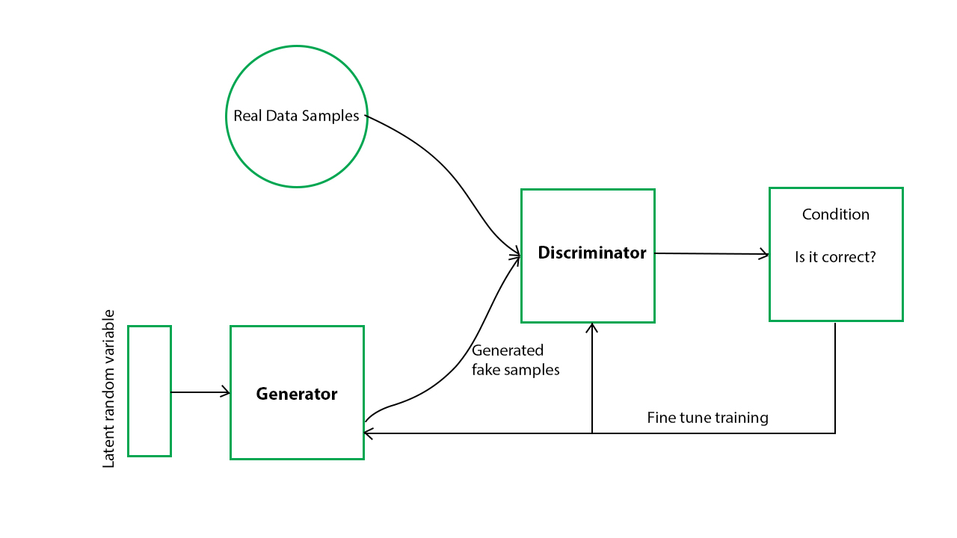
New approach: GANs

Slide 9
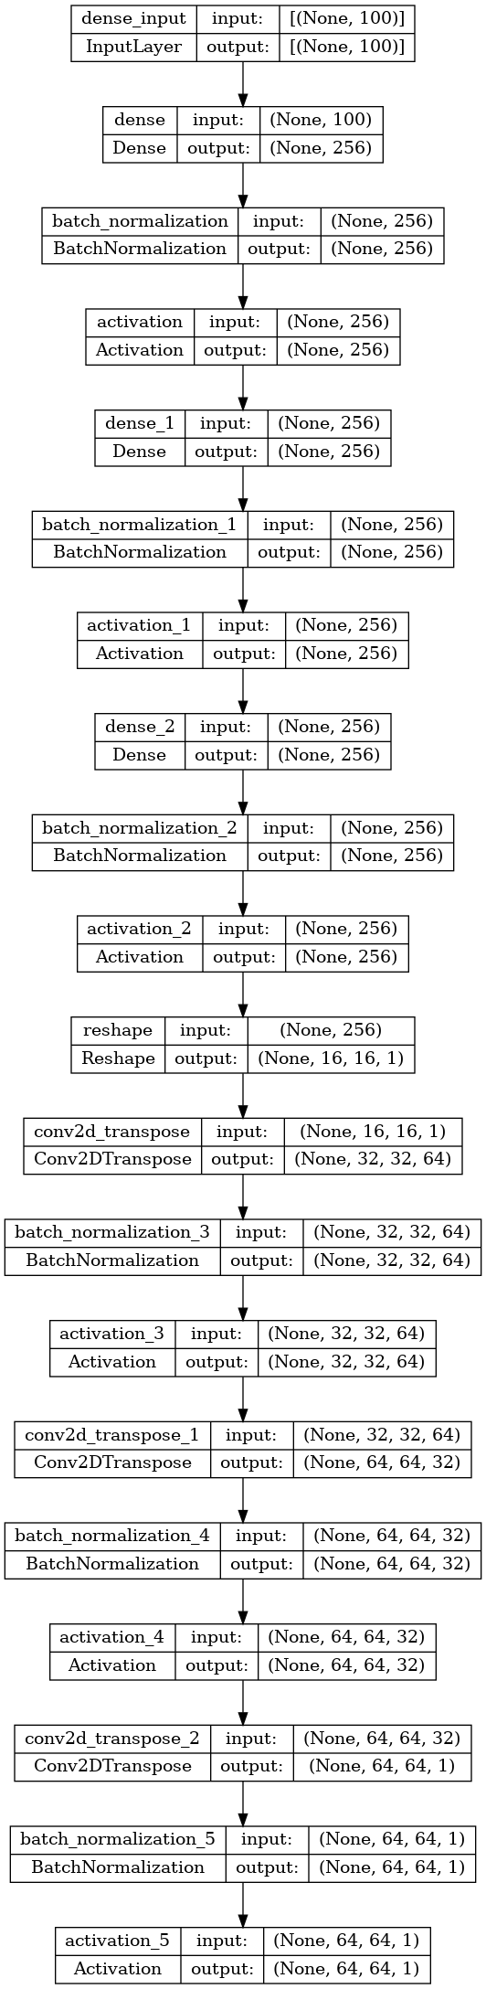

Architecture – first model

Slide 10
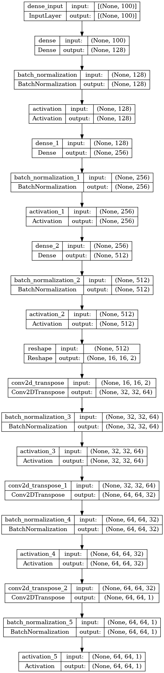

Architecture – second model

Slide 11
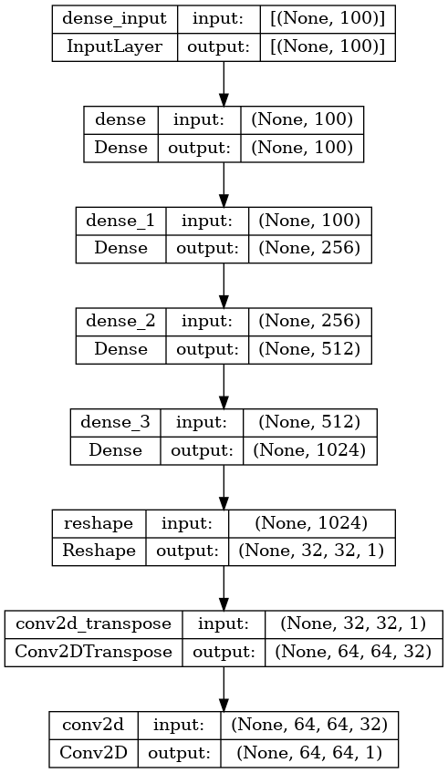

Architecture – Third model

Slide 12
Results
For a sample size of 10000 mazes with a 64x64 size:
Approach | Average speed (in seconds)
Depth First Search | 0.01074
Hunt and Kill | 0.03418
Binary Tree | 0.00283
Kruskal Randomized | 1.13519
Aldous Broder | 0.20148

Slide 13
Results
For a sample size of 10000 mazes with a 64x64 size:
Model | Input size | Average speed (in seconds)
First model | (100, 1) | 0.00003
First model | (100, 1000) | 0.00080
Second model | (100, 1) | 0.00004
Second model | (100, 1000) | 0.00010
Third model | (100, 1) | 0.00003
Third model | (100, 1000) | 0.00040

Slide 14
Future ideas
Already working on a public accessible API for maze generation using the provided techniques and models
Using Autoencoders
Using Genetic Algorithms to evolve mazes
Aiming for 4 variations for models: small D, small G, small D big G, big D, small G, big D big G over a set of predefined architectures (inspired by the cross-validation approach)
The aim is to build a fast method for creating both 2D and 3D models. For the 3D models I plan to use the API in a separate application
Other ideas:
infinite mazes generated by patches instead of a whole grid at once
Using NN designed for graph generation
Using GANs aimed not at image creation, but actual “maze” data

Slide 15
Future Ideas
Using Autoencoders (mainly the decoder part) to create mazes from random noise
Using Genetic Algorithms to evolve mazes starting from semi-random noise
Instead of relying only on random noise, preprocess it
Further testing with GANs using inspiration from cross-validation techniques
Big/small structure for both discriminator and generator
Adjust GANs for maze “data” instead of maze “pictures”
Only deep connected layers for the generator, then a post processing step to create the actual image
Using Neural Networks designed to work directly with graphs (Graph Neural Networks)

Slide 16
Future Ideas
Providing a public API for maze generation using AI (currently in active development)
The final goal is to build a reliable API for both 2D and 3D maze generation
I plan to implement a simple application that uses the 3D API to generate content for the user
Other research directions:
Infinite mazes and their applications
Analysis over whole maze generation versus patch maze generation

Slide 17
Q & A

