Slide 1
COLAB – A Maze game
Petercă Adrian
Conf. Dr. Croitoru Eugen

Slide 2
Table of Contents
Inspiration & target
Iterated Prisoner’s Dilemma
A complex environment for mutual competitive strategies
What is CoLab?
How to play
Important questions
Simulated evolution using Genetic Algorithms
Future directions
Online training gym & tournaments
More than two players

Slide 3
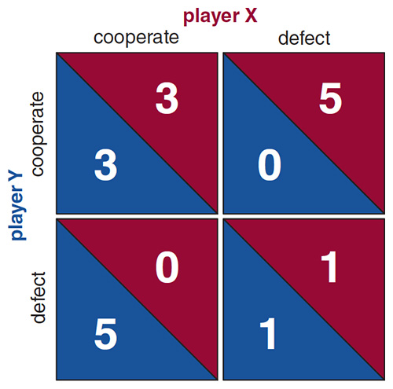
Inspiration: (Iterated) Prisoner’s Dilemma
Prisoner’s Dilemma is a known behavior problem where two rational agents compete to maximize their personal gains, either by mutual cooperation or individual betrayal.
It uses a score matrix to determine the outcome for each “round”.
It was first proposed by Merrill Flood & Melvin Dresher in 1950 and later “iterated” by Robert Axelrod in 1984, where he analyzed a tournament in which different strategies were put against one another.

Slide 4
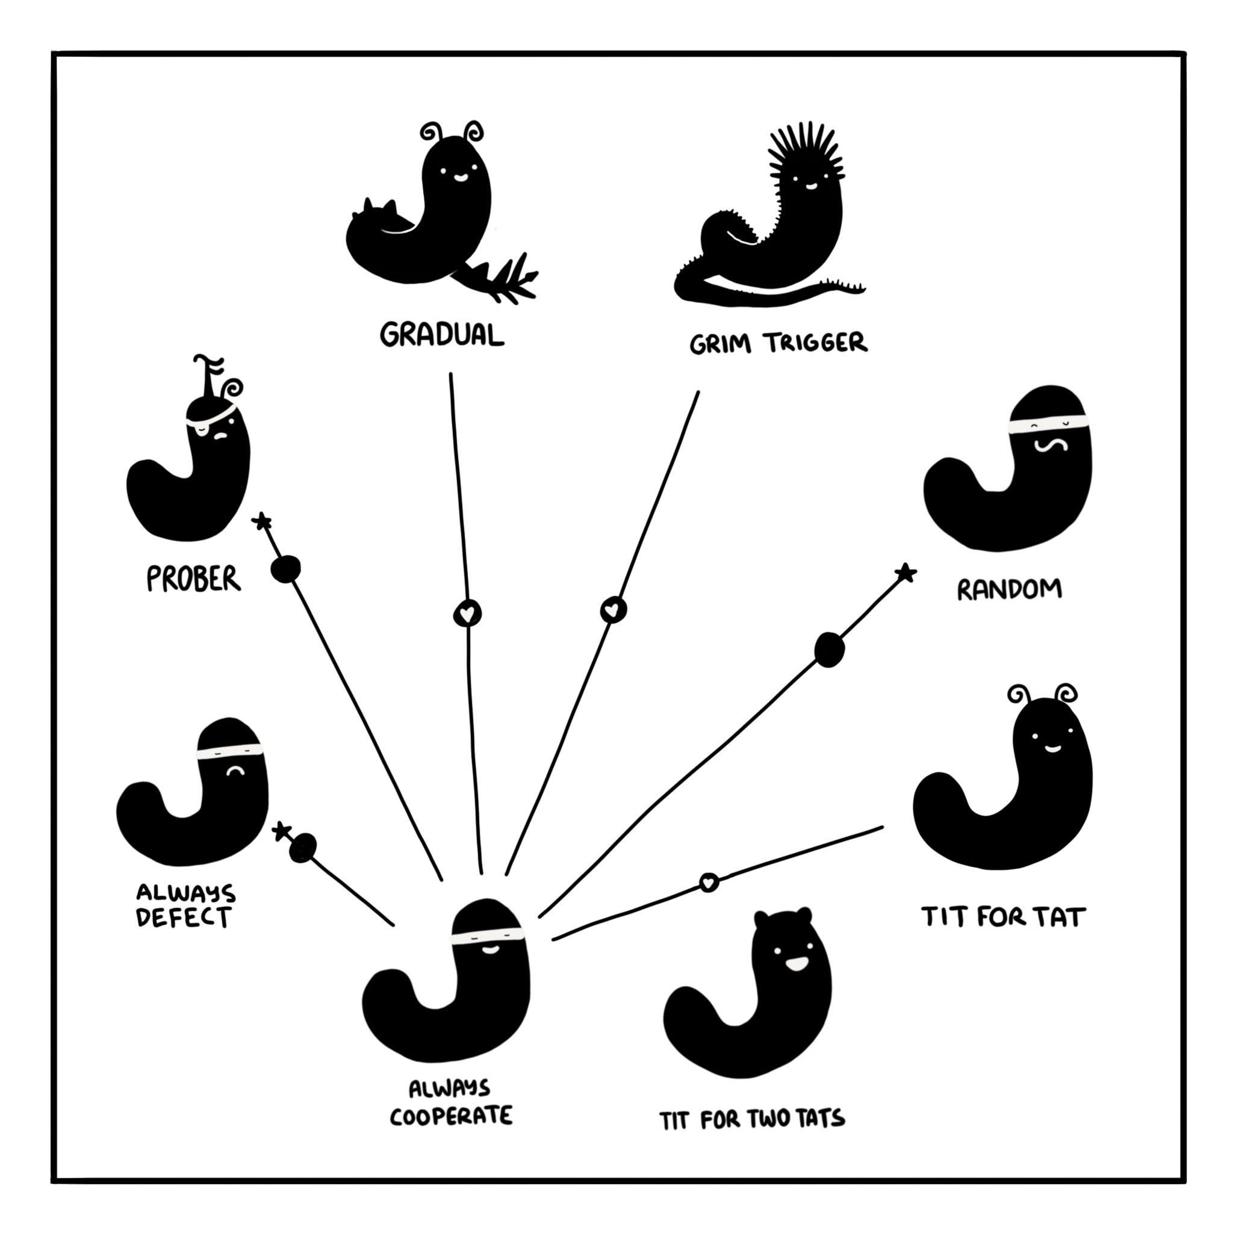
Inspiration: (Iterated) Prisoner’s Dilemma
For a single round, without additional information, the best statistical strategy for either player is to deflect, even if the natural instinct suggests a bigger score for both can be achieved if they cooperate.
For the iterated version, a strategy can be defined, which dictates how the agent will behave based on previous episodes:
Tit-for-Tat: cooperate at first, then do what the opponent did last round.
Grudge: cooperate until the opponent deflects, then just deflect.
CCD: cooperate twice and deflect, then repeat.

Slide 5
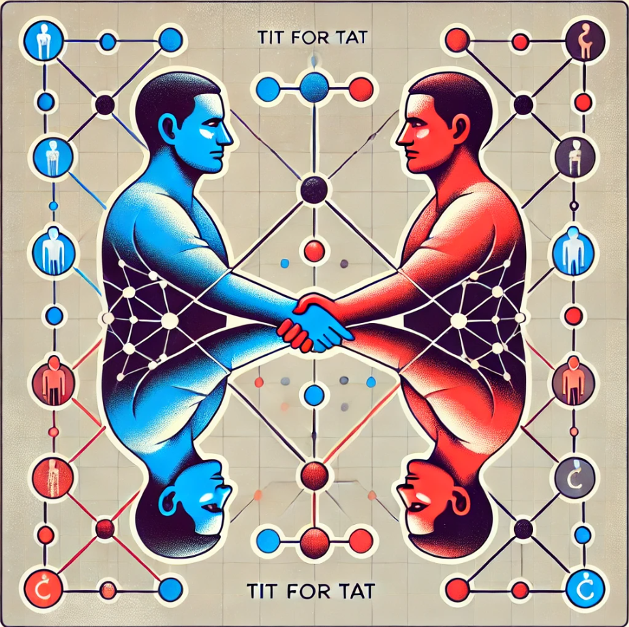
Inspiration: (Iterated) Prisoner’s Dilemma
Axelrod performed two tournaments, the first using 15 strategies, then 62. He concluded that a winning strategy needs to have four qualities:
it needs to be nice (do not be the first to deflect)
it needs to be capable of retaliation (do not let others take advantage of you)
it needs to be forgiving (forgive your opponent sometimes)
it needs to be non-envious (do not try to score more that your opponent)
The winner? Tit-for-Tat, both times.

Slide 6
A more complex environment
The idea was to build a new environment where strategies such as Tit for Tat could be evaluated in a more complex manner, not just using pointless scores with no definitive meaning.
However, one first needed to define what cooperation and deflection mean in this new proposed context.
Thus, the idea of a game using mazes was born, using knowledge trading as a way to define cooperation.

Slide 7
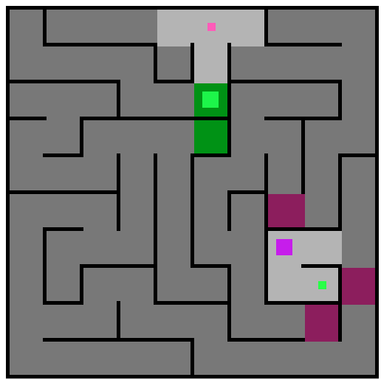
What is Colab?
CoLab, short for Collaboratory Labyrinth, is a two agents game set in a randomly generated maze, where each agent must get from a start cell to a finish cell as fast as possible.
The game builds upon the idea of mutual cooperation and negotiation, allowing information trade between players.
It is a partial information game, because each agent knows only a selected area of the maze, the rest being discoverable either by exploration or knowledge trading.

Slide 8
What is Colab?
Negotiate?
No
Yes
Each turn, the agents are faced with a question:
they can try to negotiate, each offering a cell and requesting another cell
or they can ignore the opponent’s attempt and refuse
The negotiation part works as follows:
each agent offers a known cell and requests an unknown cell
each agent evaluates the proposal: his offer, his request, the opponent’s offer and the opponent’s request
if both of them agree on the offers, they exchange information. Otherwise, the deal does not stand and they learn nothing new.
End.
Begin.
Each player
Offer & Request
Offer & Request
Analyze full proposal
Analyze full proposal
If both agree
Exchange information

Slide 9



What is COLAB?
Each agent can have a different approach. Some may use memory buffers to remember previous trades, some will use metrics to assign a score to the current proposal, while others will simply try to match the requested information.
The default agent uses a form of DFS to approximate a target to the goal, ranking cells first based on taxi cab distance, then on whether or not it knows that specific cell.
Some implemented strategies: CopyPlayer, RememberMe, SimpleGA

Slide 10
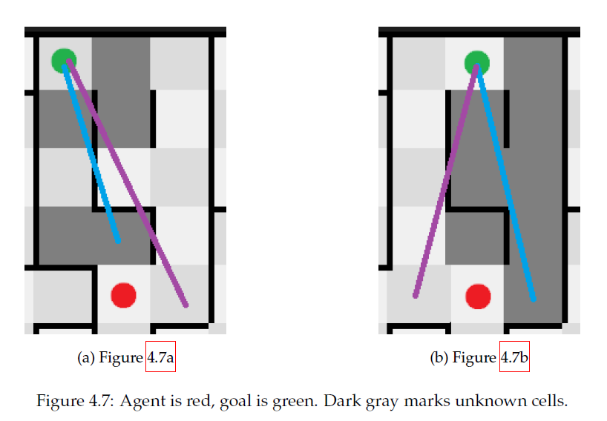

Slide 11
How to play?
The User Interface was built with simplicity in mind, displaying the absolute necessary information (such as score and approximate steps) and having two buttons:
LOOP, which allows the program to run automatically without user input
NEXT MOVE, which will perform only one move for each player, allowing for fine control and understandability.
Each player is colored differently, the agent being the bigger square and the target cell being the smaller one.
A cell is colored in gray if both players know it, or in black if neither knows it.

Slide 12
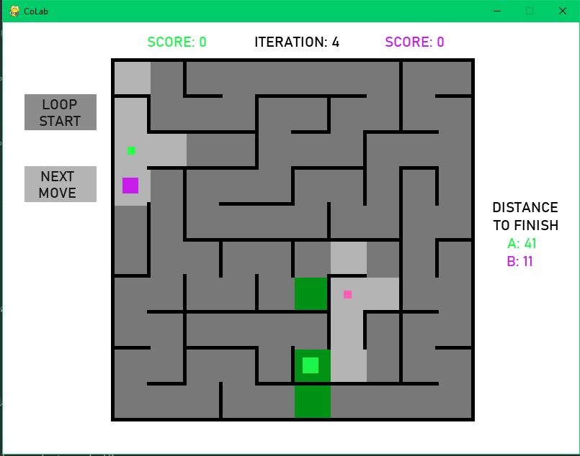

Slide 13
How to play?
The game can be played in a tournament-like fashion or just as a single round.
The game ends in one of the following situations:
either Player A or Player B won, meaning that only one of them reached the goal cell in one action
either both of them won, moving at the same time on their goal cell
either the maximum number of moves was reached.
Each game guarantees a fair challenge by using almost zero sum goals:
Player A starts from X and must reach Y
Player B starts from Y and must reach X

Slide 14
Important questions
When implementing the game, different tweaks were considered and revised:
Is it fair to split the maze 50/50 or just a limited number of cells?
Should there be a limit to how much each agent can “remember” from the maze?
What should happen if agents cannot negotiation not because they do not want to, but because they have no information to offer?
What should happen if an agent tries to move into an unknown cell, but the path is blocked by a wall?
Should players know a cell or the walls?

Slide 15
Simulated evolution using Genetic Algorithms
The structure of a strategy is as follows:
DNEXT : defines which unknown cell in the current stack should be requested.
DXNEXT : defines which known cell in the current stack should be requested.
MOFF : multiplier used to express how important it is to be requested the offered cell.
MREQ : multiplier used to express how important it is to be offered the requested cell.
SCORE THRESHOLD : defines a maximum ”bad” score. If the current proposal score is under or equal to this value, it will be accepted, otherwise denied.
EXPLORATION CHANCE : defines a chance to take the a ”suboptimal” route when calculating a solution with DFS. Inspired by the temperature used in Simulated Annealing algorithms.
UNKNOWN CELL MODIFIER : defines how the value for an unknown cell will change when a path is calculated.

Slide 16

Fitness function
The first attempt is rather simple, yet it has some disadvantages:
It only takes into consideration wins, ignoring draws and loses
It does not allow for fine grained differences between players of same “level”, due to randomness in maze generation. For example, some wins may be biased just because of random luck or discovery.

Slide 17
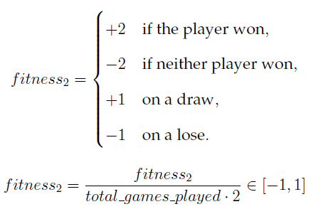
Fitness function
The second approach attempts to fix some caveats, but can be too punishing for players of the same level, leading to slow convergence.
The squashing is done to ensure a uniform score regardless of the total rounds played.

Slide 18
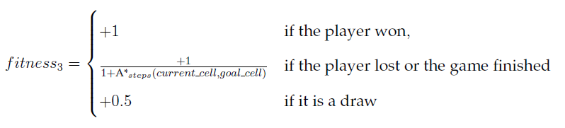
Fitness function
The last approach was the best, yielding strategies that perform considerably better.
One advantage is that it accounts for how close was a player to winning, which allows for fine grained differences between agents.

Slide 19
Future work
The main focus is to bring the environments onto a public server, where strategies can be uploaded and tested against one another.
This will allow me to get feedback for tweaks and balance changes, while also encouraging research into more advanced techniques for winning.

Slide 20
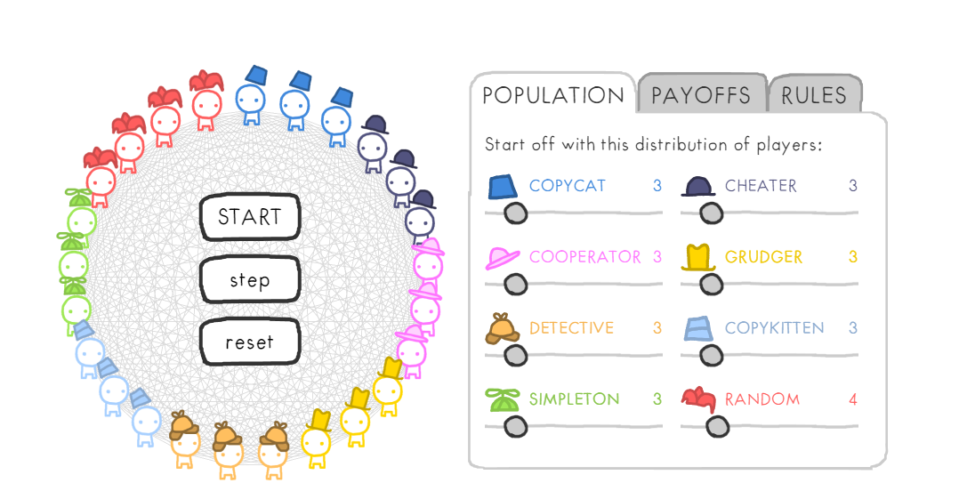
FUTURE WORK
Although the initial idea was to make the game work for only two players, more agents on a bigger maze may provide a new view of the subject of cooperation: relations such as the enemy of my enemy is my friend or birds of a feather flock together could develop between autonomous players, such as in IPD populations.
(image taken from The Evolution of Trust - https://ncase.me/trust/)

Slide 21
Q & A

