Slide 1
Applications for Generative Adversarial Networks in game development
Petercă Adrian
26 Jan 2023

Slide 2
Contents
Challenges in game development
Current state-of-the-art approaches
Personal experiments
Future work and directions
Bibliography

Slide 3
Challenges in game development
Generating levels with diverse difficulties
Adapting new levels to a user’s needs
Mimicking already created levels
Generating new, playable levels from random noise
The same goes for textures, backstories, quests, dialogue etc.

Slide 4
Current state-of-the-art approaches
Evolutionary Search
Reinforcement Learning
Deep Convoluted Neural Networks
Generative Adversarial Networks
Stable Diffusion

Slide 5
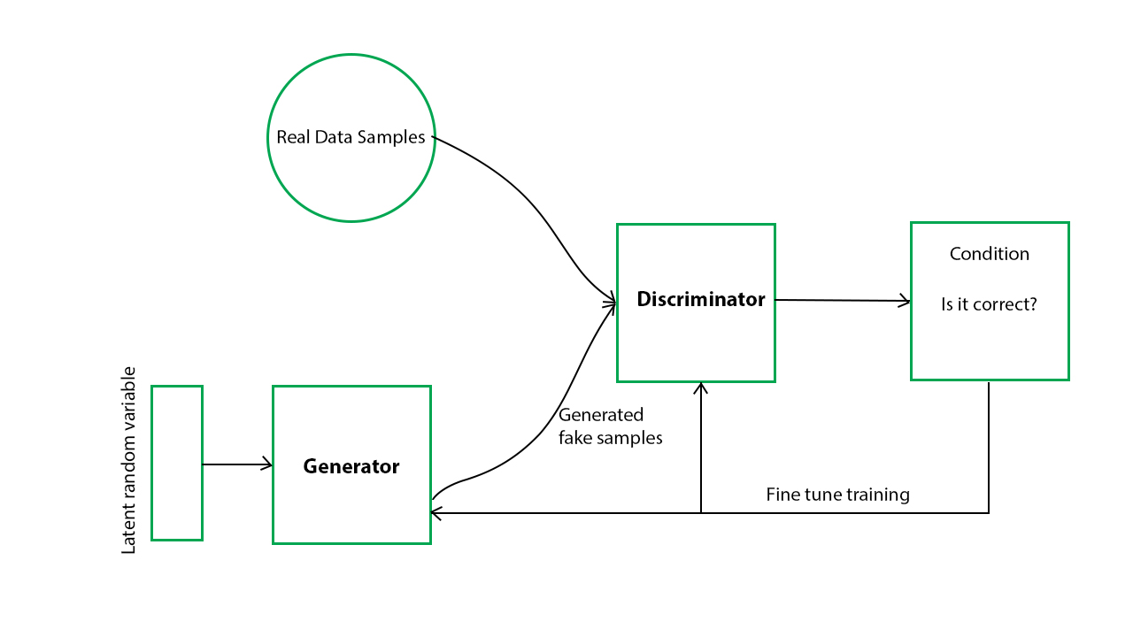
Generative Adversarial Networks

Slide 6
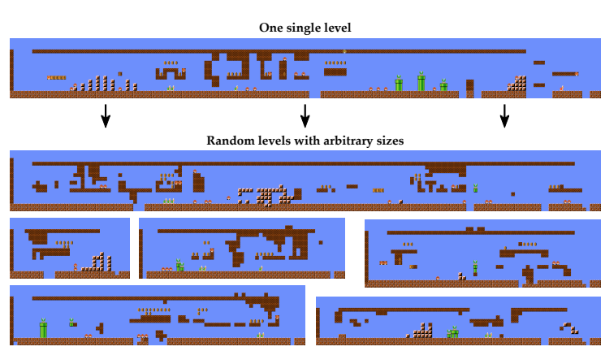
Generative Adversarial Networks
TOAD-GAN

Slide 7
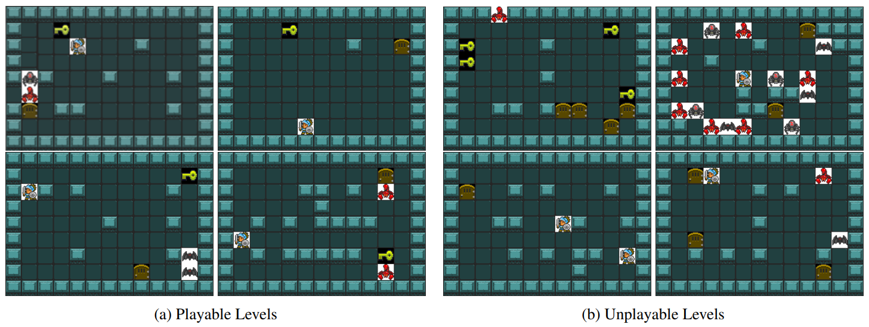
Generative Adversarial Networks
CESAGAN with bootstrapping

Slide 8
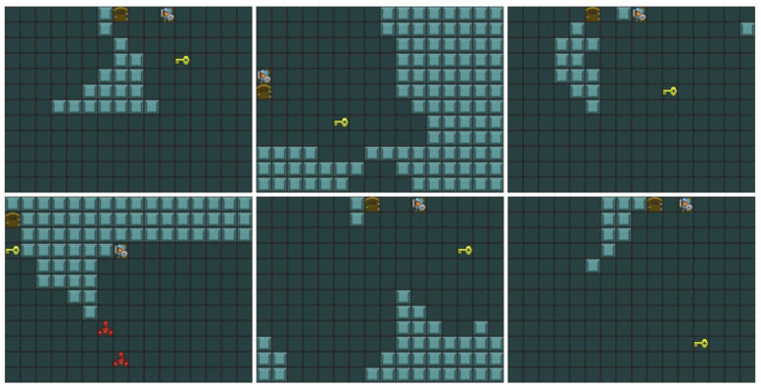
Generative Adversarial Networks
Selection of Self-Supervised Generated GVGAI Levels Trained from Nothing

Slide 9
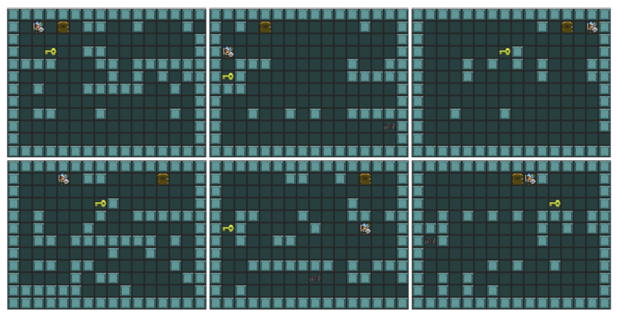
Generative Adversarial Networks
Selection of Semi-Supervised Generated GVGAI Levels Trained from 5 Examples

Slide 10
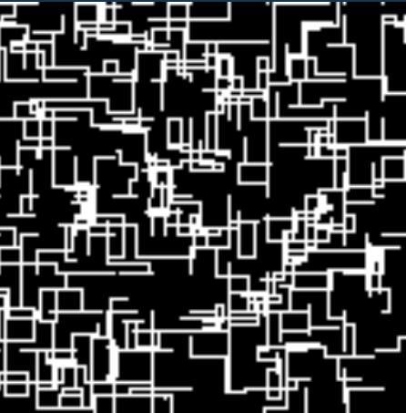
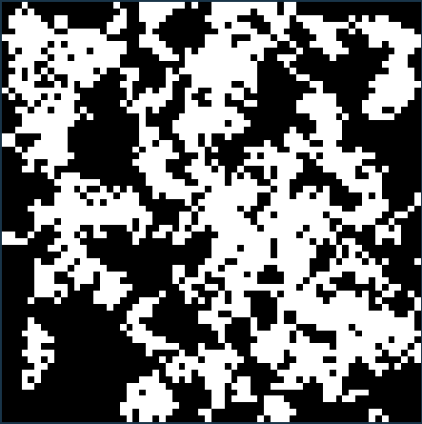
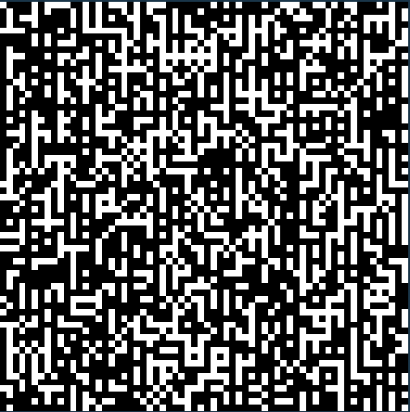
Personal experiments
Level generation using random search in order to create simple levels on which to train further implementations (in the case of a 2D puzzle game)

Slide 11
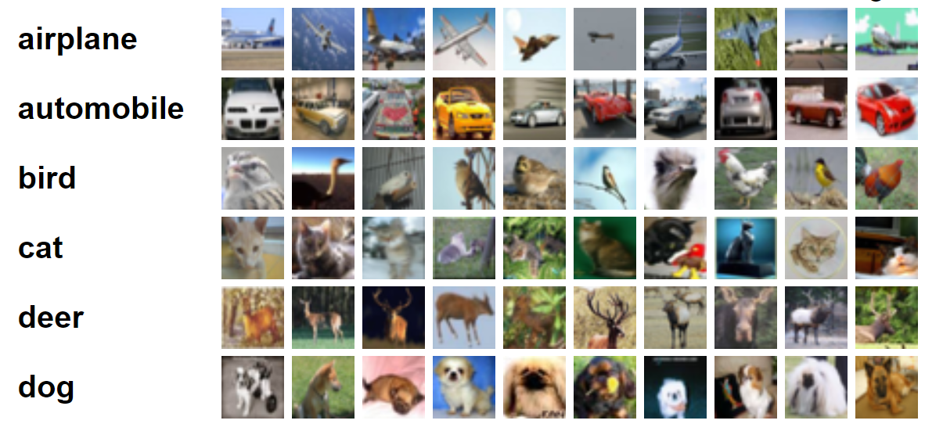
Personal experiments
Training image classifiers to test their accuracy and overall time efficiency (for example with the CIFAR-10 dataset)

Slide 12
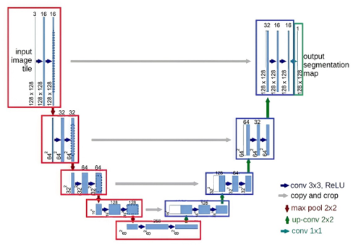
Personal experiments
Testing state-of-the-art (U-Net, DALL-E, ChatGPT to name a few) in order to understand what they are capable of

Slide 13
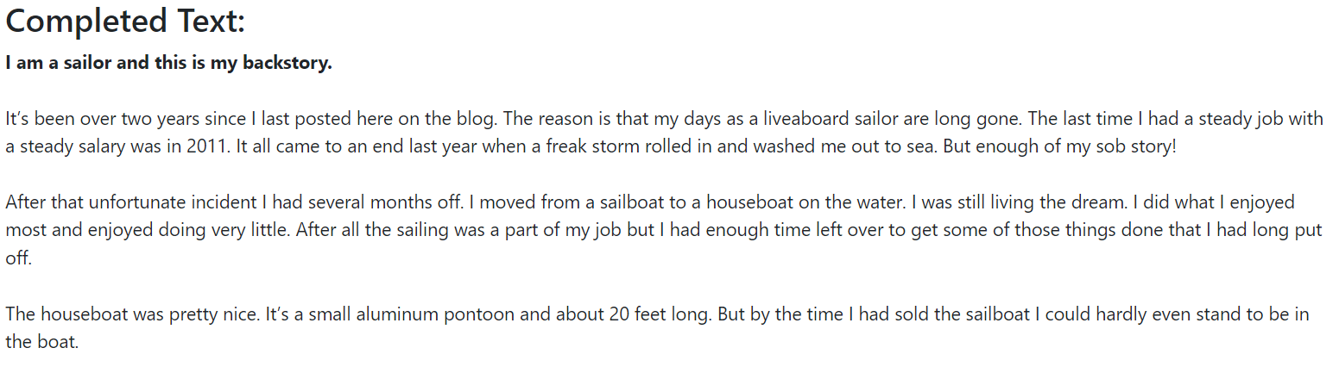
Personal experiments
Here is an example of TextSynth writing a backstory for a given character

Slide 14
Future work and directions
Testing level generation for 2D games using various implementations of GANs, for example:
simple GANs (fully connected layers and no convolutions)
evolutionary GANs (in which the generator is evolved using a population)
class conditioned GANs (similar to CycleGANs)
patch GANs (they tend to perform better than others when the training data is limited)

Slide 15
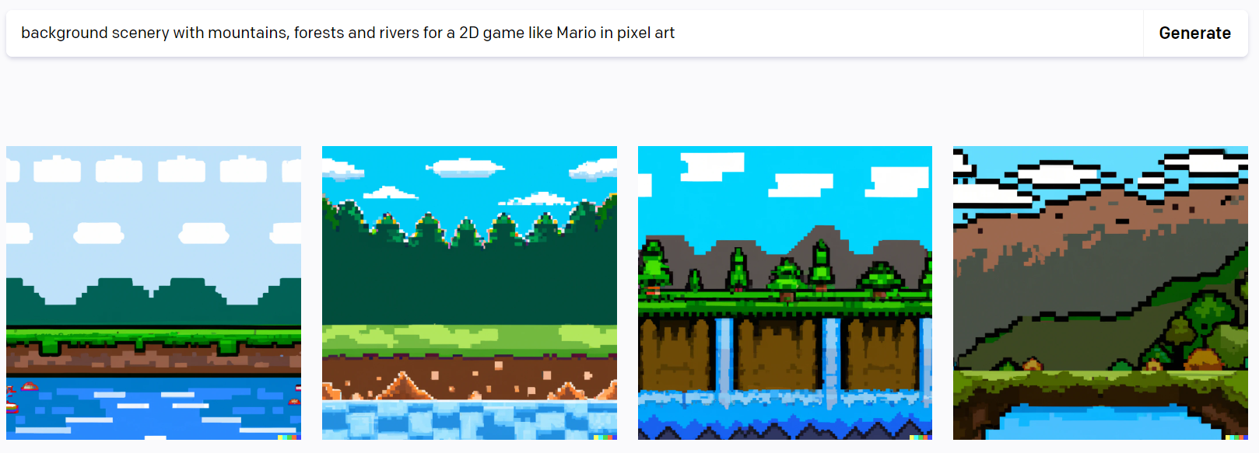
Future work and directions
Investigating other methods for content generation (for example, text-to-image applications like DALL-E)

Slide 16
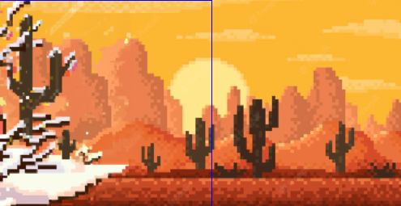
Future work and directions
Converting existing levels to different scenarios (for example, converting a desert level texture to a snowy hill texture)

Slide 17
Bibliography
Learning to Generate Levels From Nothing
Level generation and style enhancement — deep learning for game development overview
Bootstrapping Conditional GANs for Video Game Level Generation
TOAD-GAN: Coherent Style Level Generation from a Single Example
Neuroevolution of Generative Adversarial Networks
Using Multiple Generative Adversarial Networks to Build Better-Connected Levels for Mega Man

Slide 18
Q & A

