Slide 1

Chat App
נעמי מרציאנו 340879006
עדי פינקר 208375204
ונס חמון 337917959 ‘ג

Slide 2
Known bug
The project is ready in terms of all the logic and the use of functions, but it fails to add users, which prevents us from continuing the presentation regarding the use of chat and the transfer of currency between users

Slide 3
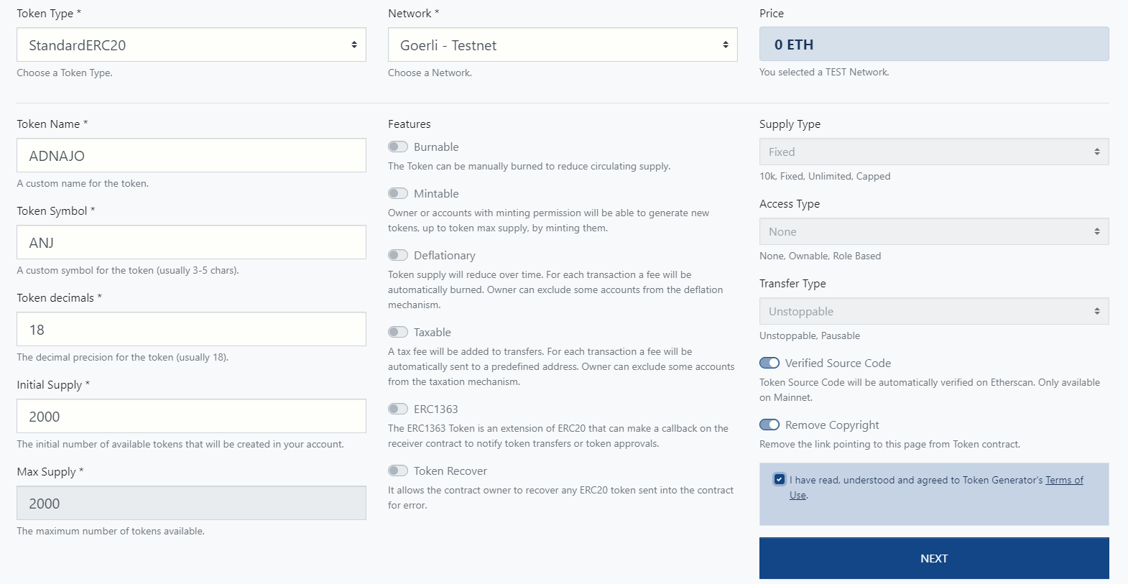
Creating ERC20

Slide 4
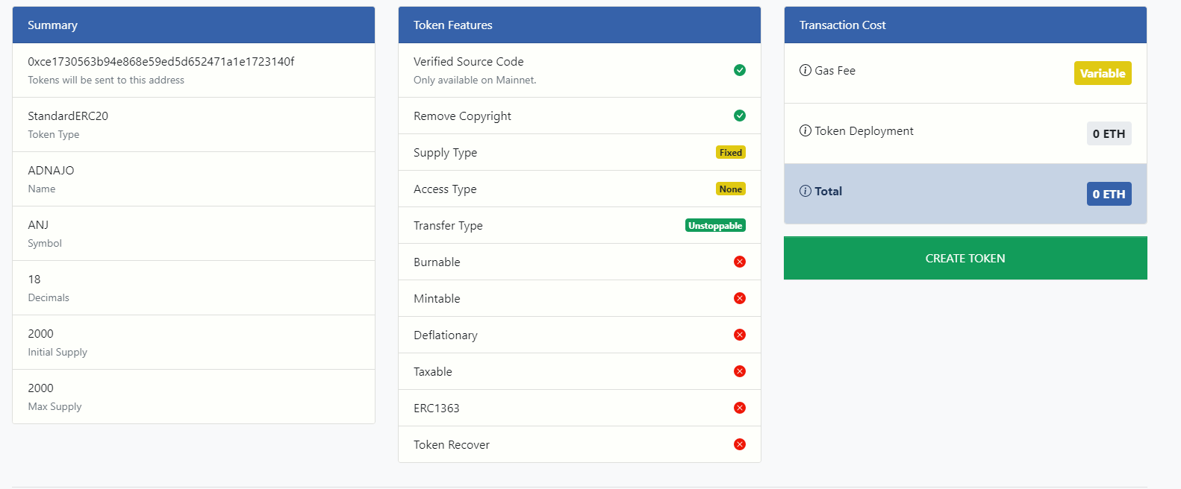
Creating ERC20
Notes:
https://goerli.etherscan.io/token/0x83B8d62C0a2F9db377473dB22fD6d9B306Dd77f5

Slide 5
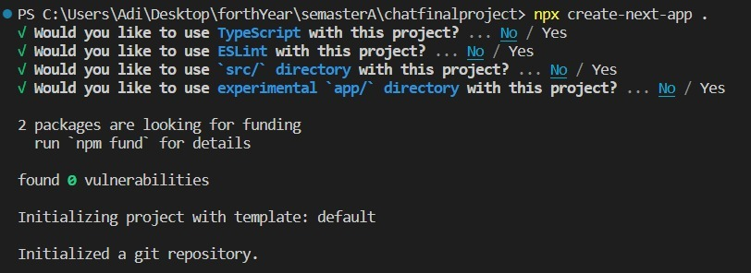
Set up Installation
npx-create-next-app : initialize next app
npx create next app in the same directory

Slide 6
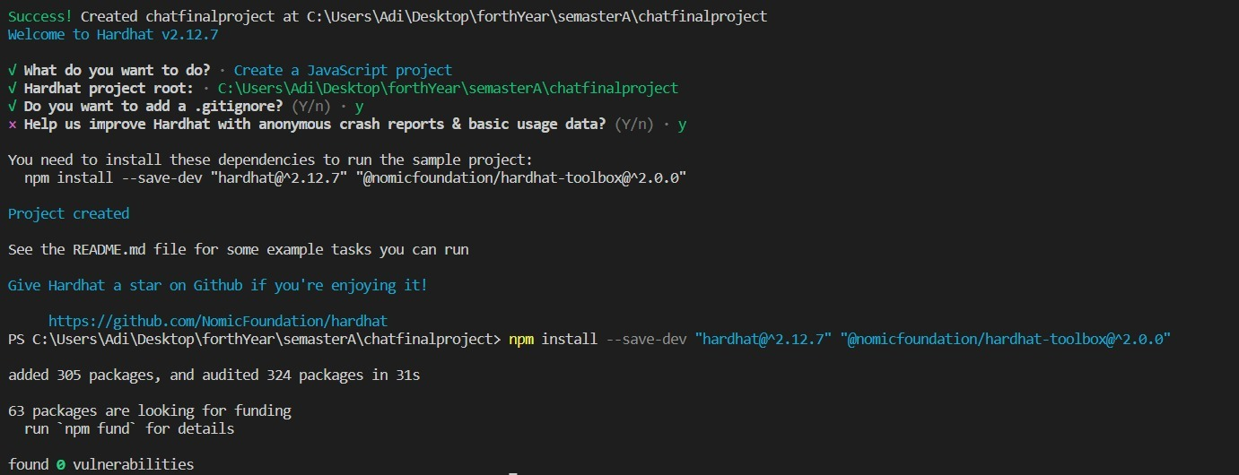
Npx hardhat
Hardhat is a development environment for Ethereum software. It consists of different components for editing, compiling, debugging and deploying your smart contracts and dApps, all of which work together to create a complete development environment.

Slide 7
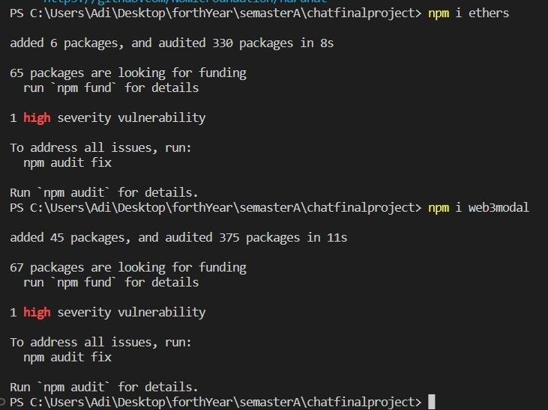
npm i ethers npm i web3modal
npm i ethers: to install the package ether
npm i web3modal : to communicate with smart contract

Slide 8
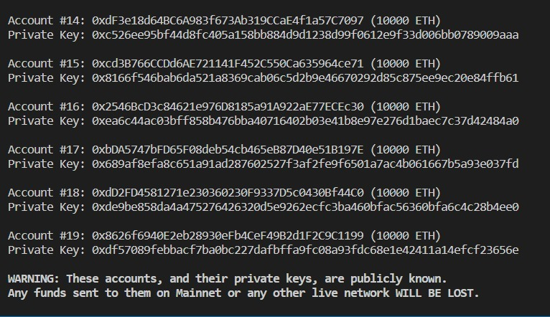
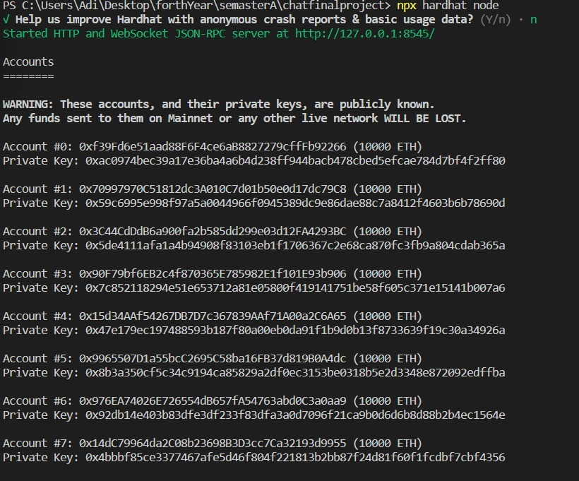
npx hardhat node
It starts a local Ethereum node on your machine using the Hardhat network configuration. This node can be used to deploy and interact with smart contracts locally for testing purposes, without needing to deploy them on the Ethereum mainnet or testnets.

Slide 9

Npx hardhat run scripts/deploy.js –network localhost
it executes the deploy.js script using the Hardhat network configuration specified by the --network flag, which in this case is localhost.
The deploy.js script is likely a script written in JavaScript that deploys one or more smart contracts to the local Hardhat network. This script may also interact with these contracts by calling their functions and performing other actions.
By using the --network flag with the value of localhost, the script is executed on a local Hardhat network instead of a live Ethereum network. This allows developers to test and debug their smart contract deployments and interactions locally before deploying them on a live network.
Overall, the npx hardhat run scripts/deploy.js --network localhost command is a useful tool for Ethereum developers who want to deploy and test their smart contracts locally before deploying them on a live network.

Slide 10
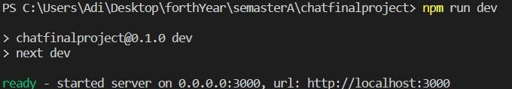
Npm run dev
It executes the dev script specified in your package.json file. Typically, the dev script is used to start a development server that serves the web application on a local host and reloads automatically whenever changes are made to the code.
The npm run dev command is a useful tool for web developers who want to test and debug their applications locally before deploying them on a live server. It allows developers to make changes to their code and see the changes reflected immediately without needing to redeploy the application.
You type in terminal: npm run dev
You copy the URL into the browser

Slide 11
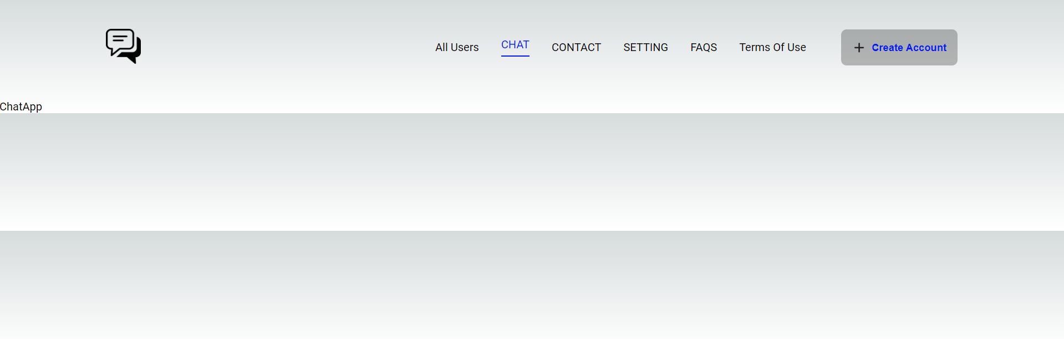
Npm run dev- a little bit of the Design
Main Screen – we worked on the :
All Users
Chat
Create Account
The rest of the buttons are preparation for future work

Slide 12

Npm run dev- a little bit of the Design
Create Account – you enter your name and address and you added to the app’s users

Slide 13
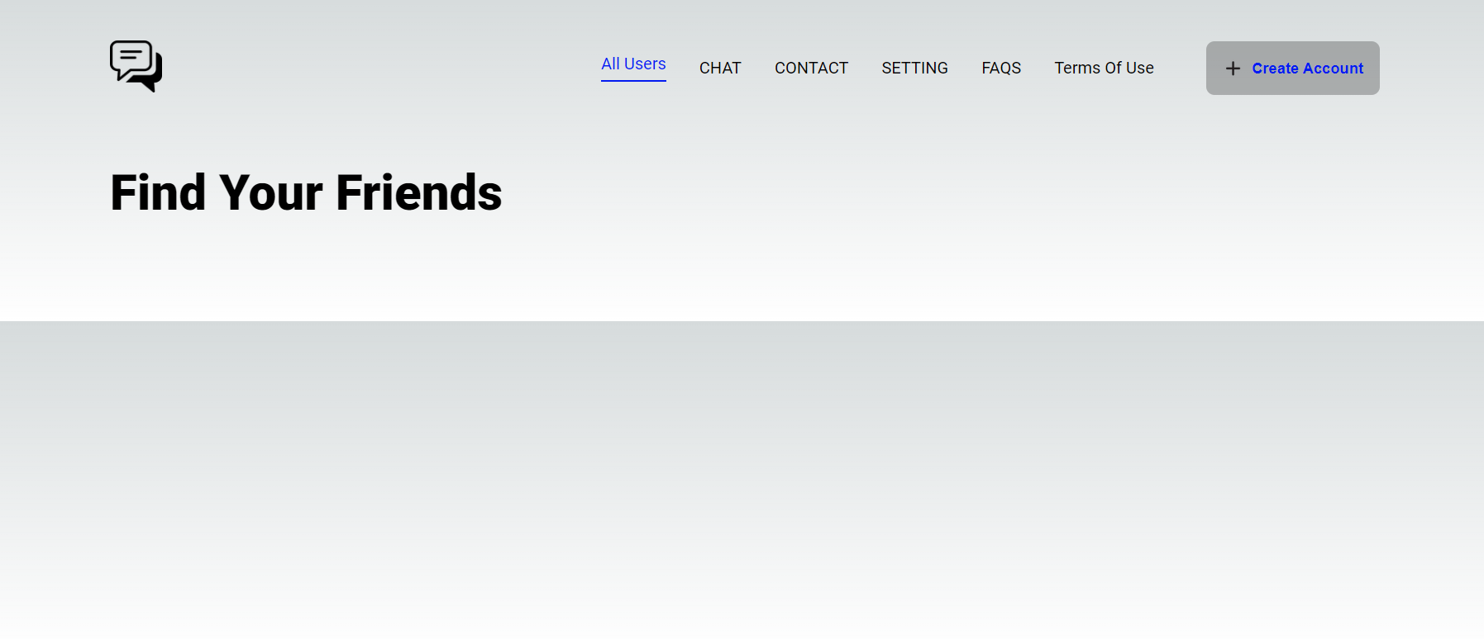
Npm run dev- a little bit of the Design
All Users- show the users that are in the app

Slide 14
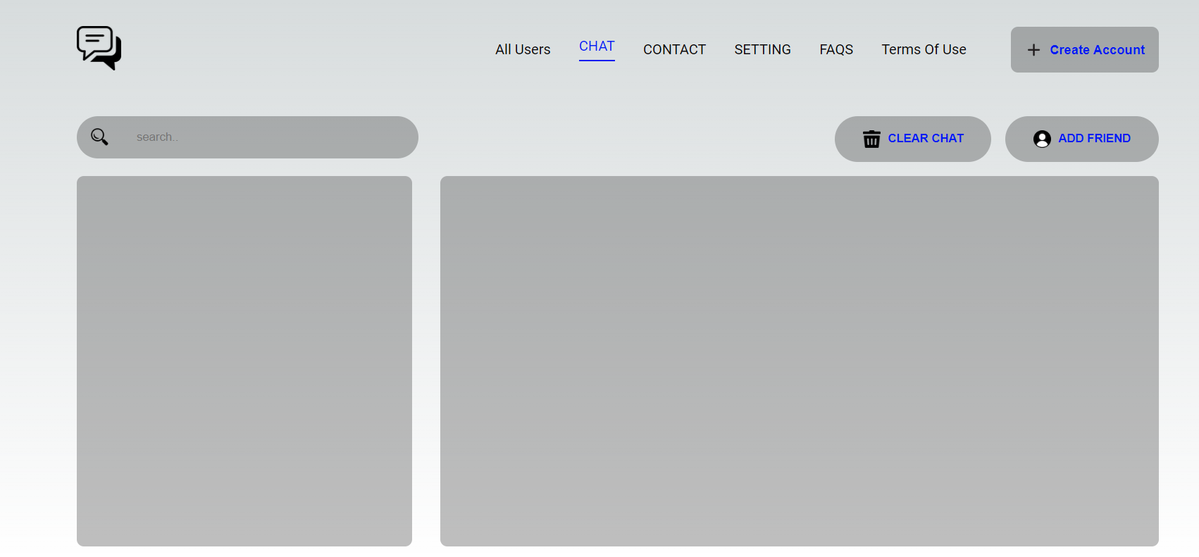
Npm run dev- a little bit of the Design
Chat – the main event of the app, the conversation happen here

Slide 15
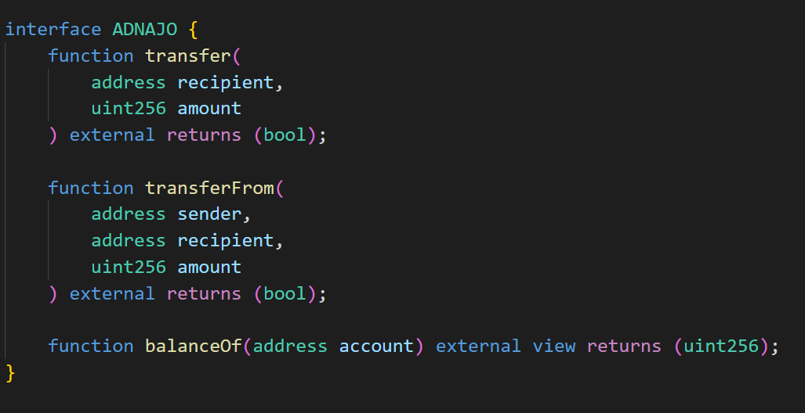
Model explanation- ChatApp.sol
The ERC20 interface- responsible for the transfer of the token

Slide 16
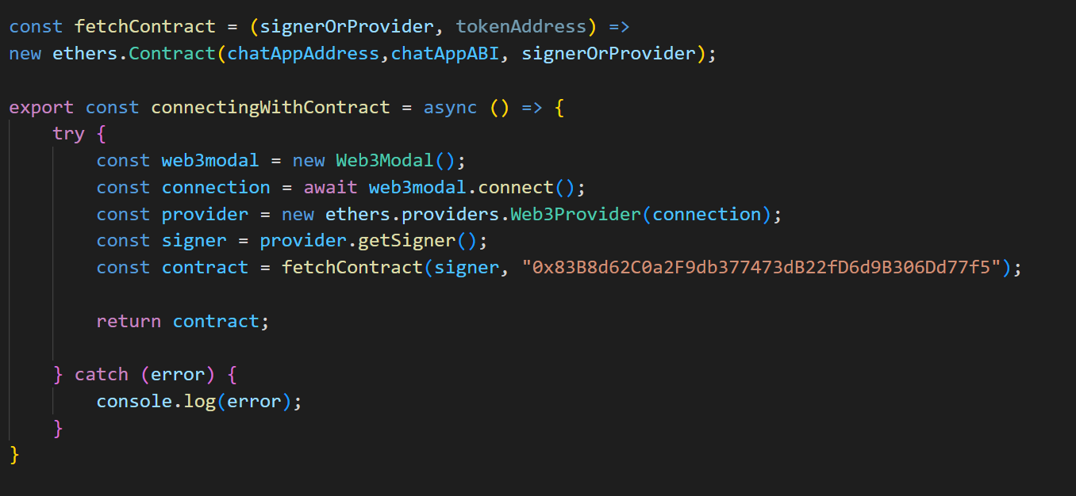
Model explanation- ApiFeature
Create the contract that we work with

Slide 17
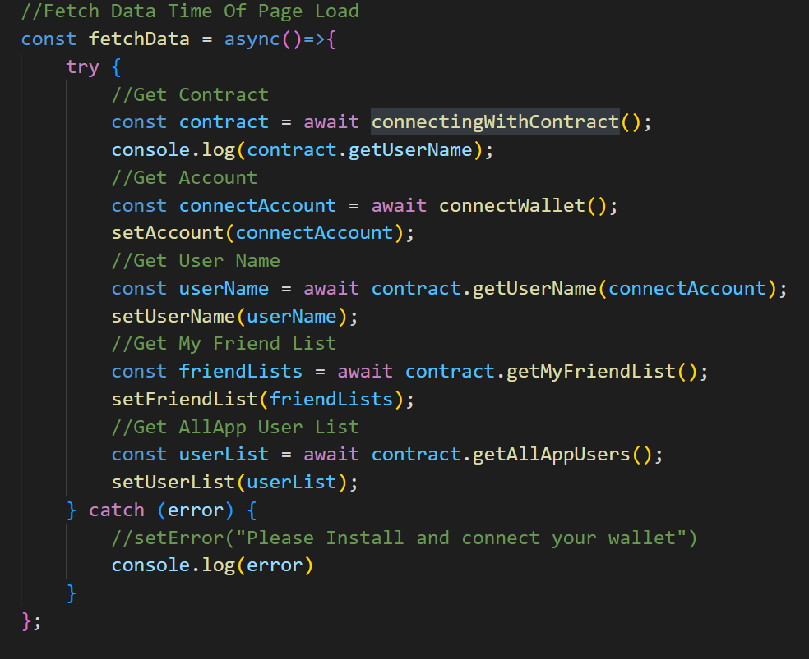
Model explanation- ChatAppContext
Get the data from the user

Slide 18
Model explanation- ChatAppContext
NavBar- create the menu and handle the create account button
Model- create the create account page
Friend- create the list of friends
Chat- create the chat interface

