Slide 1
Gaia AI — Final Report
Personalized response generation via implicit user-style learning · Adir · LLM course (HIT)

Slide 2
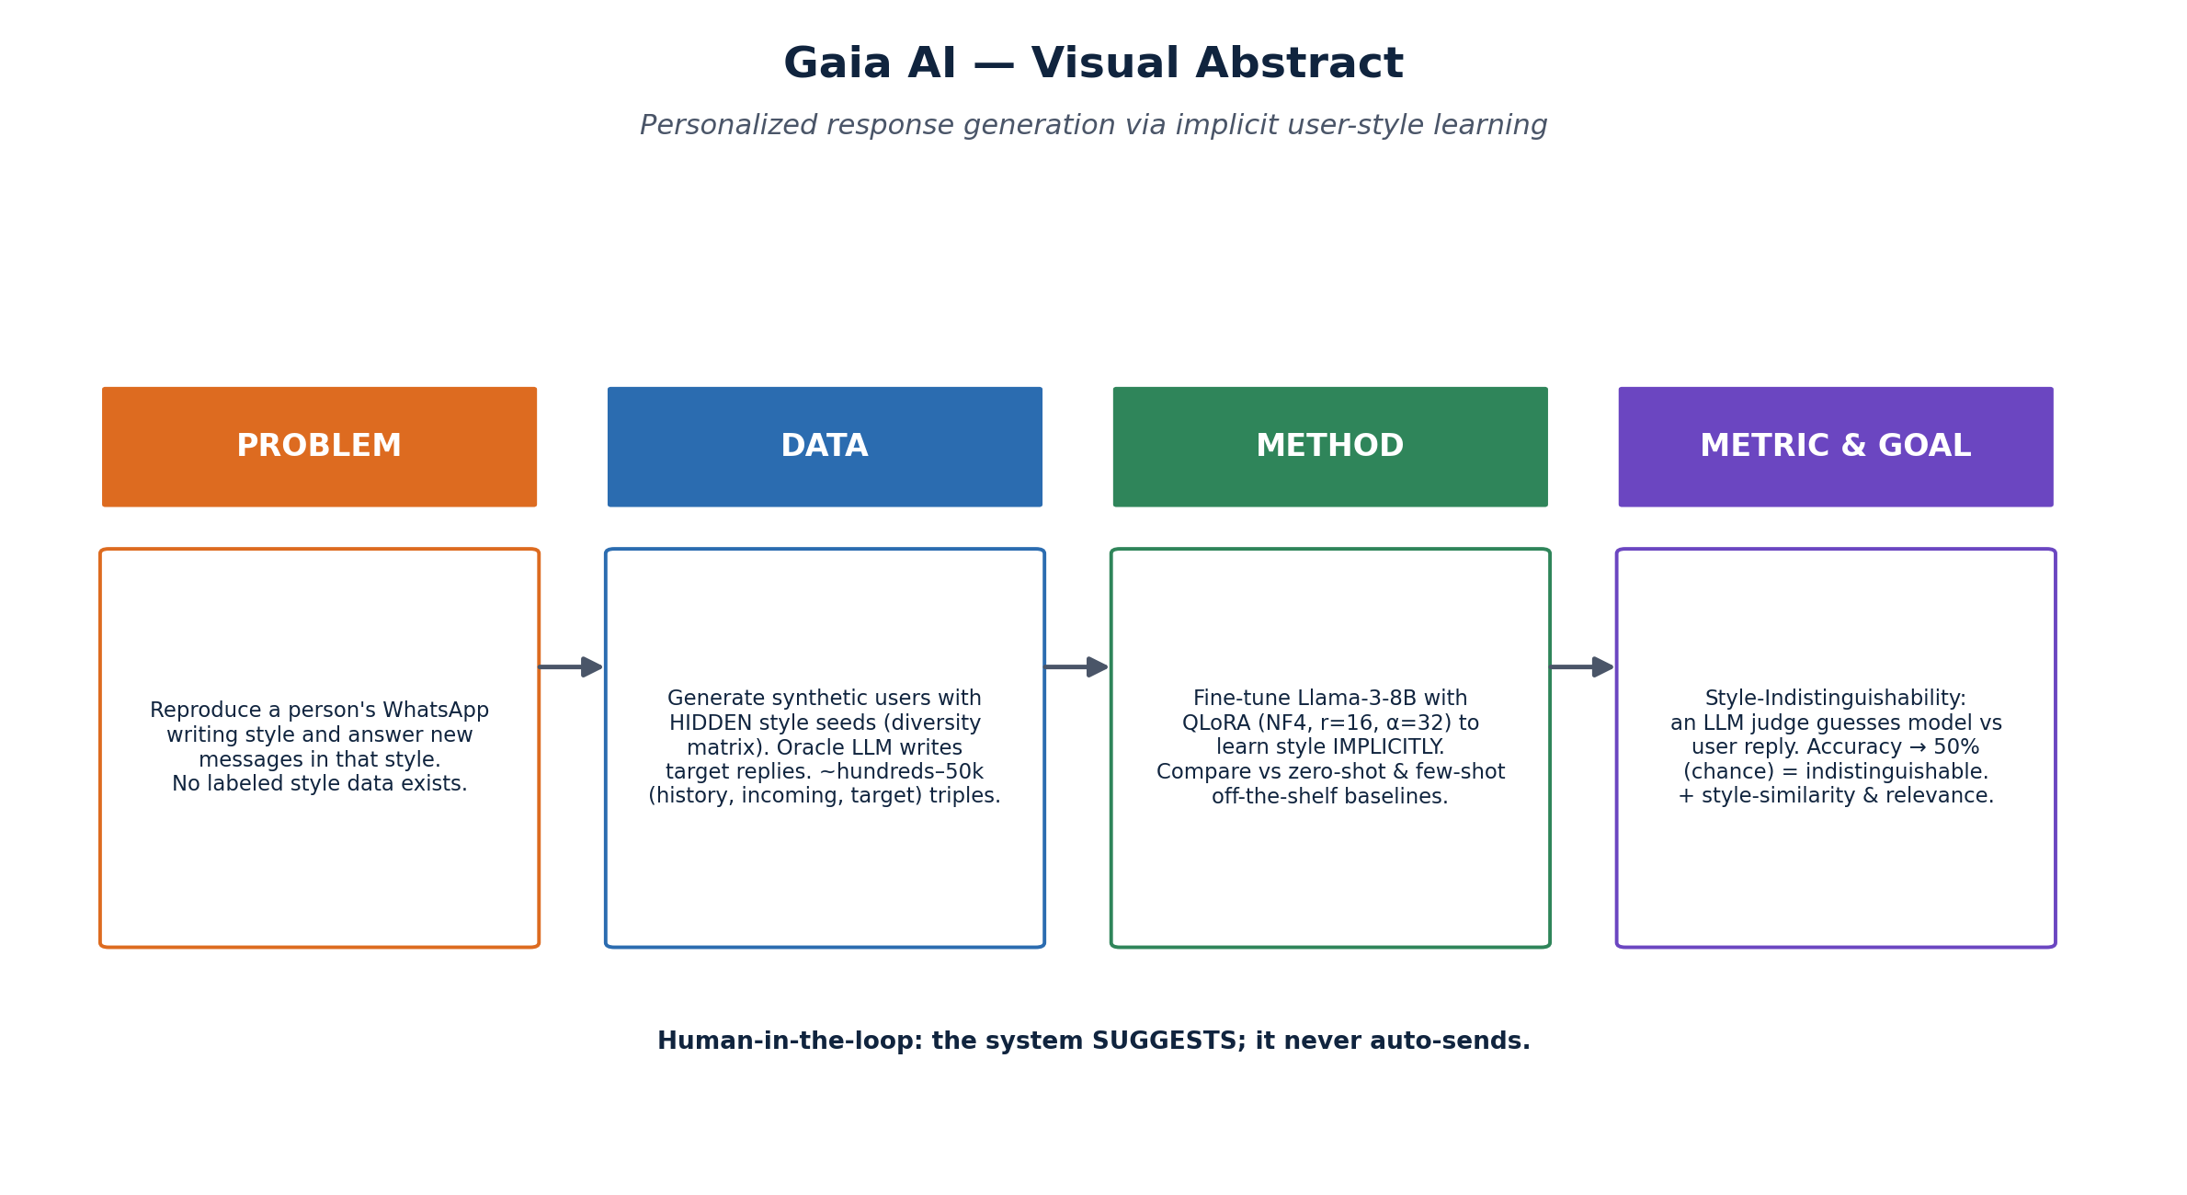
1 · Project Definition (refined)
• Problem: given a user's chat history + a new message, generate a reply in the user's IMPLICIT style.
• Models: fine-tuned Llama-3-8B (QLoRA) vs off-the-shelf zero-/few-shot; oracle = upper bound.
• Data: synthetic, persona-conditioned, bilingual; per-user splits.
• Metrics: Style-Indistinguishability (headline), style-similarity, relevance.

Slide 3
2 · Achievements & Novelty
• Built an end-to-end pipeline: diversity matrix → synthetic data → fine-tune → indistinguishability eval.
• Generated a bilingual persona-conditioned dataset with hidden style seeds (no style labels leaked).
• Produced real baseline results and a reproducible eval (JSON/MD/CSV + figures).
• Novelty: implicit style learning + indistinguishability metric — distinct from retrieval-based personalization (LaMP) and explicit personas (PersonaChat).

Slide 4
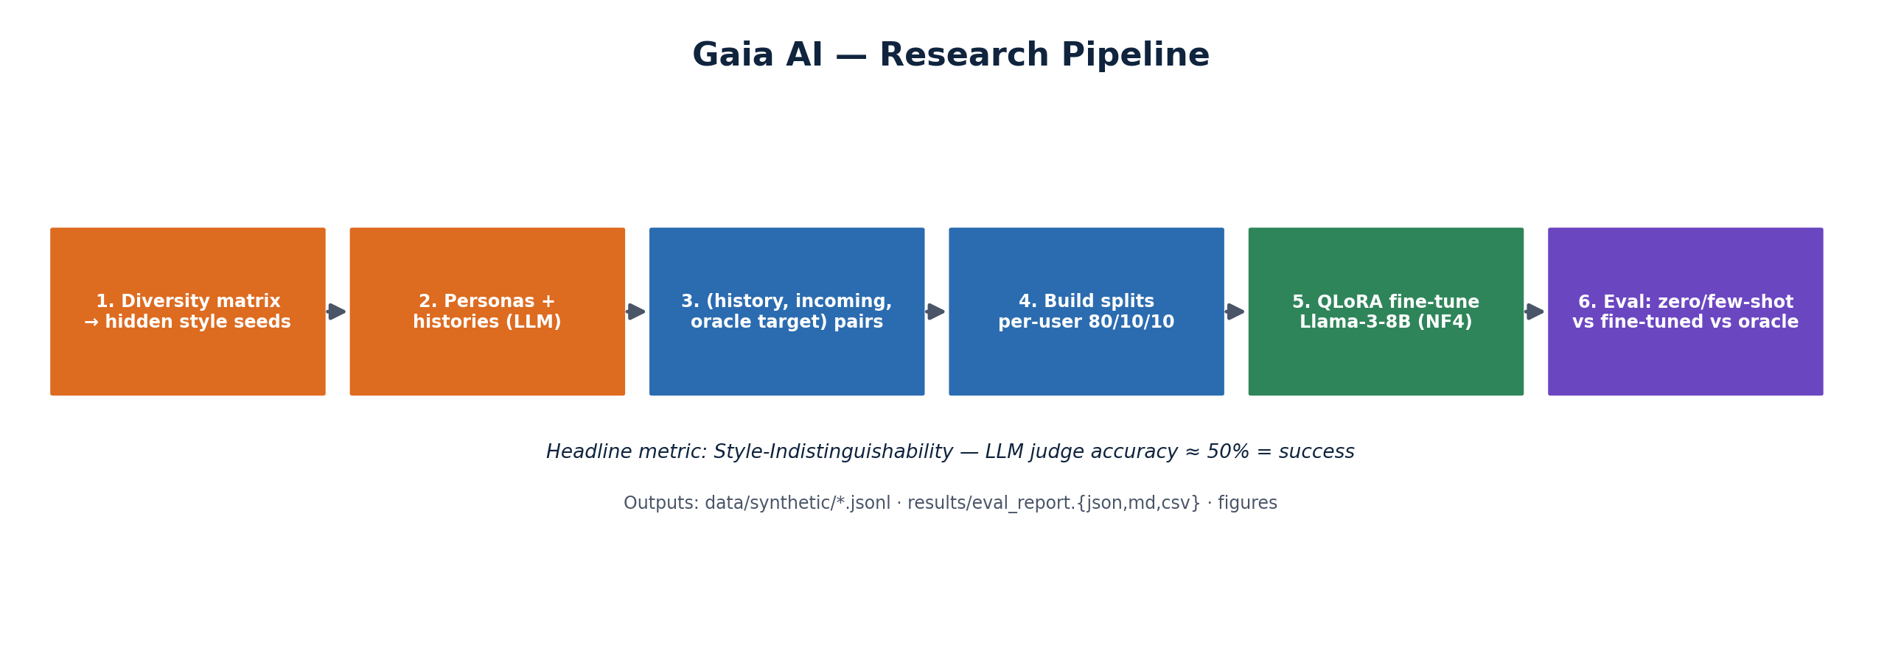
3 · Methodology
• Synthetic generation: LLM role-play with hidden seeds; oracle writes targets; robust JSON parsing.
• Fine-tuning: QLoRA (4-bit NF4, r=16, α=32, target q/k/v/o) on Llama-3-8B-Instruct (cloud GPU).
• Evaluation effort for quality:
– Per-user splits; order-randomized judge; judge model separated from generator.
– Multilingual embedder for he+en style similarity; relevance guards content.
– Rate-limit-aware generation (backoff, serialized) for reproducibility on free tiers.

Slide 5
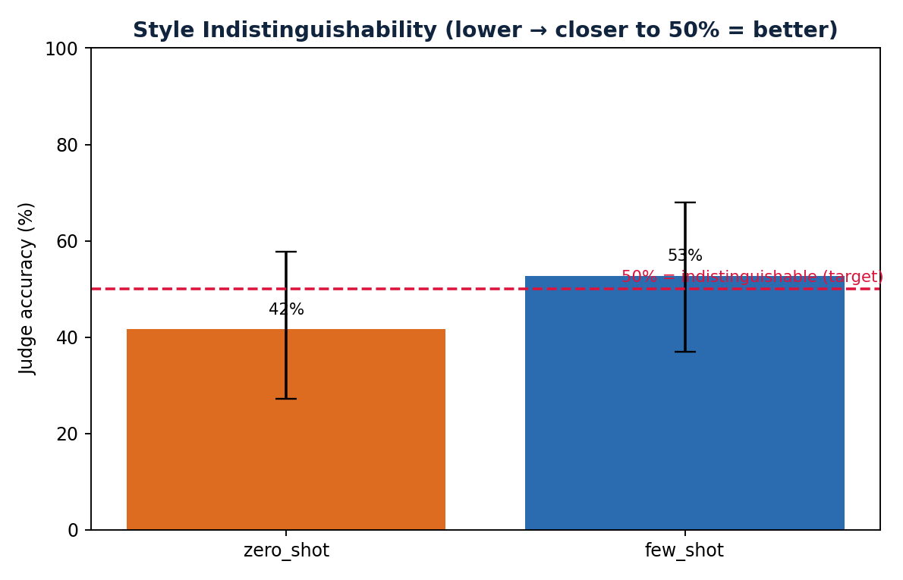
4 · Results
• Evaluated on a held-out per-user test split (test size = 18).
• Off-the-shelf baselines — zero-shot indist. 42%, few-shot 53% (closer to 50% = better).
• fine_tuned column is filled after the QLoRA GPU run (Modal/RunPod) — the core comparison.
Model | Indist. | 95% CI | StyleSim | Relev.
zero_shot | 41.7% | [27,58]% | 0.905 | 3.39
few_shot | 52.8% | [37,68]% | 0.902 | 3.56
fine_tuned | pending (GPU) | — | — | —
Indistinguishability ≈ 50% = success. Figures in visuals/results/.

Slide 6
5 · Conclusion & Future Work
• The framework works end-to-end and yields real baseline numbers; fine-tuned arm is one GPU run away.
• What I'd change: larger dataset (paid LLM tier), a stronger separate judge model, more error analysis.
• Future: real opt-in data generalization test; RLHF from user edits; multi-personality switching.
• Human-in-the-loop throughout — the system suggests; the user approves.

