Slide 1
Gaia AI — Interim Report
Dataset, EDA & baseline · Adir · LLM course (HIT)

Slide 2
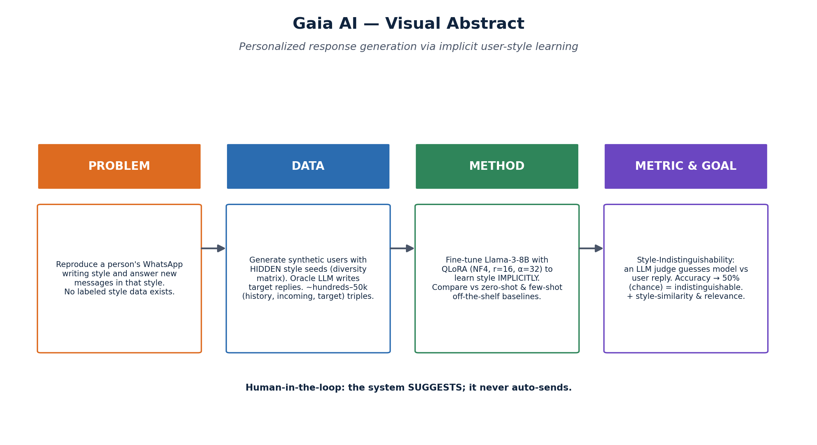
1 · Project Review
• Goal: generate WhatsApp replies in a user's own implicit style, from their chat history.
• Changed from proposal: added a MULTILINGUAL style-similarity embedder (data is he+en); hardened synthetic generation.
• Novelty/contribution:
– Implicit style learning (no tone labels) from synthetic personas with hidden seeds.
– Evaluation by Style-Indistinguishability (LLM judge → 50%) rather than a soft similarity score.

Slide 3
2 · Previous Work
• Reviewed across our four pillars (full table + citations in docs/related_work.md):
Paper (year) | Task | Relation to us
QLoRA (2023) | 4-bit LoRA fine-tuning | Our exact training method
Self-Instruct (2023) | LLM-generated training data | Our synthetic-data strategy
LLM-as-a-Judge (2023) | LLM eval + biases | Basis of our indistinguishability metric
LaMP (2024) | Personalization benchmark | We learn style implicitly, not via retrieval
PersonaChat (2018) | Persona-grounded dialogue | We use implicit, not explicit, personas
Recent, high-citation works (NeurIPS/ACL). arXiv IDs in docs/related_work.md.

Slide 4
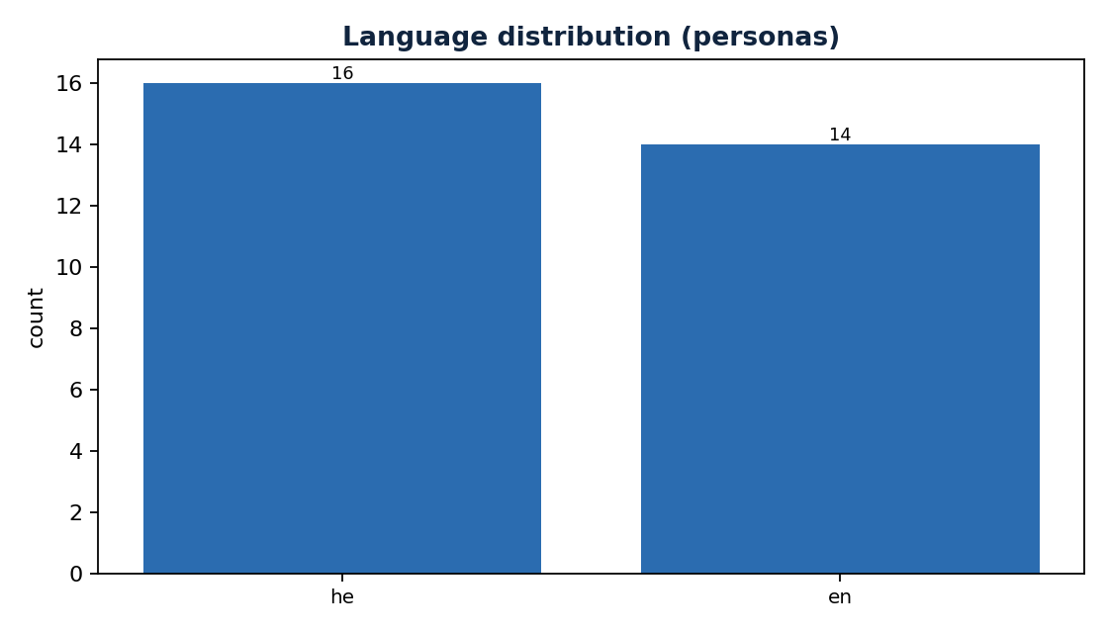
3 · Dataset & EDA
• Synthetic dataset generated with an LLM (Self-Instruct-style), bilingual he/en.
• Each user has a HIDDEN style seed from a 10-axis diversity matrix; targets written by an oracle that sees the seed.
• Splits are PER-USER (no user in both train and test) → tests generalization to unseen people.
– Scale: 30 personas · 22 histories · 170 (history, incoming, target) pairs.
– Target reply length: mean 50.2 chars (median 41.0, range 1–213).
– History message length: mean 39.5 chars over 461 messages.

Slide 5
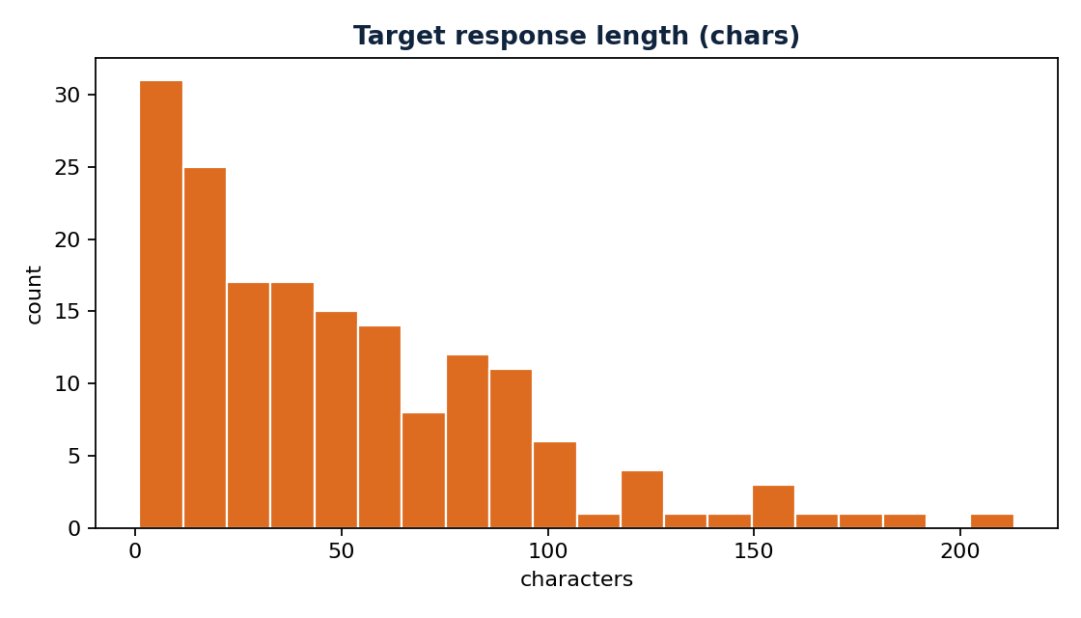
3b · EDA — length & style distributions
• Style axes are spread across the diversity matrix (formality, emoji, slang, length).
• Message and target-reply lengths skew short, matching real WhatsApp behavior.

Slide 6
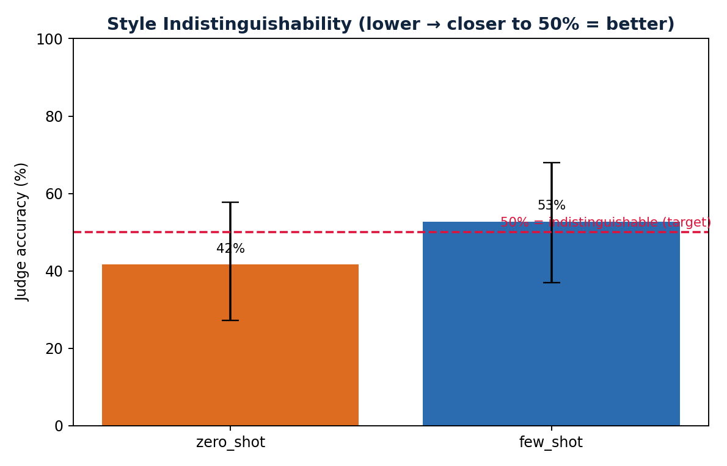
4 · Baseline Solution & Results
• Baselines (off-the-shelf, no fine-tune): zero-shot and few-shot prompting on Llama-3.x via Groq.
• Oracle = upper bound (LLM that saw the hidden seed).
• Evaluated on the held-out per-user test split with all three metrics.
Model | Indist. | 95% CI | StyleSim | Relev.
zero_shot | 41.7% | [27,58]% | 0.905 | 3.39
few_shot | 52.8% | [37,68]% | 0.902 | 3.56
fine_tuned | pending (GPU) | — | — | —
Real baseline numbers (zero/few-shot via Groq). fine_tuned = run on GPU.

Slide 7
5 · Plan
• Remaining steps to the final report:
Step | Scope | Expected outcome
Fine-tune | QLoRA Llama-3-8B on cloud GPU (Modal/RunPod) | Trained adapter
Re-eval | Add fine_tuned column vs baselines | Full comparison table
Scale data | More users (paid Groq tier / multi-day) | More robust numbers
Error analysis | Inspect bad cases, tune prompts | Quality improvements
Final deck | Results + conclusions | Submission

