Slide 1
Gaia AI — Project Proposal
Personalized response generation via implicit user-style learning · Adir · LLM course (HIT)

Slide 2
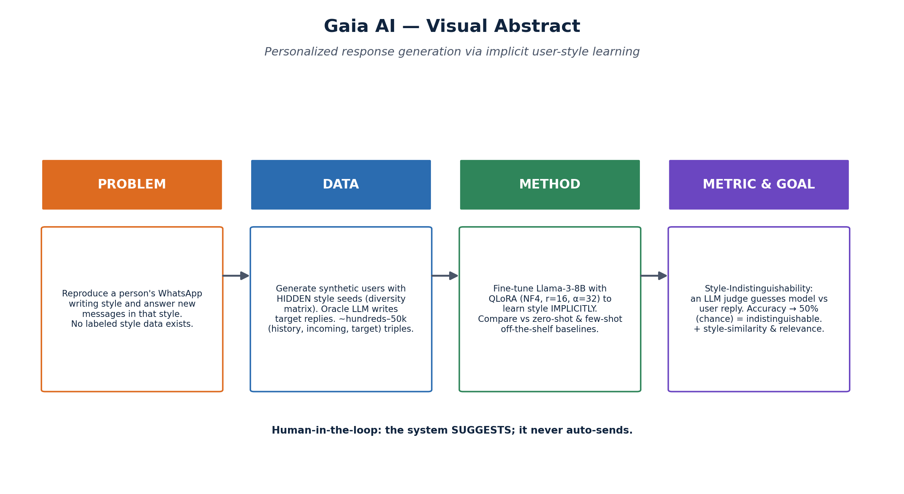
1 · Motivating Use Case
• Communication-heavy people (educators, consultants, founders, support) get floods of messages whose replies follow a consistent PERSONAL style.
• Today this is solved by typing every reply manually, or by generic auto-replies that sound nothing like the user.
– Why important: time cost is huge and tone consistency matters for relationships/brand.
– Why hard: a person's style is implicit — sentence length, emoji, slang, punctuation, rhythm — and there is NO labeled 'style' dataset.
• Gaia AI learns the user's style from their own chat history and SUGGESTS replies (never auto-sends — human approves).

Slide 3
2 · Project Task Description
• Formal problem: conditional text generation with implicit style conditioning.
– Input: a user's chat history + a new incoming message.
– Output: a reply that (a) addresses the message and (b) preserves the user's implicit writing style.
• Novelty: learn style IMPLICITLY (no tone labels) and evaluate by Style-Indistinguishability instead of a soft similarity score.
• Scope is novel & data-free: no public dataset exists → we generate synthetic training and test data.

Slide 4
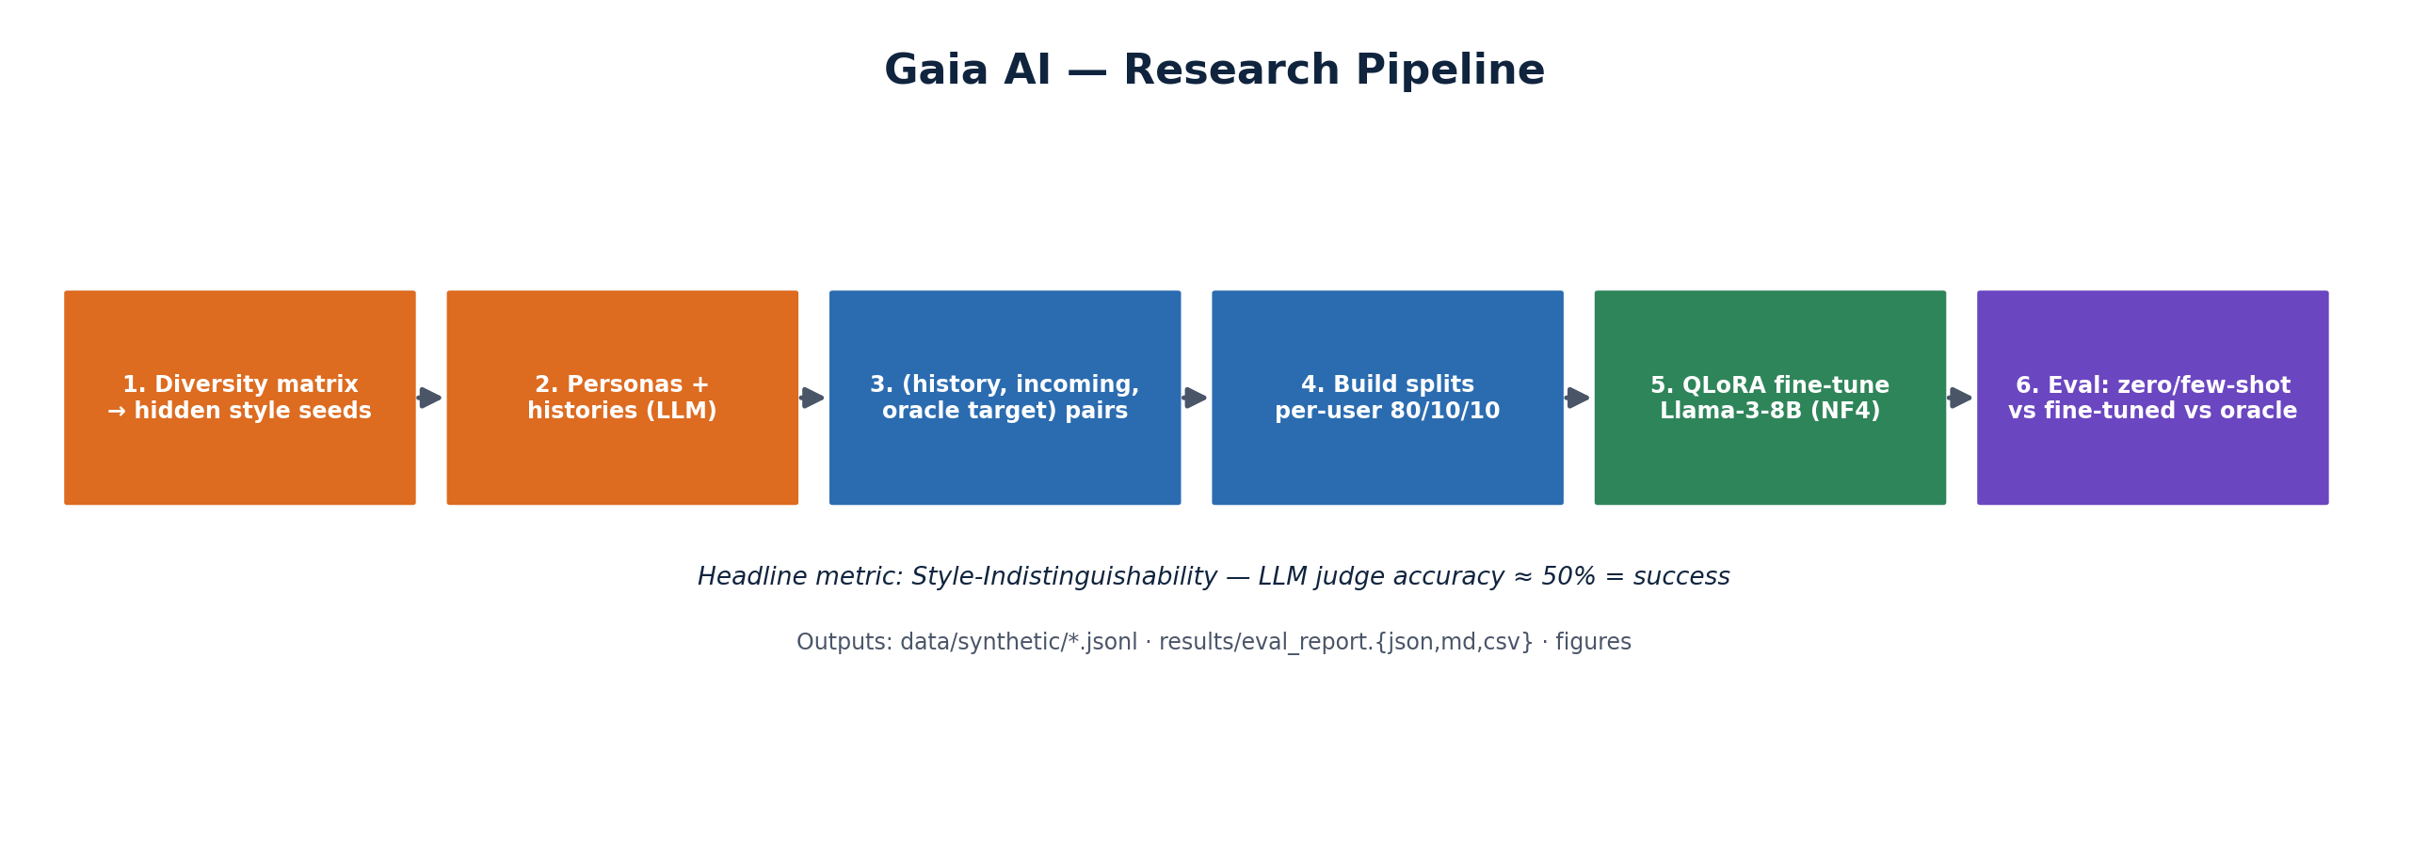
3 · Models & Methods
• Pipeline: diversity matrix → synthetic personas+histories → (history, incoming, oracle-target) pairs → splits → fine-tune → eval.
• Fine-tuned model: Llama-3-8B-Instruct + QLoRA (4-bit NF4, r=16, α=32, target q/k/v/o).
• Off-the-shelf baselines to compare against:
– Zero-shot prompting (style instruction only).
– Few-shot prompting (5–8 history examples in context).
– Oracle (LLM that saw the hidden style seed) = upper bound.
• Style memory retrieval (embeddings/Qdrant) provides relevant history at runtime.

Slide 5
4 · Data Specification & Generation
• No real labeled data → generate SYNTHETIC data with an LLM (Self-Instruct-style).
• Each synthetic user gets a HIDDEN style seed sampled from a diversity matrix:
– language (he/en) × length × emoji × slang × formality × rhythm × punctuation × greeting × occupation × age.
• Per user: ~30–50 style-reference messages + (history, incoming, target) triples; target written by an 'oracle' that sees the seed.
• Splits are PER-USER (no user in both train and test) to test generalization to unseen people.
• Real data (optional, evaluation only): opt-in, anonymized, AES-encrypted, gitignored.

Slide 6
5 · Metrics & KPIs
• Headline — Style-Indistinguishability: an LLM judge sees history+incoming+two replies (oracle vs ours, randomized) and guesses the user's.
– KPI: judge accuracy → 50% (chance) = indistinguishable = success.
– Report 95% Wilson CI + order-bias check; judge model separated from generator.
• Style similarity: cosine in a MULTILINGUAL embedding space vs the user's history (he+en).
• Relevance: LLM 1–5 — does the reply actually address the message? (style without content is useless).
• Quality protocol: per-user split, bias mitigations, ground-truth = oracle (synthetic) / real user (real test).
Targets: fine_tuned indist. ∈ [45%,55%]; baselines higher (judge can spot them).

