Slide 1
FIFA 21 Data mining and ML Final project
Adir Horesh
Stav Shalom
GitHub

Slide 2
Timeline
Define the question
Web Scraping
Data Cleansing
Exploratory Data Analyses
Building a Model
Evaluating Model’s Result
Conclusion

Slide 3
Presenting the prediction questions

Slide 4
Research Questions:
Can we predict the expected football player’s market value?
Can we determine which players are overvalued or undervalued?

Slide 5
Web Scraping

Slide 6
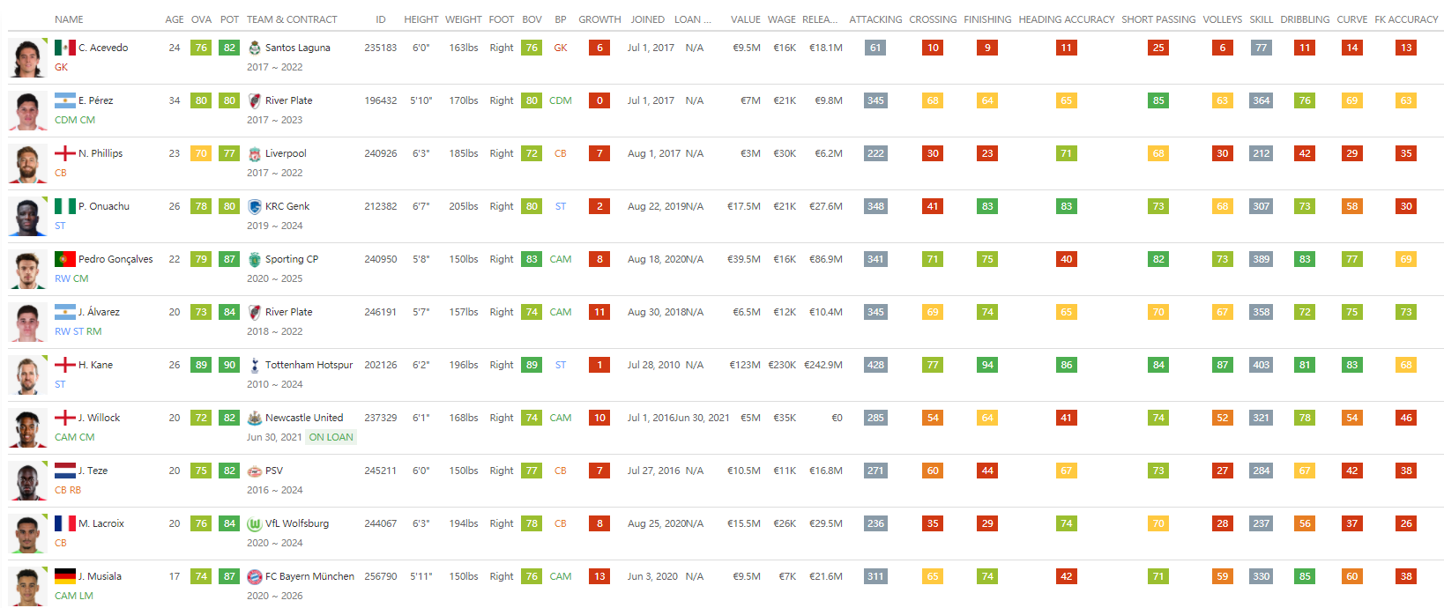
Data source:
In this project we used sofifa dataset:
Main page of sofifa shown below.

Slide 7
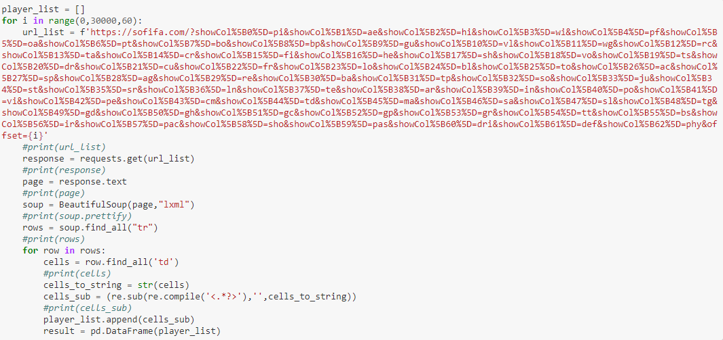
Scarping process:
The main page includes players data, and we saw that each page has 60 players. So we build a “for” loop to get all players from the site. We used BeautifulSoup python library to scrape data.

Slide 8
Data Cleaning

Slide 9
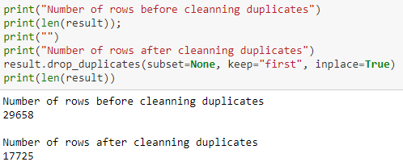
Remove duplicates:
We checked the number of rows and dropped duplicate rows. Finally we scraped 17,725 unique players from sofifa.

Slide 10
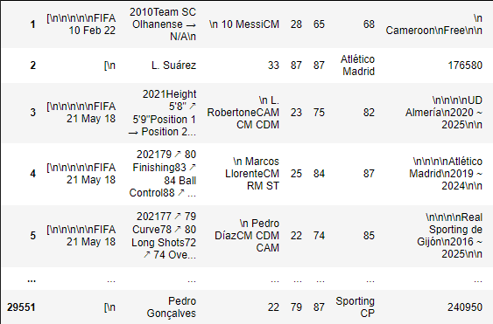
Data before cleaning:
After getting data, the data frame looks like in the picture. We Can see that the data has unwanted signs/characters for machine learning algorithm.

Slide 11
Data cleaning phases:
Converting height column to cm
Converting weight column to kg
Split columns
Remove unwanted characters (like“\n”)
Converting Value, Wage and Release_Clause to decimal money (and added €, M and K characters)
Removing some rows that columns is blank
Converting International Reputation column (X ★) to integer (X)
Converting all numeric columns from char to integer/float

Slide 12
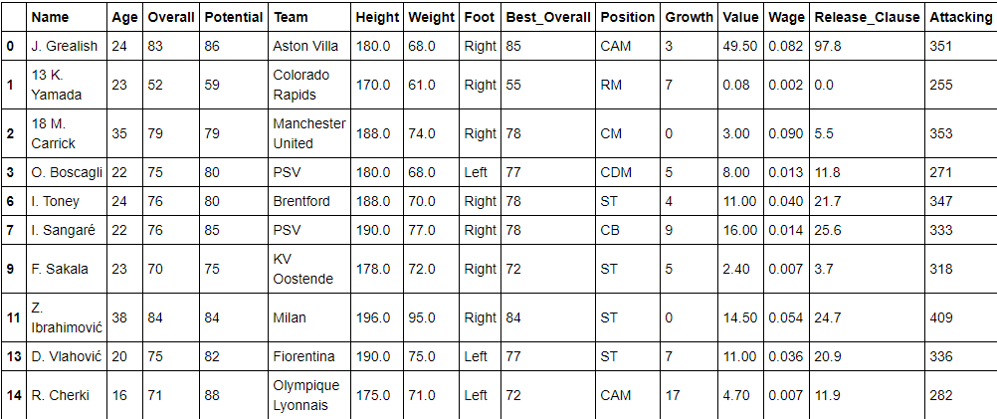
Data after cleaning:

Slide 13
Exploratory data analysis

Slide 14
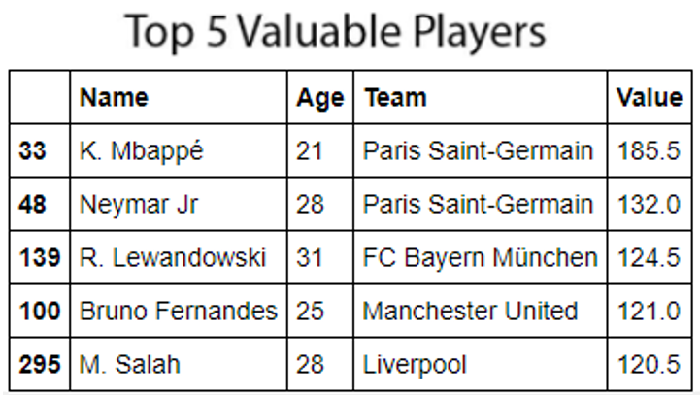
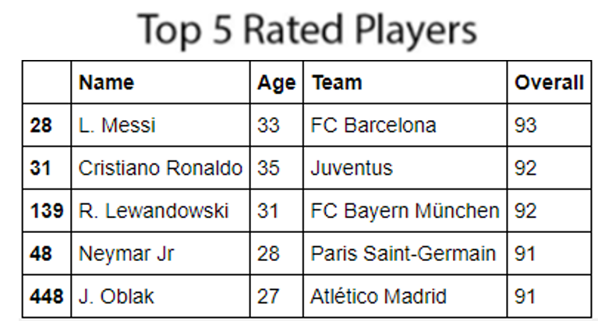
Let’s have a look at some brief information and graphics:

Slide 15
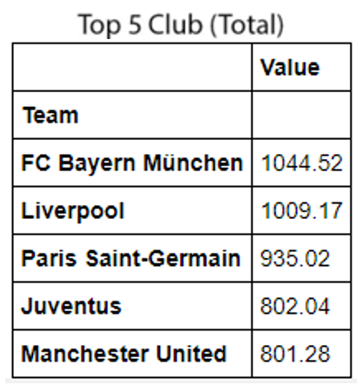
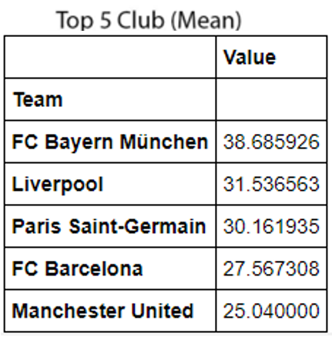
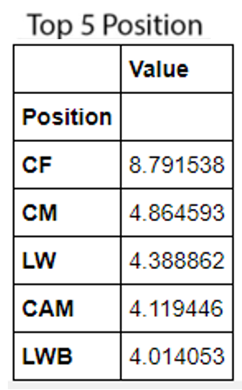
More statistics & graphs:

Slide 16
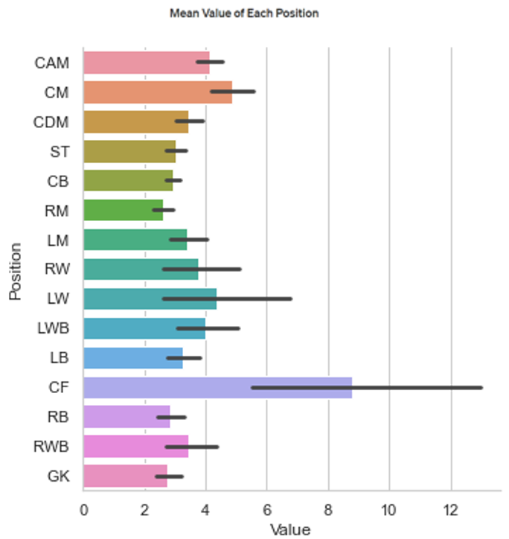
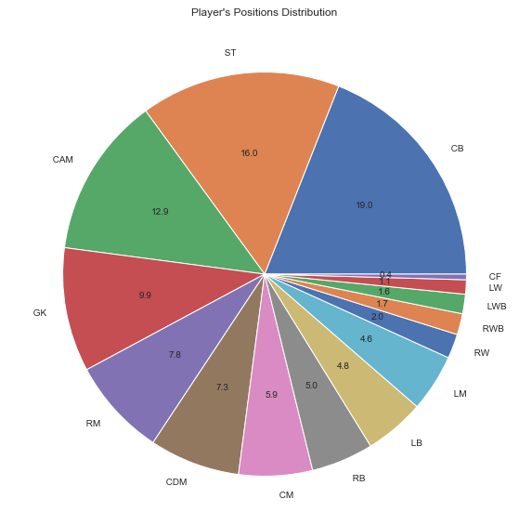
Players positions statistics:

Slide 17
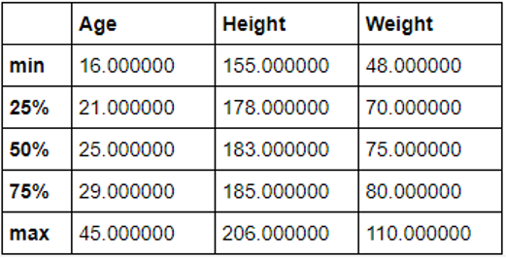
Players physical statistics:

Slide 18
Machine Learning- Building a model

Slide 19
Building a Model:
We used Regression Model (to predict a continuous value).
We split our data frame as Xb, yb for baseline model.
Xb-numeric columns (Features)
yb is our target column (Value)
Then we create OLS model.
According our baseline model, R-squared value is 0.965, It is good but model has some complexity (a lot of features).

Slide 20
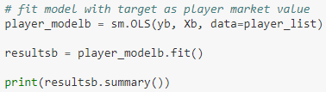
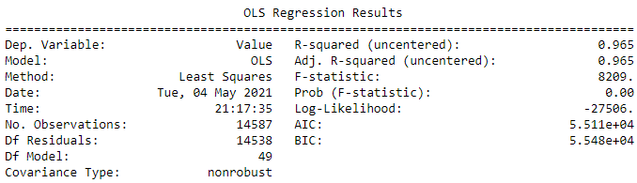
Model code & data:

Slide 21
Machine Learning- Evaluating Model

Slide 22
Evaluating Model’s Result:
Model needs some feature engineering works. We wanted to reduce the number of features. So we used correlation matrix. Let’s find highly correlated with target (Player value) columns, then we decided to use these columns to predict Value.
Overall
Age
Int_Reputation
Growth
Release_Clause

Slide 23
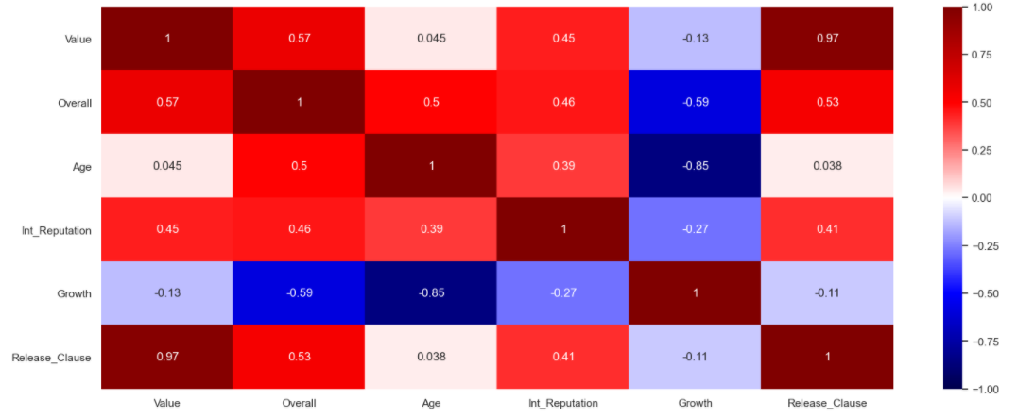
correlation matrix:
we can see the heatmap between these selected columns (That we choose in the previous slide) and target column (Player value).

Slide 24
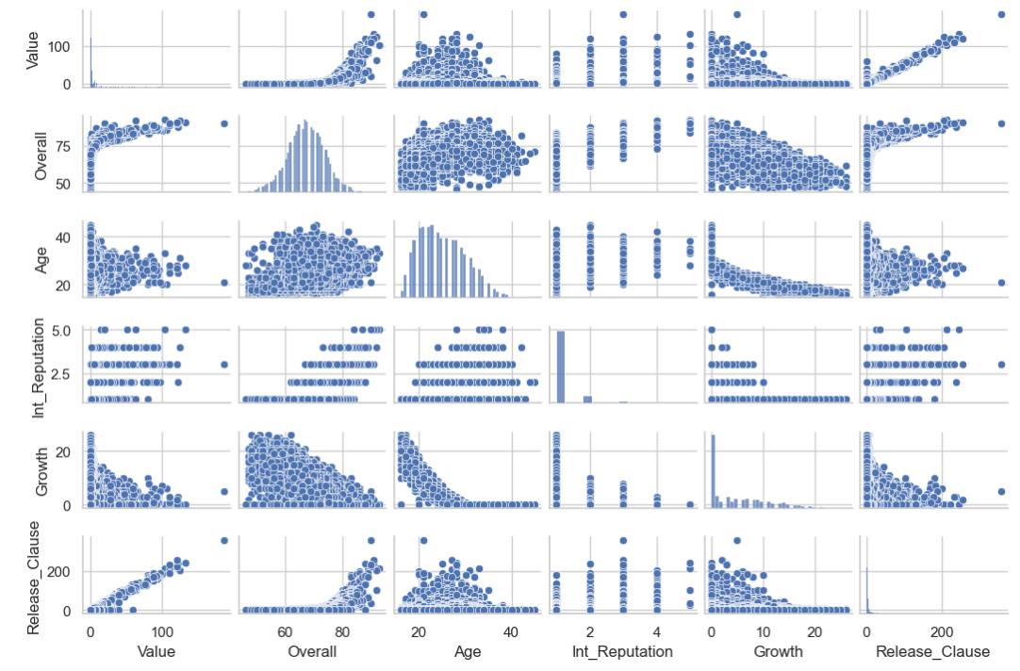
Pairplot of the selected columns:

Slide 25
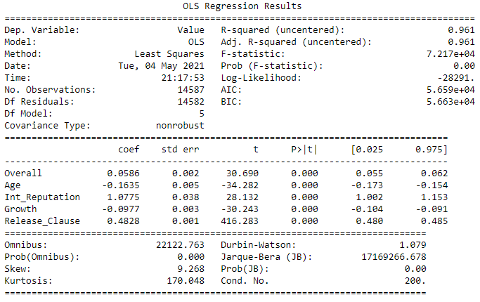
Evaluating Model’s Result:
Then we created a model with the selected five features and checking some parameters. The OLS Regression Results looks great. Because there are less feature (5) and it help us explain our model clearly, Our R-squared value is still high (0.961).

Slide 26
Conclusion

Slide 27
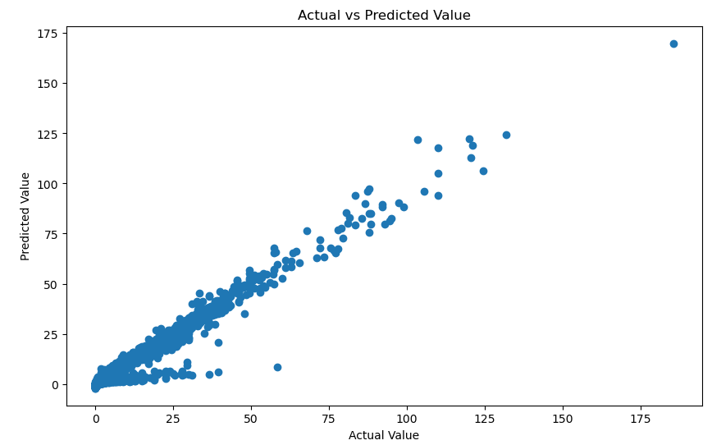
Compare actual & predicted result:
This is a comparison between actual & predicted value.

Slide 28
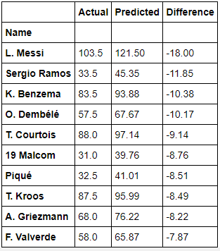
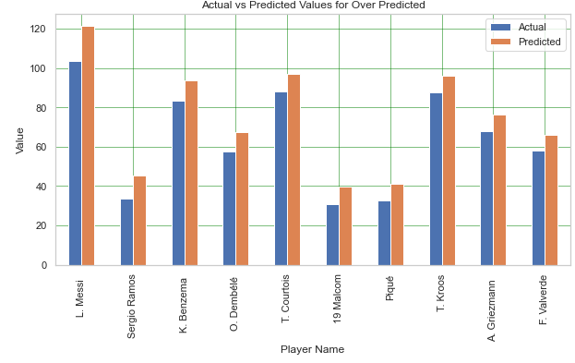
Most overvalued players :
Finally Let’s find which players are most over valued and which are most under valued player.
Biggest negative difference is 18 million € for Leo Messi. Actual market value of Leo Messi is 103.5 million € but model predicted value is 121.5 million €.

Slide 29
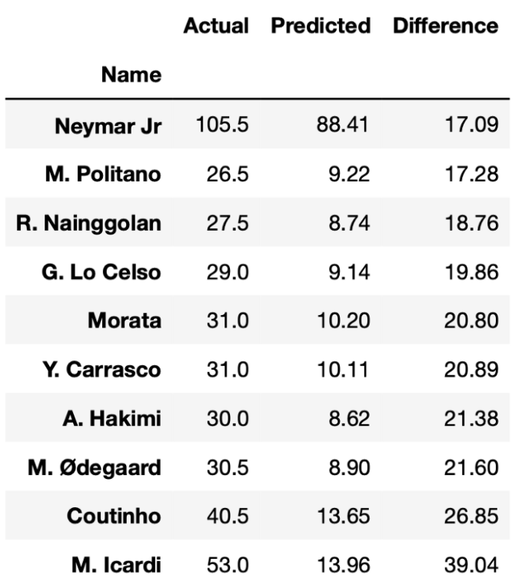
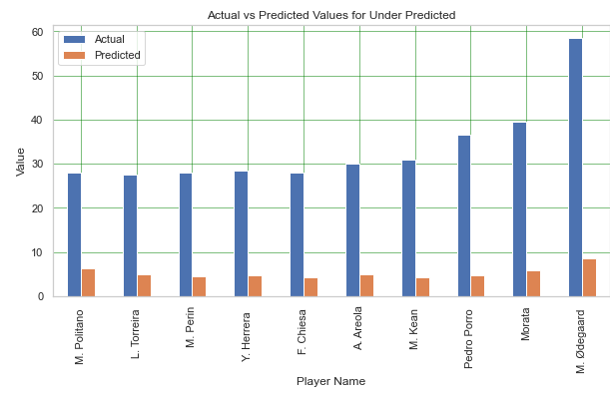
Most undervalued players :
Biggest positive difference is 39.04 million € for M.Icardi.. Actual market value of Icardi is 53 million € but model predicted value is 13.96 million €.

Slide 30
Thank you For the listening! ☺

