Slide 1


BOOTSTRAP
A PRESENTATION BY Adiras Sahu 0801IT211005 Aditi Rathi 0801IT211006 Aditya Nema 0801IT211009

Slide 2

What is Bootstrap?
Bootstrap is a free and open-source CSS framework widely
used. It is used for responsive, mobile-first front-end web
development. Bootstrap is written in HTML, CSS, Less (v3), Sass
(v4) and JavaScript.
Bootstrap was originally named Twitter Blueprint and it was
developed by Mark Otto and Jacob Thornton at Twitter as a
framework to encourage consistency across internal tools.

Slide 3
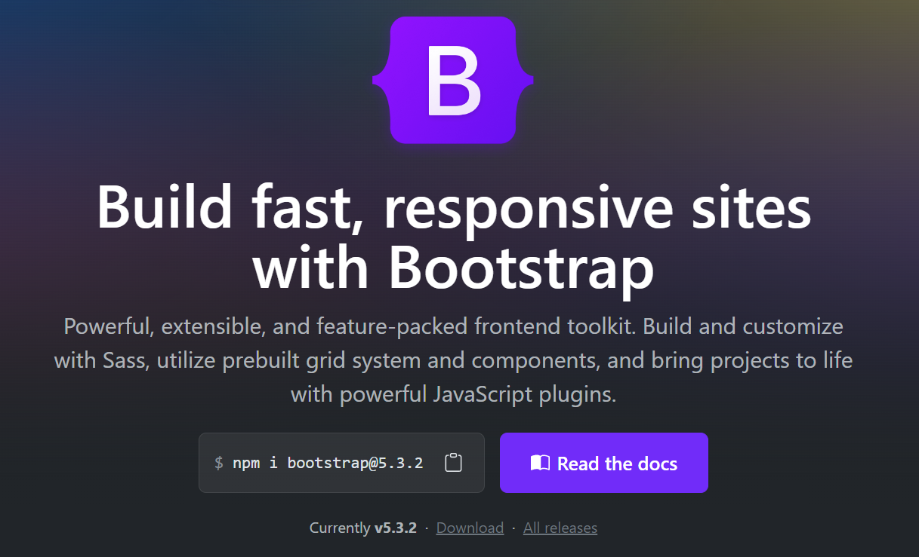

Slide 4
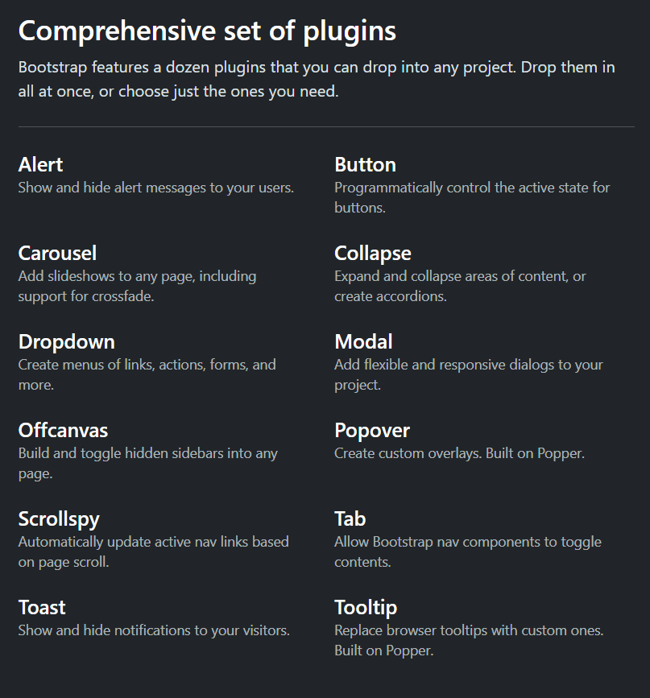

Slide 5
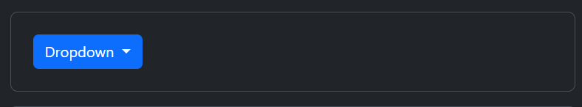
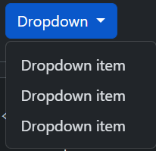
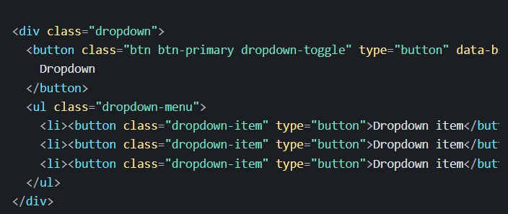

Slide 6
FEATURES OF BOOTSTRAP
Grid System: Bootstrap includes a responsive grid system that allows developers to create flexible and responsive layouts. The grid system helps organize content into rows and columns, making it easy to structure and align elements.
Component Library: Bootstrap provides a wide range of pre-styled and customizable components, such as buttons, forms, navigation bars, alerts, and more. These components can be easily integrated into projects, saving developers time and effort.
Customization: While Bootstrap offers a default styling that looks good out of the box, developers can customize the framework to suit the specific design requirements of their projects. Bootstrap can be customized using its Sass variables and mixins.

Slide 7
ADVANTAGE
Rapid Development: Bootstrap accelerates the development process by providing a set of pre-designed components and styles. This can save developers a significant amount of time when building responsive and visually appealing interfaces.
Consistency: Bootstrap ensures consistency across different browsers and devices, offering a standardized look and feel. This is particularly useful for projects where maintaining a uniform user experience is important.
Responsive Design: Bootstrap is built with a mobile-first approach, making it easy to create responsive and mobile-friendly designs without a lot of additional effort.

Slide 8
DISADVANTAGE
File Size: Including the entire Bootstrap framework in a project can lead to larger file sizes. This might impact page load times, especially for projects where performance is a critical concern.
Overhead: Projects that do not require the extensive features provided by Bootstrap may have unnecessary overhead. If a simple website or application is being developed, using a smaller, more specialized framework or starting from scratch might be more efficient.
Dependency on JavaScript: Some of Bootstrap's components rely on JavaScript. If a project has strict requirements regarding the use of JavaScript, this could be considered a disadvantage.

Slide 9
LIBRARY OF BOOTSTRAP
bootstrap Icons:
Description: A library of free, high-quality SVG icons that can be easily integrated into Bootstrap projects.
Syntax: Icons are usually added using HTML and the appropriate Bootstrap Icons classes. For example:
<i class="bi bi-heart"></i>
Where to Include:
The Bootstrap Icons library provides instructions for adding the necessary files to your project. Typically, you include them in the <head> section of your HTML file.

Slide 10
Font Awesome:
Description: A popular icon library providing a wide range of scalable vector icons. It can be used with Bootstrap for additional icon options.
Syntax: Icons are added using HTML and Font Awesome classes.
For example:
<i class="fas fa-heart"></i>
Where to Include:
Include the Font Awesome CSS file in the <head> section of your HTML file.

Slide 11
jQuery:
Description: While Bootstrap has moved towards native JavaScript in recent versions, some older versions (such as Bootstrap 3) rely on jQuery for certain components.
Syntax: jQuery syntax varies based on the specific functionality you are implementing. Here's a basic example:
<script src="https://code.jquery.com/jquery-3.6.0.min.js"></script>
<script>
$(document).ready(function(){
// Your jQuery code here
});
</script>
Where to Include:
Typically, include jQuery before the Bootstrap JavaScript file in the <head> section of your HTML file.

Slide 12
USE OF BOOTSTRAP
Responsive Web Design: Bootstrap is known for its mobile-first approach, making it a go-to choice for creating responsive websites. It provides a responsive grid system and fluid typography, allowing developers to design interfaces that adapt seamlessly to different screen sizes and devices.
Rapid Prototyping: Bootstrap's extensive set of pre-designed components and styles allows developers to quickly prototype and build user interfaces. This is particularly useful during the initial stages of a project when a fast turnaround is essential.
Consistent UI/UX: Bootstrap ensures a consistent look and feel across different browsers and devices. This is advantageous when maintaining a standardized user interface and user experience is a priority.

Slide 13
USE OF BOOTSTRAP
Cross-Browser Compatibility: Bootstrap takes care of many cross-browser compatibility issues, reducing the need for extensive testing and ensuring a consistent experience for users across various browsers.
Front-End Development Efficiency: Bootstrap simplifies front-end development by providing a set of ready-to-use components, such as navigation bars, buttons, forms, and more. This can significantly reduce the amount of manual coding and styling required.
Customization: While Bootstrap comes with default styling, it's highly customizable. Developers can use Bootstrap's Sass variables and mixins to tailor the framework to match the specific design requirements of a project. Startups and Small Projects: Bootstrap is often chosen for startups and small projects where time and resources are limited. Its ease of use and quick setup make it an attractive option for projects with tight deadlines.

Slide 14
USE OF BOOTSTRAP
Community Support: Bootstrap has a large and active community of developers. This means that developers can find ample resources, documentation, tutorials, and third-party plugins, making problem-solving and learning more accessible.

Slide 15
DEMO..

Slide 16
THANKYOU!

