Slide 1
CS:APP Chapter 4
Computer Architecture
Pipelined
Implementation
Part I
Randal E. Bryant
Carnegie Mellon University
http://csapp.cs.cmu.edu
CS:APP3e

Slide 2
Overview
General Principles of Pipelining
Goal
Difficulties
Creating a Pipelined Y86-64 Processor
Rearranging SEQ
Inserting pipeline registers
Problems with data and control hazards

Slide 3


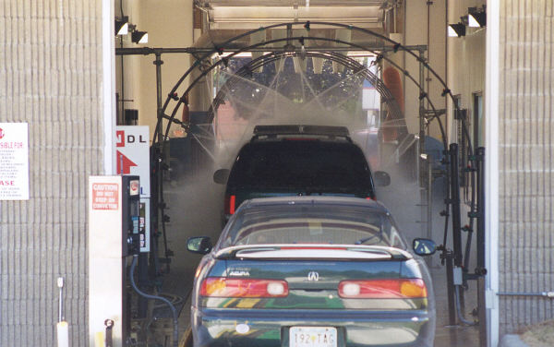
Real-World Pipelines: Car Washes
Sequential
Parallel
Pipelined
Idea
Divide process into independent stages
Move objects through stages in sequence
At any given times, multiple objects being processed

Slide 4
Computational Example
300 ps
20 ps
Combinational
logic
R
e
g
Delay = 320 ps
Throughput = 3.12 GIPS
Clock
System
Computation requires total of 300 picoseconds
Additional 20 picoseconds to save result in register
Must have clock cycle of at least 320 ps

Slide 5
3-Way Pipelined Version
100 ps
20 ps
100 ps
20 ps
100 ps
20 ps
Comb.
logic
A
R
e
g
Comb.
logic
B
R
e
g
Comb.
logic
C
R
e
g
Delay = 360 ps
Throughput = 8.33 GIPS
Clock
System
Divide combinational logic into 3 blocks of 100 ps each
Can begin new operation as soon as previous one passes through stage A.
Begin new operation every 120 ps
Overall latency increases
360 ps from start to finish

Slide 6
Pipeline Diagrams
Unpipelined
Cannot start new operation until previous one completes
3-Way Pipelined
Up to 3 operations in process simultaneously
OP1
OP2
OP3
Time
OP1
A
B
C
OP2
A
B
C
OP3
A
B
C
Time

Slide 7
Operating a Pipeline
239
241
300
359
Clock
OP1
A
B
C
OP2
A
B
C
OP3
A
B
C
0
120
240
360
480
640
Time
100 ps
20 ps
100 ps
20 ps
100 ps
20 ps
100 ps
100 ps
100 ps
20 ps
20 ps
20 ps
100 ps
100 ps
100 ps
20 ps
20 ps
20 ps
100 ps
100 ps
100 ps
20 ps
20 ps
20 ps
Comb.
logic
A
R
e
g
Comb.
logic
B
R
e
g
Comb.
logic
C
Comb.
logic
A
R
e
g
Comb.
logic
B
R
e
g
Comb.
logic
C
R
e
g
Comb.
logic
A
Comb.
logic
A
R
e
g
R
e
g
Comb.
logic
B
Comb.
logic
B
R
e
g
R
e
g
Comb.
logic
C
Comb.
logic
C
R
e
g
R
e
g
R
e
g
Clock
Clock
Clock
Clock

Slide 8
Limitations: Nonuniform Delays
50 ps
20 ps
150 ps
20 ps
100 ps
20 ps
Comb.
logic
A
R
e
g
Comb.
logic
B
R
e
g
Comb.
logic
C
R
e
g
Delay = 510 ps
Throughput = 5.88 GIPS
Clock
OP1
A
B
C
OP2
A
B
C
OP3
A
B
C
Time
Throughput limited by slowest stage
Other stages sit idle for much of the time
Challenging to partition system into balanced stages

Slide 9
Limitations: Register Overhead
50 ps
20 ps
50 ps
20 ps
50 ps
20 ps
50 ps
20 ps
50 ps
20 ps
50 ps
20 ps
Comb.
logic
R
e
g
Comb.
logic
R
e
g
Comb.
logic
R
e
g
Comb.
logic
R
e
g
Comb.
logic
R
e
g
Comb.
logic
R
e
g
Clock
Delay = 420 ps, Throughput = 14.29 GIPS
As try to deepen pipeline, overhead of loading registers becomes more significant
Percentage of clock cycle spent loading register:
1-stage pipeline: 6.25%
3-stage pipeline: 16.67%
6-stage pipeline: 28.57%
High speeds of modern processor designs obtained through very deep pipelining

Slide 10
Data Dependencies
Combinational
logic
R
e
g
Clock
OP1
OP2
OP3
Time
System
Each operation depends on result from preceding one

Slide 11
Data Hazards
Comb.
logic
A
R
e
g
Comb.
logic
B
R
e
g
Comb.
logic
C
R
e
g
Clock
OP1
A
B
C
OP2
A
B
C
OP3
A
B
C
OP4
A
B
C
Time
Result does not feed back around in time for next operation
Pipelining has changed behavior of system

Slide 12
Data Dependencies in Processors
1 irmovq $50, %rax
2 addq %rax , %rbx
3 mrmovq 100( %rbx ), %rdx
Result from one instruction used as operand for another
Read-after-write (RAW) dependency
Very common in actual programs
Must make sure our pipeline handles these properly
Get correct results
Minimize performance impact

Slide 13
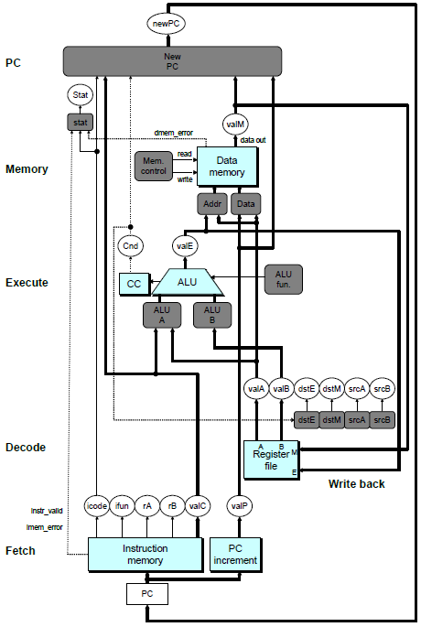
SEQ Hardware
Stages occur in sequence
One operation in process at a time

Slide 14
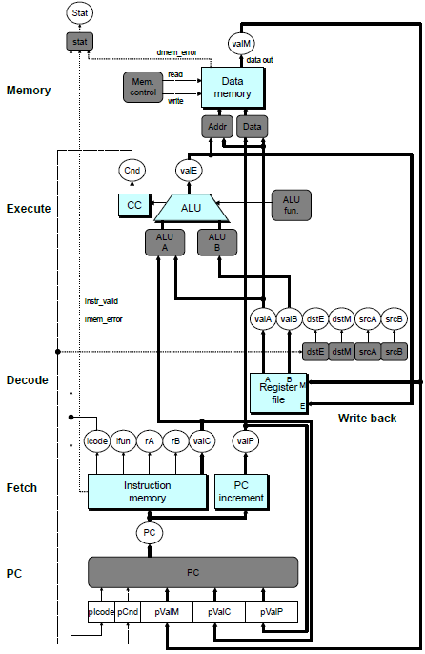
SEQ+ Hardware
Still sequential implementation
Reorder PC stage to put at beginning
PC Stage
Task is to select PC for current instruction
Based on results computed by previous instruction
Processor State
PC is no longer stored in register
But, can determine PC based on other stored information

Slide 15
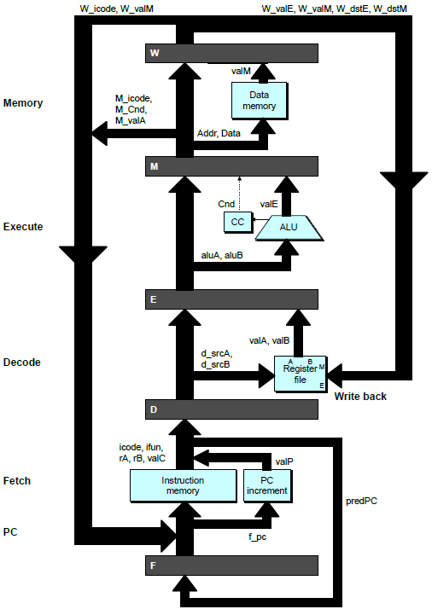
Adding Pipeline Registers
PC
newPC
valE
,
valM
Write back
valM
Data
Memory
Data
memory
memory
Addr
, Data
valE
CC
CC
ALU
Execute
Cnd
ALU
aluA
,
aluB
valA
,
valB
Decode
srcA
,
srcB
A
A
B
dstA
,
dstB
B
M
Register
M
Register
Register
Register
file
file
file
file
E
E
icode
,
ifun
valP
rA
,
rB
valC
Instruction
PC
Instruction
PC
Fetch
memory
increment
memory
increment
PC

Slide 16
Pipeline Stages
Fetch
Select current PC
Read instruction
Compute incremented PC
Decode
Read program registers
Execute
Operate ALU
Memory
Read or write data memory
Write Back
Update register file

Slide 17
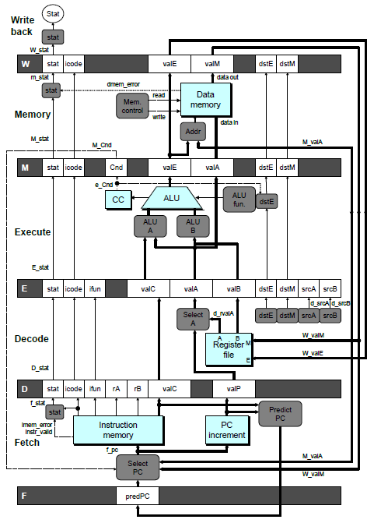
PIPE- Hardware
Pipeline registers hold intermediate values from instruction execution
Forward (Upward) Paths
Values passed from one stage to next
Cannot jump past stages
e.g., valC passes through decode

Slide 18
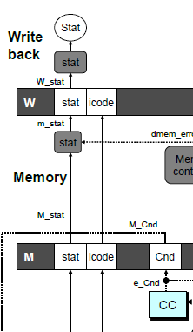
Signal Naming Conventions
S_Field
Value of Field held in stage S pipeline register
s_Field
Value of Field computed in stage S

Slide 19
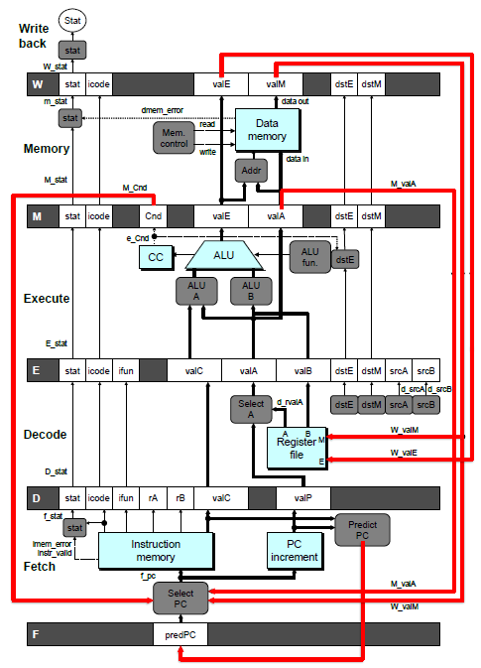
Feedback Paths
Predicted PC
Guess value of next PC
Branch information
Jump taken/not-taken
Fall-through or target address
Return point
Read from memory
Register updates
To register file write ports

Slide 20
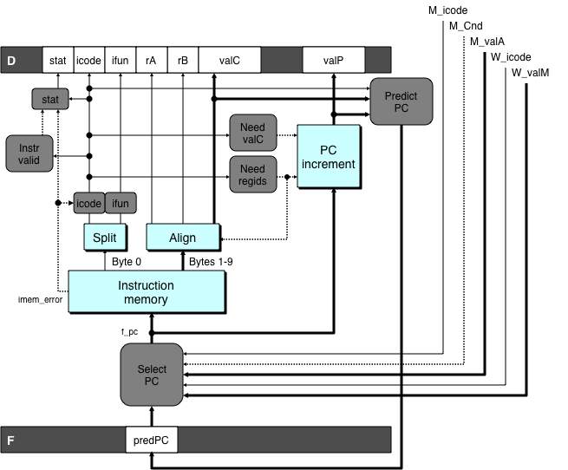
Predicting the PC
Start fetch of new instruction after current one has completed fetch stage
Not enough time to reliably determine next instruction
Guess which instruction will follow
Recover if prediction was incorrect

Slide 21
Our Prediction Strategy
Instructions that Don’t Transfer Control
Predict next PC to be valP
Always reliable
Call and Unconditional Jumps
Predict next PC to be valC (destination)
Always reliable
Conditional Jumps
Predict next PC to be valC (destination)
Only correct if branch is taken
Typically right 60% of time
Return Instruction
Don’t try to predict

Slide 22
Recovering from PC Misprediction
Mispredicted Jump
Will see branch condition flag once instruction reaches memory stage
Can get fall-through PC from valA (value M_valA)
Return Instruction
Will get return PC when ret reaches write-back stage (W_valM)

Slide 23
Pipeline Demonstration
1
2
3
4
5
6
7
8
9
irmovq $1,%rax #I1
F
D
E
M
W
irmovq $2,%rcx #I2
F
D
E
M
W
irmovq $3,%rdx #I3
F
D
E
M
W
irmovq $4,%rbx #I4
F
D
E
M
W
halt #I5
F
D
E
M
W
Cycle 5
File: demo-basic.ys
W
I1
M
I2
E
I3
D
I4
F
I5

Slide 24
Data Dependencies: 3 Nop’s
# demo-h3.ys
1
2
3
4
5
6
7
8
9
10
11
F
F
D
D
E
E
M
M
W
0x000:
irmovq
$10,%
rdx
W
F
F
D
D
E
E
M
M
W
0x00a:
irmovq
$3,%
rax
W
F
F
D
D
E
E
M
M
W
0x014:
nop
W
F
F
D
D
E
E
M
M
W
0x015:
nop
W
F
F
D
D
E
E
M
M
W
0x016:
nop
W
F
F
D
D
E
E
M
M
W
0x017:
addq
%
rdx
,%
rax
W
F
F
D
D
E
E
M
M
W
0x019: halt
W
Cycle 6
W
W
f
R[
f
R[
]
]
3
%
3
%
rax
rax
Cycle 7
D
D
f
valA
f
valA
R[
R[
]
]
=
=
10
%
10
%
rdx
rdx
f
valB
f
valB
R[
R[
]
]
=
=
3
%
3
%
rax
rax

Slide 25
Data Dependencies: 2 Nop’s
# demo-h2.ys
1
2
3
4
5
6
7
8
9
10
F
F
D
D
E
E
M
M
W
0x000:
irmovq
$10,%
rdx
W
F
F
D
D
E
E
M
M
W
0x00a:
irmovq
$3,%
rax
W
F
F
D
D
E
E
M
M
W
0x014:
nop
W
F
F
D
D
E
E
M
M
W
0x015:
nop
W
F
F
D
D
E
E
M
M
W
0x016:
addq
%
rdx
,%
rax
W
F
F
D
D
E
E
M
M
W
0x018: halt
W
Cycle 6
W
W
W
f
f
R[
f
R[
R[
]
]
]
3
3
%
3
%
%
rax
rax
rax
•
•
•
•
•
•
D
D
D
f
f
valA
f
valA
valA
R[
R[
R[
]
]
]
=
=
=
10
10
%
10
Error
%
%
rdx
rdx
rdx
f
f
valB
f
valB
valB
R[
R[
R[
]
]
]
=
=
=
0
0
%
0
%
%
rax
rax
rax

Slide 26
Data Dependencies: 1 Nop
# demo-h1.ys
1
2
3
4
5
6
7
8
9
0x000:
irmovq
$10,%
rdx
F
D
E
M
W
0x00a:
irmovq
$3,%
rax
F
D
E
M
W
F
F
D
D
E
E
M
M
W
0x014:
nop
W
F
F
D
D
E
E
M
M
W
0x015:
addq
%
rdx
,%
rax
W
F
F
D
D
E
E
M
M
W
0x017: halt
W
Cycle 5
W
W
f
R[
f
R[
]
]
10
%
10
%
rdx
rdx
M
M_
valE
= 3
M_
dstE
=
%
rax
•
•
•
D
D
Error
f
valA
f
valA
R[
R[
]
]
=
=
0
%
0
%
rdx
rdx
f
valB
f
valB
R[
R[
]
]
=
=
0
%
0
%
rax
rax

Slide 27
Data Dependencies: No Nop
# demo-h0.ys
1
2
3
4
5
6
7
8
0x000:
irmovq
$10,%
rdx
F
D
E
M
W
0x00a:
irmovq
$3,%
rax
F
D
E
M
W
0x014:
addq
%
rdx
,%
rax
F
D
E
M
W
0x016: halt
F
D
E
M
W
Cycle 4
M
M_
valE
= 10
M_
dstE
=
%
rdx
E
e_
valE
f
0 + 3 = 3
E_
dstE
=
%
rax
D
D
Error
f
valA
f
valA
R[
R[
]
]
=
=
0
%
0
%
rdx
rdx
f
valB
f
valB
R[
R[
]
]
=
=
0
%
0
%
rax
rax

Slide 28
Branch Misprediction Example
demo-j.ys
0x000: xorq %rax,%rax
0x002: jne t # Not taken
0x00b: irmovq $1, %rax # Fall through
0x015: nop
0x016: nop
0x017: nop
0x018: halt
0x019: t: irmovq $3, %rdx # Target (Should not execute)
0x023: irmovq $4, %rcx # Should not execute
0x02d: irmovq $5, %rdx # Should not execute
Should only execute first 8 instructions

Slide 29
Branch Misprediction Trace
# demo
-
j
1
2
3
4
5
6
7
8
9
0x000:
xorq
%
F
D
E
M
W
rax
,%
rax
0x002:
jne
t # Not taken
F
D
E
M
W
0x019: t:
irmovq
$3, %
rdx
# Target
F
D
E
M
W
0x023:
irmovq
$4, %
rcx
# Target+1
F
D
E
M
W
F
F
D
D
E
E
M
M
W
0x00b:
irmovq
$1, %
rax
# Fall Through
W
Cycle 5
Incorrectly execute two instructions at branch target
M
M_Cnd =
0
M_
valA
= 0x007
E
E
f
valE
f
valE
3
3
dstE
dstE
=
=
%
%
rdx
rdx
D
D
valC
valC
=
=
4
4
dstE
dstE
=
=
%
%
ecx
rcx
F
F
f
valC
f
valC
1
1
f
rB
f
rB
%
%
rax
rax

Slide 30
Return Example
demo-ret.ys
0x000: irmovq Stack,%rsp # Intialize stack pointer
0x00a: nop # Avoid hazard on %rsp
0x00b: nop
0x00c: nop
0x00d: call p # Procedure call
0x016: irmovq $5,%rsi # Return point
0x020: halt
0x020: .pos 0x20
0x020: p: nop # procedure
0x021: nop
0x022: nop
0x023: ret
0x024: irmovq $1,%rax # Should not be executed
0x02e: irmovq $2,%rcx # Should not be executed
0x038: irmovq $3,%rdx # Should not be executed
0x042: irmovq $4,%rbx # Should not be executed
0x100: .pos 0x100
0x100: Stack: # Initial stack pointer
Require lots of nops to avoid data hazards

Slide 31
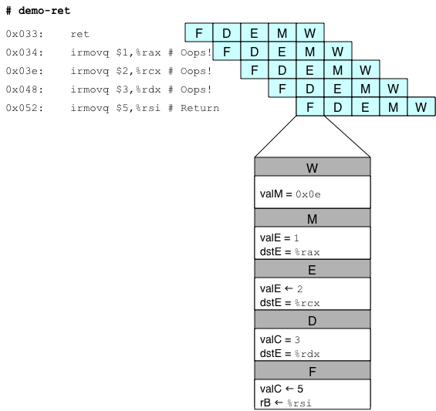
Incorrect Return Example
Incorrectly execute 3 instructions following ret

Slide 32
Pipeline Summary
Concept
Break instruction execution into 5 stages
Run instructions through in pipelined mode
Limitations
Can’t handle dependencies between instructions when instructions follow too closely
Data dependencies
One instruction writes register, later one reads it
Control dependency
Instruction sets PC in way that pipeline did not predict correctly
Mispredicted branch and return
Fixing the Pipeline
We’ll do that next time

