Slide 1
Electronic Thrust Control
Bara
Adi

Slide 2
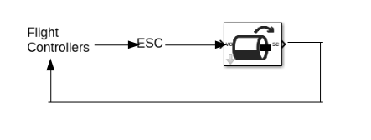
Normal Open Control

Slide 3
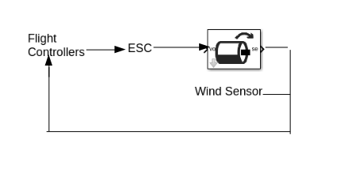
Novel Closed Control with wind sensor

