Slide 1
Tutorial 3
All About the code

Slide 2
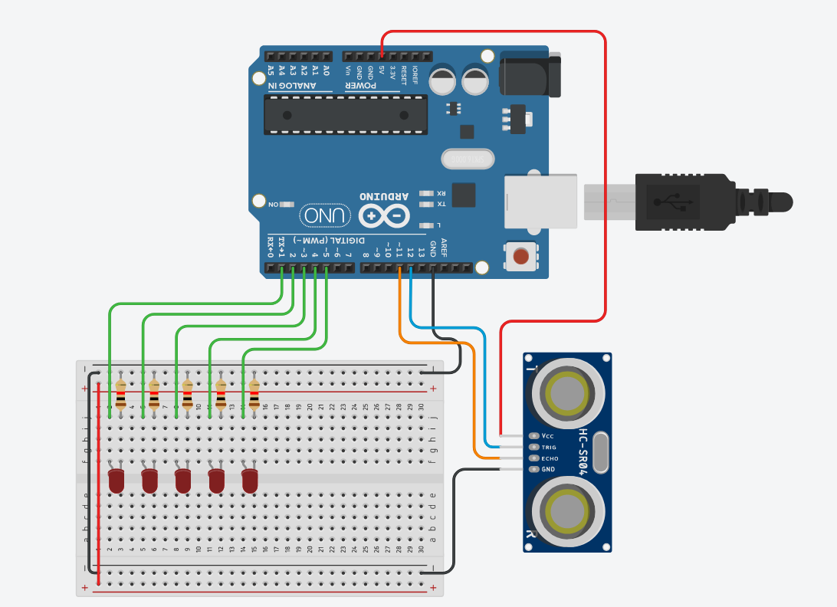
This will be our setup

Slide 3
Time to code
Install the NewPing library
Copy code from instructor
Fill in the missing parts
Test and debug

Slide 4
First code to write
Best way to define led's:
At the very top of the code we can give each LED a name and tell the code where on the arduino the led is connected. Let's do this
It would look like:
int led1 = 1;
Your turn to write the rest of the values in

Slide 5
Define the pins
Next we have to tell the code what we want the arduino pins to do.
In void setup() we have to write:
pinMode(led1,OUTPUT);
This way the board knows that it is sending out data

Slide 6
Function to turn on the light
A function is a set of instructions that we can call from the main program (void loop) without having to retype it
Our function here will tell the board which led's will light up
You are given example for one led on and two leds on.
Follow a similar method to sequentially turn the rest of the leds on

Slide 7
Debugging
Click the compile button
If something went wrong, the arduino program (IDE) will tell you what is wrong and you can fix it
This is a very big part of programming, finding errors and understanding the fix
Try a couple fixes before asking the instructor

Slide 8
Good Luck and Have fun!!

