Slide 1
Tutorial 5: Wireless Control

Slide 2
In today's tutorial we will work on controlling a motor using a remote
Connect the DC motor and the IR Reciever to the arduino
Determine what the IR Remote sends to the Arduino
Adjust the Final Code to make sure it is looking for the right code
Setup the proper code and upload it to the arduino, test out the functionality of the motor
There are a couple main steps

Slide 3
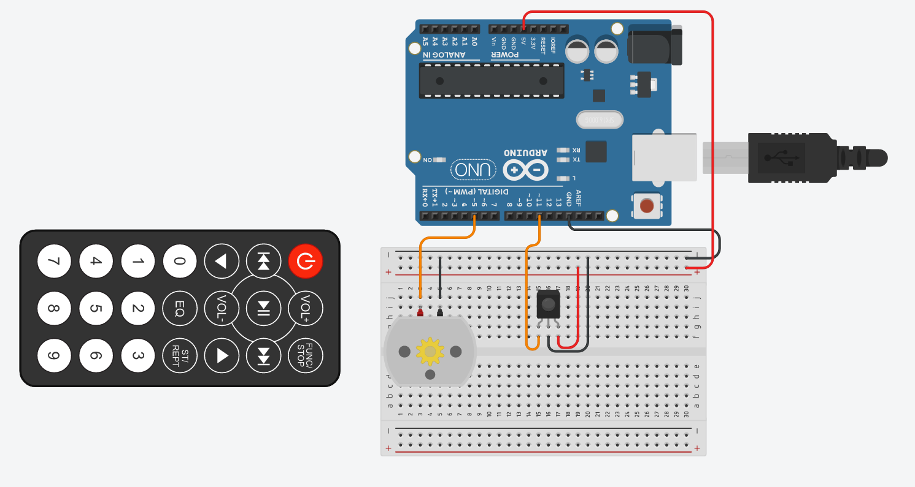
Make sure that the motor is Connected to Pin 5, and the IR sensor is connected to pin 11
For the IR SENSOR:
G = Ground
R = 5V
Y = Signal – Pin 11
1. Wiring of the Motor and the IR Reciever

Slide 4
Upload the code IR_RECV
Now we upload the code for testing the IR sensor
This code will run just the IR sensor and tell you what the Arduino Sees when you press a button
Upload
Open Serial Monitor
Purpose
Press the Vol + button and copy the output to Motor_test to where it require the value for VOL+
Open
Test Vol -
Press the Vol - button and copy the output to Motor_test to where it require the value for VOL-
Test Vol+

Slide 5
Motor_Test
Make sure that everything is wired properly
Now once the code is uploaded, you can press the VOL+ and VOL- keys on the remote to make your motor spin faster and slower. Try it out
Open Serial Monitor, It will tell you what is being sent to the motor
*Be careful not to hold the button, quick presses
Compare your code to Finalcode file if there are any errors

