Slide 1

Tutorial 6

Slide 2
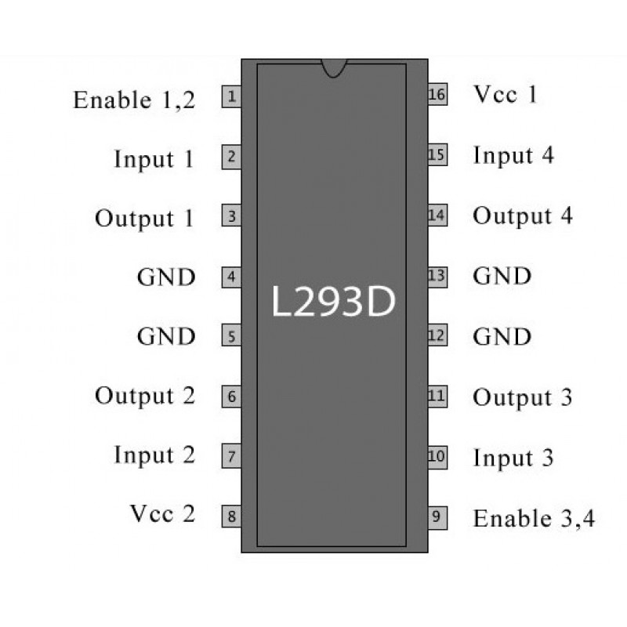
Motor Drivers
Motor Drivers control which wire of the motor gets a voltage
There are three important pins in our layout
The enable pin – To this pin we send what the speed of motor will be
The inA pin, and inB pin- this controls which wire gets the positive and negative voltage
This way we can control which direction the motor spins

Slide 3
Using Functions
In code, functions separate tasks that are supposed to be performed
This allows us to have cleaner looking code
Helps us when code doesn’t work the way it is supposed to

Slide 4
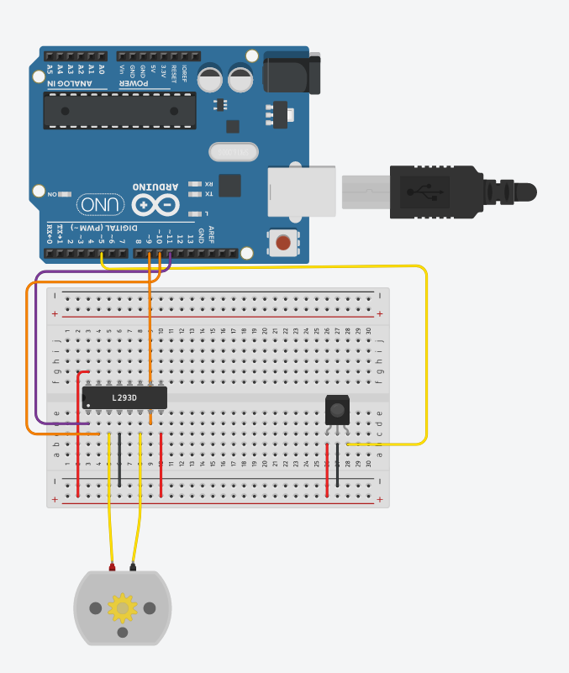
The Wiring
Remember that the wiring in this diagram is complicated. Pay attention
Make sure the microcontroller is facing the correct direction
Let's go left to Right
first pin to pin 11 (purple)
second pin 10 (orange)
Third pin to motor+ (yellow)
Fourth pin to ground (black)
Sixth pin to motor- (yellow)
Seventh pin to pin 9 (orange)
Eighth pin to 5V+ (red)
First Pin second side to 5V+ (red)
IR SENSOR:
G – Ground (Black)
R – 5V+ (red)
Y – Pin 5 (yellow)

