Slide 1
Introduction to Circuits and Arduinos

Slide 2
What is a circuit
2main parts
Power source
Something to use the power
Other parts
Resistors
Capacitors
Transistors
Notes:
A circuit is a series of connections between a power source, an object that uses the power and possibly other items to manipulate the electricity.
Resistors bring the voltage down.
Capacitors store a certain amount of energy and when activated they quickly release their energy
Transistors store information and when a voltage is applied they can store different information.

Slide 3
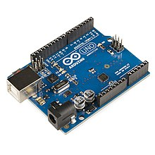
Intro to Arduino
Arduinos are microcontrollers
Mini computers that you can command using code.
Can interact with physical systems
Many different types for different functions
To control them we use code
Language called C
We program through the Arduino IDE (Integrated Development Environment)
Lots of examples and documentation online
Can control physical systems
It does this by sending a voltage of a certain value or reading a voltage of a certain value
Notes:
Arduinos are basically tiny computers that you can use to control anything that's physical like a motor, or an LED, so many different types of sensors, or so many other little electronics.
(I.e, humidity sensors, temperature sensors, motion sensors, displays, speakers, and so many more)
We use code to specifically control what we what the arduino to do. In these tutorials for the most part we will give you the code for you to use.
The code is very simple to learn and we will do a brief tutorial on this in a future lecture.
There are so many examples online for any and everything you could want ot do.
The way the arduino controls the physical systems is by sending a particular voltage at a particular time and this informs the system to do a particular task
There are other boards like this such as raspberry pi's and upboards and beaglebones, but for the purposes of this tutorial, we will use arduinos.
Check out https://hackaday.io/list/3611-arduino-projects
https://www.hackster.io/adafruit
And for more projects with arduinos and tutorials check out https://www.adafruit.com/

Slide 4
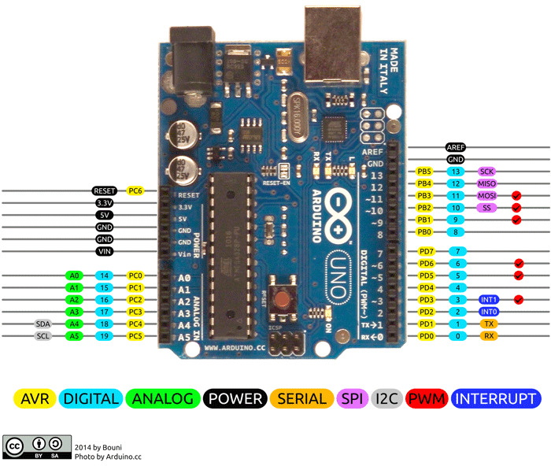
Important Sections of an Arduino
5Different types of pins
1. Digital Voltage
2. Analog Voltage
3. Power Pins
4. Communication Pins
5. ADC / DAC
Notes:
There are 5 main types of pins on the arduino.
1. The Digital Voltage Pins- These pins can either send 0 Volts (LOW) or can send 3.3 Volts (HIGH), or in other words, can either turn something on or off. There are ways to send voltages in between but we don't need to worry about that for now. These are the pins labelled with just the numbers.
2. Then there are analog pins which can send any voltage between 0 Volts and 3.3 Volts. This way we can specifically control a particular object. These are the pins with A0 A1 A2 and so on.
3. The power pins are the pins labelled 3.3V, 5V, GND. They provide power to whatever that needs direct power.
4. The communications pins send data between devices. We won’t use those in the series of these tutorials. These are the pins labelled rx and tx
5. ADC/ DAC or Analog-Digital Converter and Digital-Analog COnverter. These pins convert between the two using some special knowledge on the board's part.

Slide 5
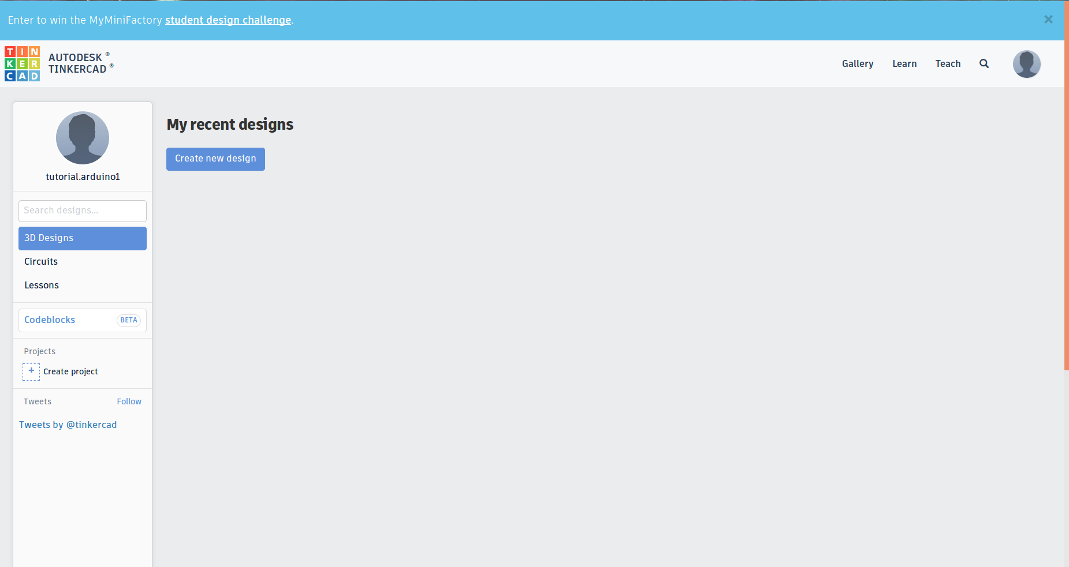
TinkerCad
Online Simulation of circuits
Allows us to demonstrate how a circuit will behave
Allows for proper planning without breaking certain material
Can input code and see how a particular system will behave
Notes:
Login: tutorial.arduino1@gmail.com
Password: aberdeen_hall1
It would be nice if they could all have an account to play around with. Then they could experiment with circuit simulations. Plus it is also good for 3d design. If not use this account and show them how a circuit works.

Slide 6
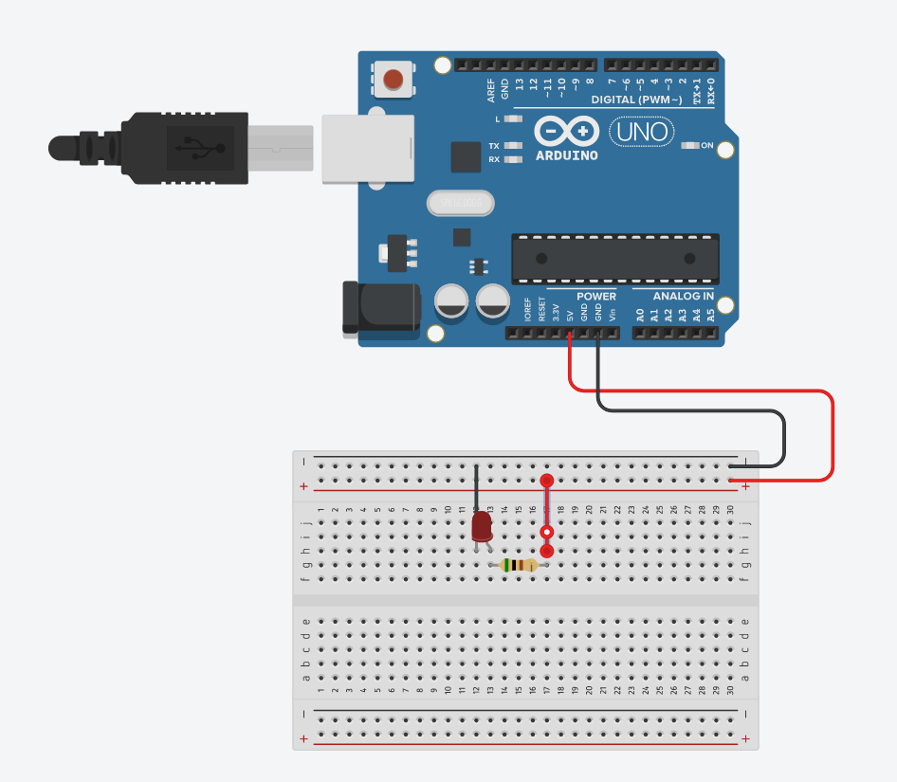
Basics of Circuits - LED
3 Parts to an LED circuit
Power Supply
LED
Resistor
The Breadboard 2 Parts-
Power bus
Circuit board
Notes:
In this case we will power the circuit with the 5V power supply.
The led takes 2.5V, if we put too much, the LED will break so we must use a resistor to bring the voltage down. LED's have something called polarity. This means that electricity has to flow in a particular direction. The positive side of the LED (the bent leg, the longer side), and the negative side (the shorter, straight leg). Electricity must flow from the positive voltage through the positive side of the resistor to the negative side and then to the negative voltage.
One special thing about resistors is that it doesn’t matter which way you place them. It will work either way. The term for this is called nonpolar.
The resistor in this case is 1milliOhm. This value is not important for right now, but it means that the LED will get the appropriate amount of voltage.
What is a breadboard and how does it work.
The bread board allows us to create circuits without having to make them permanent. Allows us to prototype it so that we can change it if something doesn’t work.
The two parts.
1. The power bus.
- The power bus are the two columns that run on the side. The red and blue lines mark them. The red is for the positive voltage, and the blue is for the negative.
In this section, a copper plate runs along the length of each column so that all along the column, there is the same voltage. This means that every row is connected, but the individual columns are isolated.
In the middle section, the circuit section, each row is connected by a copper plate. This means that each row is connected to itself, but one row and another are isolated.
OPEN TINKERCAD, click on CIRCUITS, open INTRO1
Let's create our first circuit.
1. Connect the 5V pin on the arduino to the positve side of the power bus.
2. Connect the GND pin on the arduino to the negative side of the power bus. Now our breadboard has power.
3. Place a wire from the positive bus to one of the rows (15)
4. Take a resistor and place one end on the same row as the wire placed previously (15). Connect the other side to a different row. (20)
5. Take the positive side of the LED and connect it to the same row as the resistor (20), and then connect the negative side to a different row (23).
6. Connect a wire from the negative side of the LED (23) to the negative voltage .
This should have powered up the LED. This is the basic steps to make an LED work. Now we can play around with this.

Slide 7
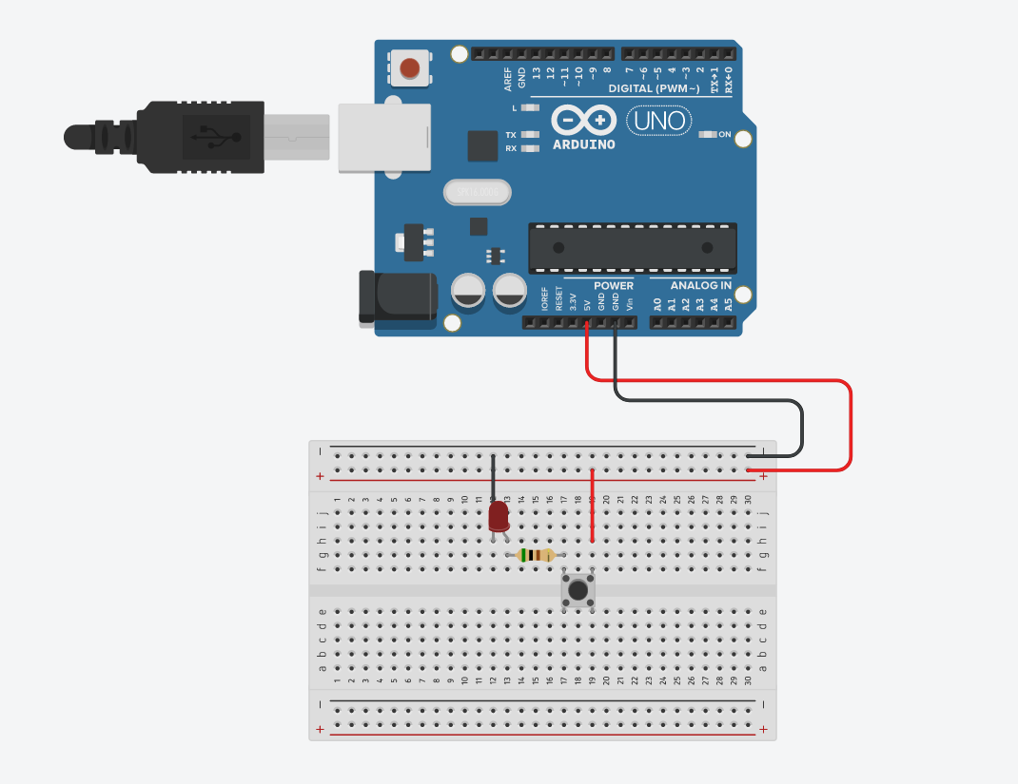
What happens if we add a Button
Buttons also have a polarity.
If it doesn’t work one way, rotate it and try again
Notes:
OPEN TINKERCAD, click on CIRCUITS, open INTRO2
Buttons work by allowing the voltage through or not.
To add a button to the circuit, we must place the button in series (in the same line of voltage) as the rest of the LED.
And then connect it the normal way that we would.

Slide 8
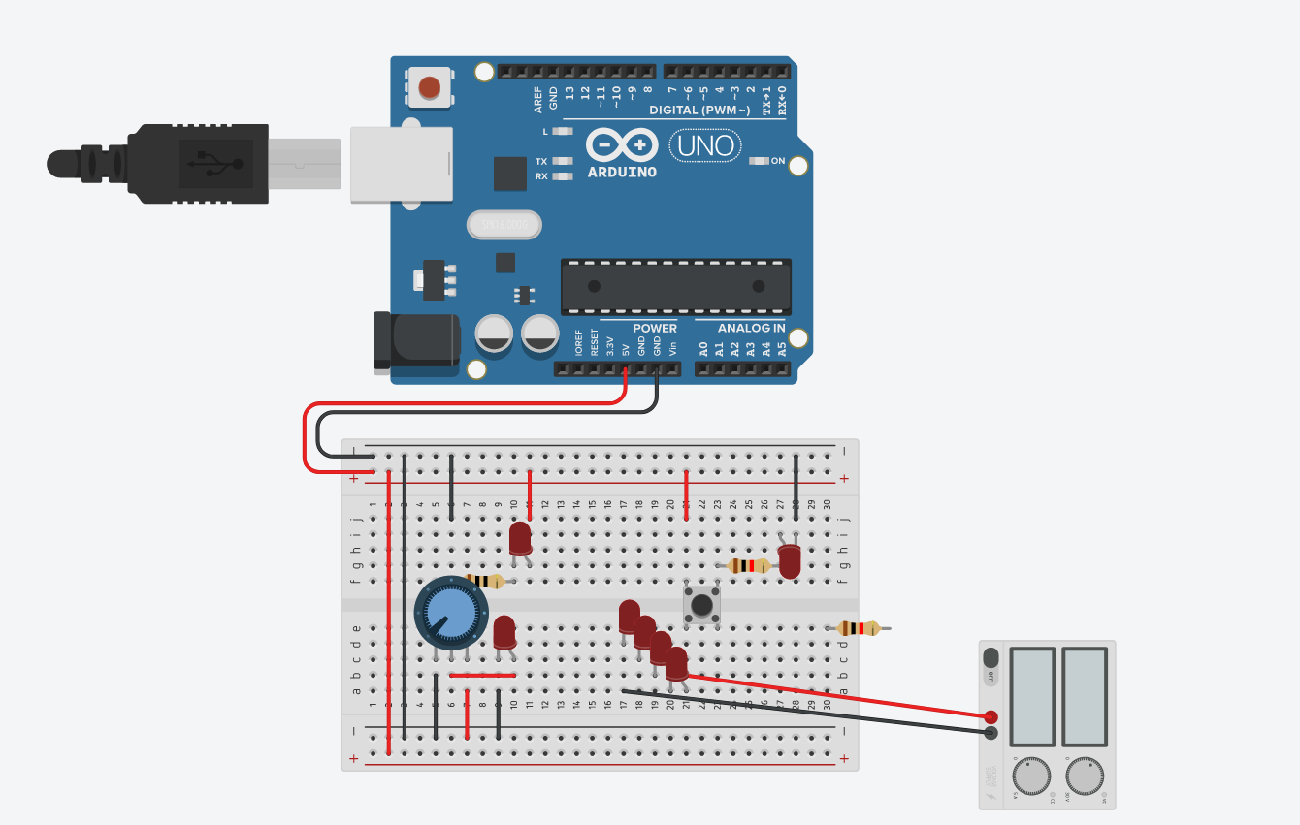
More Circuits
There are ways to break LEDs by providing too much power
We can also use variable resistors, basically dimmer switches to change the brightness of the LED
Notes:
More examples of basic LED circuits
OPEN TINKERCAD, click on CIRCUITS, open INTRO2
Show them a tutorial using the power supply and what happens if we provide too much power.
Also show them what happens when a variable resistor is introduced.
Or what if there are two LED's in series

Slide 9
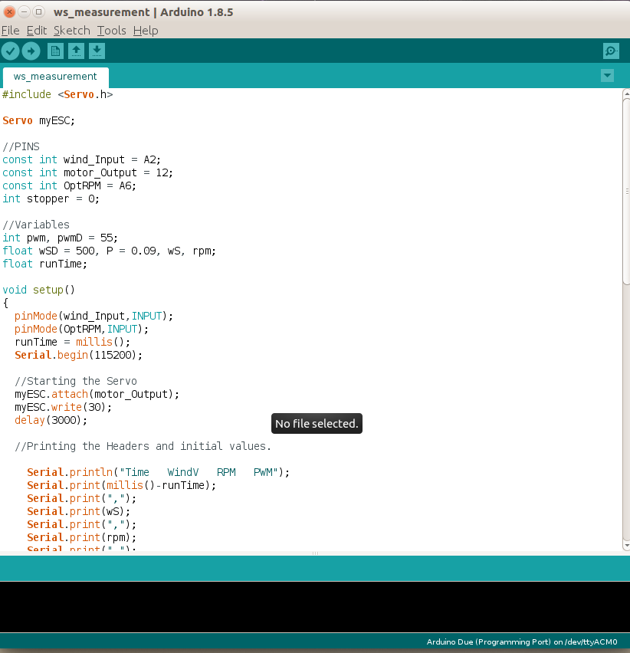
Using Code to control LED's
Now we are going to start using the Arduino IDE
Open the Blink Example
Upload this to the board
Notes:
1. Start the program
2. Click on file, go to examples, basic, blink
3.Connect the board to the computer and upload the code.
If you do this, the light on the board itself will blink.
Now to make your LED blink

Slide 10
Making an External LED blink
To the code add:
"const int LED = 6;"
Where it says pinMode(LED_BUILTIN,OUTPUT), change the LED_BUILTIN to LED
Do that everywhere else it says LED_BUILTIN
Notes:
The const int LED = 6; goes above all the other code. Remember to not capitalize const.
Make sure that there is the semi colon after the command. IT WILL NOT WORK WITHOUT IT.
Remember to change the LED_BUILTIN in the code to LED

Slide 11
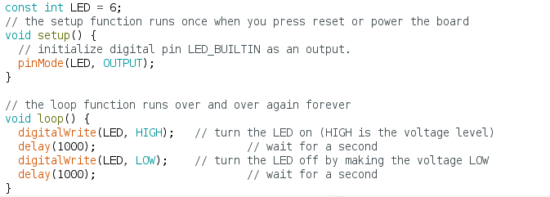
What the code will look like

Slide 12
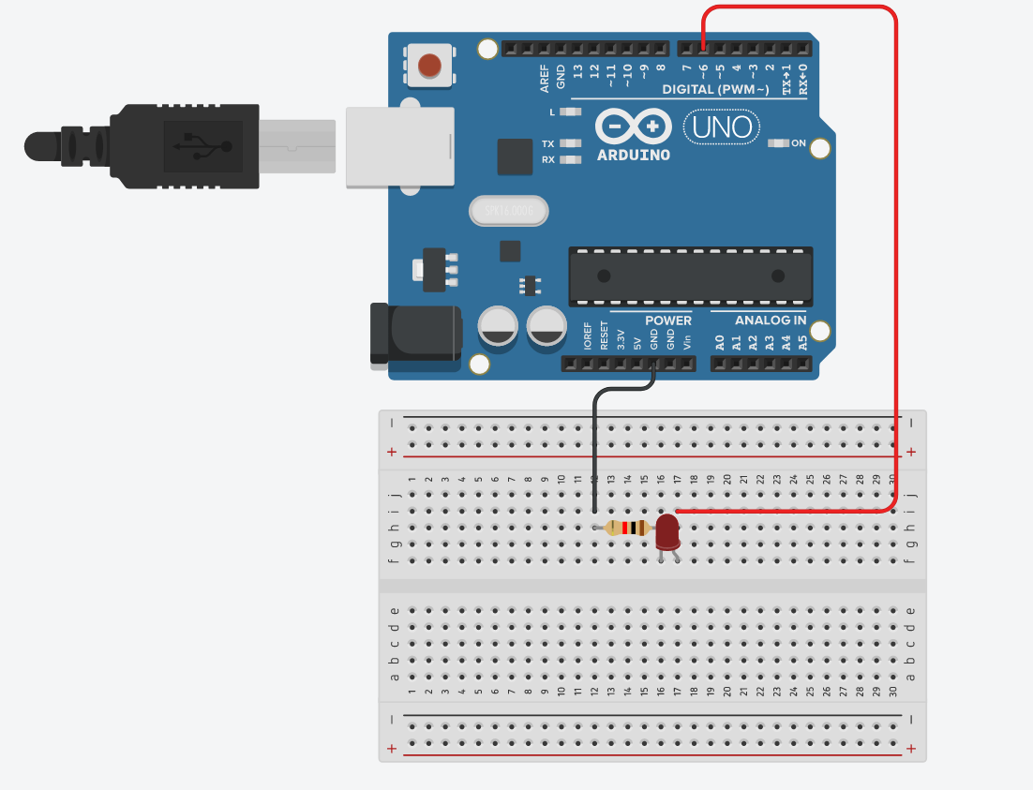
New Circuit
Notes:
OPEN TINKERCAD, click on CIRCUITS, open INTRO3
Upload the code and you will see that the external LED will start blinking every second.
In the code it says that the led will be on for one second and off for one second.
This is where it says delay(1000).
If you change that value it can either blink slower or faster. Try it out.
Also try uploading fade. Again remember to change form LED_BUILTIN to LED and remember to add the code at the top to define LED. "const int LED = 6;"

Slide 13
Controlling Multiple LED's
This is just extending what we did to multiple LED's.
The positive voltage in this case will come from one the the digital voltage pins. These are the ones that are just numbers.
The ground will be common for all of them
Notes:
Explain that the control signal for each LED has to be individual. The ground on the other hand will be the same as before. Show them the next slide with the circuit diagram.

Slide 14
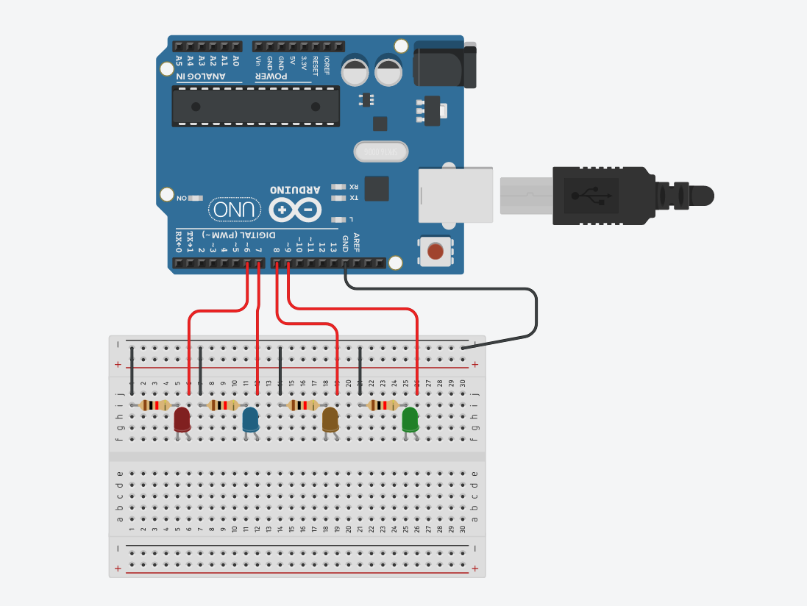
Notes:
OPEN TINKERCAD, click on CIRCUITS, open INTRO4
Upload the code blink_multiLED and see how the LED's turn on consecutively.
You can change the delay times and play around with how quickly the LED's work.
Next upload blink_multiLED_return and see how this works.
Again feel free to play around with the delay or even the order of leds.

Slide 15
What do you want to be able to do
Give us Ideas on what you want to do with an arduino and we can play around with that
Notes:
See what they are interested in and I can tailor future tutorials based around that.

