Slide 1
Tutorial 6

Slide 2
Objectives
In our final Project, our cars will be controlled by a joystick sending messages through IR
So we will learn how to wire and code using a Joystick today.
As well we will also learn how to use the L293D Motor Controller

Slide 3
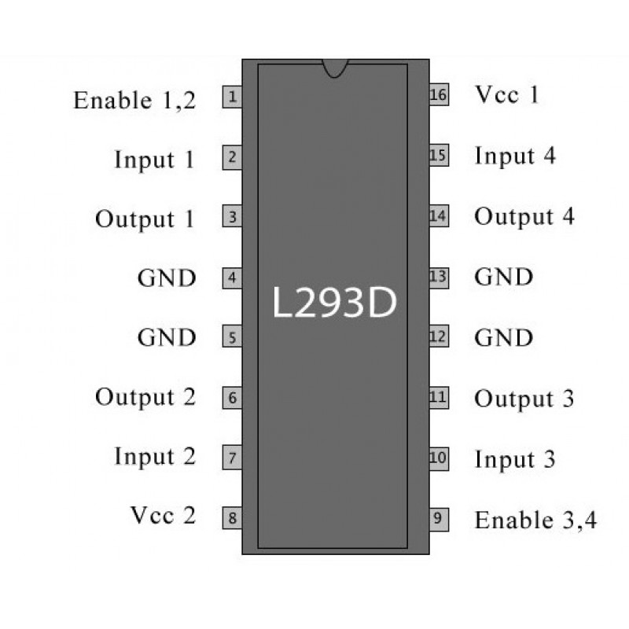
Motor Drivers
Motor Drivers control which wire of the motor gets a voltage
There are three important pins in our layout
The enable pin – To this pin we send what the speed of motor will be
The inA pin, and inB pin- this controls which wire gets the positive and negative voltage
This way we can control which direction the motor spins

Slide 4
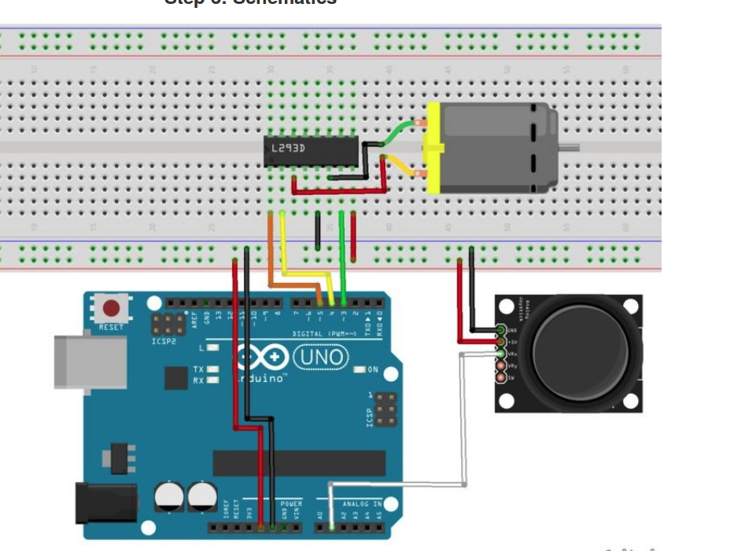
Wiring

Slide 5
Joysticks
Joysticks work by measuring how far in a particular direction the joystick is
From that we get a value and can control other systems
They read a value from 0-1023
We can set 0-512 for one direction and 513-1023 in another direction

