Slide 1
Circuits and Arduinos-2
Let's take it a bit further!

Slide 2
Using Serial
Serial is the method we use to print and send messages to the arduino
Functions:
Serial.print("Enter message here");
Serial.println("Enter message here");
Int x = Serial.parseInt();
String y = Serial.readString();
Remember to put Serial.begin(9600); in the void setup section
Notes:
In the Serial.print you can type in particular strings, or you can put in a variable name and it will print the appropriate value.
For Serial.readString and Serial.parseInt you set it to equal a value, then in the Serial monitor you can send a particular value for the system to read. Then you can use that value wherever required.
Remember to start serial with Serial.begin(9600) in the void setup area

Slide 3
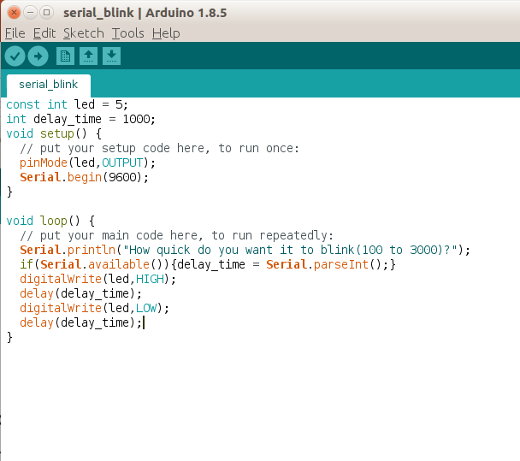
Testing out Serial
Back to the basic led Setup, new code
You can now set how long the light will be on and off for

Slide 4
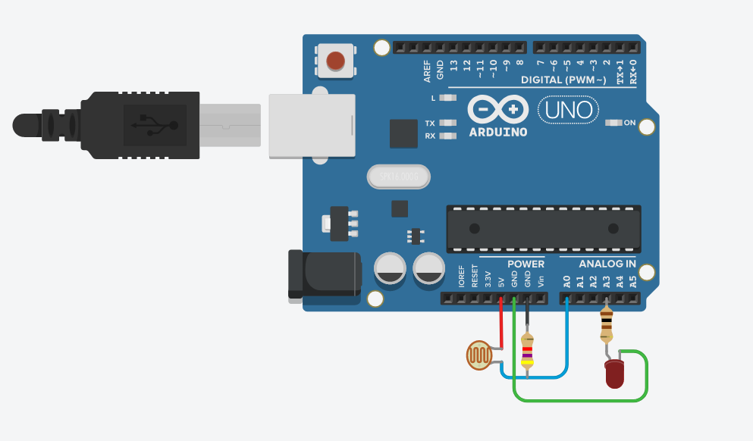
Controlling, Through Light
Going back to LED's:
Last week we used a digital signal, now let's use an analog signal
Example- Back up sensor with LED
Notes:
1.Explain the difference between an analog output/ input and a digital one.
2.Talk about control of LED's through analog signals
Explain we are going to go more indepth into coding
3. Introduce a photodiode
4. Show control of LED through Photodiode
Open tutorial2-1
Talk about how this could relate to a back up sensor, the closer you get to an object, less light will be visibleto the photodiode, and the led will get brighter to warn you

Slide 5
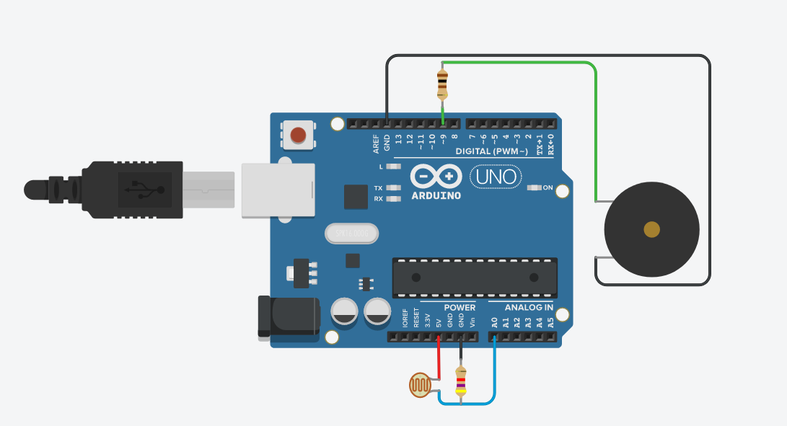
Controlling, Through Light Cont'd
Similar to the last setup, we can also use sound instead of an LED
This is more like a car backup sensor
Also learn how to use the tone function
tone(pin, frequency)
Notes:
This is basically the same but instead of the LED we use a piezo electric speaker.
Needs a 100 OHM resistor or something close.

Slide 6

Motors
2 Types we are going to play with:
1. Servo Motors
2.Stepper Motor (DC Motor)
Notes:
Talk about motors, and how each one has a specific functions
Servo, doesn’t move fast, can measure the angle of rotate, usually can only rotate 180 degrees.
Stepper and DC motors, move faster, can continuously rotate, we cant know accurate information.
Notice that the servo requires 3 inputs while the DC only has 2. Servo has fine control while DC has voltage control.

Slide 7
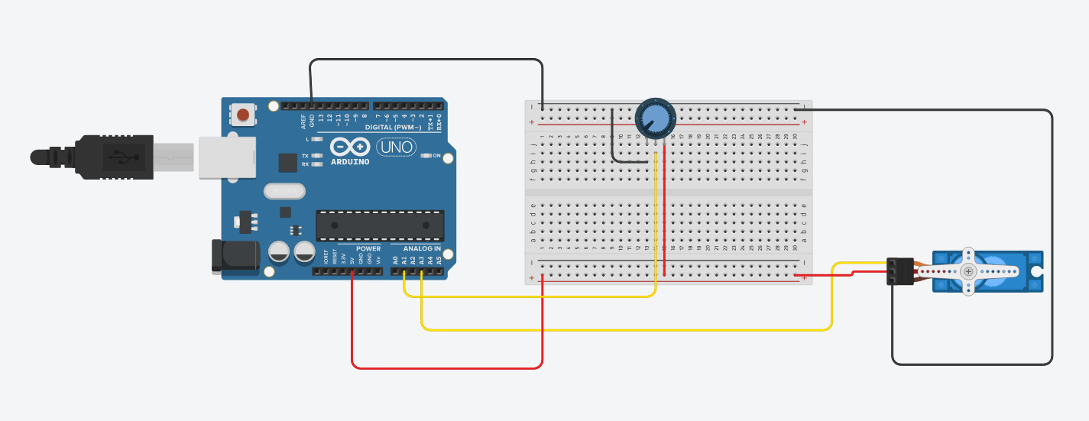
Servo Motor
Servo Motors can only rotate 180 Degrees.
This could be used to move a finger or an arm a particular distance
Notes:
For the servo motor need to have #include <Servo.h> at the top of the code for the servo motor to work well.
Build this system. Use the potentiometer to rotate the servo back and forth.

Slide 8
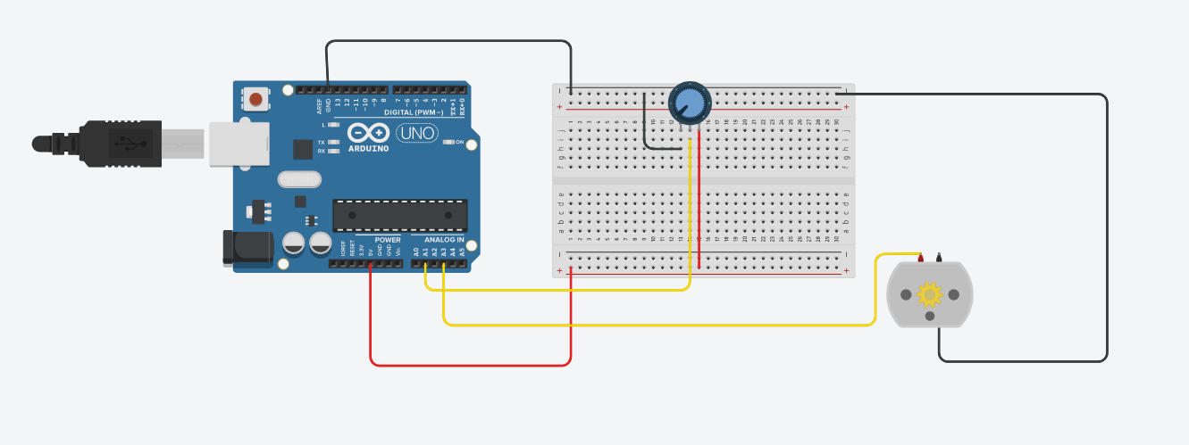
DC motor
DC motors are controlled only by the voltage (PWM)
Think of car wheels, or a fan
Much easier to use, but cannot know specific information about the motor
Notes:
DC motors generally take an input called PWM (((( MENTION THIS, DON’T WORRY ABOUT EXPLANATIONS))))
Talk about how these can spin much faster.
There are other ways to control this, but for now this is the easiest to explain.

