Slide 1
BlogZy
Aditya kr. singh (2002901540009 / csds / a)
Saksham kumar (2002900100129 / cse / c)

Slide 2
Objective
The objective of the project is to create an engaging and informative blog platform that showcases famous places, shops, sweets, and other popular attractions of a city. The primary goal is to provide potential visitors with a comprehensive resource where they can explore and learn about the best things a city has to offer before they visit. The project aims to enhance the user's experience by enabling them to enjoy all the famous aspects of the city, thereby maximizing their enjoyment during their visit.

Slide 3
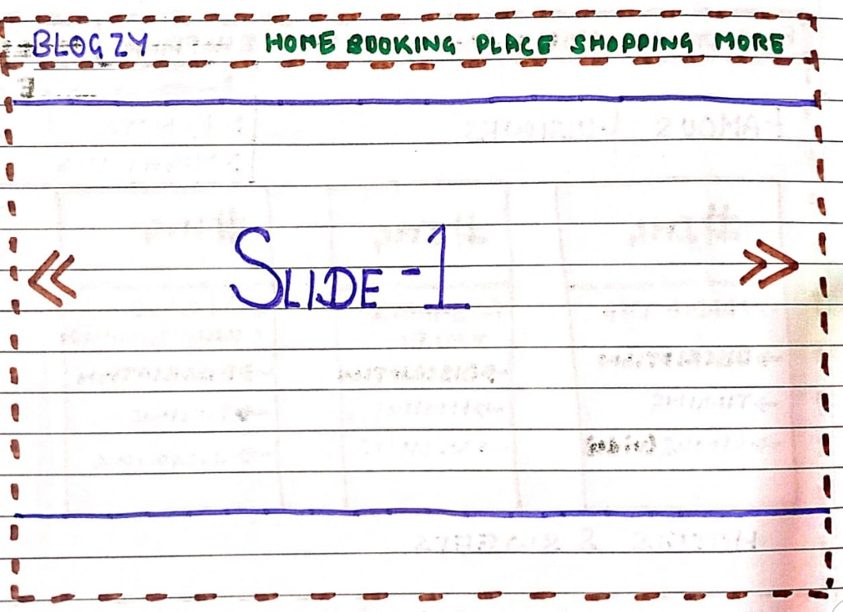
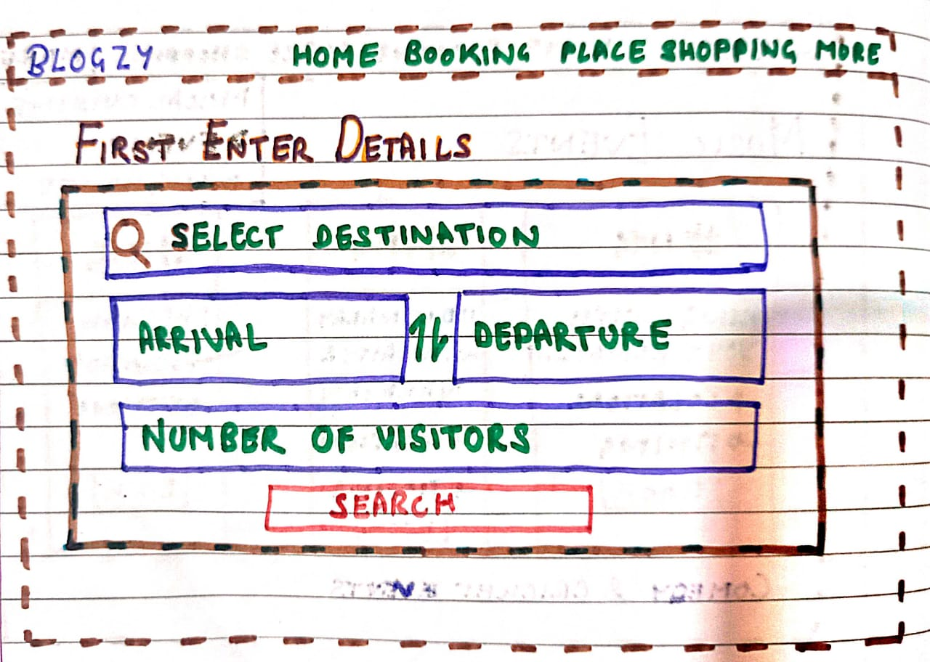
Front Page

Slide 4
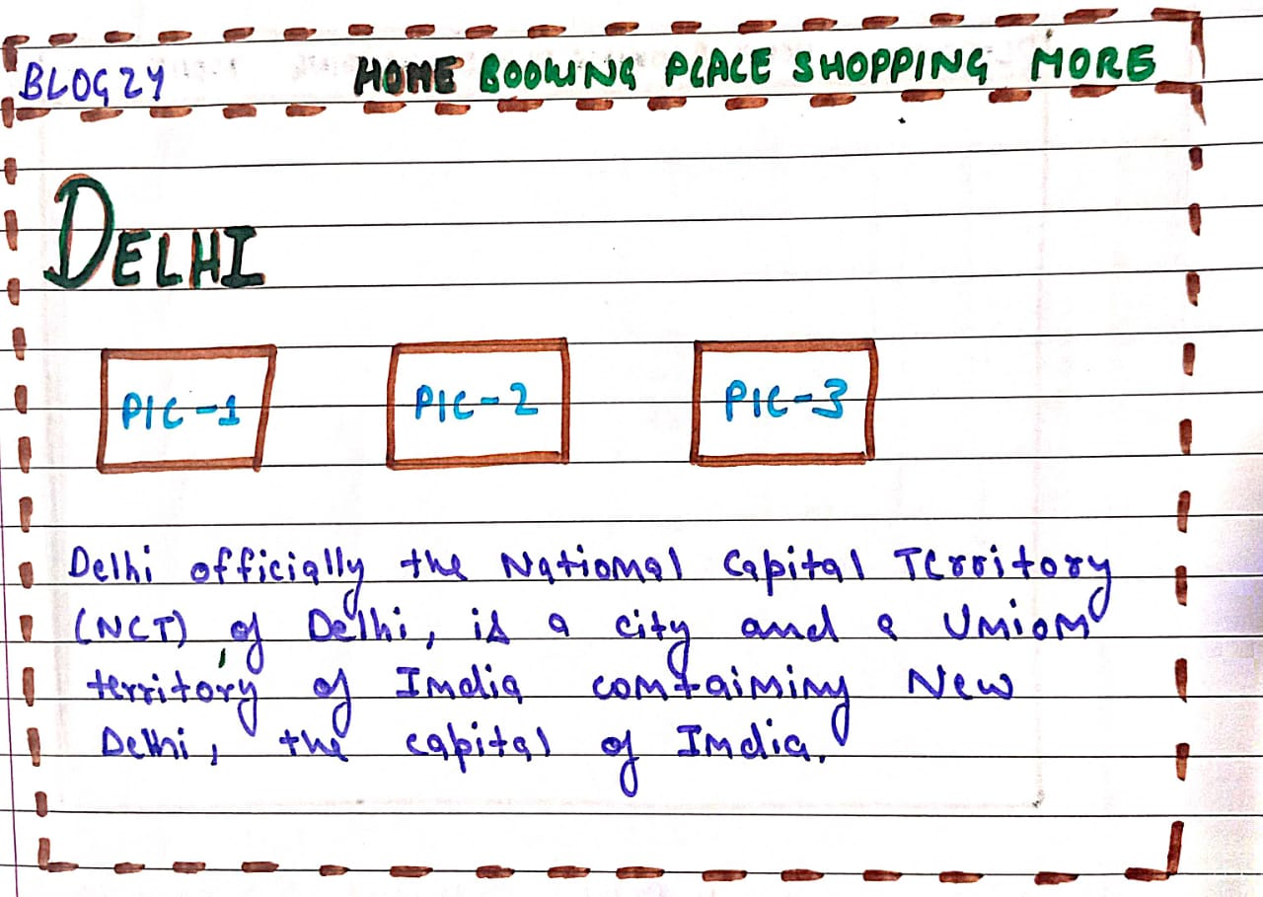
Home Page

Slide 5
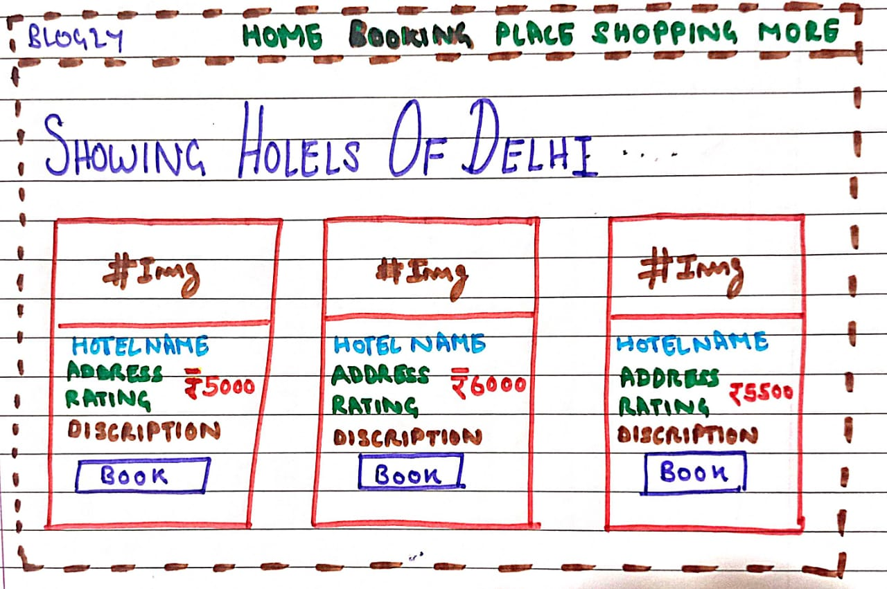
Booking Page

Slide 6
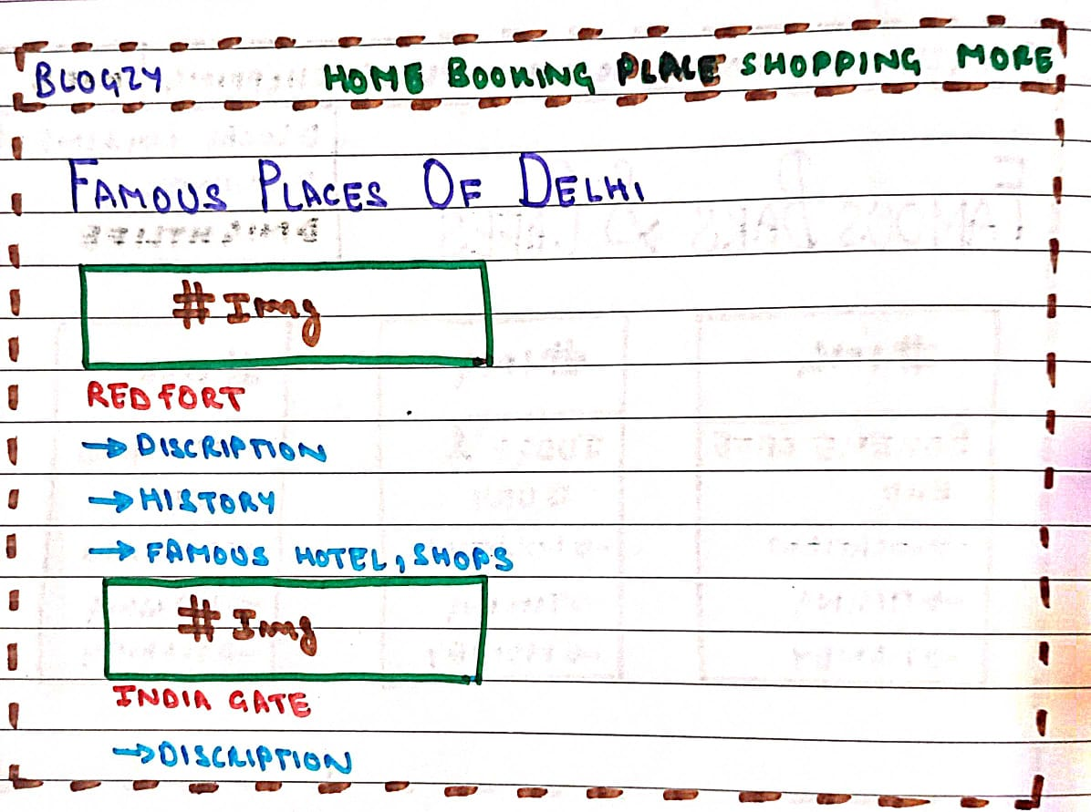
Places and Tourism

Slide 7
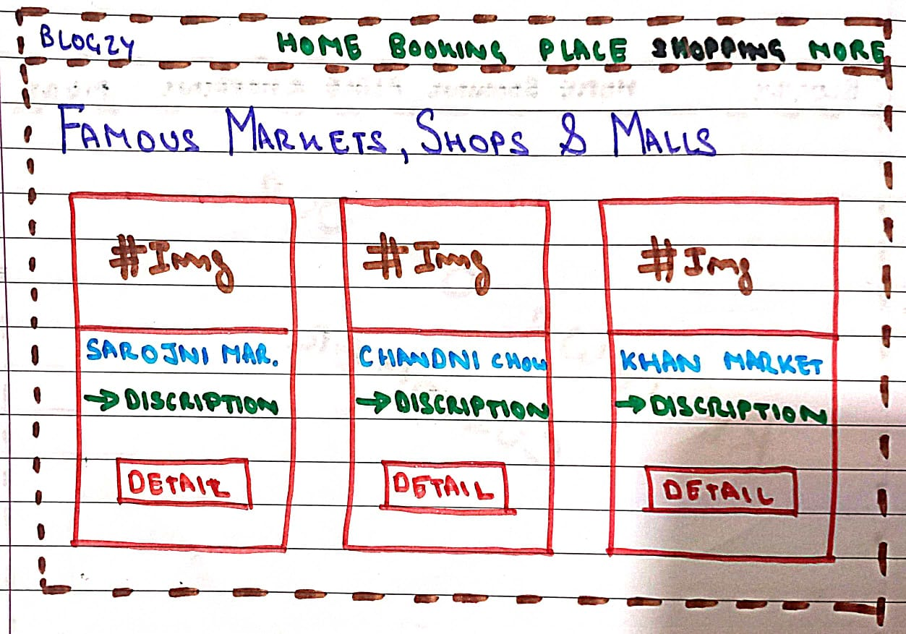
Shopping Page

Slide 8
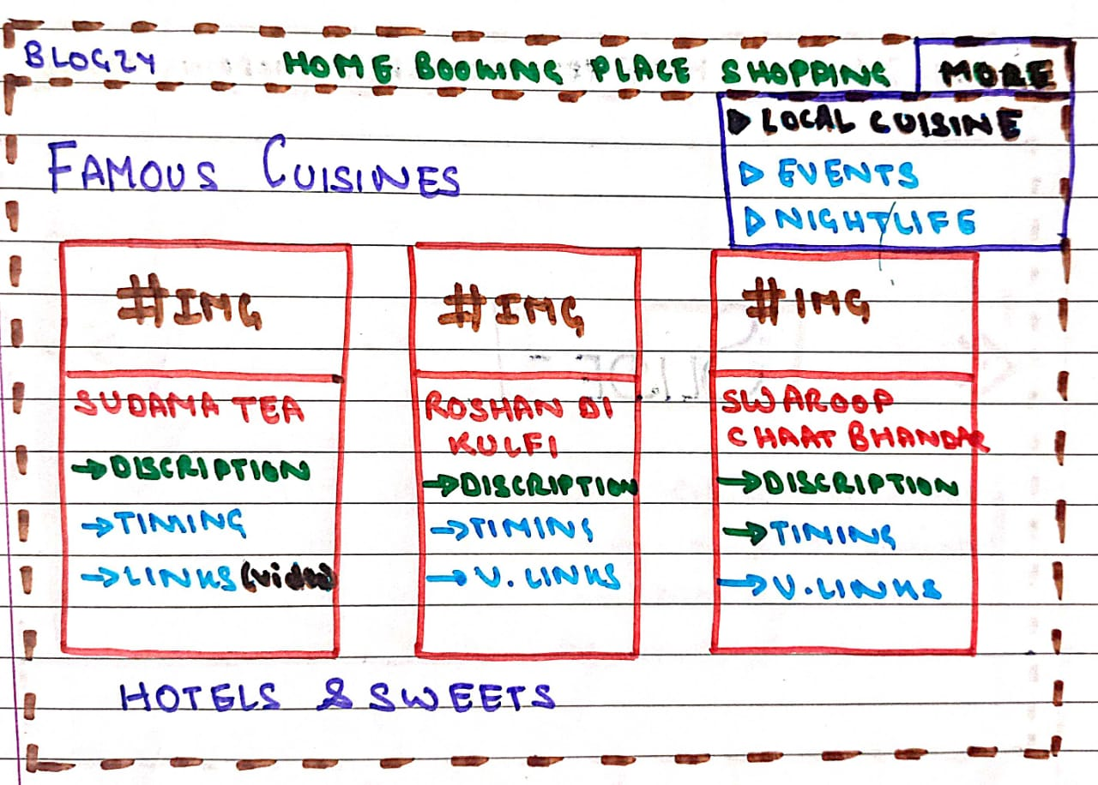
More(Local Cuisine)

Slide 9
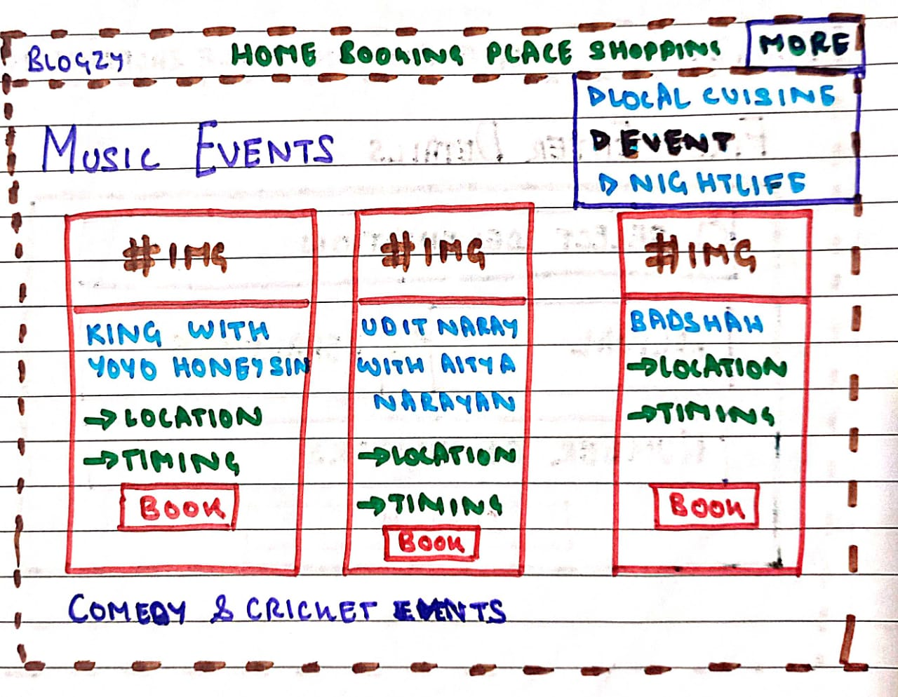
More(Events)

Slide 10
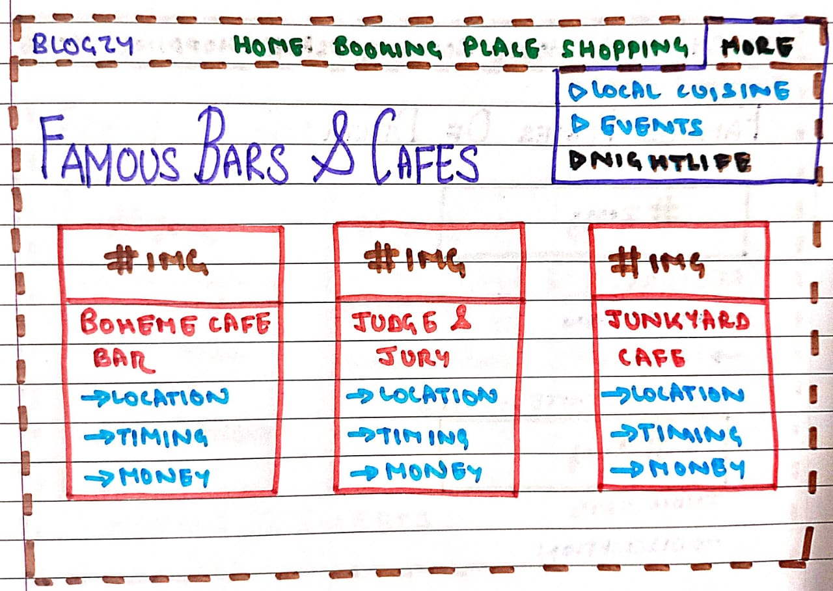
More(Nightlife)

Slide 11
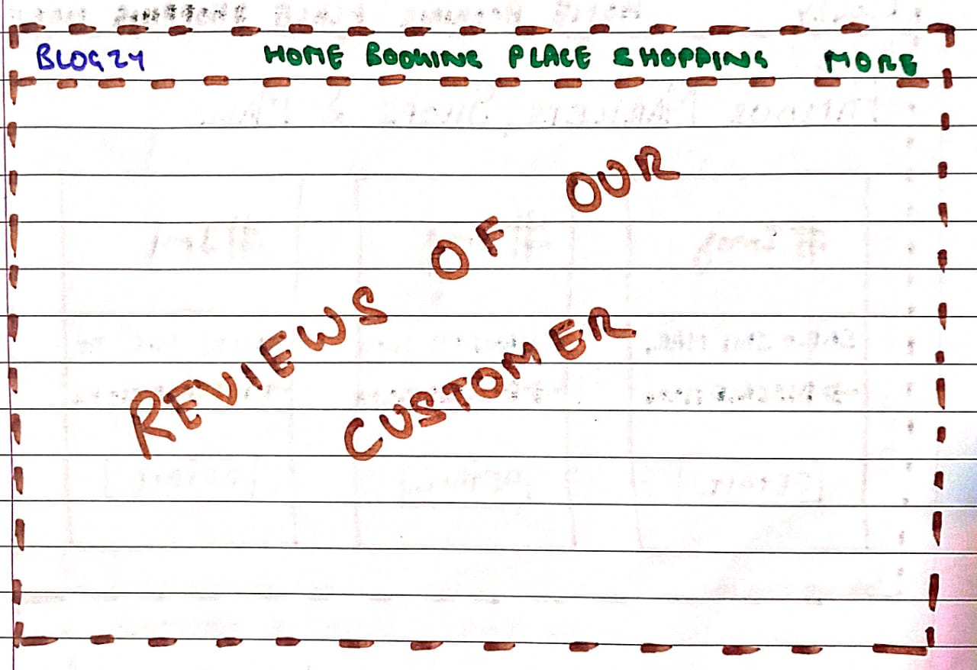
Customer Review

Slide 12
Details about component
Front Page:
Header and Navbar
Blogzy logo which contain hyperlink to the home page
Home
Booking
Places
Shopping
More
Carousel

Slide 13
Home page
Navbar
Description about entered city

Slide 14
Booking page
Navbar
Card
Hotels according to your arrival and departure
Hotel discription ,price,location etc.

Slide 15
Place and tourism
Navbar
Card
Contains Description about famous places like monuments,parks,historical places etc. of entered city.
It also contains information about famous shops nearby above places.

Slide 16
Shopping page
Navbar
Card
Contains information about famous market , shops and malls.

Slide 17
More
Navbar
It contains three bullet points
Local cuisine
It contains all famous food shops , hotels and sweets shops.
Events
It contains all live events according your entered arrival and departure.
Nightlife
It contains information about all famous bar and cafes.

Slide 18


