Slide 1
Unsupervised: PCA and Clustering
Today we will have some math

Slide 2
What is clustering?
In data science, problems can be classified into
Supervised learning (use x₁, x₂,… to predict y)
Unsupervised learning (don’t have a y target, need to understand the data)
Clustering is an unsupervised learning method with which we can learn:
What groups exist in the data?
What are “similar” observations?

Slide 3
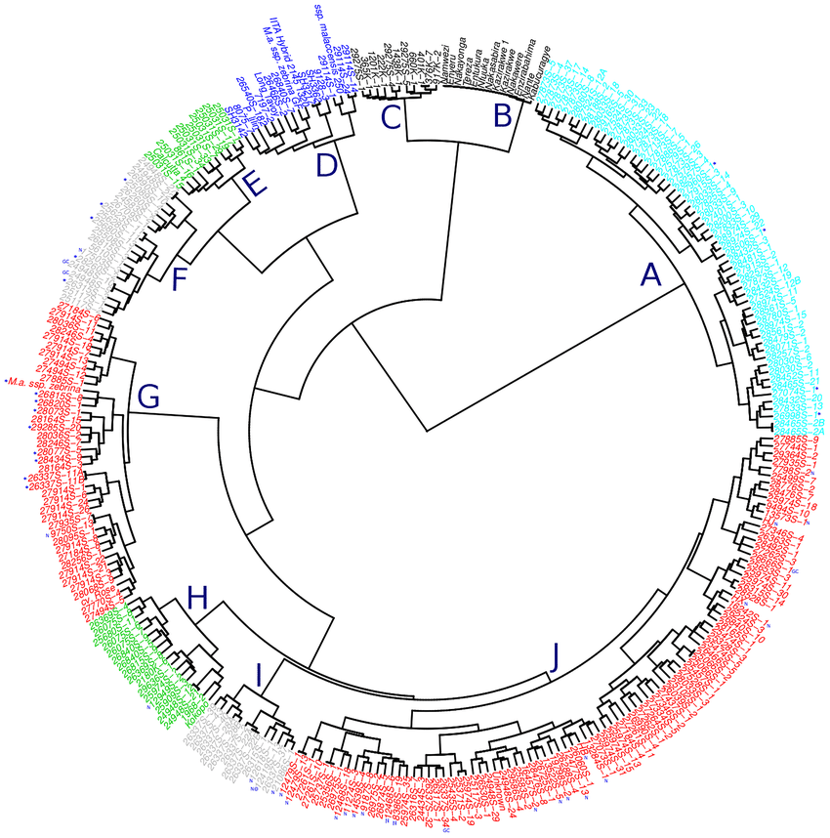
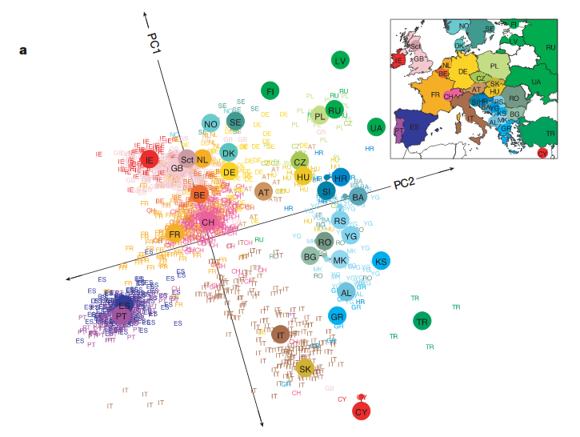
Example - population genetics
Dendrogram showing how different species relate to one another
PCA on DNA markers separates European populations
https://www.researchgate.net/figure/Dendrogram-showing-the-genetic-diversity-of-the-genomic-selection-training-population_fig2_317632929
https://stats.stackexchange.com/questions/8777/in-genome-wide-association-studies-what-are-principal-components

Slide 4
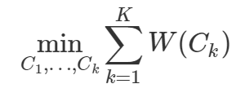
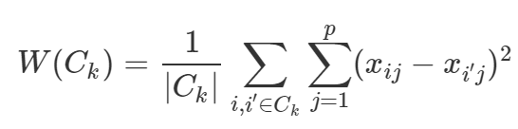
KMeans Clustering
KMeans divides observations in an n-dimensional space by distance from one another
Minimize the within variance
Maximize the between-group variance
For example, find partition (C₁,…, C_{k}) to reach:
With W(C_{k}) defined as:
What is this distance?

Slide 5
KMeans Clustering - explained
We need to find a partition to K clusters, but how do we determine K?
Sometimes it’s in the work’s goals, sometimes trial and error
How does the algorithm work?
Randomly assign a cluster to each point 1,…, n
Repeat the following until no re-assignments are made
Calculate each cluster’s centroid (central mass of the cluster, e.g., average position)
Change the observation’s classification according to centroid
Update centroids
Return to previous step

Slide 6
K Means - illustration (initial classification, randomly)

Slide 7
K Means - illustration (set centroids)

Slide 8
K Means - illustration (find closest centroid)

Slide 9
K Means - illustration (update classification, update centroids)

Slide 10
K Means - illustration (no more updates - algorithm concludes)

Slide 11
Example with R
K Means clustering in R is performed using kmeans
In the simplest form:
Additional options to control the algorithm method
Open 05-Clustering.Rmd
kmeans_result <- kmeans(dataset, centers = k)

Slide 12
Hierarchical clustering
What happens when you don’t know k or want a better “mapping”?
Instead of assign->update-re-assign look for the “next merge”
Algorithm
Start with n observations and a distance function between each observation
In total there are n(n-1)/2 such pairs, every pair is now a “cluster”
While the number of current clusters > 1:
Check all distances from all current clusters to each other
Choose the two clusters which are the closest and merge them
The number of clusters is decreased by 1
Re-compute the cluster distances
Bottom-up approach

Slide 13
Hierarchical clustering - illustration
1
2
3
4
5
3
2
4
1
5

Slide 14
Hierarchical clustering - illustration
1
2
3
4
5
3
2
4
1
5

Slide 15
Hierarchical clustering - illustration
1
2
3
4
5
3
2
4
1
5

Slide 16
Hierarchical clustering - illustration
1
2
3
4
5
3
2
4
1
5

Slide 17
Hierarchical clustering - illustration
1
2
3
4
5
tree height is determined by distance function
3
2
4
1
5

Slide 18
What is the “linkage” (distance) function?
To determine the “closest” cluster we can either use:
Central mass between clusters (centroid as in the K Means)
The two closest points (single linkage)
The average distance (average linkage)
The maximum distance (complete linkage)
The function is specified in the command argument method
hclust_result <- hclust(dataset, method = "euclidean")

Slide 19
PCA (Principle component analysis)
PCA is a computation which utilizes linear algebra to reduce the dimension of the data
Question: why would we want to reduce the dimension of the data? (the number of features)
new axis (1)
original y
new axis (2)
original x

