Slide 1
Introduction to Statistics and Data Analysis with R
Tel-Aviv University, course#0560.1823
Adi Sarid
2021

Slide 2
Lecturer – Adi Sarid TA – Raphael Shuhendler TA – Yotam Dery
Professional: Market Research, Data Scientist, Operations Research, Educator
Academia: Mathematics, Statistics and Operations Research (Bsc, MA, Phd)
Software: R, Python

Slide 3
Today’s lecture
Course goals
Course requirements (prerequisites, grading)
Data analysis foundations (what activities are performed)
Lab – Visualizing COVID19 mobility trends
Descriptive statistics

Slide 4
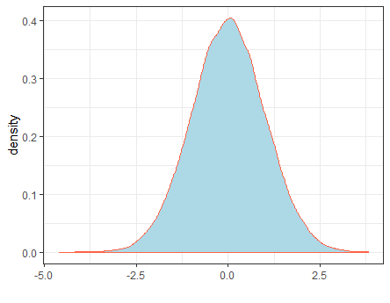


Course goals
Statistics
Students will learn the fundamentals of statistics and their context in data analysis
Students will be able to create a data analysis project from A-Z
(Examples: the spotify project and the income project)
Enjoy!
Data analysis is interesting and fun, and so is R

Slide 5
What will we learn in this course?
Overview of a research – from design to insights
Statistical inference and parameter estimation
Confidence intervals
Hypothesis testing (means, variance, goodness of fit)
Linear regression
Correlations
If time permits
Analysis of variance (ANOVA)
Logistic regression
Theory+Practice (R)

Slide 6

Technicalities
We have a github repository
https://github.com/adisarid/intro_statistics_R
We will be uploading the materials to moodle as well
Moodle will be used for exercise submission and grading
Please make sure you have:
Latest R (4.0.4) – https://www.r-project.org/
Rstudio IDE (https://www.rstudio.com/products/rstudio/download/)
The tidyverse package (install.packages('tidyverse'))
Books – see in the GitHub repository

Slide 7
Grading
60% Exam
40% Data analysis project in R
Homework submission is mandatory (5/6) but ungraded (solutions will be published)
For a non-submission (i.e. 4/6 and under) there will be a -2 point per homework

Slide 8
Course challenges
Theory is hard, formulas are hard to follow
Stop me and ask questions
Use our reception hours
Re-read the lecture notes
The materials are in English
This is an opportunity to get you into a softer landing into hi-tech
Learning a new programming language – Creates an overload
I will give you a lot of videos and examples
Find opportunities to practice your coding
Work in groups

Slide 9
The foundations
(Of a research project)

Slide 10
A “quiz” In groups of 3, 10 minuets
Introduce yourself to the group
Rank the following activities starting from the one which takes up most of your time to the one which takes up the least:
Gathering and preparing data
Visualizing
Finding insights
Building models
Putting things into production
Other activities
Arrange these activities to a workflow model: import, visualize, communicate to decision makers, transformations of data, models

Slide 11
Arrange this into a workflow model:
Communicate
Import
Model
Tidy
Transform
Visualize
* R for Data Science, chapter 1

Slide 12
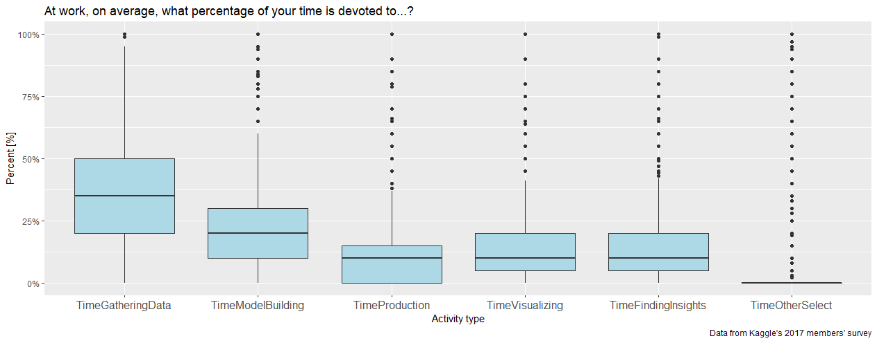
Here’s what 45,000+ kaggle members thought (and what is a “boxplot”)

Slide 13
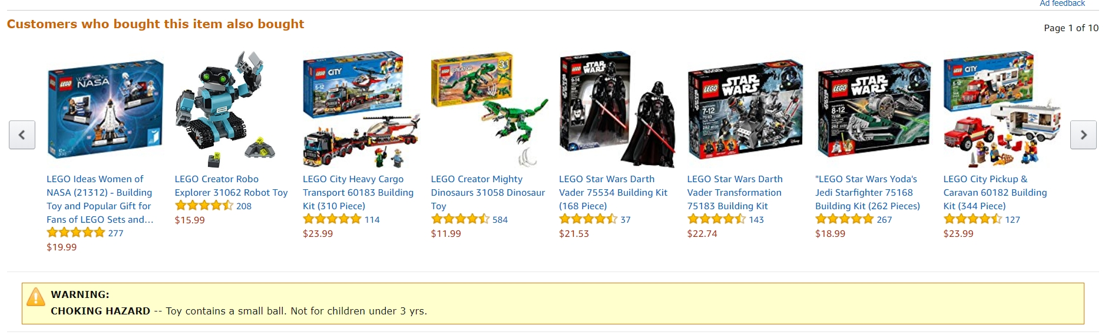
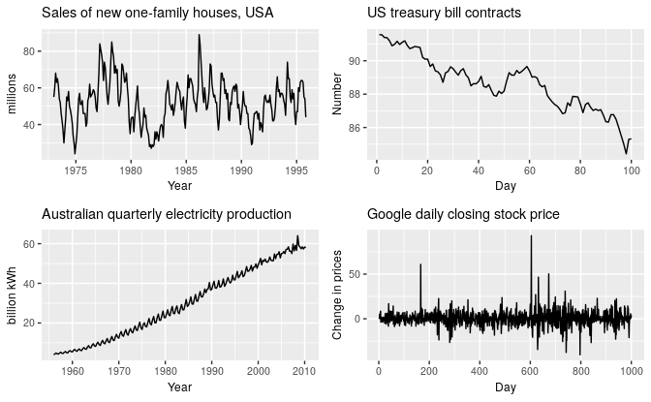
Examples for Data Science Problems
Time series analysis:
Recommendation systems:
(example from Amazon)
Commerce:
Fraud detection, identify and prevent churn
Healthcare (mortality analysis): https://colorectalcancermortalityprediction.shinyapps.io/CRCShiny/
Rob J. Hyndman and George Athansasopoulos, Forecasting: Principles and Practice 2nd edition,
OTexts, 2018. Available Online https://otexts.org/fpp2/ (fetched Sep 2018)
Dashboards: https://datadashboard.health.gov.il/COVID-19/general

Slide 14




What is R?
A free software environment for statistical computing and graphics (r-project.org)
An analogy I adopted (from Garret Grolemund)
C++

Slide 15

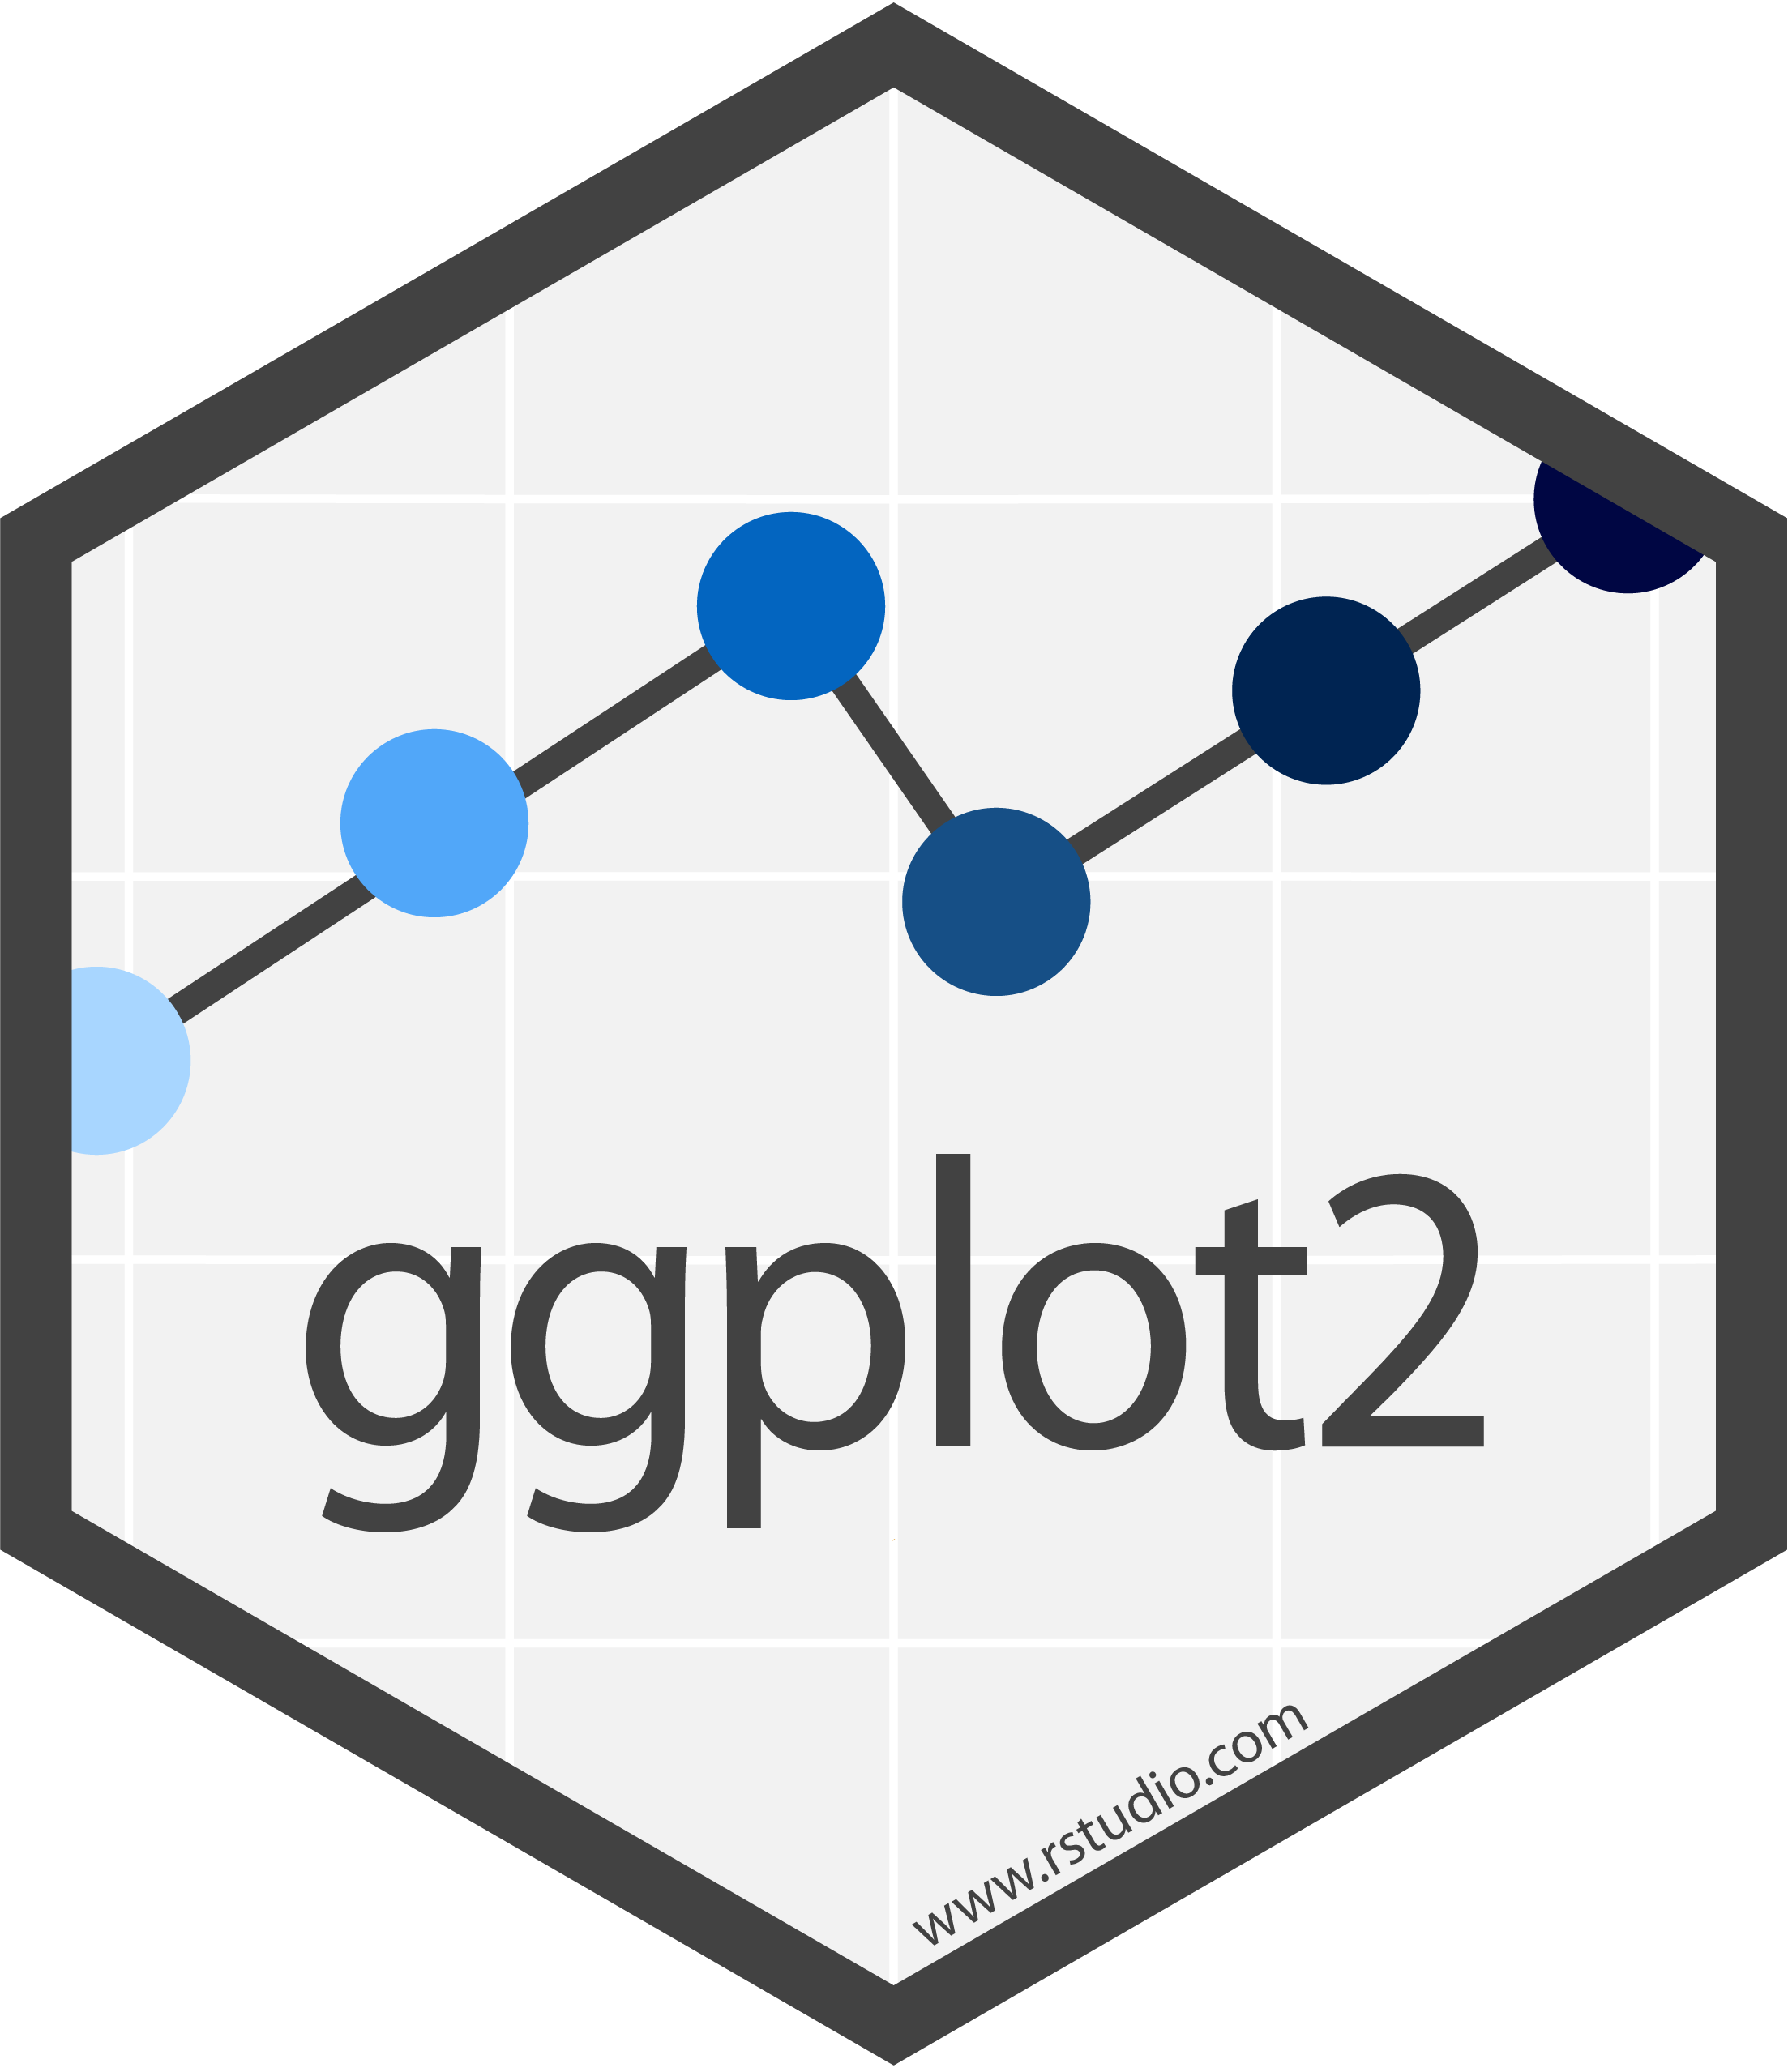


Some terms
Packages
(e.g. stringr)
functions
(e.g., str_to_lower,
str_replace,…)
Bare-bone
.R files
(script)
.Rmd files
Notes:
R-Base – the “bare bone R”
functions – extend the base capabilities
str_to_lower() takes an “UPPERCASE” and turns it to “uppercase”
packages – wraps together a set of functions with a shared vision
(e.g., stringr contains functions for working with strings)
scripts – contains code that R can run (.R files)
Rmarkdown – combination of code and text formatted documentation
R Studio IDE – an environment for working with R
Which adds a lot of functionality for the programmer’s convenience
gui (shiny) and api (plumbr) – allows you to bring R into production

Slide 16
Lab: Visualizing COVID19 Mobility trends
30 minutes in groups of 3
https://sarid.shinyapps.io/covid19_mobility

Slide 17
How does data look like?

Slide 18
The Tidy Philosophy
There is a “package of packages” called tidyverse. Why tidyverse? because it deals with “tidy” data. So, what is tidy data?
“An opinionated collection of R packages designed for data science. All packages share an underlying design philosophy, grammar, and data structures” – https://www.tidyverse.org
A | B | C
Each row is an observation
Each column is a variable

Slide 19
Contents for Today
Rows (observations)
The tidy philosophy
Columns (variables)
Data
Working with data
Variable types
Visualizing
Summarizing
Numeric (Integer, Double)
Factor (categorial, ordinal)

Slide 20
Quiz – which is “tidy”?
Which of the following files are tidy? which are un-tidy? Explain.
The central Bureau of Statistics
Population by group, religion, gender and age (/00-Introduction/st02_03.xls)
Ministry of Health
Weekly Epidemiological report (/00-Introduction/IWER34_2019.xlsx)
Lego brick data (rebrickable.com)
Lego parts (/00-Introduction/Lego_parts.csv)

Slide 21
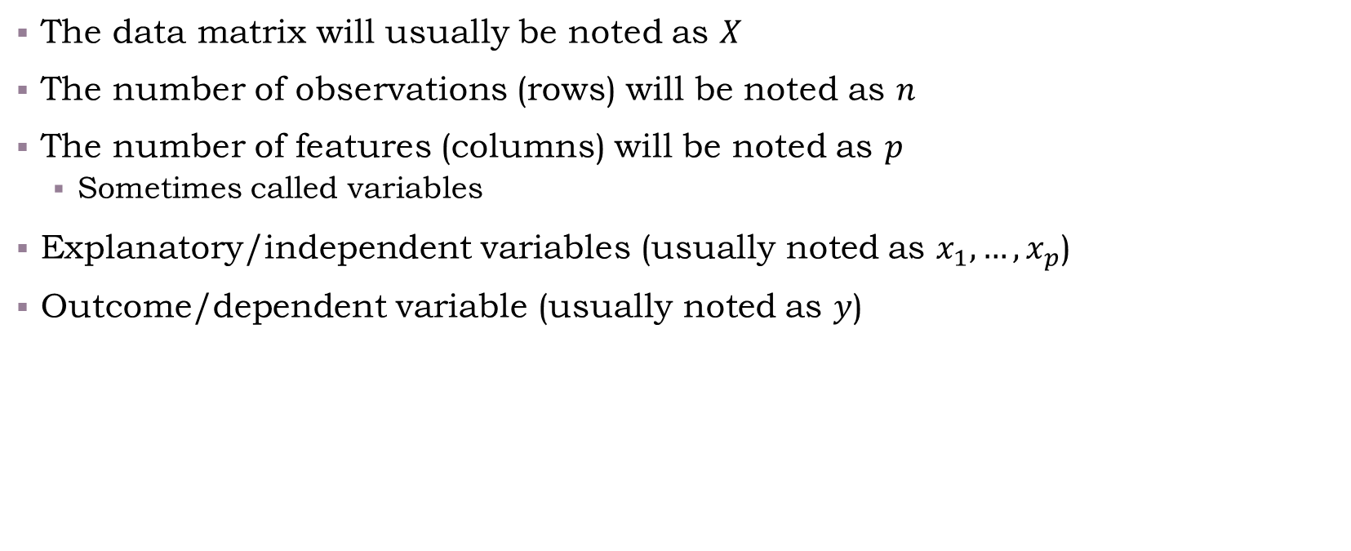
Common Notations
The data matrix will usually be noted as $X$
The number of observations (rows) will be noted as $n$
The number of features (columns) will be noted as $p$
Sometimes called variables
Explanatory/independent variables (usually noted as $x_{1},…,x_{p}$)
Outcome/dependent variable (usually noted as $y$)

Slide 22
Types of Variables
The common types of variables include:
Numeric (integer, double)
Factor (category, ordinal)
Date or datetime (2020-01-30; 2020-01-30 13:25:00)
Logical (True/False)
Character

Slide 23
Contents for Today
Rows (observations)
The tidy philosophy
Columns (variables)
Data
Working with data
Variable types
Visualizing
Summarizing
Numeric (Integer, Double)
Factor (categorial, ordinal)

Slide 24
What are descriptive statistics?
Assume we want to answer the following questions:
How long does it take to heal from COVID19?
How long does it take to show symptoms of COVID19 from transmission (symptom onset)?
Are people “the same” or very different from on another in terms of healing or symptom onset?
If I was exposed to COVID19, but I’m not showing symptoms after 9 days, what is the probability that I’m healthy?
There is no definitive answer to these. We can use different measures such as the mean, median, quantiles, standard deviation, and more.

Slide 25
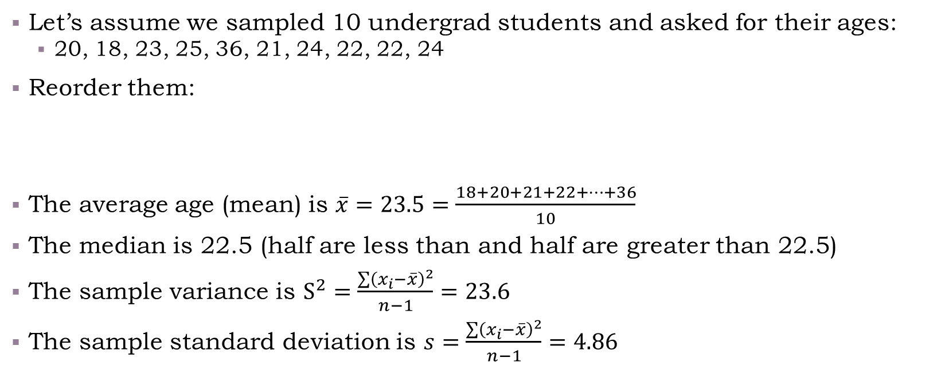
Descriptive statistics
Let’s assume we sampled 10 undergrad students and asked for their ages:
20, 18, 23, 25, 36, 21, 24, 22, 22, 24
Reorder them:
The average age (mean) is $\overline{x}=23.5=\frac{18+20+21+22+…+36}{10}$
The median is 22.5 (half are less than and half are greater than 22.5)
The sample variance is $S^{2}=\frac{\sum{{\left(x_{i}−\overline{x}\right)}^{2}}}{n−1}=23.6$
The sample standard deviation is $s=\frac{\sum{{\left(x_{i}−\overline{x}\right)}^{2}}}{n−1}=4.86$
18
20
21
22
22
23
24
24
25
36

Slide 26
Descriptive statistics
Let’s assume we sampled 10 undergrad students and asked for their ages:
20, 18, 23, 25, 36, 21, 24, 22, 22, 24
Reorder them:
What is the first quartile?
splits the lowest 25% of the data from the highest 75% of the data
What is the second quartile? (50%)
What is the third quartile? (75%)
What is the 90%th quantile?
18
20
21
22
22
23
24
24
25
36

Slide 27
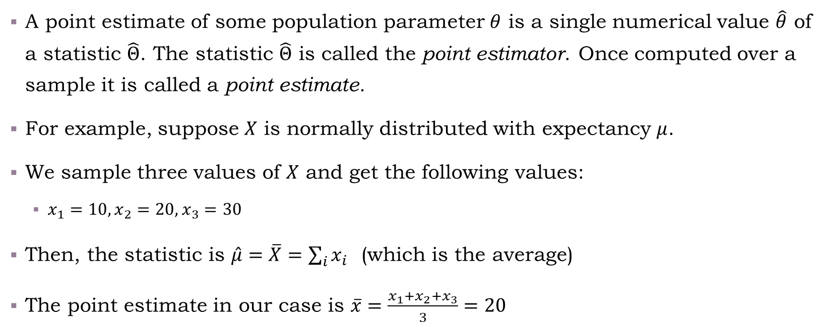
Point Estimates
A point estimate of some population parameter $θ$ is a single numerical value $\hat{θ}$ of a statistic $\hat{Θ}$. The statistic $\hat{Θ}$ is called the point estimator. Once computed over a sample it is called a point estimate.
For example, suppose $X$ is normally distributed with expectancy $μ$.
We sample three values of $X$ and get the following values:
$x_{1}=10, x_{2}=20, x_{3}=30$
Then, the statistic is $\hat{μ}=\overline{X}=\sum_{i}{x_{i}}$ (which is the average)
The point estimate in our case is $\overline{x}=\frac{x_{1}+x_{2}+x_{3}}{3}=20$

Slide 28
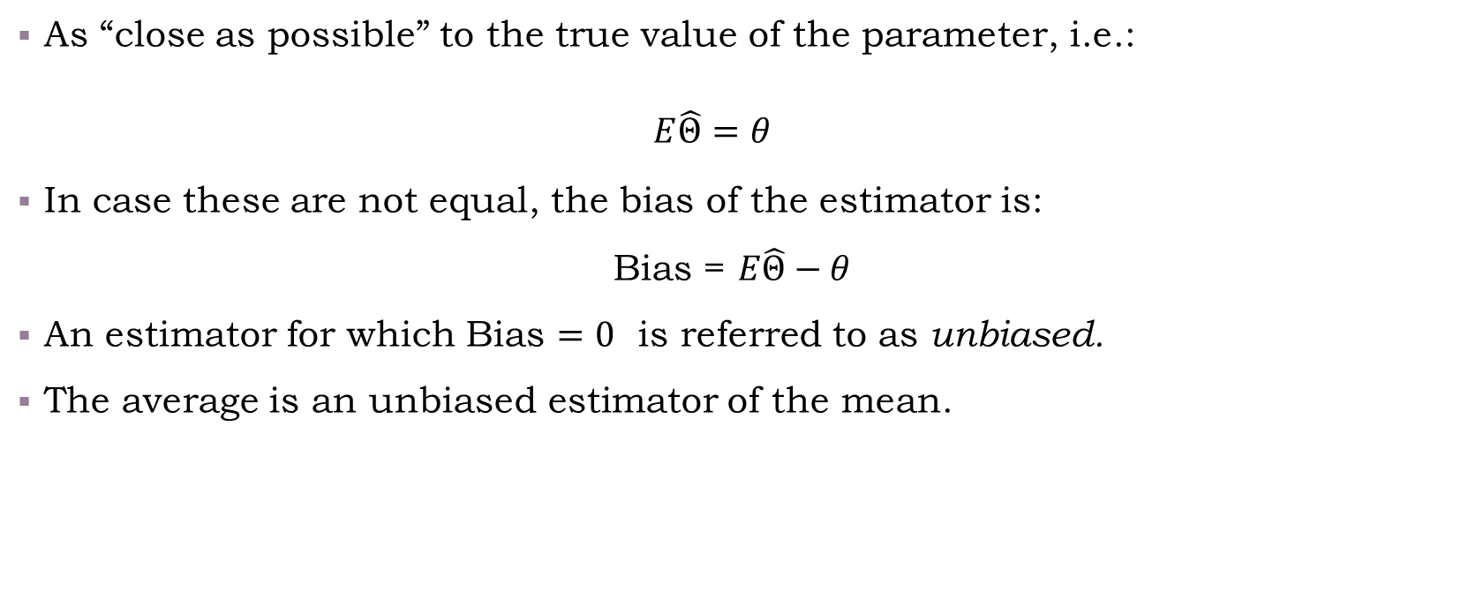
Desired Properties of Point Estimates: Unbiased
As “close as possible” to the true value of the parameter, i.e.:
$$E\hat{Θ}=θ$$
In case these are not equal, the bias of the estimator is:
Bias = $E\hat{Θ}−θ$
An estimator for which Bias $=0$ is referred to as unbiased.
The average is an unbiased estimator of the mean.

Slide 29
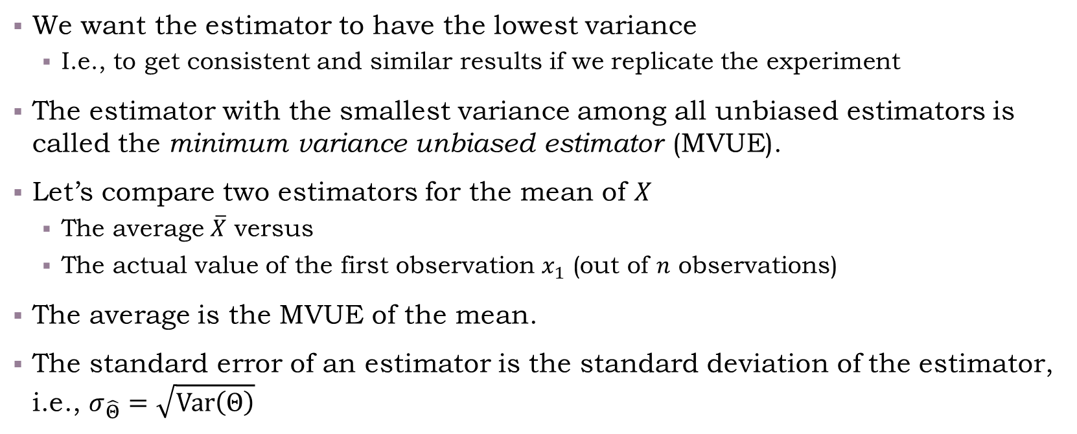
Desired Properties of Point Estimates (2): Minimum Variance
We want the estimator to have the lowest variance
I.e., to get consistent and similar results if we replicate the experiment
The estimator with the smallest variance among all unbiased estimators is called the minimum variance unbiased estimator (MVUE).
Let’s compare two estimators for the mean of $X$
The average $\overline{X}$ versus
The actual value of the first observation $x_{1}$ (out of $n$ observations)
The average is the MVUE of the mean.
The standard error of an estimator is the standard deviation of the estimator, i.e., $σ_{\hat{Θ}}=\sqrt{\text{Var}\left(Θ\right)}$

Slide 30
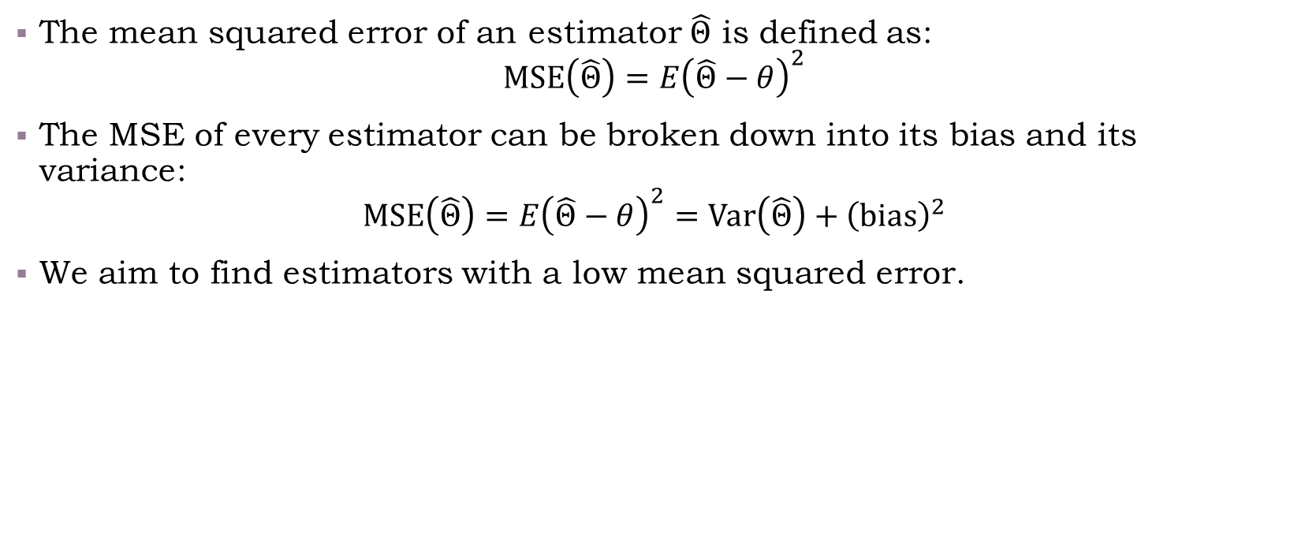
The Bias-Variance Decomposition
The mean squared error of an estimator $\hat{Θ}$ is defined as:
$$\text{MSE}\left(\hat{Θ}\right)=E{\left(\hat{Θ}−θ\right)}^{2}$$
The MSE of every estimator can be broken down into its bias and its variance:
$$\text{MSE}\left(\hat{Θ}\right)=E{\left(\hat{Θ}−θ\right)}^{2}=\text{Var}\left(\hat{Θ}\right)+{\left(\text{bias}\right)}^{2}$$
We aim to find estimators with a low mean squared error.

Slide 31
Contents for Today
Rows (observations)
The tidy philosophy
Columns (variables)
Data
Working with data
Variable types
Visualizing
Summarizing
Numeric (Integer, Double)
Factor (categorial, ordinal)

Slide 32
Visualizations

Slide 33
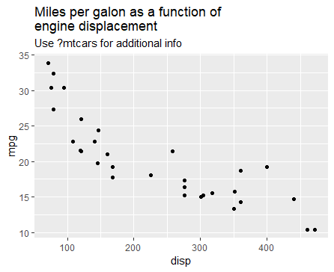
The Grammar of Graphics (visualizations, package ggplot2)
Each ggplot is based on “aesthetics”, the different elements which are data-dependent and are “mapping” data elements into chart elements (like a function). I.e., how the data influences the chart (e.g., fill, color, axis, etc.)
How many “aesthetics” can you spot in the following graph?
What story does this chart tells you?
ggplot(data = mtcars, mapping = aes(x = disp, y = mpg)) + geom_point()
Use the mtcars data.frame
disp (displacement)
should be mapped to x
mpg (miles per galon)
should be mapped to y
Add a layer of points
(scatter plot) which uses the
aforementioned aesthetics
If specified “in order” the “data =” and “mapping =” can be dropped:
ggplot(mtcars, aes(x = disp, y = mpg)) + geom_point()
This is generally true for every function’s arguments

Slide 34
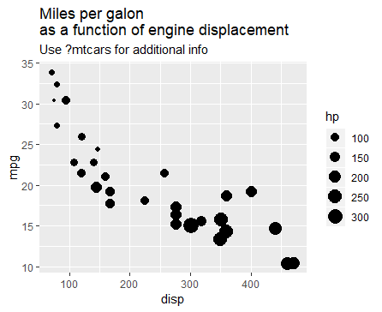
Let’s complicate things Spot the aesthetics (2)
What have I added?
What can you deduce from this chart, that you couldn’t from the previous one?
ggplot(data = mtcars, mapping = aes(x = disp, y = mpg)) +
geom_point(aes(size = hp))

Slide 35
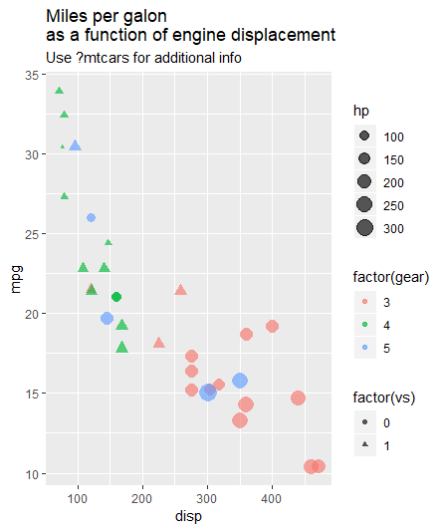
Even further
I added vs: 0=V-shaped engine, 1=strait
What can you deduce from this chart, that you couldn’t from the previous one?

Slide 36
Summarizing and Visualizing Data
“Working with Data” will be covered in more details in the next weeks and homework.
Throughout the course we will show examples via R, specifically I’m using tidyverse packages
Now, we’re going to demonstrate live:
/00-introduction/00-introduction_script.R

Slide 37
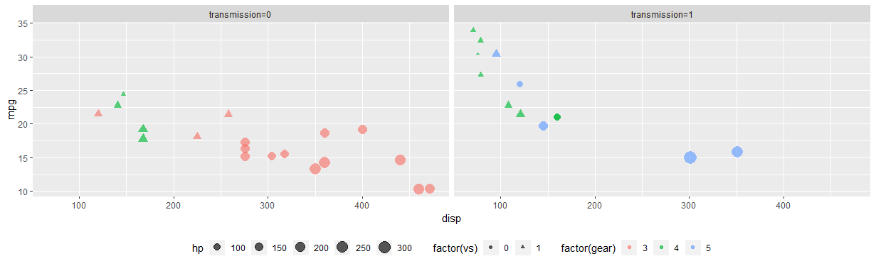
Facets
We can “split” the chart (or look at different levels), using “facets”
For example, split by the transmission type (1 = manual, 0 = automatic)
Try to analyze the graph, what makes cars more efficient (=higher mpg)

Slide 38
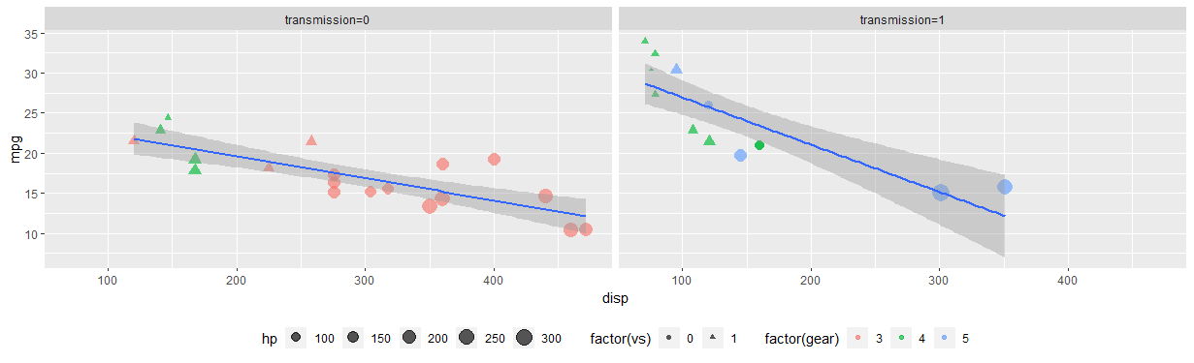
Stats
We can add various “statistics helpers”, such as smoothing (linear regression, lowess, polynoms, etc.)

Slide 39
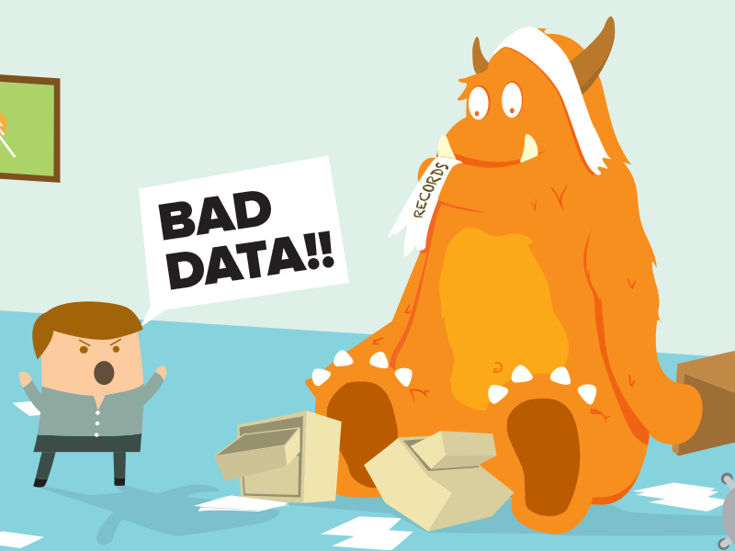
Warning!
https://dribbble.com/shots/1231599-Data-Monster-2x
Let’s stop here.
ggplot2 has a lot of flexibility, but does that mean we should “push it”?
6 dimensions (mpg, disp, hp, vs, gear, am) means
15 (6 choose 2) 2-vars relationships
20 (6 choose 3) 3-vars relationships….
Not really helpful: our short-term memory can process up to 7±2 “items” (some say even less)
Too complex chart simply get lost in translation, and here comes our true challenge
Match the chart’s complexity to your audience
Generate charts that drive understanding and insights

Slide 40
Contents for Today
Rows (observations)
Sampling
The tidy philosophy
Columns (variables)
Data
Working with data
Variable types
Visualizing
Summarizing
Numeric (Integer, Double)
Factor (categorial, ordinal)

Slide 41
Sampling
In most cases, we can’t compute measures on the “entire population”
e.g., that’s what a census does
In such cases we sample the population: selecting observations out of a given population (a “sample”), which would represent the population, for statistical purposes
Various methods for sampling, e.g.:
Random sampling
Layered sampling
Cluster sampling
Important to make sure: avoid a method which causes bias in the sample
Garbage in-garbage out
Population
Sample

Slide 42
Summarizing
We talked about course expectations, goals, and challenges
We talked about data analysis foundations (activities, data structures)
We did a lab – “Visualizing COVID19 mobility trends”
Experimenting with some R code, visualizing and learning from the plots
We learned about descriptive statistics, and about point estimates

