Slide 1

Distributed Cloud Computing
Aditya Saripalli
Avani Gupta
Shivam Mangle

Slide 2
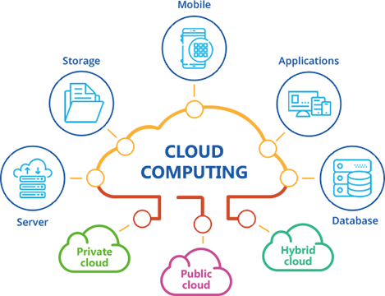
What is Cloud Computing ?
Cloud computing is delivery of computing services (like servers, storage, networking, software etc) over the internet (“the cloud”) to offer flexible resources and economies of scale.
You pay only for the cloud services you use – lowering your operating costs.
Create and run your infrastructure more efficiently and scale as per your business needs.

Slide 3
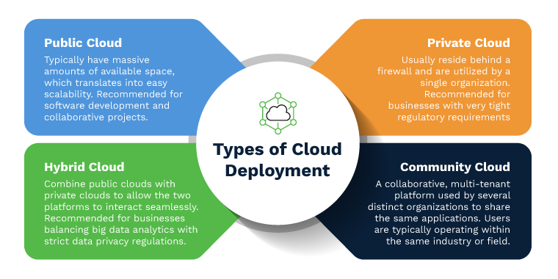

Slide 4
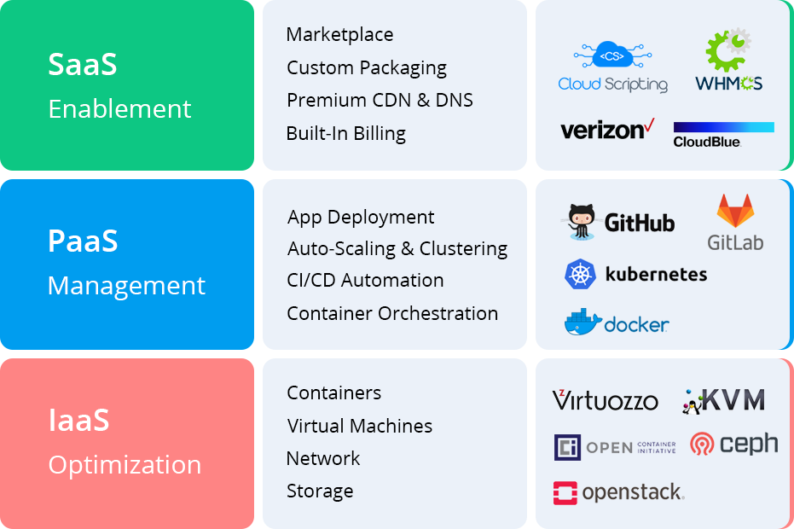
Types of Cloud Services

Slide 5
Distributed Cloud Computing
Definition: A generalized cloud computing model to position, process, and serve from geographically distributed sites to meet requirements for performance, redundancy and regulations.
It is a public cloud computing service that lets you run cloud infrastructure in multiple locations and manage everything from a single control plane.
It is the first cloud model that incorporates physical location of cloud-delivered services as part of its definition.

Slide 6
Distributed Cloud Computing Requirements
While distributed computing spreads computation workload across multiple interconnected servers, distributed cloud computing generalizes it to an execution environment where compute modules are placed at appropriate geographically-dispersed locations chosen to meet the requirements of the application.
Location
To enable more responsive and performant service delivery, where latency is critical and bulk data transfer to and from a central cloud is expensive.
Redundancy
Beyond that provided by local, regional, or national site redundancy to mitigate large scale outages that can affect enterprises.
Security
To ensure certain data/processes remain within an enterprise’s private cloud/data center, with which a public cloud is integrated.
Regulations
Which may require that data never leaves the user’s country, as in with Europe.

Slide 7
Distributed Cloud Computing (Contd..)
The distributed cloud service provider ensures the end-to-end management for the optimal placement of data, computing processes, and network interconnections based on the above-mentioned requirements.
From the cloud user’s point of view, It appears as a single solution.
Example: Content Delivery Network (CDN)
Storage (e.g., video content) is positioned in geographically diverse regions to reduce the latency of delivery.
Enterprises using CDNs to distribute content - get the benefits of scaling both storage and performance.

Slide 8
Edge Computing
Edge Computing is a distributed architecture that reduces latency by housing applications, data, and compute resources at locations geographically closer to end users.
In layman's terms, edge computing lets you "bring the math to the data".
Put the computation where the data is created instead of moving the data back-and-forth from the centralized cloud data centre for processing.
Increasingly essential for applications that process huge volumes of data at high speeds in real time, when low latency is critical.

Slide 9
Distributed Cloud and Edge Computing
Other cases where edge computing offers benefits are
Where the transport network is bandwidth constrained or unreliable.
When the data is too sensitive to be sent over public networks, even if encrypted, etc.
Edge Computing paradigm is not different but an extension of the Distributed Cloud Computing.
The two models can be reconciled by considering edge computing resources as a "micro" cloud data centre, with the edge storage and network resources connected to larger cloud data centres for big data analysis and bulk storage.

Slide 10
Examples
Intelligent Transport:
Autonomously driven vehicles can locally process the data through sensors to maintain a steady speed and separation between vehicles, while sending traffic and engine data back to a central cloud.
Their path to the destination is monitored by a fleet management application in a regional cloud, which analyses data from multiple vehicles to determine optimal routes and identify vehicles for maintenance.
Intelligent Caching:
A video service provider uses a central cloud to transcode and format videos for different device types served over different networks.
The content is cached in multiple formats in geographically dispersed CDNs.
In anticipation of major demand for a newly released series in a given region, it pre-positions that content in caches closest to end users.

Slide 11
Advantages
Offers Reliability, Availability and Serviceability (RAS) which reduces the cost.
Offers immediate fail-overs, with the help of remote replicas, that can instantly reset the failure nodes.
Reduction in wide-area traffic.
Allows breaking complex problems and data into smaller problems and have multiple computers worked upon in parallel (Distributed Edge Compute).

Slide 12
Disadvantages
Distributed cloud computing systems are difficult to deploy and troubleshoot.
These complexities are not only related to hardware but also need software that can handle security and communication.
The processing overhead due to additional computation and exchange also increases the overall cost.
Difficult to manage the security, as data accesses require more maintenance and security.
Along with network, one has to control, secure and maintain the replicated data across multiple locations.

Slide 13
Key Takeaways
Expands the traditional cloud model to a set of distributed cloud infrastructure components that are geographically dispersed.
Offer on-demand scaling of computing and storage while moving it closer to where these are needed for improved performance.
Edge computing is a complementary aspect of distributed cloud computing, and represents the farthest end of a distributed cloud architecture.

Slide 14
Famous quotes from Gartner
"The next generation of cloud computing, retains the advantages of cloud computing while extending the range and use cases for cloud”
"By 2024, most cloud service platforms will provide at least some distributed cloud services that execute at the point of need”
"Next-generation cloud will work based on an assumption that cloud substations are everywhere — much like Wi-Fi hot spots"

Slide 15
Thank You

