Slide 1
Distributed Mutual Exclusion Algorithms
Most slides taken from the textbook slides posted. Some slides from the lecture material by Sukumar Ghosh (U. Iowa) and Indranil Gupta (UIUC)
Notes:
Lecture 14

Slide 2
Example
Code:
NewBalance= Balance + Amount;
Balance= NewBalance;
Say initially Balance is 1000 and both Jack and Jill are depositing 200 each. This should have resulted in 1400.
Consider the below sequence of execution
Jack: Line 1 (NewBalance = 1000+200)
Jill: Line 1 (NewBalance= 1000 +200)
Jack: Line 2 (Balance = 1200)
Jill: Line 2 (Balance=1200)

Slide 3
Mutual Exclusion
Mutual exclusion in operating systems solved by algorithms such as
  The bakery algorithm
  Peterson’s algorithm
These algorithms require assumptions on the system such as
  Centralized control
  Atomic operations
Review this material for your own ease of understanding what follows next.

Slide 4
Mutual Exclusion
Mutual exclusion is important in the context of distributed computations too.
However, achieving mutual exclusion may not be any easier than in centralized settings.
  No centralized control!!
Surprisingly, several algorithms exist in this setting.
We will study some of them in this lecture today.

Slide 5
Mutual Exclusion
Mutual exclusion: Concurrent access of processes to a shared resource or data is executed in mutually exclusive manner.
Only one process is allowed to execute the critical section (CS) at any given time.
In a distributed system, shared variables (semaphores) or a local kernel cannot be used to implement mutual exclusion.
Message passing is the sole means for implementing distributed mutual exclusion.
Distributed mutual exclusion algorithms must deal with unpredictable message delays and incomplete knowledge of the system state.

Slide 6
Assumptions
Data Structures Week 1
Messages dont get dropped, channels dont fail
One process on each site
While waiting for CS, a process can not make further requests for CS
Site either requesting CS, executing CS, or idle (not requesting or executing). In Idle state the site is executing outside CS.

Slide 7
Performance Metrics
Data Structures Week 1
Message complexity -number of messages that are required
per CS execution by a site
Synchronisation Delay - After a site leaves the CS, it is the time required before the next site enters CS
Response Time - This is the time interval a request waits for its CS execution to be over after its request messages have been sent out .
System Throughput - Rate at which the system executes requests for the CS.
SD : synchronization delay E : avg CS execution time
System throughput : 1/ (SD+E)

Slide 8
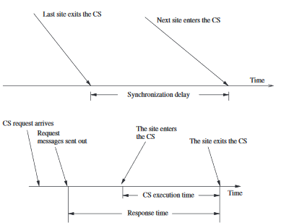
Data Structures Week 1

Slide 9
Data Structures Week 1
A process wishing to enter the CS requests all other or a subset of processes by sending REQUEST messages, and waits for appropriate replies before entering the CS.
While waiting the process is not allowed to make further requests to enter the CS.
A site can be in one of the following three states: - requesting the CS, - executing the CS, - neither requesting nor executing the CS (i.e., idle).
In the “requesting the CS” state, the site is blocked and cannot make further requests for the CS. In the “idle” state, the site is executing outside the CS.
At any instant, a site may have several pending requests for CS. A site queues up these requests and serves them one at a time.

Slide 10
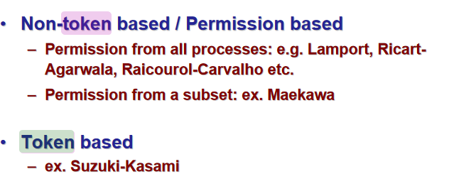
Data Structures Week 1

Slide 11
Lamport’s Algorithm for Mutual Exclusion
Uses logical scalar clocks
Assumes FIFO channels
Every site Si keeps a queue (request_queue_{i}) which contains CS (critical section) requests ordered by their timestamps(priority queue).
Note: The request_queue is a set of waiting processes ordered by timestamp

Slide 12
Lamport’s Algorithm for Mutual Exclusion
Requesting the critical section:
  When a site S_{i} wants to enter the CS, it broadcasts a REQUEST(ts_{i} , i) message to all other sites and places the request on request_queuei. ((ts_{i} , i) denotes the timestamp of the request.)
  When a site S_{k} receives the REQUEST(ts_{i} , i) message from site S_{i} ,places site S_{i} ’s request on request_queue_{k} and it returns a timestamped REPLY message to S_{i}.
Executing the critical section:
  Site S_{i} enters the CS when the following two conditions hold:
  L1: S_{i} has received a message with timestamp larger than (ts_{i}, i) from all other sites. note: need not be reply msg
  L2: S_{i} ’s request is at the top of request_queuei.

Slide 13
Lamport’s Algorithm
Releasing the critical section:
  Site S_{i}, upon exiting the CS, removes its request from the top of its request queue and broadcasts a timestamped RELEASE message to all other sites.
  When a site S_{j} receives a RELEASE message from site S_{i}, it removes S_{i}’s request (tsi, i) from its request queue.
  When a site removes a request from its request queue, its own request may come at the top of the queue, enabling it to enter the CS.

Slide 14
Lamport’s Algorithm for Mutual Exclusion
Why do we need two conditions. Instead why cant Pi just enter CS when he is on the top of the queue ? – Because a request with lower ts may be on its way from Pj and Pj would enter the CS as he finds himself on top of his queue.
How does reply with higher timestamp take care of this? FIFO channel so when Pi gets the higher timestamp he knows nothing with lower timestamp is on its way
How come it works for “any” message with larger timestamp. Need not even be a reply msg? Takes care that lower ts is not on its way.
Scalar clock is not strongly consistent. Does this cause a problem?
No. If tsi <tsk then tsi either before tsk or concurrent to it. The clock value however ensures that one is always ordered over the other and hence tsk though concurrent will wait for tsi due to the lower time stamp.
Two timestamps of two processes could be the same. How can this be managed? Break the tie by pid
Can this work for non FIFO channels ? No.waiting for higher timestamp will now make nosense
Notes:
4. No. If tsi <tsk then tsi either before tsk or concurrent to it. The clock value however ensures that one is always ordered over the other and hence tsk though concurrent will wait for tsi due to the lower time stamp.
5. Break the tie by process id.

