Slide 1
Minimum spanning-tree based termination detection algorithm
Aditya Saripalli (20173071)
Issac Balaji (20163051)

Slide 2
Pre Work
01. Simple Algorithm
02. Rodney Topor's
A token based algorithm when all children are done terminated parent is terminated.
Color based token which address the issue in simple algo.
03. Chandrasekaran
And Venkatesan’s
04. Arora Gupta's
05. Our Work
Distributed Termination Algorithm using message optimal termination detection
Distributed Termination Algorithm by 2 phases detection and temination
Used Rodney Topor's algo with our change in algo.

Slide 3
Assumption
Minimum spanning tree (path) is known
Nodes are available and not modified.
No new channels (other than the edges of the MST) are established.

Slide 4
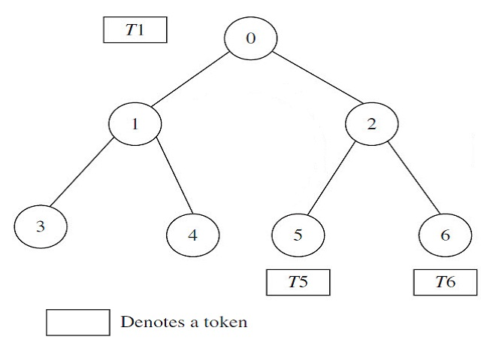
Simple Algorithm
N processes P_{i} , 0 ≤ i ≤N, which are modeled as the nodes i
edges of the graph represent the communication channels.
Children report to their parents, if they have terminated.
parent node will similarly report to its parent when it has completed processing and all of its immediate children have terminated
Algorithm terminated when root terminates.

Slide 5
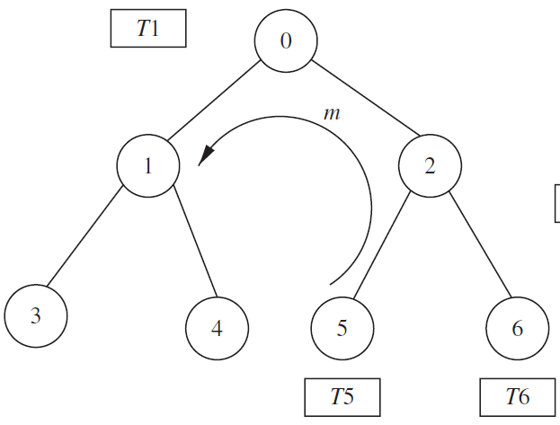

Problem with the algorithm: The algorithm fails when a process (after it has sent a token to its parent), receives a message from some other process.

Slide 6
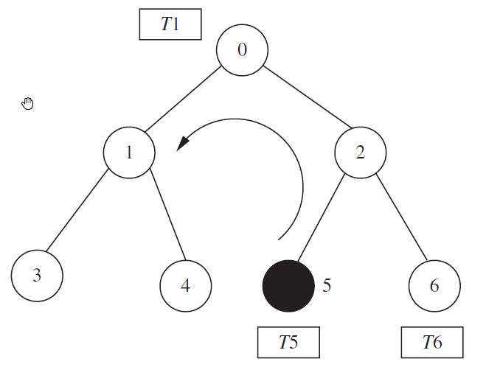
Rodney.W.Topor’s
Initially color all the processes and tokens as WHITE.
A process turns BLACK when it sends a message to some other process. It turns WHITE, after it has sent the BLACK token to its parent.
Upon receiving a BLACK token (from one of the child(s)) Root will send a REPEAT signal to all its children propagating till leaf node.
The leaf nodes then restart the algorithm on receiving the REPEAT signal.
Root node concludes that termination detection is complete only on receiving WHITE tokens from all the child nodes.

Slide 7
Performance
Best case Message Complexity O(N)
One round
Worst case Message Complexity O(N*M)
M – no of computation messages exchanged on black token.
The best case involves token needs to be sent to its parent so N nodes will lead to O(N) complexity whereas Worst case if it takes M no of rounds then M times N nodes has to communicate and marks for complexity O(N * M).

Slide 8
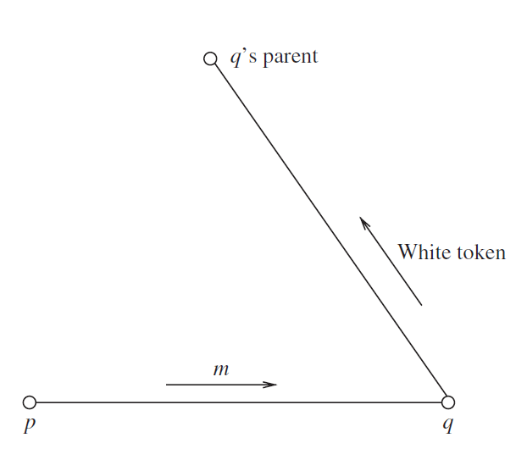
S.Chandrasekaran And S.Venkatesan’s
An extension of Rodney.W.Topor.
When a node p sends a message m to node q, p should wait until q becomes idle.
When the node q terminates, it sends an acknowledgement (a CONTROL message) to node p informing node p
Both the sender and the receiver keep track of each message exchange.
All nodes will only send WHITE token.
A message optimal way of termination detection.

Slide 9
Performance
Topor’s model
Message Optimal
Worse Case Message Complexity O(N*M)
the total number of messages generated by the algorithm is 2* |E| + |V| − 1 + M.
E edges – links / warning messages
M remove message
V nodes
Message Complexity O(|E| + M)
as |E| > |V|

Slide 10
R.K.Arora and M.N.Gupta’s

Slide 11
R.K.Arora and M.N.Gupta’s
The detection-message is issued only when the process and all its communicating neighbors become PASSIVE.
The detection message wave once issued by the root process first spreads downwards and then contracts upwards.
No additional effort is required to maintain the local information in the control section of a process.

Slide 12
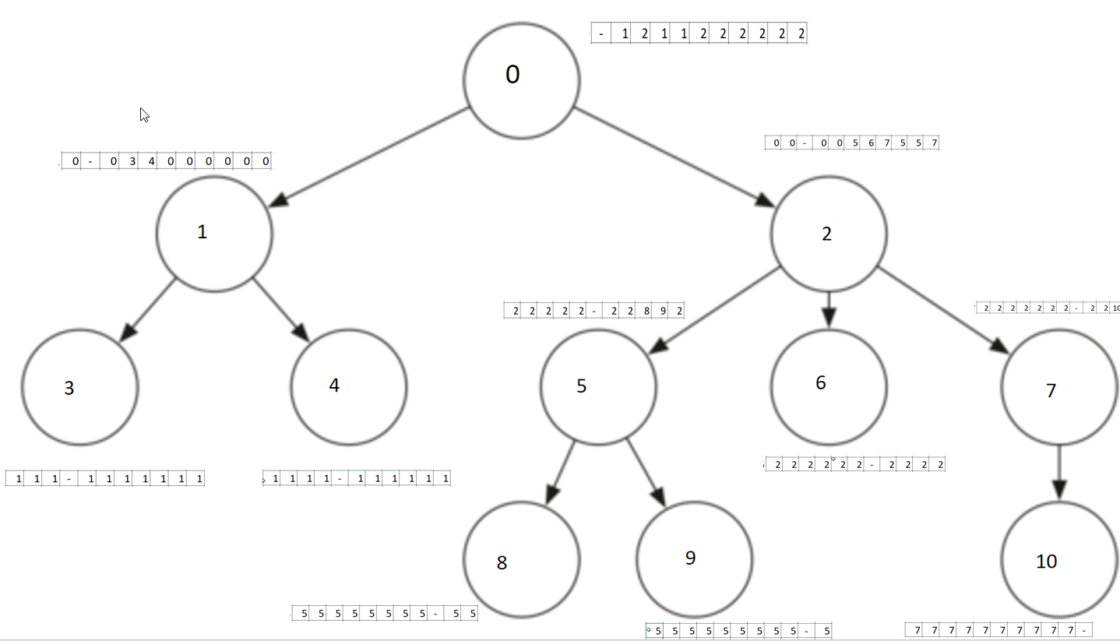
Our Model
We have used Rodney.W.Topor’s model for termination detection
In addition to the above algorithm, we maintain a routing array for message passing.
Messages are sent only along the edges of the nodes using the routing path mentioned in the array.

Slide 13
Comparision
Topor
Message Optimal
Our model
Simple
More messages
Frequent Repeats
Complete env repeats for even one black token
Less message overheads and message traffic
Mostly waiting for other nodes to go to idle.
In Arora’s method even waiting for neighborhood nodes to become passive
Comparatively Simple after initialization.

Slide 14

Thank you

