Slide 1
Minimum spanning-tree based termination detection algorithm
Aditya
Issac Balaji (20163051)

Slide 2
Pre Work
01. Simple Algorithm
02. Rodney Topor's
A token based algorithm when all children are done terminated parent is terminated.
Color based token which address the issue in simple algo.
03. Chandrasekaran
And Venkatesan’s
04. Arora Gupta's
05. Our Work
Distributed Termination Algorithm using message optimal termination detection
Distributed Termination Algorithm by 2 phases detection and temination
Used Rodney Topor's algo with our change in algo.

Slide 3
Assumption
Minimum spanning tree (path) is known
Nodes are available and not modified.
No new channels are established.

Slide 4
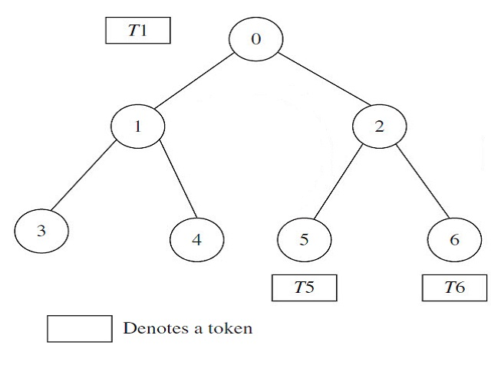
Simple Algorithm
N processes P_{i} , 0 ≤ i ≤N, which are modeled as the nodes i
edges of the graph represent the communication channels.
Children report to their parents, if they have terminated.
parent node will similarly report to its parent when it has completed processing and all of its immediate children have terminated
Algorithm terminated when root terminates.

Slide 5
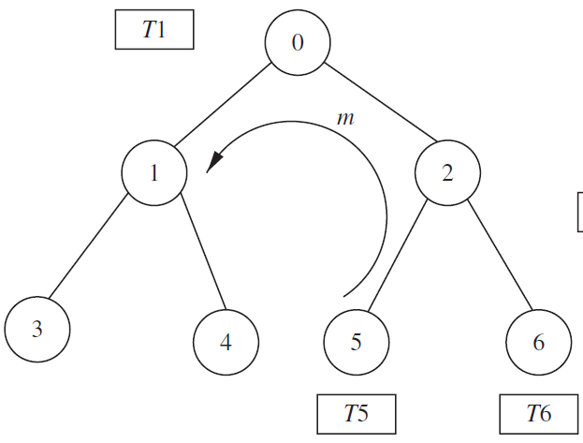

Problem with the algorithm fails when a process after it has sent a token to its parent, receives a message from some other process

Slide 6
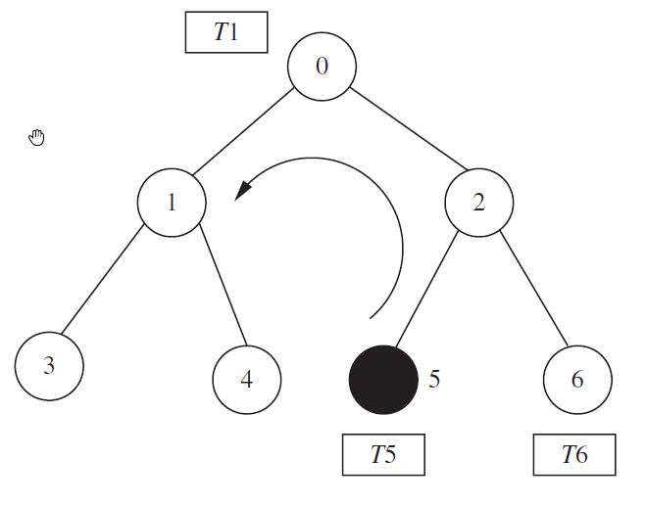
Rodney Topor's
to color the processes and tokens, all initially white.
process turns black when it sends a message to some other process and turns to white, after it has sent a black token to its parent.
upon receiving a black token root will send a repeat to all its children propagating to leaf.
The leaf nodes restart the algorithm on receiving the Repeat signal.
root concludes that termination only on receiving white token

Slide 7
Performance
Best case Message Complexity O(N)
One round
Worst case Message Complexity O(N*M)
M – no of computation messages exchanged on black token.

Slide 8
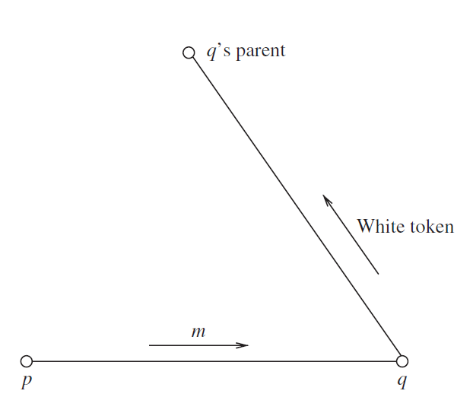
Chandrasekaran And Venkatesan’s
when a node p sends a message m to node q, p should wait until q becomes idle
when node q terminates, it sends an acknowledgement (a control message) to node p informing node p
both the sender and the receiver keep track of each message
All nodes will only send white token

Slide 9
Performance
Topor’s model
Message Optimal
Worse Case Message Complexity O(N*M)
the total number of messages generated by the algorithm is 2* |E| + |V| − 1 + M.
E edges – links / warning messages
M remove message
V nodes
Message Complexity O(|E| + M)
as |E| > |V|

Slide 10
Arora and Gupta’s

Slide 11
Arora and Gupta’s
The detection-message is issued only when the process and all its communicating neighbors become passive.
The detection message wave once issued by the root process first spreads downwards and then contracts upwards.
no extra effort is required to maintain the local information in the control section of a process.

Slide 12
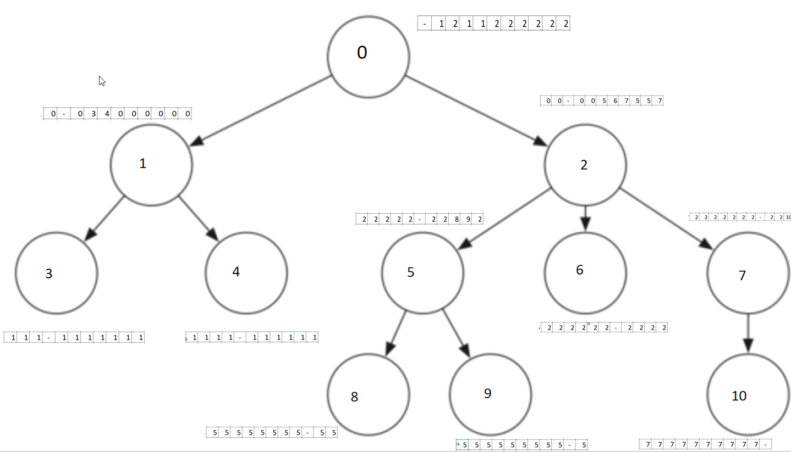
Our Model
We use the same model as Rodney Topor’s
Additionally we maintain the Routing array apart along with token.
Repeat is done only for the nodes that is still active and not all by using the route path.

Slide 13
Comparision
Topor
Message Optimal
Our model
Simple
More messages
Frequent Repeats
Complete env repeats for even one black token
Less message overheads and message traffic
Mostly waiting for other nodes to go to idle.
In Arora’s method even waiting for neighborhood nodes to become passive
Comparatively Simple after initialization
Lesser message
Only repeat is applied to the nodes which invoked later and not entire env repeated.

Slide 14

Thank you

