Slide 1

Real-Time Systems Lecture 1- Introduction
Deepak Gangadharan

Slide 2
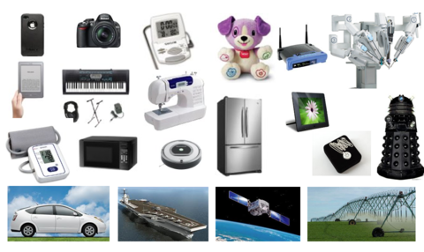
What is an Embedded System?
A computer system that has a
dedicated function within a larger electrical/mechanical system - Wikipedia
Source: https://www.embedded.fm/blog/2016/12/6/an-introduction-to-the-tricky-parts-of-embedded-systems-1

Slide 3


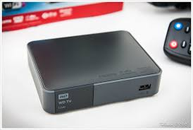

What is a Real-Time System?
A system whose correctness is not just adherence to functional correctness, but also timeliness of results.
Any violation of required timing
can lead to undesirable consequences
https://www.flickr.com/photos/tolbxela/16008698917
https://www.pexels.com/photo/red-mercedes-benz-suv-moving-on-road-3972759/
https://pixabay.com/photos/aeroplane-fly-flying-landing-4347341/

Slide 4
Embedded vs Real-Time System
Embedded, but not Real-Time
Blood pressure meter
Washing machine, Refrigerator
Real-Time, but not Embedded
Stock trading system
Skype
Real-Time Embedded System (RTES)
Flight control, Drone
Nuclear reactor control
Mobile phone
Real-Time
Systems
Embedded
Systems
RTES

Slide 5
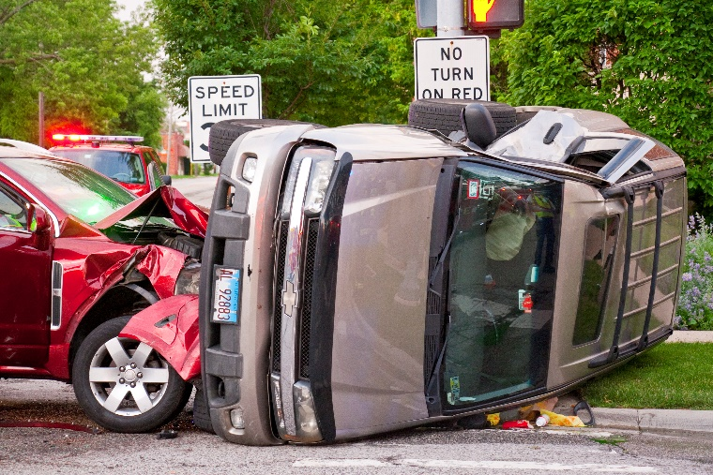
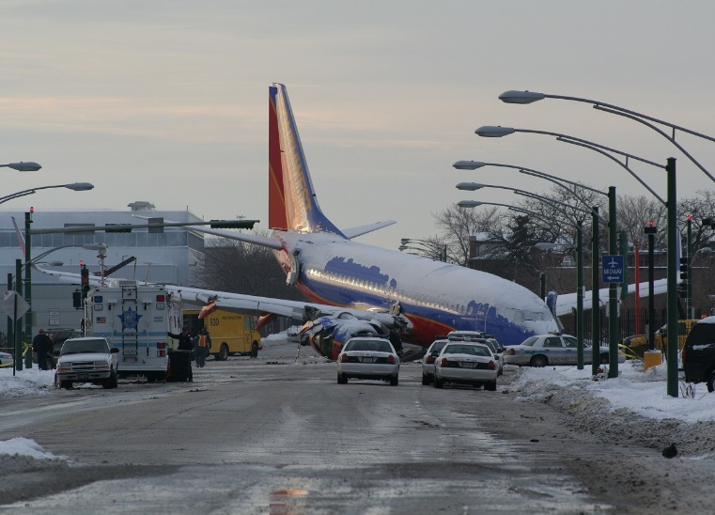
Classes of Real-Time Systems
Hard real-time (Safety Critical Systems)
Imperative that responses to inputs come within a safe deadline
Wrong/late responses can endanger human life or lead to other catastrophic consequences
Validation techniques are very conservative
https://commons.wikimedia.org/wiki/File:Car_Crash_7-1-18_2246_(42450607644).jpg
https://en.wikipedia.org/wiki/List_of_accidents_and_incidents_involving_the_Boeing_737

Slide 6
Classes of Real-Time Systems
Hard real-time (Business Critical Systems)
Imperative that responses to inputs come within a safe deadline
Wrong/late decisions can lead to huge financial losses
https://en.wikipedia.org/wiki/List_of_accidents_and_incidents_involving_the_Boeing_737

Slide 7
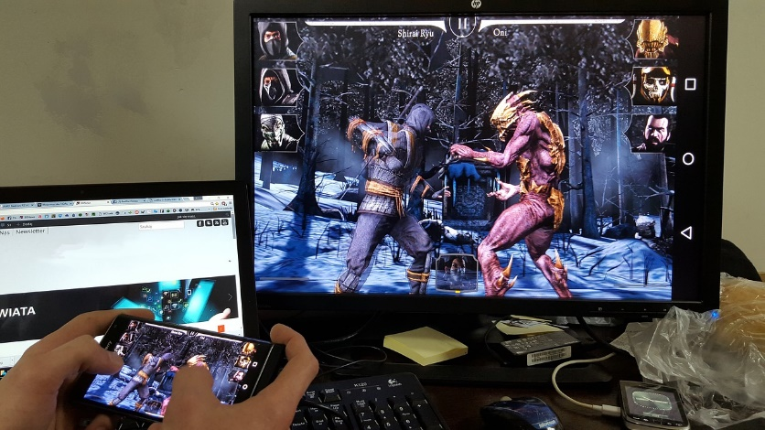
Classes of Real-Time Systems
Soft real-time
Deadlines are important, but still will function correctly with occasional deadline misses
Usefulness of the data decreases as the response moves further away from the deadline – User satisfaction or Quality of Service affected
https://www.needpix.com/photo/1100165/mobile-gaming-android-gaming-smartphone-games-mortal-kombat-android-blackberry

Slide 8
Classes of Real-Time Systems
Firm real-time
Successive deadline misses must be adequately spaced
There is no benefit from late delivery of service
https://www.flickr.com/photos/tolbxela/16008698917

Slide 9
Digital Controller (Integral to RTS)
Reference input, Sensor measurements are typically analog
Controller performs A/D conversion, applies a control law and performs computation and D/A conversion of the control output
The analog control output controls the actuator, which in turn changes the state of the plant
Periodic Digital
Controller

Slide 10
Digital Controller (Integral to RTS)
Reference input, Sensor measurements are typically analog
Controller performs A/D conversion, applies a control law and performs computation and D/A conversion of the control output
The analog control output controls the actuator, which in turn changes the state of the plant

Slide 11
Digital Controller (Integral to RTS)
Faster sampling better approximates the analog signal, but increases the computation demand on the controller
Faster the sampling better the response
Slower the sampling may result in late response and lesser stability

Slide 12
Questions?

