Slide 1

Lecture 3- Modeling Real-Time Systems
Deepak Gangadharan

Slide 2
Modeling Real-Time System - Recap
Application/ Workload modeled as task graph
Scheduling and Resource Access control algorithms
Resource Model

Slide 3
An Example – Inverted Pendulum
Model should be adequately expressive and tractable
A model
Actual System
Source: http://www.st.ewi.tudelft.nl/mitra/teaching/rts/2019/files/lect02-online-scheduling.pdf

Slide 4
What is good modeling?
Read input
Write
output
Intractability
Too
Complex
Good
Model
Compute
Far from
reality
Alternate Model
Any details abstracted?
Control task
Expressiveness
Source: http://www.st.ewi.tudelft.nl/mitra/teaching/rts/2019/files/lect02-online-scheduling.pdf

Slide 5
Application/Task Modeling

Slide 6
Relationship between deadline and period
Implicit deadline: Deadline is equal to period
Constrained deadline: Deadline is less than or equal to period
Arbitrary deadline: Deadline can be smaller, equal or greater than period

Slide 7
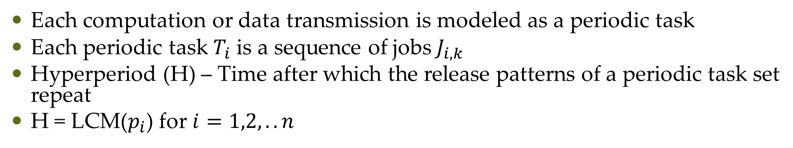
Periodic Task Model – Hyperperiod
Each computation or data transmission is modeled as a periodic task
Each periodic task $T_{i}$ is a sequence of jobs $J_{i,k}$
Hyperperiod (H) – Time after which the release patterns of a periodic task set repeat
H = LCM($p_{i}$) for $i=1,2,..n$
H = 24
Task 1
Period = 8
Task 2
Period = 6

Slide 8
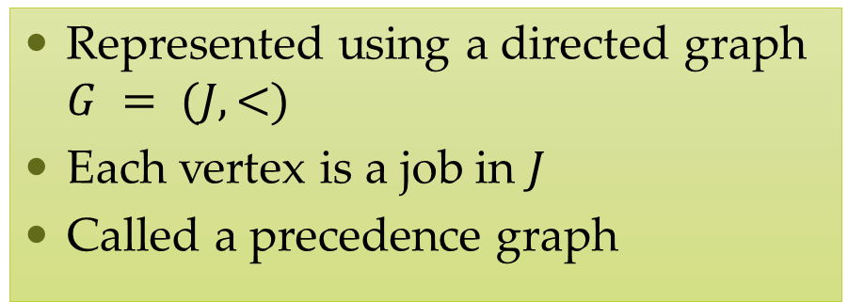
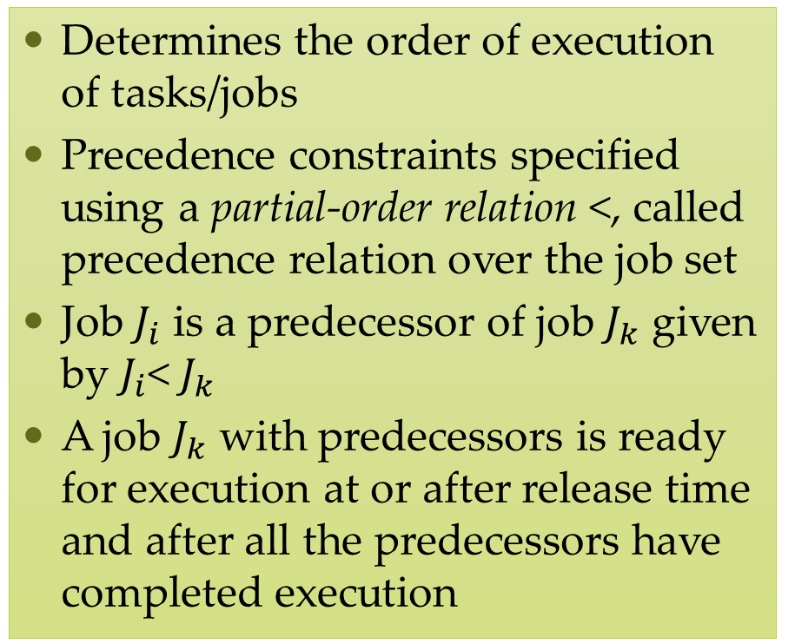
Precedence Constraints
Determines the order of execution of tasks/jobs
Precedence constraints specified using a partial-order relation <, called precedence relation over the job set
Job $J_{i}$ is a predecessor of job $J_{k}$ given by $J_{i}$< $J_{k}$
A job $J_{k}$ with predecessors is ready for execution at or after release time and after all the predecessors have completed execution
Represented using a directed graph $G = (J,<)$
Each vertex is a job in $J$
Called a precedence graph

Slide 9
Task Graph
Independent jobs with
period = 2 and relative deadline = 7
A general way to represent an application
Vertices represent jobs and edges represent dependencies among jobs
If all edges are precedence edges, then the graph is a precedence graph
The numbers in brackets above each job give the release time and absolute deadline
A task graph can contain different types of edges representing different types of dependencies
Dependent jobs with
period = 3 and relative deadline = 3

Slide 10
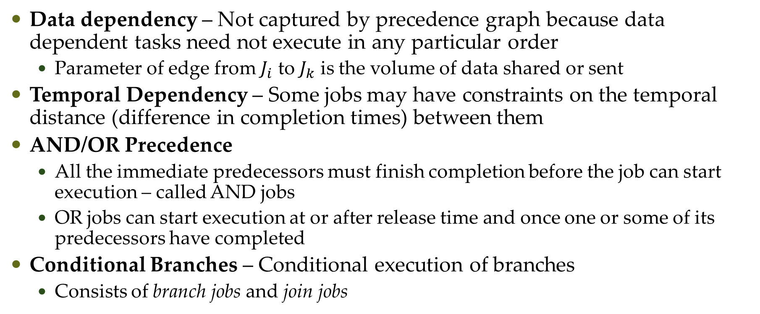
Types of Dependencies
Data dependency – Not captured by precedence graph because data dependent tasks need not execute in any particular order
Parameter of edge from $J_{i}$ to $J_{k}$ is the volume of data shared or sent
Temporal Dependency – Some jobs may have constraints on the temporal distance (difference in completion times) between them
AND/OR Precedence
All the immediate predecessors must finish completion before the job can start execution – called AND jobs
OR jobs can start execution at or after release time and once one or some of its predecessors have completed
Conditional Branches – Conditional execution of branches
Consists of branch jobs and join jobs

Slide 11
Resource Modeling

Slide 12
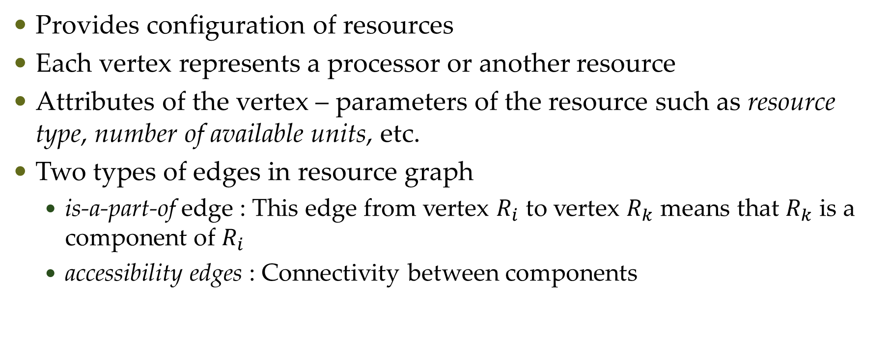
Resource Graph
Provides configuration of resources
Each vertex represents a processor or another resource
Attributes of the vertex – parameters of the resource such as resource type, number of available units, etc.
Two types of edges in resource graph
is-a-part-of edge : This edge from vertex $R_{i}$ to vertex $R_{k}$ means that $R_{k}$ is a component of $R_{i}$
accessibility edges : Connectivity between components

Slide 13
Scheduling and Resource Access Control

Slide 14
Scheduling
Jobs scheduled using scheduling algorithms
Jobs allocated resources using resource access-control protocols
Scheduler implements both the above algorithms
Scheduler assigns jobs to processors or other resources
Schedule: Assignment of jobs in the system on the available processors
Valid schedules:
Every processor is assigned to at most one job at any time
Every job is assigned at most one processor at any time
A job is scheduled only after release time
As per scheduling algorithm, the total amount of processor time assigned to a job is its maximum or actual execution time
Satisfies all the precedence and resource usage constraints

Slide 15
Feasibility and Optimality
A valid schedule is a feasible schedule if every job is finished by deadline or meets its timing constraints
Schedulability: A set of jobs is schedulable according to a scheduling algorithm if it always produces a feasible schedule
Optimality of a Scheduler: A scheduling algorithm is optimal if it always produces a feasible schedule of the jobs if there exists a feasible schedule
Scheduler may work on performance measures such as tardiness, lateness, response time, and miss, loss and invalid rates.

Slide 16
Questions?

