Slide 1

Lecture 5- Commonly used Scheduling Techniques (Chapter 4)
Deepak Gangadharan

Slide 2
FIFO scheduling
Disadvantages
Creates a non-preemptive schedule
Ignores tasks’ deadline and priority
Response times are heavily dependent on arrival times
Low schedulability
Advantages
Fast
Simple implementation
Low runtime overhead
Widely applied in network systems

Slide 3


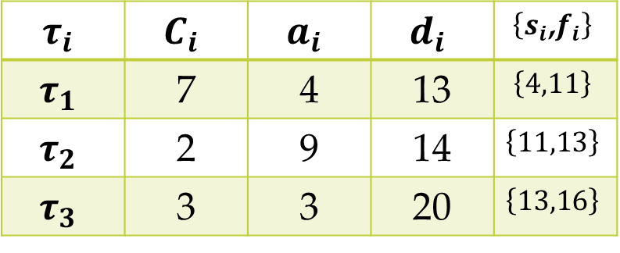


Clock-Driven Approach
Also called time-driven.
Scheduling decisions are made at specific time instants chosen a priori
All parameters of hard real-time jobs are fixed and known
Schedule computed offline and stored for use at run time – scheduling overhead minimized
$$τ_{1}$$
4
13
$$τ_{i}$$ | $$C_{i}$$ | $$a_{i}$$ | $$d_{i}$$ | $$\left\{s_{i}\text{,}f_{i}\right\}$$
$$τ_{1}$$ | 7 | 4 | 13 | $$\left\{4,11\right\}$$
$$τ_{2}$$ | 2 | 9 | 14 | $$\left\{11,13\right\}$$
$$τ_{3}$$ | 3 | 3 | 20 | $$\left\{13,16\right\}$$
$$τ_{2}$$
9
14
$$τ_{3}$$
$s_{i}$ - Start time, $f_{i}$ - Finish time
3
11
13
16
20

Slide 4
Clock-Driven Approach
One option – Scheduling at regularly spaced time instants or periodically
Timer used to make scheduling decisions periodically

Slide 5
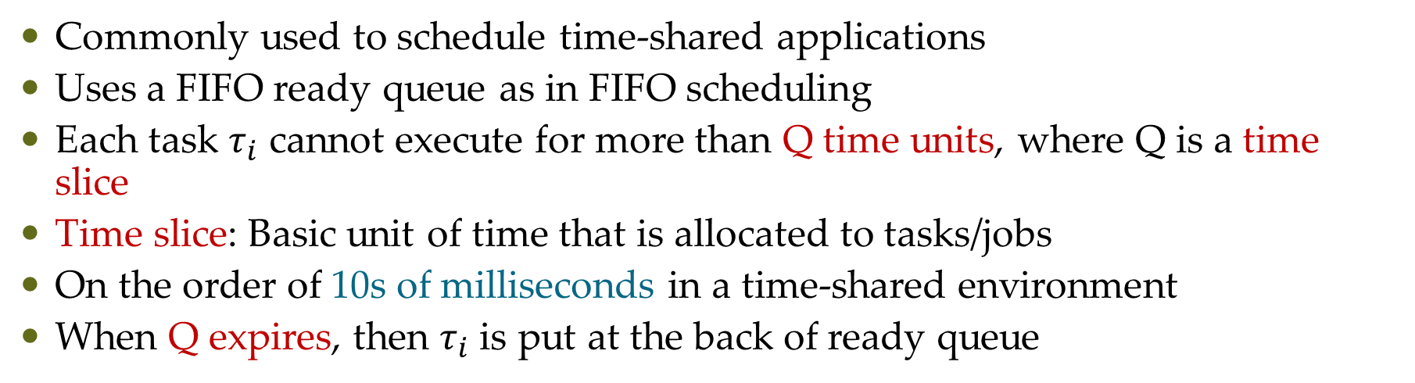
Round-Robin Approach
Commonly used to schedule time-shared applications
Uses a FIFO ready queue as in FIFO scheduling
Each task $τ_{i}$ cannot execute for more than Q time units, where Q is a time slice
Time slice: Basic unit of time that is allocated to tasks/jobs
On the order of 10s of milliseconds in a time-shared environment
When Q expires, then $τ_{i}$ is put at the back of ready queue
Source: http://www.st.ewi.tudelft.nl/mitra/teaching/rts/2019/files/lect03-scheduling-aperiodic.pdf

Slide 6







Round-Robin Approach
Let n be the number of tasks in the ready queue
Round length = n . Q
$$τ_{1}$$
$$C_{1}=4$$
8
16
$$τ_{2}$$
$$C_{2}=5$$
4
14
$$τ_{3}$$
$$C_{3}=3$$
6
13
CPU
2
2
2
3
2
3
3
1
2
3
4
5
6
7
Round

Slide 7
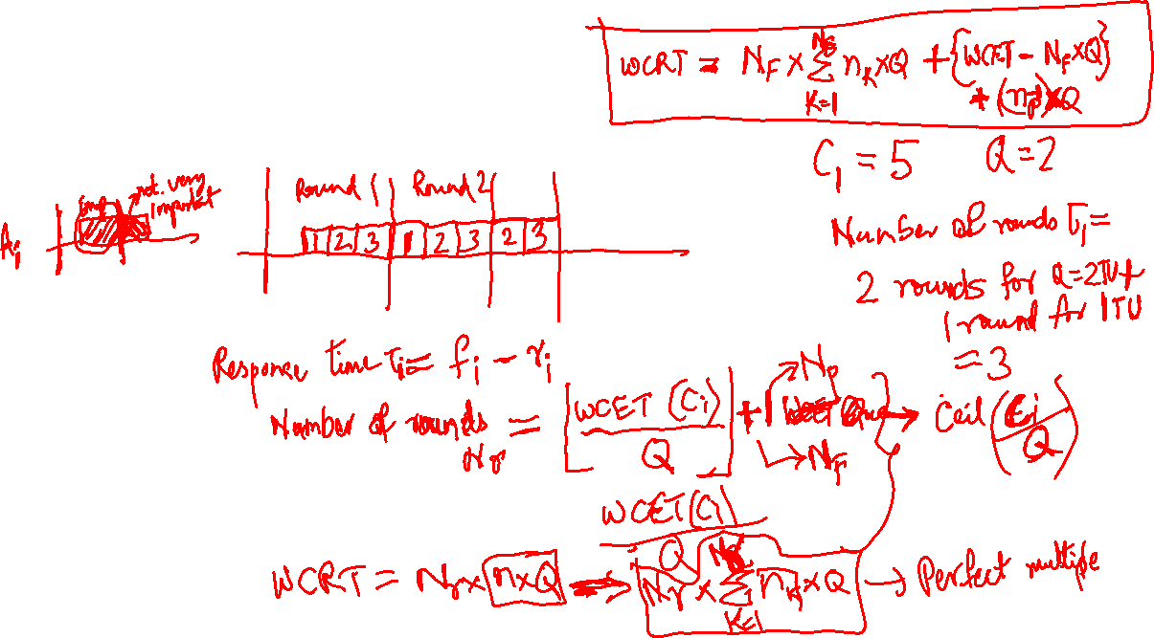
Round-Robin Approach
Worst-Case Response Time

Slide 8
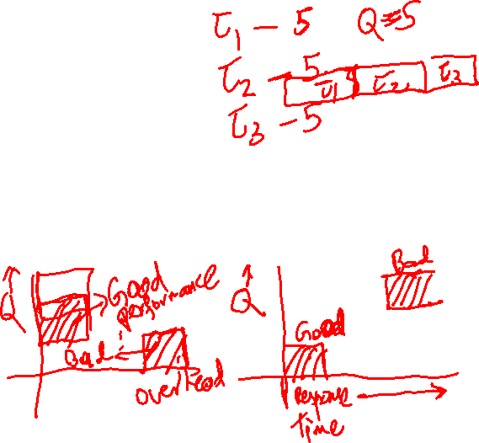
Round-Robin Approach
Performance Depends on Size of Q
Small Q => interleaved
Large Q is like FCFS
Q must be large with respect to context switch time, otherwise overhead is too high (spending most of your time context switching!)

Slide 9
Priority-Driven Approach
Scheduling decisions made during release or completion events – Event Driven
Class of algorithms, which does not leave any resource idle intentionally
Also called greedy scheduling/list scheduling/work-conserving scheduling
Example: Shortest Execution Time First (SETF), Longest Execution Time First (LETF)

Slide 10
Properties of Scheduling Algorithms
Preemptive vs Non-preemptive
Work-conserving vs non-work-conserving
Static vs Dynamic
Offline vs Online
Optimal vs Non-Optimal

Slide 11
Work-conserving vs non-work-conserving
Work-conserving
Such algorithm does not leave the processor idle as long as there is a ready task
Non-work-conserving
Such algorithm may leave the processor idle even if there is a ready task

Slide 12
Static vs Dynamic
Static
Scheduling decisions are taken based on fixed parameters, statically assigned to tasks before activation
Dynamic
Scheduling decisions are taken based on parameters that can change with time Example: Remaining execution time, absolute deadline

Slide 13
Offline vs Online
Offline
All scheduling decisions taken before task activation
Example: Table Driven Scheduling – Schedule stored in a table
Online
Scheduling decisions are taken at run time on the set of active tasks

Slide 14
Optimality Criteria
Feasibility: Find a feasible schedule if one exists
Minimize the maximum lateness
Minimize the number of deadline misses
Maximize the utility value of feasible tasks

Slide 15
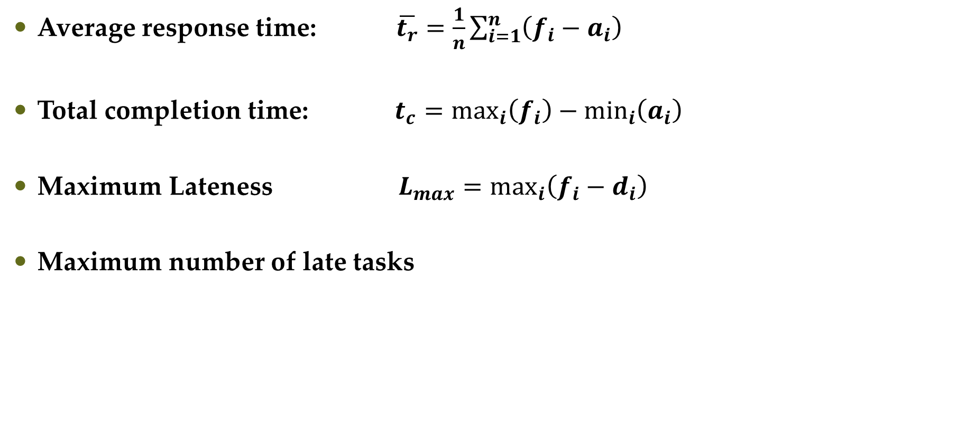
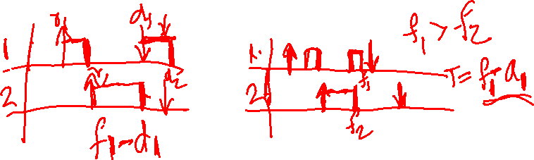
Common definitions for optimality criteria
Average response time: $\overline{t_{r}}=\frac{1}{n}\sum_{i=1}^{n}{\left(f_{i}−a_{i}\right)}$
Total completion time: $t_{c}=\max_{i}\left(f_{i}\right)−\min_{i}\left(a_{i}\right)$
Maximum Lateness $L_{max}=\max_{i}\left(f_{i}−d_{i}\right)$
Maximum number of late tasks

Slide 16
Questions?

