Slide 1

Lecture 7: Clock-Driven Scheduling (Chapter 5)
Deepak Gangadharan

Slide 2
Clock-Driven Scheduling – An Introduction
Applicable when the system is mostly deterministic
Could include few aperiodic or sporadic jobs

Slide 3
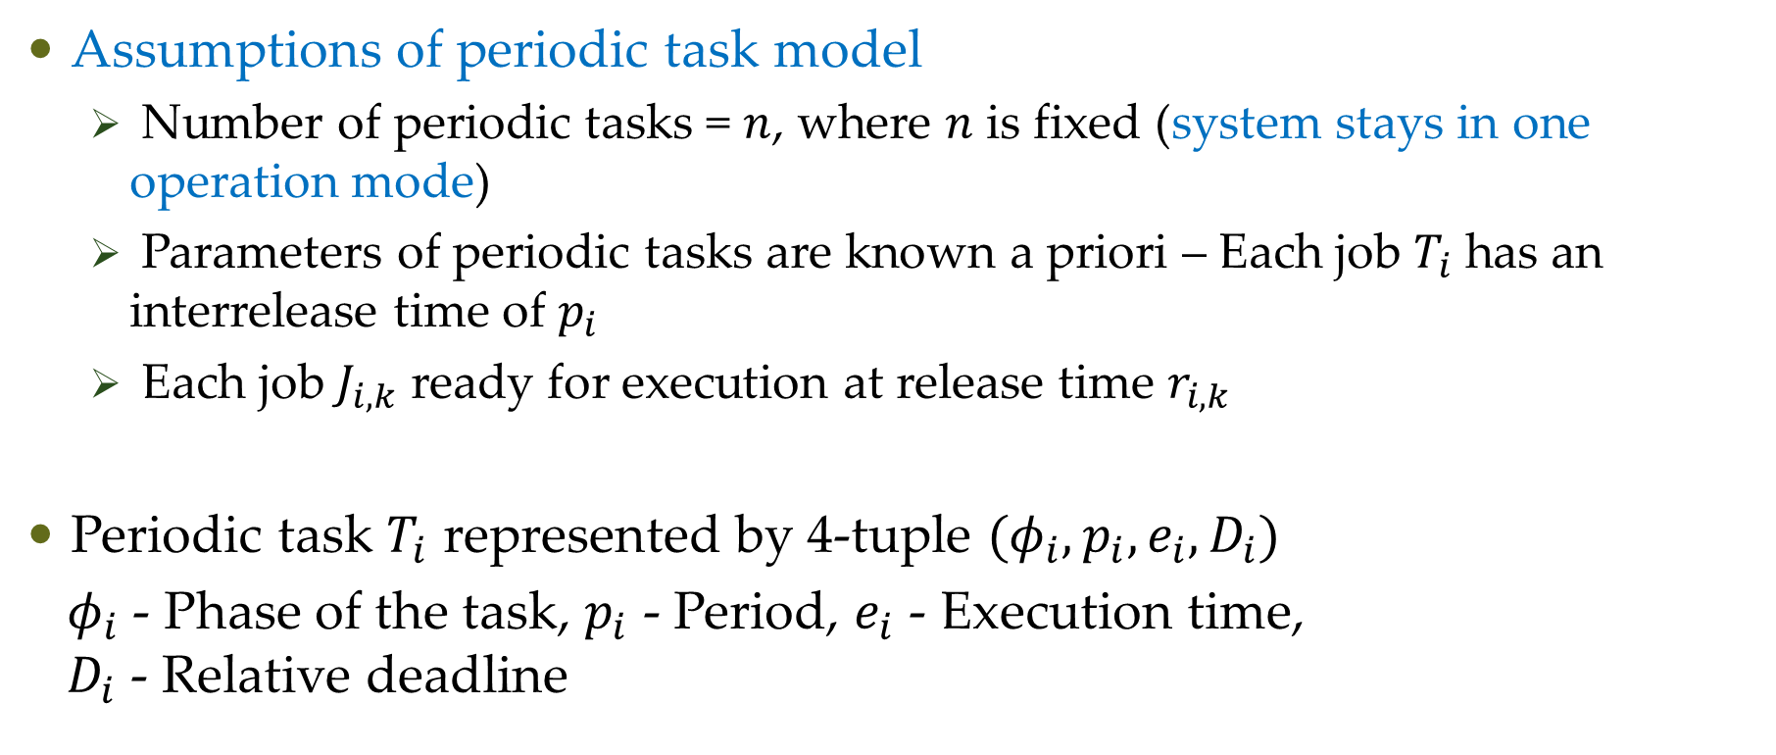
Clock-Driven Scheduling – Notations
Assumptions of periodic task model
Number of periodic tasks = $n$, where $n$ is fixed (system stays in one operation mode)
Parameters of periodic tasks are known a priori – Each job $T_{i}$ has an interrelease time of $p_{i}$
Each job $J_{i,k}$ ready for execution at release time $r_{i,k}$
Periodic task $T_{i}$ represented by 4-tuple $(φ_{i},p_{i},e_{i},D_{i})$
$φ_{i}$ - Phase of the task, $p_{i}$ - Period, $e_{i}$ - Execution time, $D_{i}$ - Relative deadline

Slide 4







Clock-Driven Scheduling
Example – Periodic Task (2,12,4,8) is shown below
$$φ_{i}=2$$
$$p_{i}=12$$
$$p_{i}=12$$
$$p_{i}=12$$
2
10
14
22
26
34
38
$$D_{i}=8$$
$$D_{i}=8$$
$$D_{i}=8$$
Utilization of the task = $\frac{e_{i}}{p_{i}}$ = $\frac{1}{3}$ (Measure of how busy the processor could be)

Slide 5
Static, Timer-Driven Scheduler
Assumption: OS maintains a queue for the aperiodic jobs and aperiodic jobs are placed in this queue when they are released
For jobs with hard deadlines
parameters are known a priori → Construct static schedule off-line
at run time, the scheduler dispatches the jobs according to the static schedule
if no job overruns, all deadlines are deterministically met
static schedule can be derived with sophisticated and complex algorithms

Slide 6
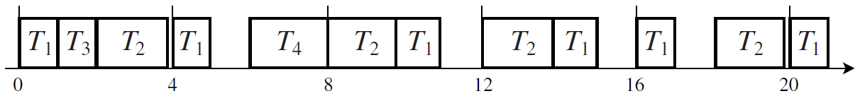
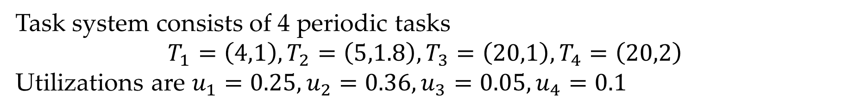

Static, Timer-Driven Scheduler
Task system consists of 4 periodic tasks $$T_{1}=\left(4,1\right), T_{2}=\left(5,1.8\right), T_{3}=\left(20,1\right), T_{4}=\left(20,2\right)$$ Utilizations are $u_{1}=0.25,u_{2}=0.36,u_{3}=0.05,u_{4}=0.1$
Intervals (3.8,4), (5,6), (10.8,12), (14.8,16), (17,18), (19.8,20) are not used and can be used to execute aperiodic jobs.

Slide 7
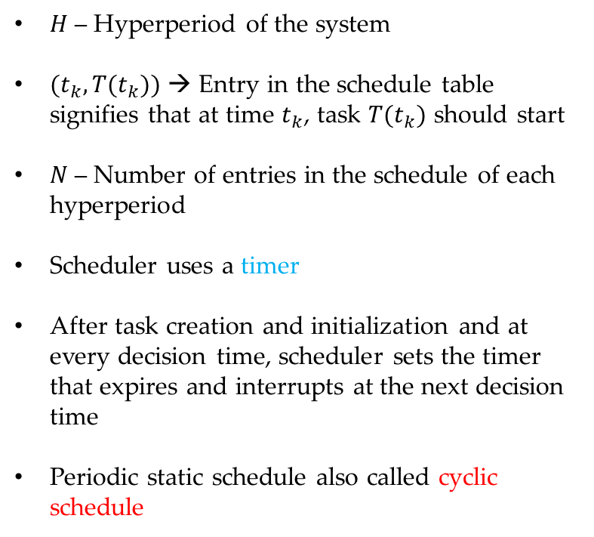
Static, Timer-Driven Scheduler
$H$ – Hyperperiod of the system
$(t_{k},T(t_{k}))$ → Entry in the schedule table signifies that at time $t_{k}$, task $T(t_{k})$ should start
$N$ – Number of entries in the schedule of each hyperperiod
Scheduler uses a timer
After task creation and initialization and at every decision time, scheduler sets the timer that expires and interrupts at the next decision time
Periodic static schedule also called cyclic schedule

Slide 8
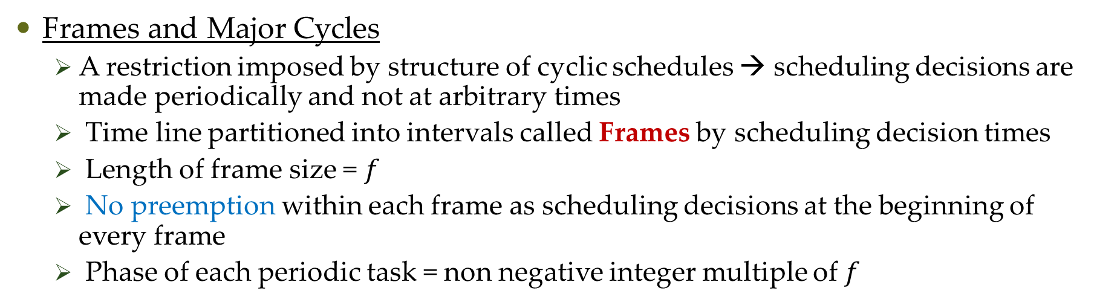
General Structure of Cyclic Schedules
Frames and Major Cycles
A restriction imposed by structure of cyclic schedules → scheduling decisions are made periodically and not at arbitrary times
Time line partitioned into intervals called Frames by scheduling decision times
Length of frame size = $f$
No preemption within each frame as scheduling decisions at the beginning of every frame
Phase of each periodic task = non negative integer multiple of $f$

Slide 9
General Structure of Cyclic Schedules
Scheduler must perform monitoring and enforcement actions at the beginning of each frame
Monitored aspects – task has released and ready for execution, any overrun

Slide 10
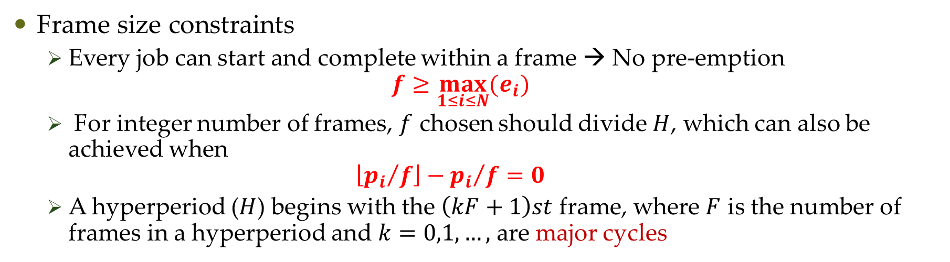
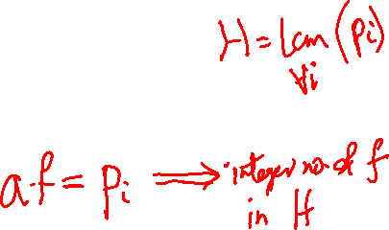
General Structure of Cyclic Schedules
Frame size constraints
Every job can start and complete within a frame → No pre-emption $f≥\max_{1≤i≤N}{{(e}_{i})}$
For integer number of frames, $f$ chosen should divide $H$, which can also be achieved when $\left\lfloor {p_{i}}/f\right\rfloor −{p_{i}}/f=0$
A hyperperiod ($H$) begins with the $\left(kF+1\right)st$ frame, where $F$ is the number of frames in a hyperperiod and $k=0,1,…,$ are major cycles

Slide 11
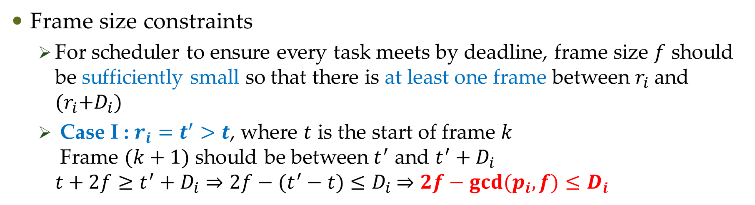
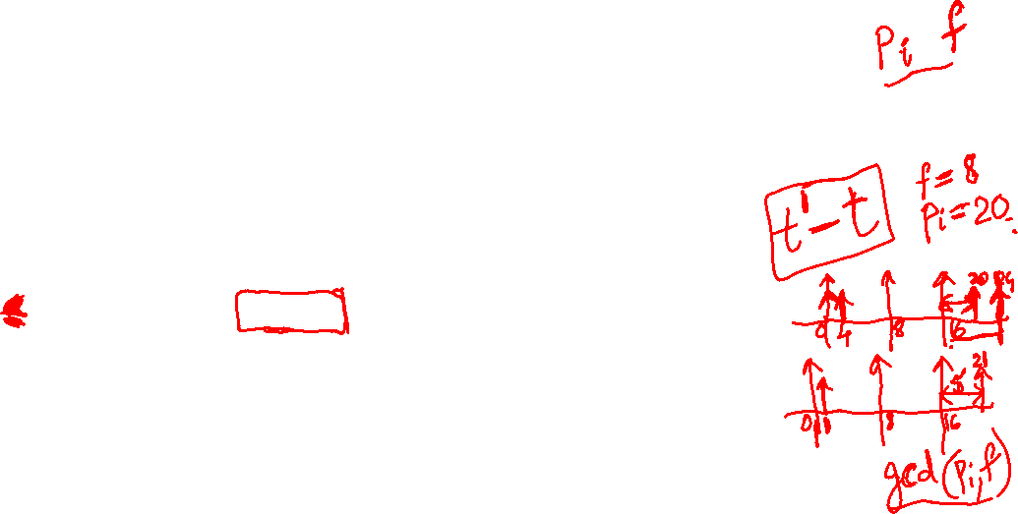
General Structure of Cyclic Schedules
Frame size constraints
For scheduler to ensure every task meets by deadline, frame size $f$ should be sufficiently small so that there is at least one frame between $r_{i}$ and ${(r}_{i}+D_{i})$
Case I : $r_{i}=t^{′}>t$, where $t$ is the start of frame $k$ Frame $(k+1)$ should be between $t^{′}$ and $t^{′}+D_{i}$ $t+2f≥t^{′}+D_{i}⇒2f−(t^{′}−t)≤D_{i}$ $⇒2f−gcd(p_{i},f)≤D_{i}$

Slide 12
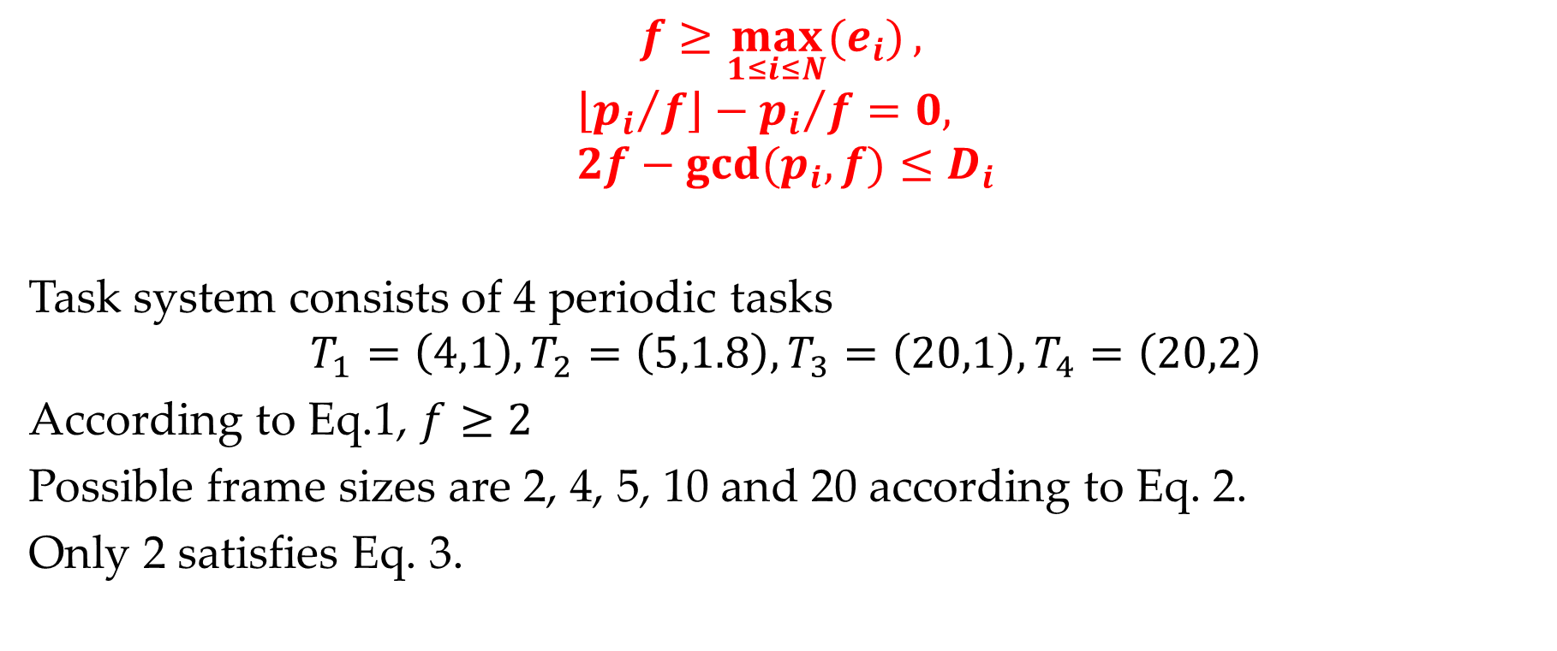
General Structure of Cyclic Schedules
$$f≥\max_{1≤i≤N}{{(e}_{i})},$$
$$\left\lfloor {p_{i}}/f\right\rfloor −{p_{i}}/f=0, \\ 2f−gcd(p_{i},f)≤D_{i}$$
Task system consists of 4 periodic tasks $$T_{1}=\left(4,1\right), T_{2}=\left(5,1.8\right), T_{3}=\left(20,1\right), T_{4}=\left(20,2\right)$$
According to Eq.1, $f≥2$
Possible frame sizes are 2, 4, 5, 10 and 20 according to Eq. 2.
Only 2 satisfies Eq. 3.

Slide 13
Cyclic Schedule
Problems
What to do with overruns Let the task continue → Can have domino effect on all other tasks Abort the task → Can lead to inconsistent system states
Cannot expand the schedule or change the code

Slide 14
Questions?

