Slide 1

Lecture 10: Priority-Driven Scheduling (Chapter 6)
Deepak Gangadharan

Slide 2
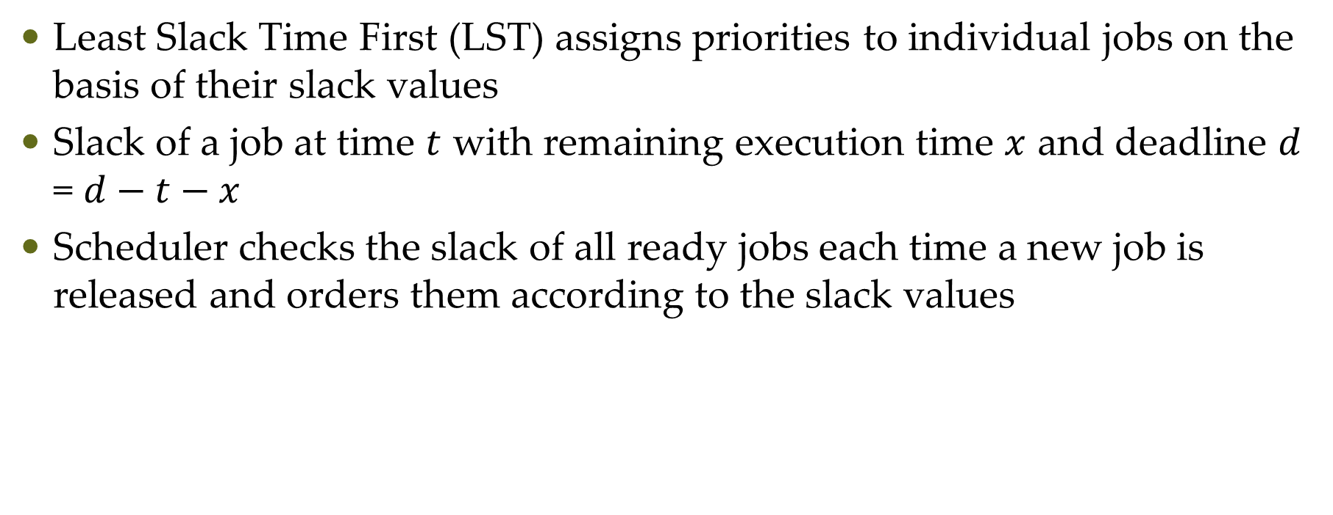
Least Slack Time First Scheduling - Recap
Least Slack Time First (LST) assigns priorities to individual jobs on the basis of their slack values
Slack of a job at time $t$ with remaining execution time $x$ and deadline $d$ = $d−t−x$
Scheduler checks the slack of all ready jobs each time a new job is released and orders them according to the slack values

Slide 3

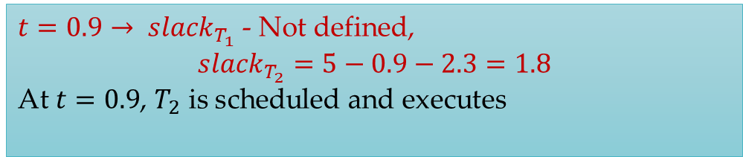
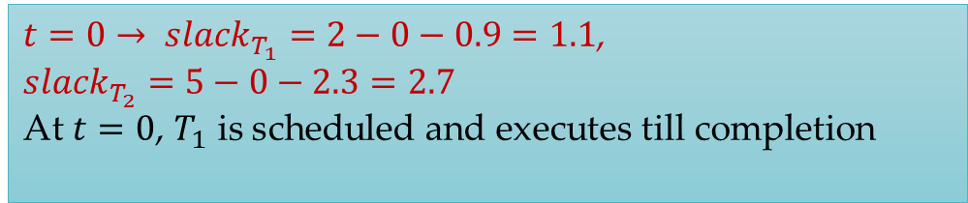
Least Slack Time First Scheduling – Example 1
Slack of a job at time $t$ with remaining execution time $x$ and deadline $d$ = $d−t−x$
Task system $T_{1}(2,0.9)$ and $T_{2}(5,2.3)$
LST scheduling
$t=0→ {slack}_{T_{1}}=2−0−0.9=1.1$, ${slack}_{T_{2}}=5−0−2.3=2.7$ At $t=0$, $T_{1}$ is scheduled and executes till completion
$t=0.9→ {slack}_{T_{1}}$ - Not defined, $${slack}_{T_{2}}=5−0.9−2.3=1.8$$ At $t=0.9$, $T_{2}$ is scheduled and executes
EDF scheduling

Slide 4

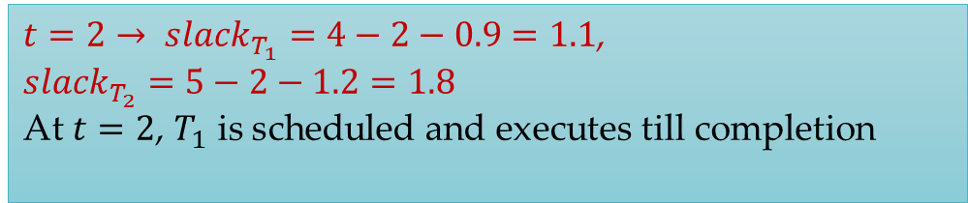
Least Slack Time First Scheduling – Example 1
Slack of a job at time $t$ with remaining execution time $x$ and deadline $d$ = $d−t−x$
Task system $T_{1}(2,0.9)$ and $T_{2}(5,2.3)$
LST scheduling
$t=2→ {slack}_{T_{1}}=4−2−0.9=1.1$, ${slack}_{T_{2}}=5−2−1.2=1.8$ At $t=2$, $T_{1}$ is scheduled and executes till completion
$t=2.9→ {slack}_{T_{1}}$ - Not defined, $${slack}_{T_{2}}=5−2.9−1.2=0.9$$ At $t=2.9$, $T_{2}$ is scheduled and executes
EDF scheduling

Slide 5
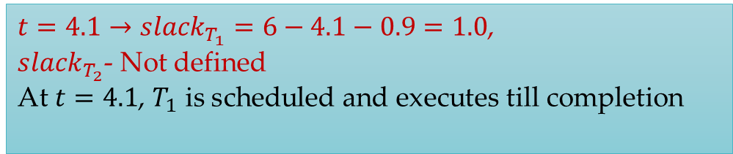
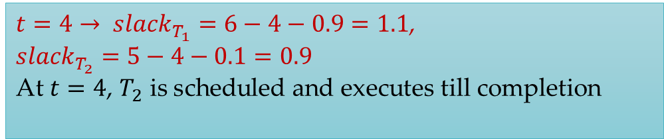
Least Slack Time First Scheduling – Example 1
Slack of a job at time $t$ with remaining execution time $x$ and deadline $d$ = $d−t−x$
Task system $T_{1}(2,0.9)$ and $T_{2}(5,2.3)$
LST scheduling
Same as EDF schedule
$t=4→ {slack}_{T_{1}}=6−4−0.9=1.1$, ${slack}_{T_{2}}=5−4−0.1=0.9$ At $t=4$, $T_{2}$ is scheduled and executes till completion
$t=4.1→{slack}_{T_{1}}=6−4.1−0.9=1.0$, ${slack}_{T_{2}}$- Not defined At $t=4.1$, $T_{1}$ is scheduled and executes till completion
EDF scheduling

Slide 6

Least Slack Time First Scheduling – Example 2
Slack of a job at time $t$ with remaining execution time $x$ and deadline $d$ = $d−t−x$
Task system $T_{1}(2,0.8)$, $T_{2}(5,1.5)$, $T_{3}(5.1,1.5)$

Slide 7

Least Slack Time First Scheduling – Example 2
Task system $T_{1}(2,0.8)$, $T_{2}(5,1.5)$, $T_{3}(5.1,1.5)$
0
1
2
3
4
5
6
At $t=0, {slack}_{T_{1}}=2−0−0.8=1.2,{slack}_{T_{2}}=5−0−1.5=3.5,{slack}_{T_{3}}=5.1−0−1.5=3.6$ At $t=0,$ $T_{1}$ is scheduled

Slide 8
Least Slack Time First Scheduling – Example 2
Task system $T_{1}(2,0.8)$, $T_{2}(5,1.5)$, $T_{3}(5.1,1.5)$
0
1
2
3
4
5
6
At $t=0.8, {slack}_{T_{1}}=undefined,{slack}_{T_{2}}=5−0.8−1.5=2.7,{slack}_{T_{3}}=5.1−0.8−1.5=2.8$ At $t=0.8,$ $T_{2}$ is scheduled

Slide 9
Least Slack Time First Scheduling – Example 2
Task system $T_{1}(2,0.8)$, $T_{2}(5,1.5)$, $T_{3}(5.1,1.5)$
Different from EDF
LST is job level dynamic priority algorithm
EDF is job level fixed priority algorithm
0
1
2
3
4
5
6
At $t=2, {slack}_{T_{1}}=4−2−0.8=1.2,{slack}_{T_{2}}=5−2−0.3=2.7,{slack}_{T_{3}}=5.1−2−1.5=1.6$ At $t=2,$ $T_{1}$ is scheduled, but $T_{3}$ has now more priority than $T_{2}$

Slide 10
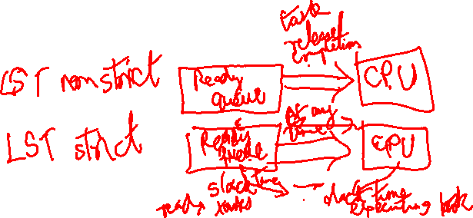
Least Slack Time First Scheduling
We saw a nonstrict version of LST algorithm until now – Scheduling decision or slacks are checked when a job is released/completes
The strict version of the LST algorithm will check for the slacks of all ready jobs and executing job at every time instant
If there is any ready job which has lower slack than executing job, then the ready job pre-empts the executing job.

Slide 11

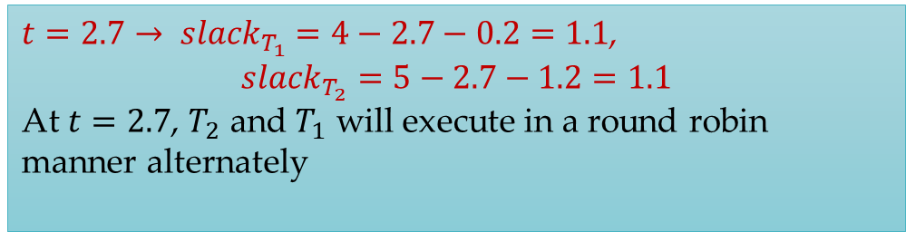
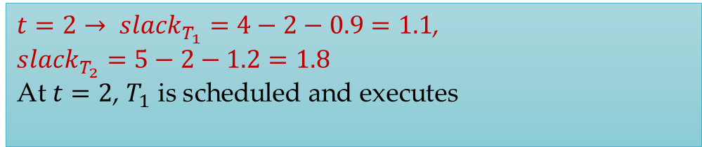
Least Slack Time First Scheduling – Example 1
Task system $T_{1}(2,0.9)$ and $T_{2}(5,2.3)$
LST strict scheduling
$t=2→ {slack}_{T_{1}}=4−2−0.9=1.1$, ${slack}_{T_{2}}=5−2−1.2=1.8$ At $t=2$, $T_{1}$ is scheduled and executes
$t=2.7→ {slack}_{T_{1}}$ $=4−2.7−0.2=1.1$, $${slack}_{T_{2}}=5−2.7−1.2=1.1$$ At $t=2.7$, $T_{2}$ and $T_{1}$ will execute in a round robin manner alternately
EDF scheduling

Slide 12
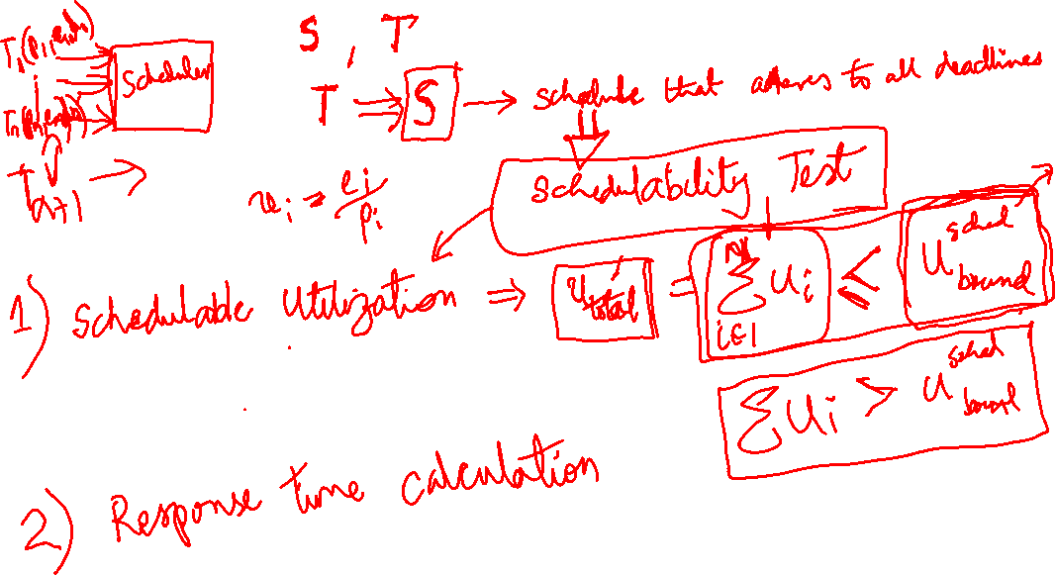

Slide 13
Questions?

