Slide 1

Lecture 11: Priority-Driven Scheduling (Chapter 6)
Deepak Gangadharan

Slide 2
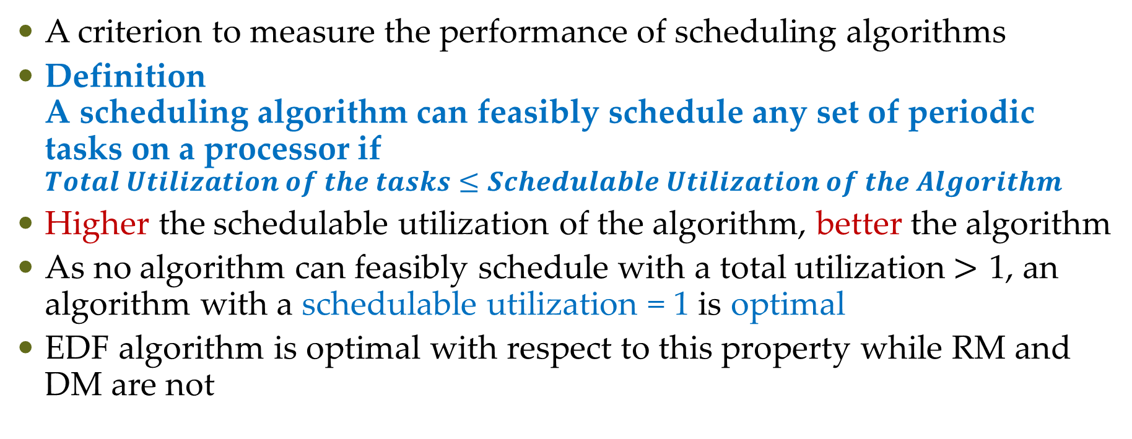
Schedulable Utilization
A criterion to measure the performance of scheduling algorithms
Definition A scheduling algorithm can feasibly schedule any set of periodic tasks on a processor if $Total Utilization of the tasks≤Schedulable Utilization of the Algorithm$
Higher the schedulable utilization of the algorithm, better the algorithm
As no algorithm can feasibly schedule with a total utilization$>$ 1, an algorithm with a schedulable utilization = 1 is optimal
EDF algorithm is optimal with respect to this property while RM and DM are not

Slide 3
Schedulable Utilization
In terms of schedulable utilization, optimal dynamic priority algorithms perform better than fixed priority algorithms
But timing behaviour of a system scheduled using a fixed priority algorithm is more predictable
In fixed priority algorithms, overruns of jobs in a task can never affect higher priority tasks → possible to predict which tasks miss deadlines

Slide 4
Schedulable Utilization
In terms of schedulable utilization, optimal dynamic priority algorithms perform better than fixed priority algorithms
But timing behaviour of a system scheduled using a fixed priority algorithm is more predictable
In fixed priority algorithms, overruns of jobs in a task can never affect higher priority tasks → possible to predict which tasks miss deadlines
Difficult to predict which tasks will miss deadlines in dynamic priority algorithms during overruns

Slide 5
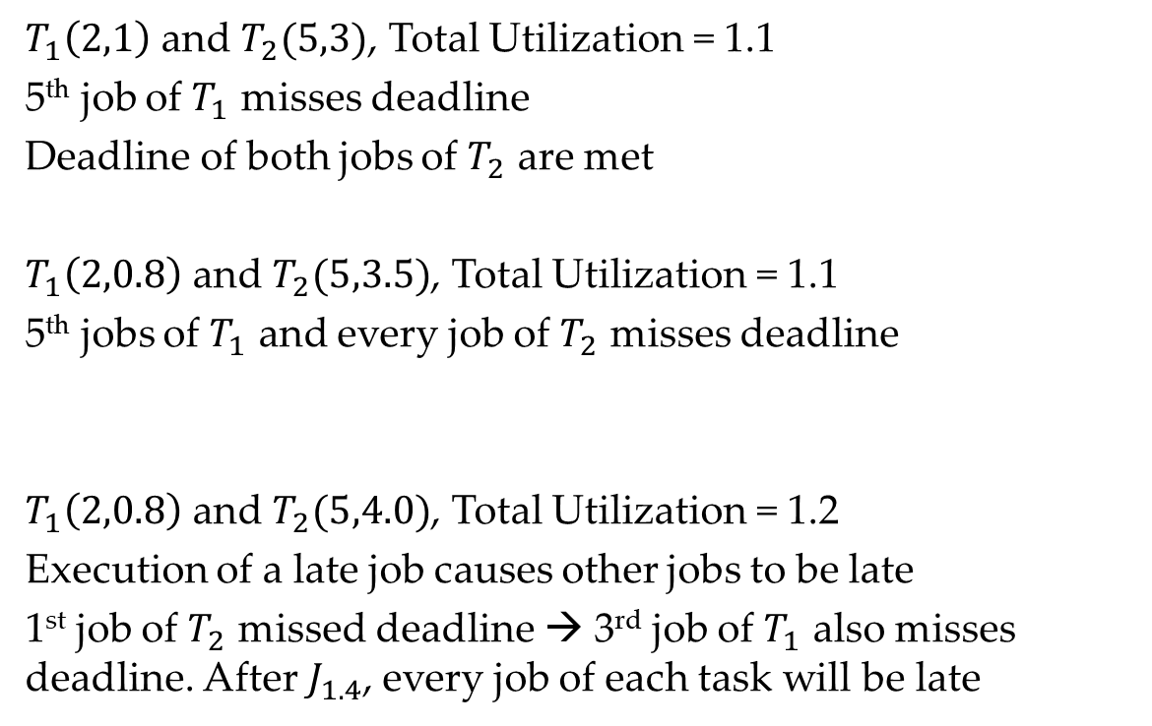
Unpredictability of EDF algorithm
$T_{1}\left(2,1\right)$ and $T_{2}(5,3)$, Total Utilization = 1.1
5th job of $T_{1}$ misses deadline
Deadline of both jobs of $T_{2}$ are met
$T_{1}\left(2,0.8\right)$ and $T_{2}(5,3.5)$, Total Utilization = 1.1
5th jobs of $T_{1}$ and every job of $T_{2}$ misses deadline
$T_{1}\left(2,0.8\right)$ and $T_{2}(5,4.0)$, Total Utilization = 1.2
Execution of a late job causes other jobs to be late
1st job of $T_{2}$ missed deadline → 3rd job of $T_{1}$ also misses deadline. After $J_{1.4}$, every job of each task will be late

Slide 6
Maximum Schedulable Utilization
A system is schedulable by an algorithm if the algorithm always produces a feasible schedule
A system is schedulable if it is schedulable by some algorithm
Question: How large can the total utilization of the system be for the system to be definitively schedulable?

Slide 7
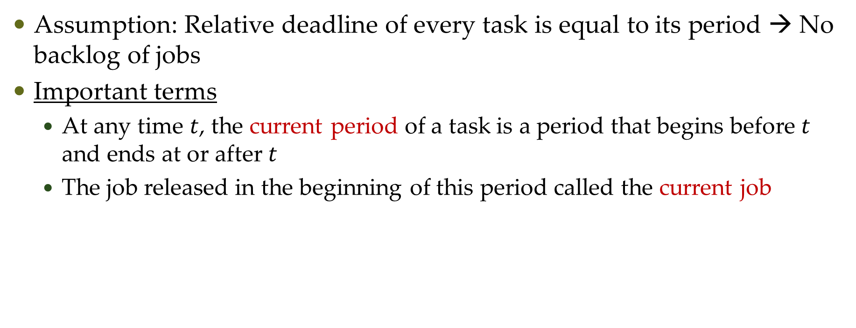

Schedulable Utilization of EDF Algorithm
Assumption: Relative deadline of every task is equal to its period → No backlog of jobs
Important terms
At any time $t$, the current period of a task is a period that begins before $t$ and ends at or after $t$
The job released in the beginning of this period called the current job

Slide 8
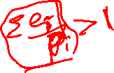
Schedulable Utilization of EDF Algorithm
Theorem A system T of independent, preemptable tasks with relative deadlines equal to periods can be feasibly scheduled on one processor iff its total utilization is equal to or less than 1.
Proof
System is not feasible with total utilization larger than 1 is obvious.
EDF known to produce feasible schedule if exists.
Sufficient to prove that EDF can produce feasible schedule of any system with total utilization = 1
Done by showing that if according to EDF schedule, the system fails to meet deadlines, then its total utilization is larger than 1

Slide 9
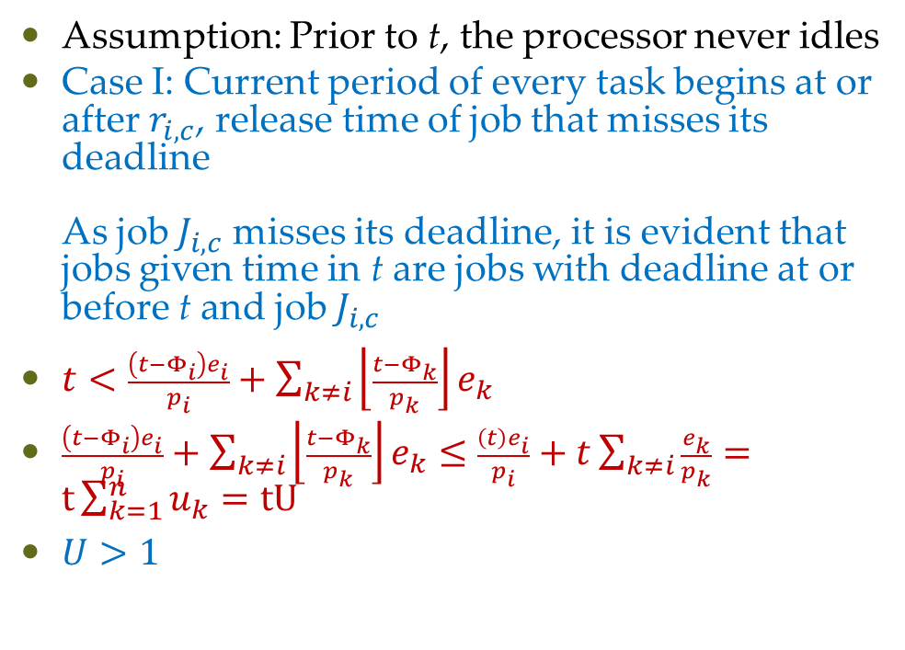

Schedulable Utilization of EDF Algorithm
Assumption: Prior to t, the processor never idles
Case I: Current period of every task begins at or after $r_{i,c}$, release time of job that misses its deadline As job $J_{i,c}$ misses its deadline, it is evident that jobs given time in t are jobs with deadline at or before t and job $J_{i,c}$
$t<\frac{\left(t−Φ_{i}\right)e_{i}}{p_{i}}+\sum_{k≠i}{\left\lfloor \frac{t−Φ_{k}}{p_{k}}\right\rfloor e_{k}}$
$\frac{\left(t−Φ_{i}\right)e_{i}}{p_{i}}+\sum_{k≠i}{\left\lfloor \frac{t−Φ_{k}}{p_{k}}\right\rfloor e_{k}}≤$ $\frac{\left(t\right)e_{i}}{p_{i}}+t\sum_{k≠i}{\frac{e_{k}}{p_{k}}}=t\sum_{k=1}^{n}{u_{k}}=tU$
$U>1$

Slide 10
Questions?

