Slide 1

Lecture 12: Priority-Driven Scheduling (Chapter 6)
Deepak Gangadharan

Slide 2
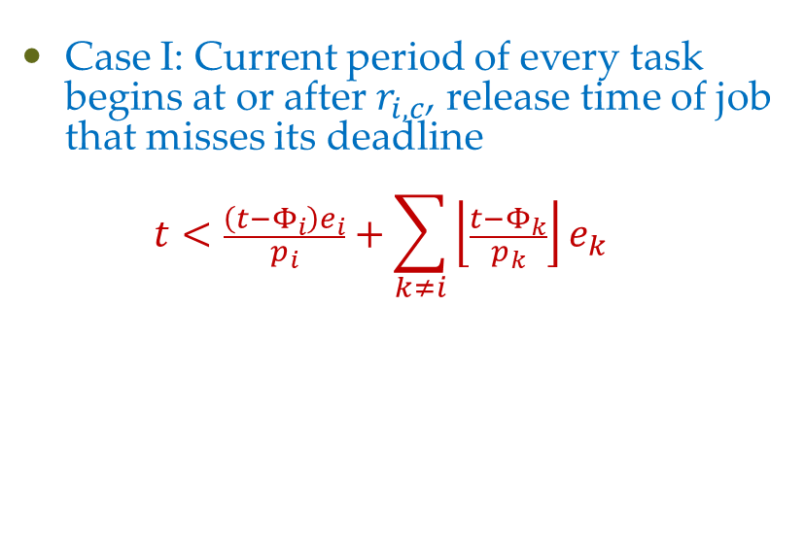
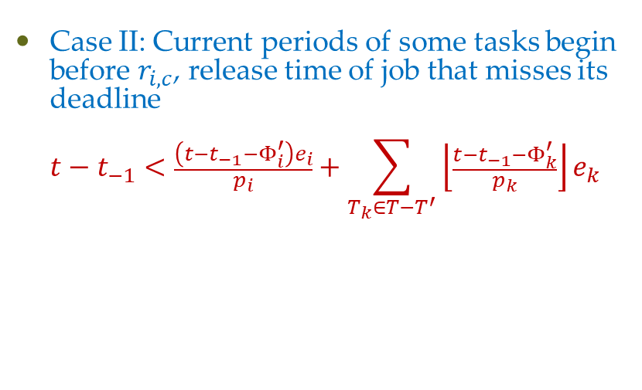
Schedulable Utilization of EDF Algorithm
Case I: Current period of every task begins at or after $r_{i,c}$, release time of job that misses its deadline $t<\frac{\left(t−Φ_{i}\right)e_{i}}{p_{i}}+\sum_{k≠i}{\left\lfloor \frac{t−Φ_{k}}{p_{k}}\right\rfloor e_{k}}$
Case II: Current periods of some tasks begin before $r_{i,c}$, release time of job that misses its deadline $t−t_{−1}<\frac{\left(t−t_{−1}−Φ_{i}^{′}\right)e_{i}}{p_{i}}+\sum_{T_{k}∈T−T^{′}}{\left\lfloor \frac{t−t_{−1}−Φ_{k}^{′}}{p_{k}}\right\rfloor e_{k}}$

Slide 3
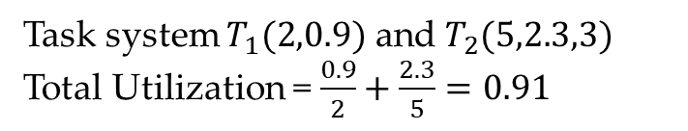
Facts from the Schedulable Utilization of EDF
Schedulable utilization of n independent, preemptable periodic tasks with relative deadlines equal to or longer than periods is equal to 1
Schedulable utilization of LST algorithm is also 1
System may not be schedulable if relative deadlines of tasks less than their periods even if total utilization < 1
Deadline miss
Task system $T_{1}(2,0.9)$ and $T_{2}(5,2.3,3)$
Total Utilization = $\frac{0.9}{2}+\frac{2.3}{5}=0.91$
0
1
2
3
4
5
6

Slide 4
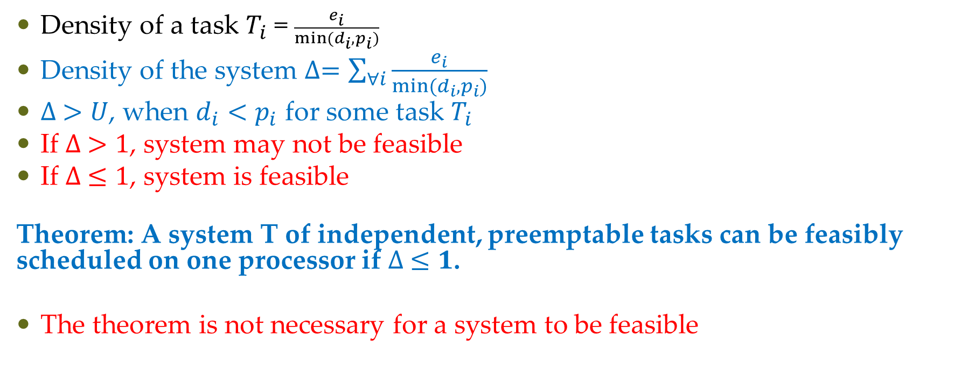
Facts from the Schedulable Utilization of EDF
Density of a task $T_{i}$ = $\frac{e_{i}}{min⁡(d_{i},p_{i})}$
Density of the system $∆=\sum_{∀i}{\frac{e_{i}}{min⁡(d_{i},p_{i})}}$
$∆ >U$, when $d_{i}<p_{i}$ for some task $T_{i}$
If $∆ >1$, system may not be feasible
If $∆ ≤1$, system is feasible
Theorem: A system T of independent, preemptable tasks can be feasibly scheduled on one processor if $∆ ≤1$.
The theorem is not necessary for a system to be feasible

Slide 5


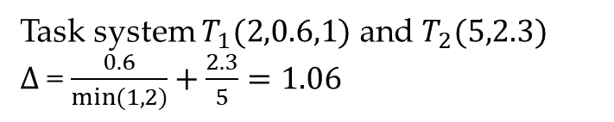
Facts from the Schedulable Utilization of EDF
A system may be feasible when $∆ >1$
$$T_{1}$$
Task system $T_{1}(2,0.6,1)$ and $T_{2}(5,2.3)$
$∆$= $\frac{0.6}{min⁡(1,2)}+\frac{2.3}{5}=1.06$
$$T_{2}$$
0
1
2
3
4
5
6
7

Slide 6
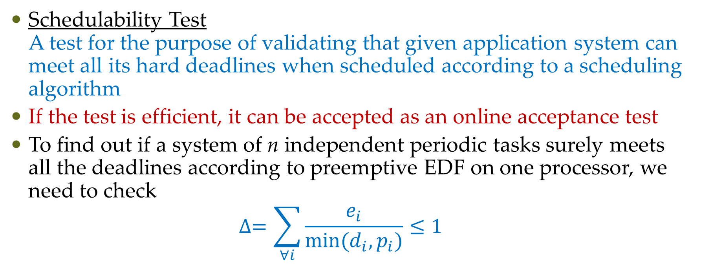
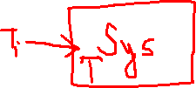
Schedulability test for EDF
Schedulability Test A test for the purpose of validating that given application system can meet all its hard deadlines when scheduled according to a scheduling algorithm
If the test is efficient, it can be accepted as an online acceptance test
To find out if a system of n independent periodic tasks surely meets all the deadlines according to preemptive EDF on one processor, we need to check $∆=\sum_{∀i}{\frac{e_{i}}{min⁡(d_{i},p_{i})}≤1}$

Slide 7
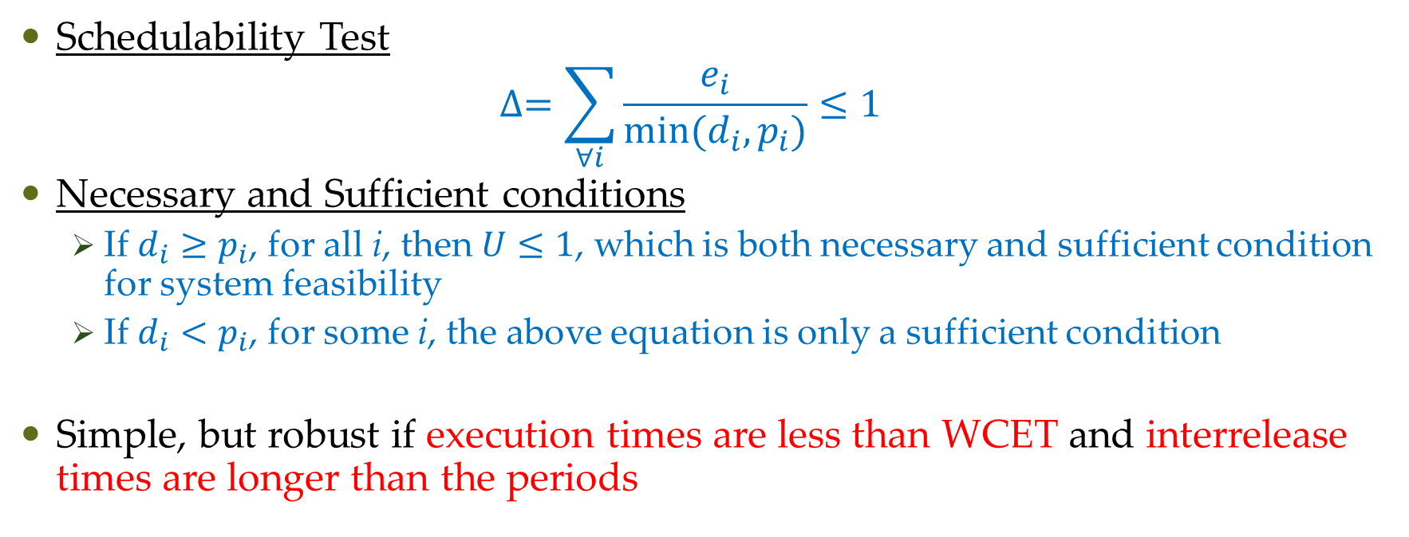
Schedulability test for EDF
Schedulability Test $∆=\sum_{∀i}{\frac{e_{i}}{min⁡(d_{i},p_{i})}≤1}$
Necessary and Sufficient conditions
If $d_{i}≥p_{i}$, for all i, then $U≤1$, which is both necessary and sufficient condition for system feasibility
If $d_{i}<p_{i}$, for some i, the above equation is only a sufficient condition
Simple, but robust if execution times are less than WCET and interrelease times are longer than the periods

Slide 8
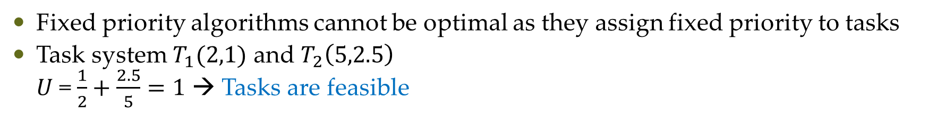
Optimality of RM and DM
Fixed priority algorithms cannot be optimal as they assign fixed priority to tasks
Task system $T_{1}(2,1)$ and $T_{2}\left(5,2.5\right)$ $U$= $\frac{1}{2}+\frac{2.5}{5}=1$ → Tasks are feasible
Deadline miss
0
1
2
3
4
5
6

Slide 9
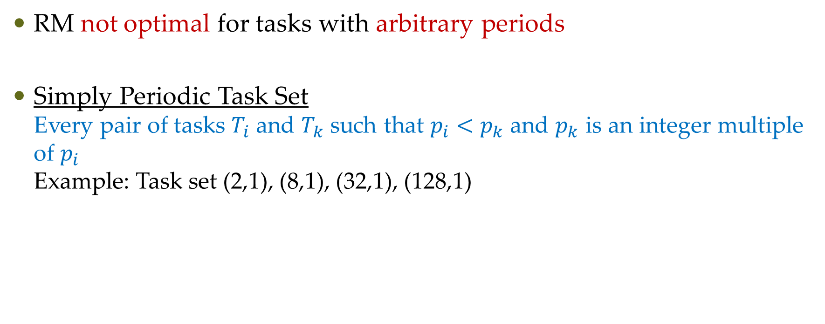
Optimality of RM
RM not optimal for tasks with arbitrary periods
Simply Periodic Task Set Every pair of tasks $T_{i}$ and $T_{k}$ such that $p_{i}<p_{k}$ and $p_{k}$ is an integer multiple of $p_{i}$ Example: Task set (2,1), (8,1), (32,1), (128,1)

Slide 10
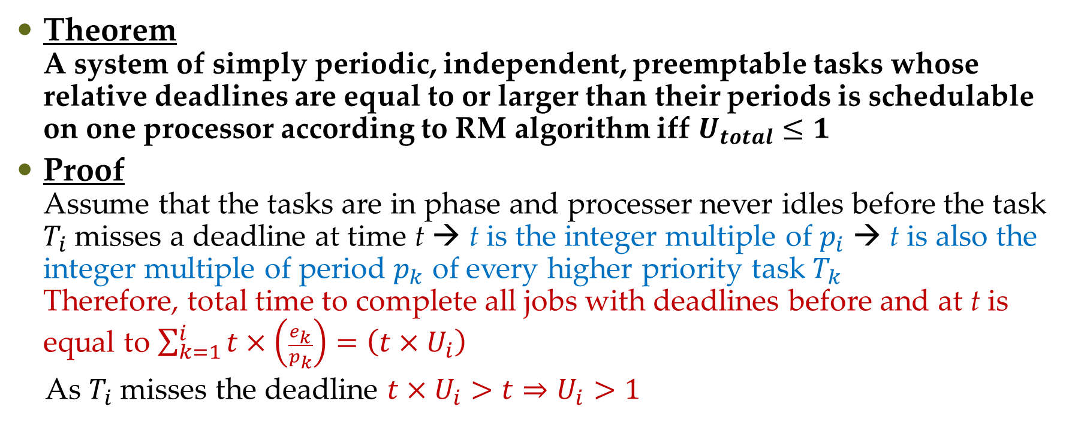
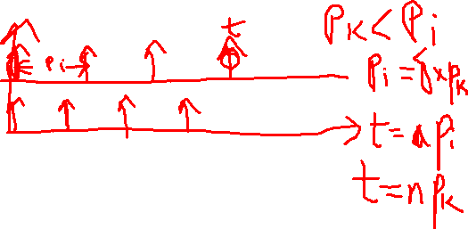
Optimality of RM
Theorem A system of simply periodic, independent, preemptable tasks whose relative deadlines are equal to or larger than their periods is schedulable on one processor according to RM algorithm iff $U_{total}≤1$
Proof Assume that the tasks are in phase and processer never idles before the task $T_{i}$ misses a deadline at time t → t is the integer multiple of $p_{i}$ → t is also the integer multiple of period $p_{k}$ of every higher priority task $T_{k}$ Therefore, total time to complete all jobs with deadlines before and at t is equal to $\sum_{k=1}^{i}{t×\left(\frac{e_{k}}{p_{k}}\right)}=\left(t×U_{i}\right)$
As $T_{i}$ misses the deadline $t×U_{i}>t⇒U_{i}>1$

Slide 11
Optimality of DM
Optimal fixed priority algorithm
Theorem A system T of independent, preemptable periodic tasks that are in phase and have relative deadlines equal to or less than their respective periods can be feasibly scheduled on one processor according to the DM algorithm whenever it can be feasibly scheduled by any other fixed-priority algorithm

Slide 12
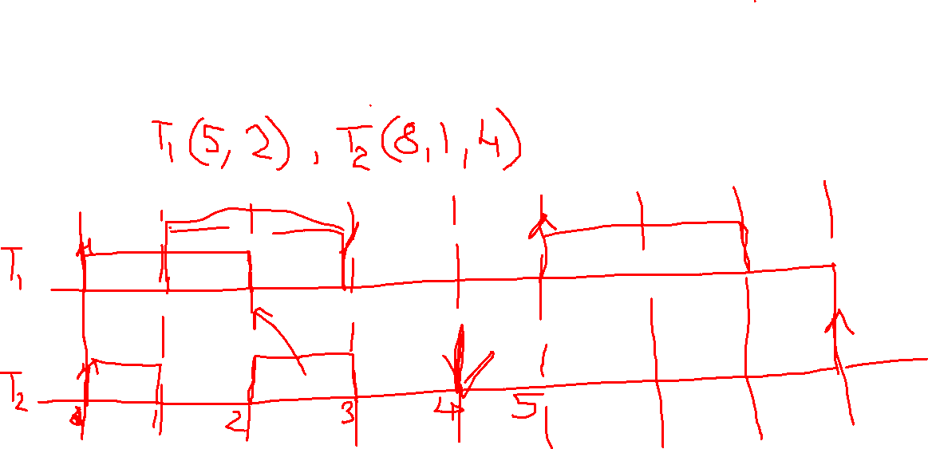
Optimality of DM

Slide 13
Questions?

