Slide 1

Lecture 13: Priority-Driven Scheduling (Chapter 6)
Deepak Gangadharan

Slide 2
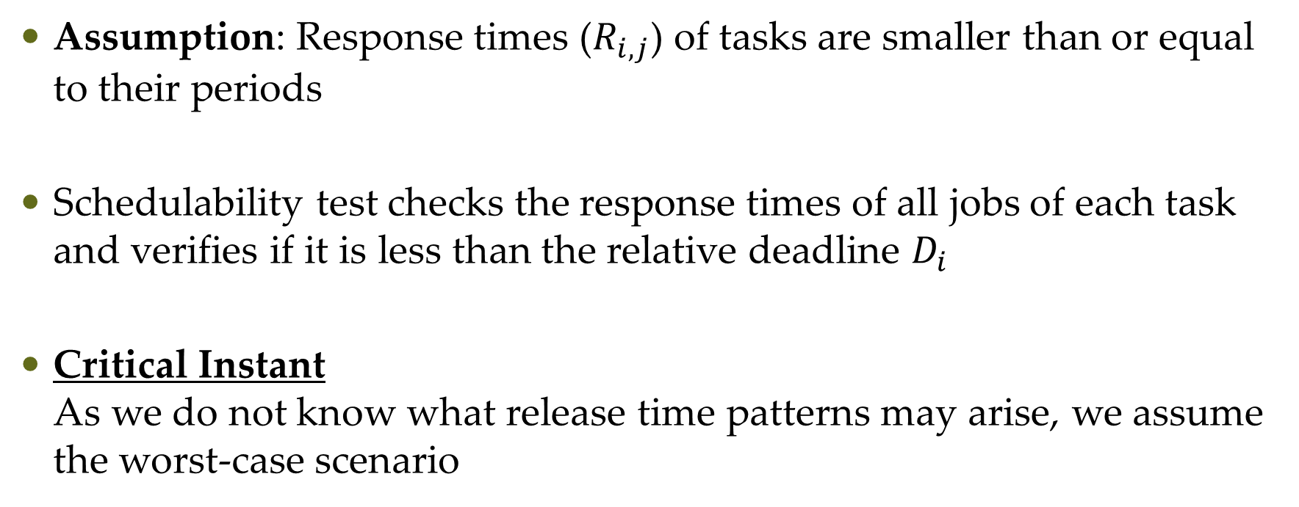
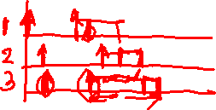
Schedulability Test for FP tasks with Short Response Times
Assumption: Response times ($R_{i,j}$) of tasks are smaller than or equal to their periods
Schedulability test checks the response times of all jobs of each task and verifies if it is less than the relative deadline $D_{i}$
Critical Instant As we do not know what release time patterns may arise, we assume the worst-case scenario

Slide 3
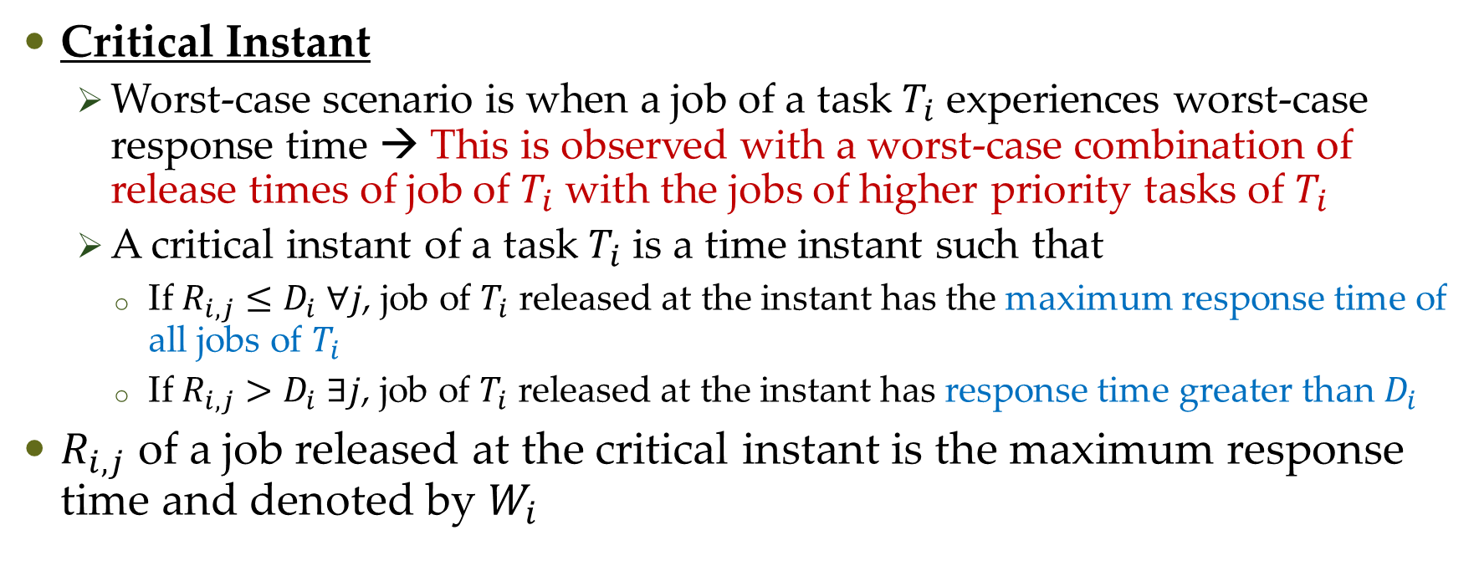

Schedulability Test for FP tasks with Short Response Times
Critical Instant
Worst-case scenario is when a job of a task $T_{i}$ experiences worst-case response time → This is observed with a worst-case combination of release times of job of $T_{i}$ with the jobs of higher priority tasks of $T_{i}$
A critical instant of a task $T_{i}$ is a time instant such that
If $R_{i,j}≤D_{i} ∀j$, job of $T_{i}$ released at the instant has the maximum response time of all jobs of $T_{i}$
If $R_{i,j}>D_{i} ∃j$, job of $T_{i}$ released at the instant has response time greater than $D_{i}$
$R_{i,j}$ of a job released at the critical instant is the maximum response time and denoted by $W_{i}$

Slide 4
Schedulability Test for FP tasks with Short Response Times
Critical Instant
Worst-case scenario is when a job of a task $T_{i}$ experiences worst-case response time → This is observed with a worst-case combination of release times of job of $T_{i}$ with the jobs of higher priority tasks of $T_{i}$
A critical instant of a task $T_{i}$ is a time instant such that
If $R_{i,j}≤D_{i} ∀j$, job of $T_{i}$ released at the instant has the maximum response time of all jobs of $T_{i}$
If $R_{i,j}>D_{i} ∃j$, job of $T_{i}$ released at the instant has response time greater than $D_{i}$
$R_{i,j}$ of a job released at the critical instant is the maximum response time and denoted by $W_{i}$

Slide 5
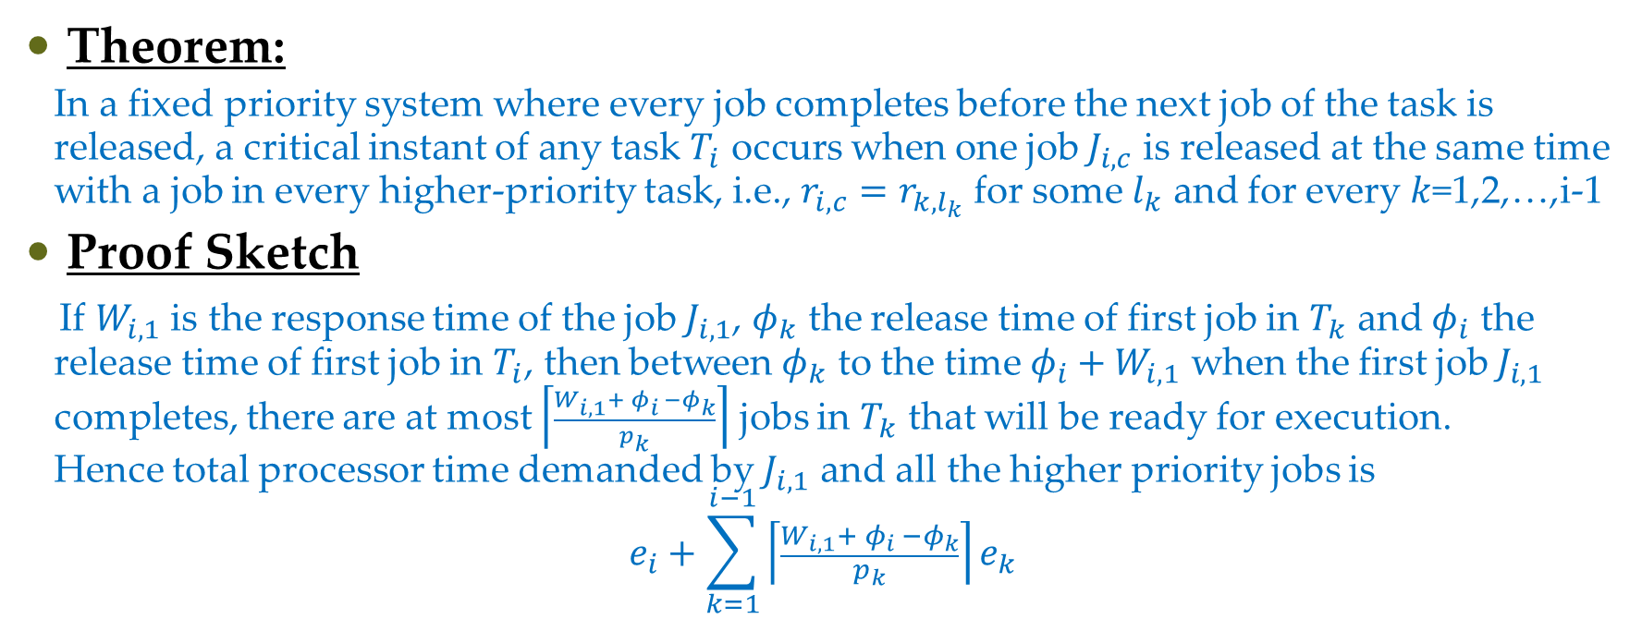
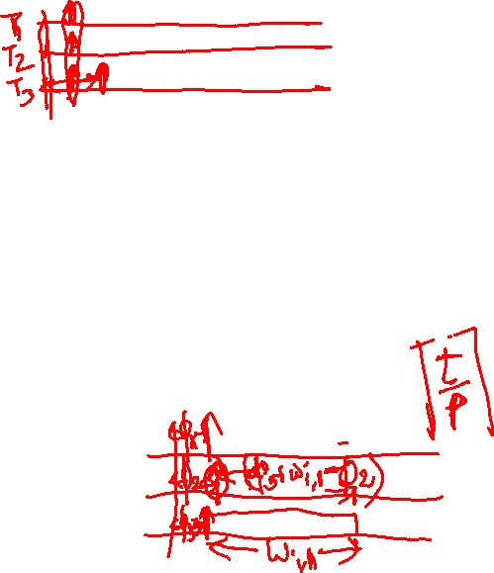
Schedulability Test for FP tasks with Short Response Times
Theorem:
In a fixed priority system where every job completes before the next job of the task is released, a critical instant of any task $T_{i}$ occurs when one job $J_{i,c}$ is released at the same time with a job in every higher-priority task, i.e., $r_{i,c}=r_{k,l_{k}}$ for some $l_{k}$ and for every $k$=1,2,…,i-1
Proof Sketch
If $W_{i,1}$ is the response time of the job $J_{i,1}$, $φ_{k}$ the release time of first job in $T_{k}$ and $φ_{i}$ the release time of first job in $T_{i}$, then between $φ_{k}$ to the time $φ_{i}+W_{i,1}$ when the first job $J_{i,1}$ completes, there are at most $\left\lceil \frac{W_{i,1}{+ φ}_{i} −φ_{k}}{p_{k}}\right\rceil$ jobs in $T_{k}$ that will be ready for execution. Hence total processor time demanded by $J_{i,1}$ and all the higher priority jobs is $$e_{i}+\sum_{k=1}^{i−1}{\left\lceil \frac{W_{i,1}{+ φ}_{i} −φ_{k}}{p_{k}}\right\rceil e_{k}}$$

Slide 6
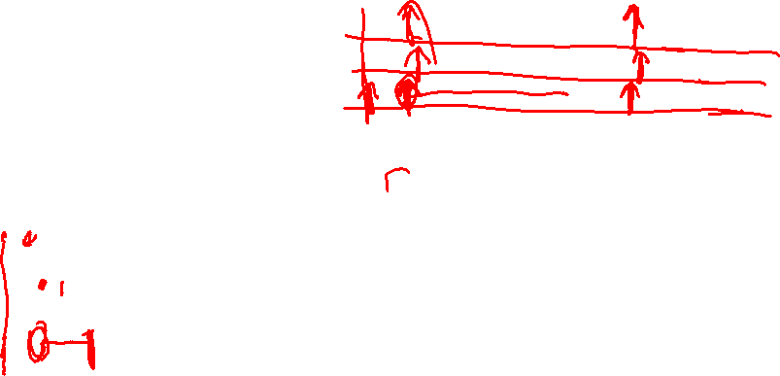


Schedulability Test for FP tasks with Short Response Times
Proof Sketch
$W_{i,1}$ is equal to the smallest of all solutions of $$W_{i,1}=e_{i}+\sum_{k=1}^{i−1}{\left\lceil \frac{W_{i,1}{+ φ}_{i} −φ_{k}}{p_{k}}\right\rceil e_{k}}−φ_{i}$$
$$t=e_{i}+\sum_{k=1}^{i−1}{\left\lceil \frac{t}{p_{k}}\right\rceil e_{k}}$$

Slide 7
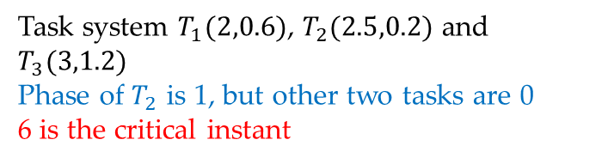
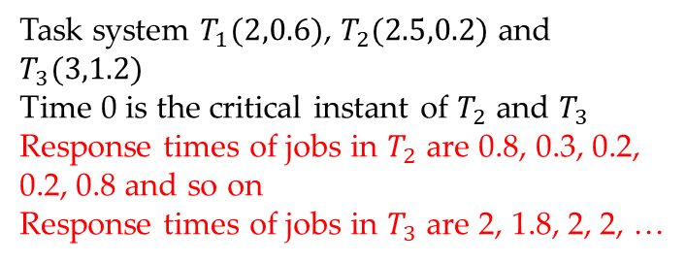
Schedulability Test for FP tasks with Short Response Times
Task system $T_{1}(2,0.6)$, $T_{2}(2.5,0.2)$ and $T_{3}(3,1.2)$
Time 0 is the critical instant of $T_{2}$ and $T_{3}$
Response times of jobs in $T_{2}$ are 0.8, 0.3, 0.2, 0.2, 0.8 and so on
Response times of jobs in $T_{3}$ are 2, 1.8, 2, 2, …
Task system $T_{1}(2,0.6)$, $T_{2}(2.5,0.2)$ and $T_{3}(3,1.2)$
Phase of $T_{2}$ is 1, but other two tasks are 0 6 is the critical instant

Slide 8
Critical Instant

Slide 9
Critical Instant

Slide 10
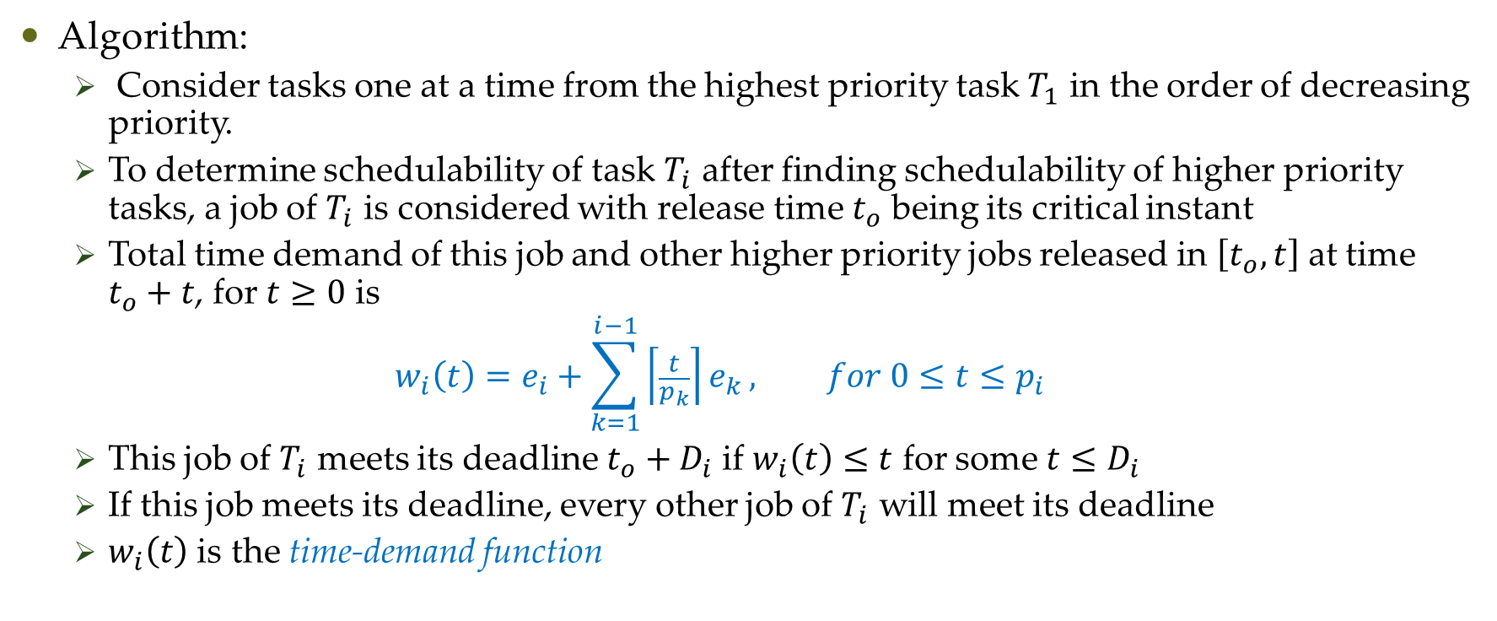
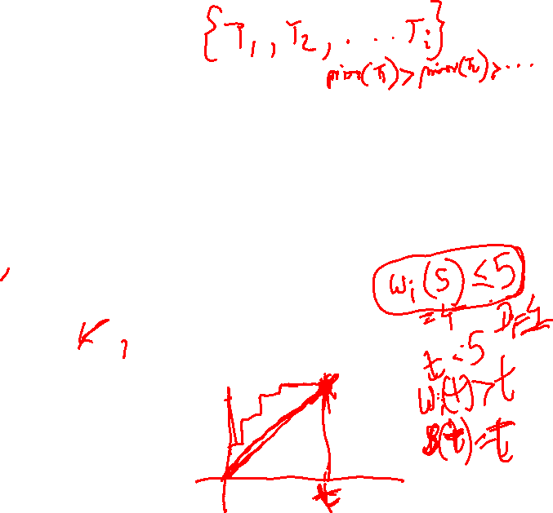
Time-Demand Analysis
Algorithm:
Consider tasks one at a time from the highest priority task $T_{1}$ in the order of decreasing priority.
To determine schedulability of task $T_{i}$ after finding schedulability of higher priority tasks, a job of $T_{i}$ is considered with release time $t_{o}$ being its critical instant
Total time demand of this job and other higher priority jobs released in $\left[t_{o},t\right]$ at time $t_{o}+t$, for $t≥0$ is
$$w_{i}\left(t\right)=e_{i}+\sum_{k=1}^{i−1}{\left\lceil \frac{t}{p_{k}}\right\rceil e_{k}}, for 0≤t≤p_{i}$$
This job of $T_{i}$ meets its deadline $t_{o}+D_{i}$ if $w_{i}\left(t\right)≤t$ for some $t≤D_{i}$
If this job meets its deadline, every other job of $T_{i}$ will meet its deadline
$w_{i}\left(t\right)$ is the time-demand function

Slide 11
Questions?

