Slide 1

Lecture 14: Priority-Driven Scheduling (Chapter 6)
Deepak Gangadharan

Slide 2
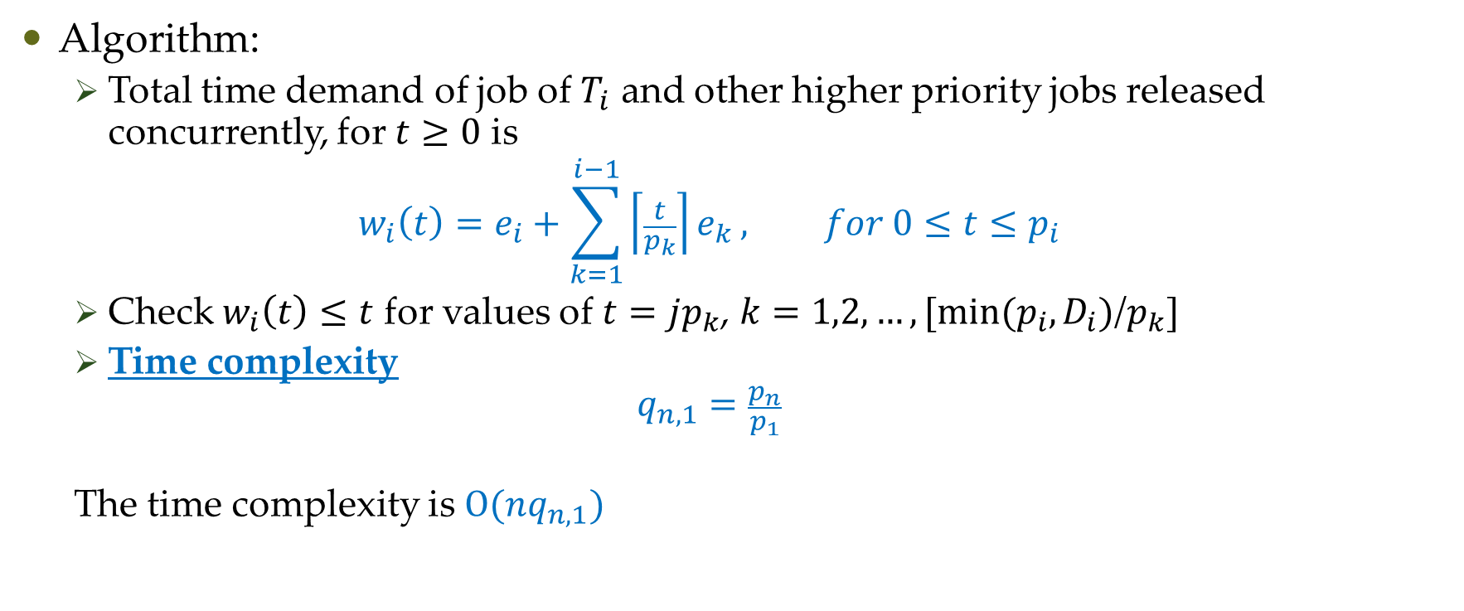
Time-Demand Analysis
Algorithm:
Total time demand of job of $T_{i}$ and other higher priority jobs released concurrently, for $t≥0$ is
$$w_{i}\left(t\right)=e_{i}+\sum_{k=1}^{i−1}{\left\lceil \frac{t}{p_{k}}\right\rceil e_{k}}, for 0≤t≤p_{i}$$
Check $w_{i}\left(t\right)≤t$ for values of $t=jp_{k}$, $k=1,2,…,[min⁡(p_{i},D_{i})$/$p_{k}]$
Time complexity $q_{n,1}=\frac{p_{n}}{p_{1}}$
The time complexity is $Ο(nq_{n,1})$

Slide 3
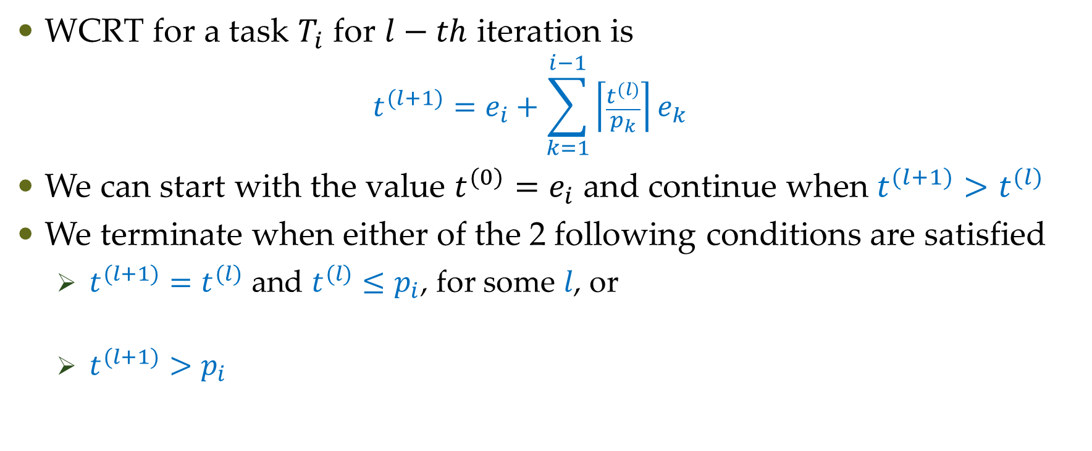


Response Time Analysis (RTA)
WCRT for a task $T_{i}$ for $l−th$ iteration is
$$t^{(l+1)}=e_{i}+\sum_{k=1}^{i−1}{\left\lceil \frac{t^{(l)}}{p_{k}}\right\rceil e_{k}}$$
We can start with the value $t^{(0)}=e_{i}$ and continue when $t^{(l+1)}>t^{(l)}$
We terminate when either of the 2 following conditions are satisfied
$t^{(l+1)}=t^{(l)}$ and $t^{(l)}≤p_{i}$, for some $l$, or
$t^{(l+1)}>p_{i}$
Convergence of WCRT value
$W_{i}=t^{(l)}$ and $T_{i}$ is schedulable
Fails to find $W_{i}$
$T_{i}$ is not schedulable

Slide 4

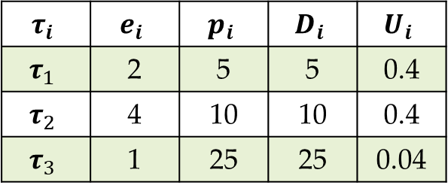


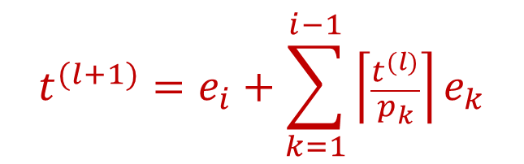


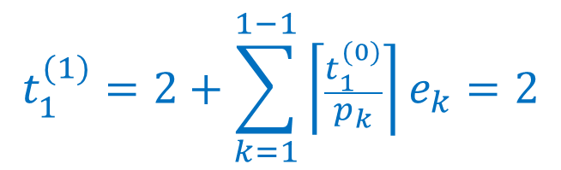
RTA Example
Find the WCRT of tasks when they are scheduled by rate monotonic priorities.
$$t^{(l+1)}=e_{i}+\sum_{k=1}^{i−1}{\left\lceil \frac{t^{(l)}}{p_{k}}\right\rceil e_{k}}$$
$$τ_{i}$$ | $$e_{i}$$ | $$p_{i}$$ | $$D_{i}$$ | $$U_{i}$$
$$τ_{1}$$ | 2 | 5 | 5 | 0.4
$$τ_{2}$$ | 4 | 10 | 10 | 0.4
$$τ_{3}$$ | 1 | 25 | 25 | 0.04
$$t^{(0)}=e_{i}$$
$$U=0.84$$
Continue if $t^{(l+1)}>t^{(l)}$
$$t_{1}^{(0)}=2$$
$$t_{1}^{(1)}=2+\sum_{k=1}^{1−1}{\left\lceil \frac{t_{1}^{(0)}}{p_{k}}\right\rceil }e_{k}=2$$
Computation stops here as $t_{1}^{(1)}=t_{1}^{(0)}$ WCRT of $τ_{1}$ is 2

Slide 5

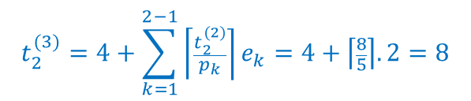



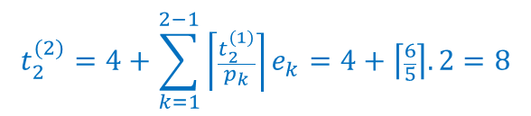
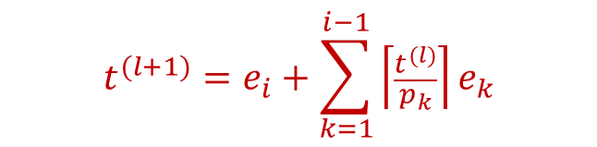


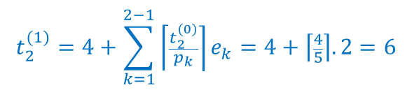

RTA Example
Find the WCRT of tasks when they are scheduled by rate monotonic priorities.
$$t^{(l+1)}=e_{i}+\sum_{k=1}^{i−1}{\left\lceil \frac{t^{(l)}}{p_{k}}\right\rceil e_{k}}$$
$$τ_{i}$$ | $$e_{i}$$ | $$p_{i}$$ | $$D_{i}$$ | $$U_{i}$$
$$τ_{1}$$ | 2 | 5 | 5 | 0.4
$$τ_{2}$$ | 4 | 10 | 10 | 0.4
$$τ_{3}$$ | 1 | 25 | 25 | 0.04
$$t^{(0)}=e_{i}$$
Continue if $t^{(l+1)}>t^{(l)}$
$$U=0.84$$
$$t_{2}^{(0)}=4$$
$$t_{2}^{(1)}=4+\sum_{k=1}^{2−1}{\left\lceil \frac{t_{2}^{(0)}}{p_{k}}\right\rceil }e_{k}=4+\left\lceil \frac{4}{5}\right\rceil .2=6$$
$t_{2}^{(1)}=t_{2}^{(0)}$? NO, so continue
$$t_{2}^{(2)}=4+\sum_{k=1}^{2−1}{\left\lceil \frac{t_{2}^{(1)}}{p_{k}}\right\rceil }e_{k}=4+\left\lceil \frac{6}{5}\right\rceil .2=8$$
$t_{2}^{(2)}=t_{2}^{(1)}$? NO, so continue
$$t_{2}^{(3)}=4+\sum_{k=1}^{2−1}{\left\lceil \frac{t_{2}^{(2)}}{p_{k}}\right\rceil }e_{k}=4+\left\lceil \frac{8}{5}\right\rceil .2=8$$
WCRT of $τ_{2}$ is 8
$t_{2}^{(3)}=t_{2}^{(2)}$? YES, so stop

Slide 6

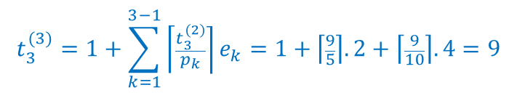

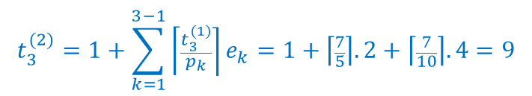


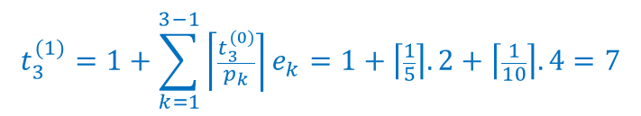

RTA Example
Find the WCRT of tasks when they are scheduled by rate monotonic priorities.
$$t^{(l+1)}=e_{i}+\sum_{k=1}^{i−1}{\left\lceil \frac{t^{(l)}}{p_{k}}\right\rceil e_{k}}$$
$$τ_{i}$$ | $$e_{i}$$ | $$p_{i}$$ | $$D_{i}$$ | $$U_{i}$$
$$τ_{1}$$ | 2 | 5 | 5 | 0.4
$$τ_{2}$$ | 4 | 10 | 10 | 0.4
$$τ_{3}$$ | 1 | 25 | 25 | 0.04
$$t^{(0)}=e_{i}$$
Continue if $t^{(l+1)}>t^{(l)}$
$$U=0.84$$
$$t_{3}^{(0)}=1$$
$$t_{3}^{(1)}=1+\sum_{k=1}^{3−1}{\left\lceil \frac{t_{3}^{(0)}}{p_{k}}\right\rceil }e_{k}=1+\left\lceil \frac{1}{5}\right\rceil .2+\left\lceil \frac{1}{10}\right\rceil .4=7$$
$t_{3}^{(1)}=t_{3}^{(0)}$? NO, so continue
$$t_{3}^{(2)}=1+\sum_{k=1}^{3−1}{\left\lceil \frac{t_{3}^{(1)}}{p_{k}}\right\rceil }e_{k}=1+\left\lceil \frac{7}{5}\right\rceil .2+\left\lceil \frac{7}{10}\right\rceil .4=9$$
$t_{3}^{(2)}=t_{3}^{(1)}$? NO, so continue
$$t_{3}^{(3)}=1+\sum_{k=1}^{3−1}{\left\lceil \frac{t_{3}^{(2)}}{p_{k}}\right\rceil }e_{k}=1+\left\lceil \frac{9}{5}\right\rceil .2+\left\lceil \frac{9}{10}\right\rceil .4=9$$
$t_{3}^{(3)}=t_{3}^{(2)}$? YES, so stop
WCRT of $τ_{3}$ is 9

Slide 7
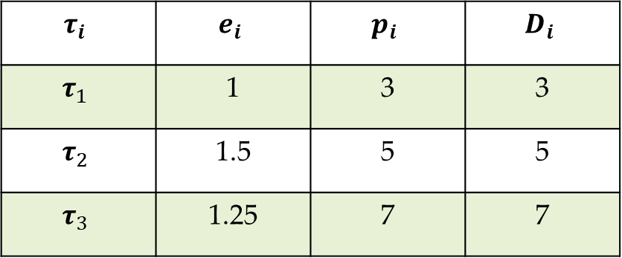
RTA - Exercise
Find the WCRT of tasks when they are scheduled by rate monotonic priorities.
$$τ_{i}$$ | $$e_{i}$$ | $$p_{i}$$ | $$D_{i}$$
$$τ_{1}$$ | 1 | 3 | 3
$$τ_{2}$$ | 1.5 | 5 | 5
$$τ_{3}$$ | 1.25 | 7 | 7

Slide 8
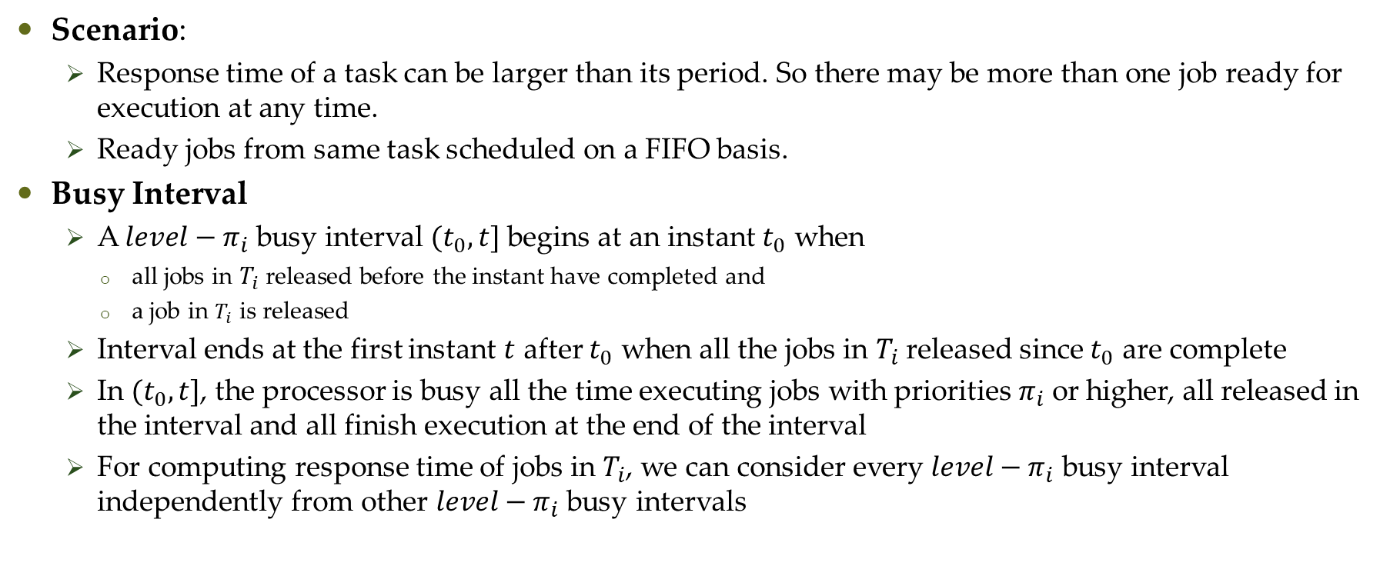
Schedulability Test for FP Tasks With Arbitrary Response Times
Scenario:
Response time of a task can be larger than its period. So there may be more than one job ready for execution at any time.
Ready jobs from same task scheduled on a FIFO basis.
Busy Interval
A $level−π_{i}$ busy interval $(t_{0}, t]$ begins at an instant $t_{0}$ when
all jobs in $T_{i}$ released before the instant have completed and
a job in $T_{i}$ is released
Interval ends at the first instant $t$ after $t_{0}$ when all the jobs in $T_{i}$ released since $t_{0}$ are complete
In $(t_{0}, t]$, the processor is busy all the time executing jobs with priorities $π_{i}$ or higher, all released in the interval and all finish execution at the end of the interval
For computing response time of jobs in $T_{i}$, we can consider every $level−π_{i}$ busy interval independently from other $level−π_{i}$ busy intervals

Slide 9
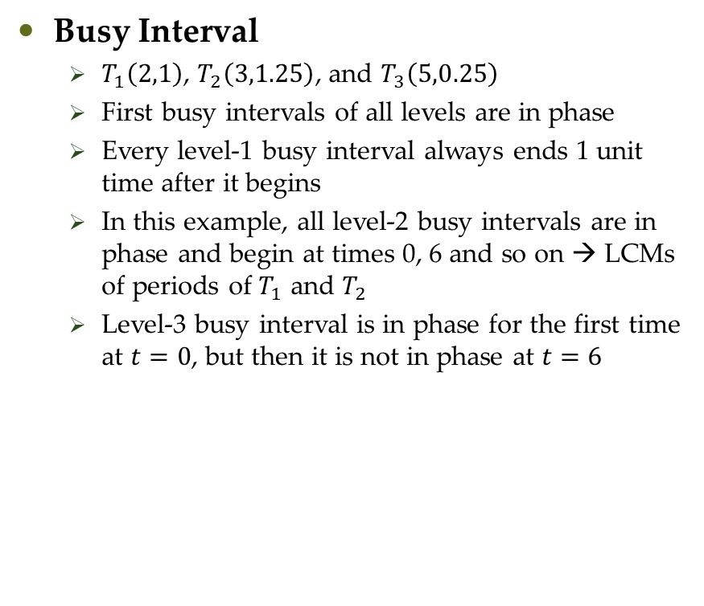
Schedulability Test for FP Tasks With Arbitrary Response Times
Busy Interval
$T_{1}\left(2,1\right)$, $T_{2}\left(3,1.25\right)$, and $T_{3}\left(5,0.25\right)$
First busy intervals of all levels are in phase
Every level-1 busy interval always ends 1 unit time after it begins
In this example, all level-2 busy intervals are in phase and begin at times 0, 6 and so on → LCMs of periods of $T_{1}$ and $T_{2}$
Level-3 busy interval is in phase for the first time at $t=0$, but then it is not in phase at $t=6$

Slide 10
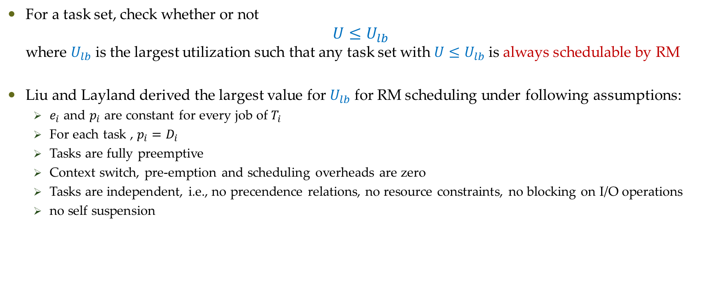
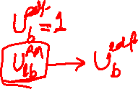
Liu and Layland test for RM
For a task set, check whether or not $U≤U_{lb}$ where $U_{lb}$ is the largest utilization such that any task set with $U≤U_{lb}$ is always schedulable by RM
Liu and Layland derived the largest value for $U_{lb}$ for RM scheduling under following assumptions:
$e_{i}$ and $p_{i}$ are constant for every job of $T_{i}$
For each task , $p_{i}=D_{i}$
Tasks are fully preemptive
Context switch, pre-emption and scheduling overheads are zero
Tasks are independent, i.e., no precendence relations, no resource constraints, no blocking on I/O operations
no self suspension

Slide 11

Liu and Layland test for RM
$$U≤n.(2^{1/n}−1)$$

Slide 12
Liu and Layland test for RM
$$U≤n.(2^{1/n}−1)$$

Slide 13

Hyperbolic bound
In 2000, Bini et. al. proved that a set of $n$ periodic tasks is schedulable with RM if
$$\prod_{i=1}^{n}{\left(U_{i}+1\right)}≤2$$

Slide 14
Questions?

