Slide 1

Lecture 9: Priority-Driven Scheduling (Chapter 6)
Deepak Gangadharan

Slide 2
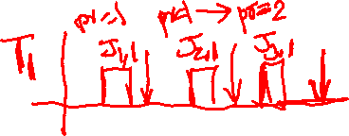
Fixed Priority vs Dynamic Priority Algorithms
A priority-driven scheduler is an on-line scheduler – Assigns priorities to jobs after they are released
If pre-emption is allowed at any time, scheduling decision is made whenever a job is released or completed.
Two types of priority-driven algorithm
Fixed Priority: Assigns same priority to all jobs of a task, i.e., the priority of a task is fixed relative to other tasks
Dynamic Priority: Assigns different priorities to individual jobs of a task→ Priority of a task changes with respect to other tasks based on when they are released and completed
Most real-time scheduling algorithms of practical interest assign fixed priorities to individual jobs

Slide 3
Rate Monotonic Algorithm
Assigns priorities to tasks based on their periods → shorter the period, higher the priority
Rate of a task is inverse of its period
Will call it RM algorithm in short

Slide 4

Rate Monotonic Algorithm – Example 1
Tasks: $T_{1}=\left(4,1\right), T_{2}=\left(5,2\right), T_{3}=(20,5)$
Each job of $T_{1}$ is placed at the head of the priority queue

Slide 5

Rate Monotonic Algorithm – Example 2
Tasks: $T_{1}=\left(2,0.9\right), T_{2}=\left(5,2.3\right)$
$T_{1}$ has higher priority than $T_{2}$

Slide 6
Deadline Monotonic Algorithm
Assigns priorities to tasks based on their relative deadlines → shorter the relative deadline, higher the priority
Will call it DM for short

Slide 7

Deadline Monotonic Algorithm - Example
Tasks: $T_{1}=\left(50,50,25,100\right), T_{2}=\left(0,62.5,10,20\right), T_{3}=(0,125,25,50)$
Utilizations are $u_{T_{1}}=0.5,u_{T_{2}}=0.16,u_{T_{3}}=0.2$

Slide 8
RM vs DM
When relative deadline is proportional to period, RM and DM algorithms are identical
When relative deadlines are arbitrary, DM performs better, i.e. DM can sometimes produce a feasible schedule when RM fails
RM always fails when DM algorithm fails

Slide 9

Illustration - DM can perform better
Tasks: $T_{1}=\left(50,50,25,100\right), T_{2}=\left(0,62.5,10,20\right), T_{3}=(0,125,25,50)$
DM
RM

Slide 10
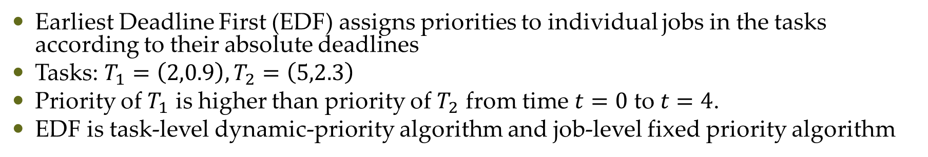
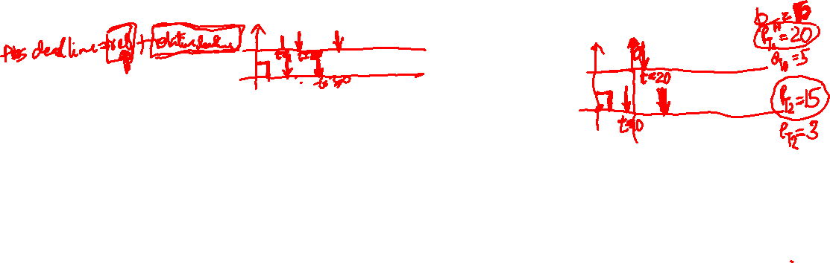
Dynamic Priority Algorithms - EDF
Earliest Deadline First (EDF) assigns priorities to individual jobs in the tasks according to their absolute deadlines
Tasks: $T_{1}=\left(2,0.9\right), T_{2}=\left(5,2.3\right)$
Priority of $T_{1}$ is higher than priority of $T_{2}$ from time $t=0$ to $t=4$.
EDF is task-level dynamic-priority algorithm and job-level fixed priority algorithm

Slide 11
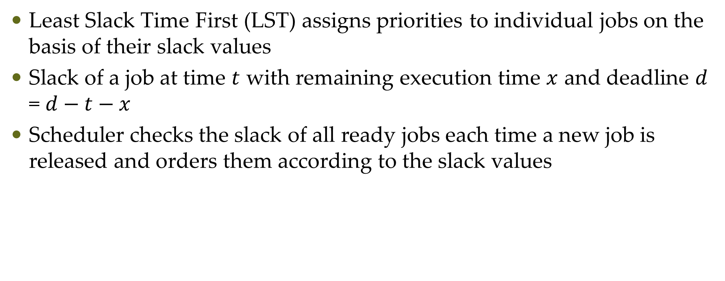

Dynamic Priority Algorithms – Least Slack Time First
Least Slack Time First (LST) assigns priorities to individual jobs on the basis of their slack values
Slack of a job at time $t$ with remaining execution time $x$ and deadline $d$ = $d−t−x$
Scheduler checks the slack of all ready jobs each time a new job is released and orders them according to the slack values

Slide 12
Questions?

