Slide 1

FreeRTOS: Task Management
Deepak Gangadharan

Slide 2
Task Functions
Tasks implemented as C functions
Task function prototype void taskFunction(void *pvParameters)
Each task is a small program, has an entry point and will normally run forever within an infinite loop.
FreeRTOS tasks must not be allowed to return from the implementing function, i.e., no return statement
If a task is no longer required, it should be explicitly deleted
A single task function definition can be used to create any number of tasks, each being a separate execution instance, with its own stack and copy of stack variables defined within the task

Slide 3
Structure of a Typical Task Function
void taskFunction(void *pvParameters) { /* variables can be declared as per normal function*/
for ( ; ; ) { /* code to implement the task functionality */ }
/* If the task implementation ever breaks out of the above loop, then the task must be deleted before reaching the end*/ vTaskDelete(NULL);
}

Slide 4
Creating Tasks
xTaskCreate() API Function
Tasks are created using this function
xTaskCreate() API function prototype BaseType_t xTaskCreate(TaskFunction_t pvTaskCode, const char * const pcName, uint16_t usStackDepth, void *pvParameters, UBaseType_t uxPriority, TaskHandle_t *pxCreatedTask) pvTaskCode – A pointer to the function that implements the task (just the name of the function) pcName – A descriptive name for the task. Not used by FreeRTOS. Purely for debugging. Application defined constant configMAX_TASK_NAME_LEN defines the maximum length a task name can take.

Slide 5
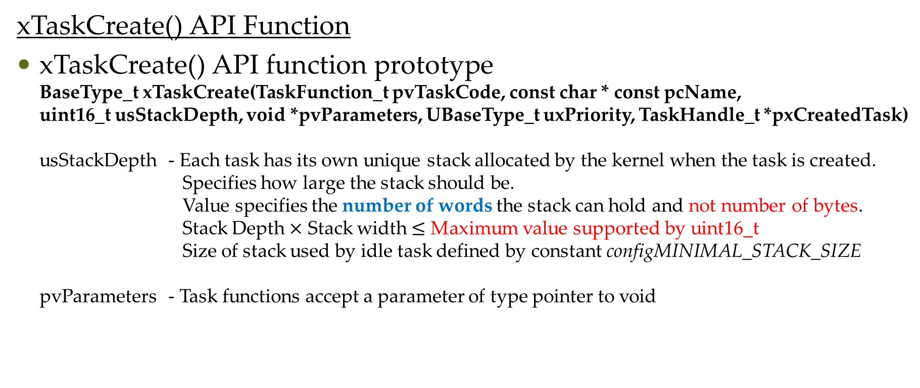
Creating Tasks
xTaskCreate() API Function
xTaskCreate() API function prototype BaseType_t xTaskCreate(TaskFunction_t pvTaskCode, const char * const pcName, uint16_t usStackDepth, void *pvParameters, UBaseType_t uxPriority, TaskHandle_t *pxCreatedTask) usStackDepth - Each task has its own unique stack allocated by the kernel when the task is created. Specifies how large the stack should be. Value specifies the number of words the stack can hold and not number of bytes. Stack Depth $×$ Stack width $≤$ Maximum value supported by uint16_t Size of stack used by idle task defined by constant configMINIMAL_STACK_SIZE pvParameters - Task functions accept a parameter of type pointer to void

Slide 6
Creating Tasks
xTaskCreate() API Function
xTaskCreate() API function prototype BaseType_t xTaskCreate(TaskFunction_t pvTaskCode, const char * const pcName, uint16_t usStackDepth, void *pvParameters, UBaseType_t uxPriority, TaskHandle_t *pxCreatedTask) uxPriority - Defines the priority of the task Priorities can be assigned from 0 to (configMAX_PRIORITIES-1) pxCreatedTask - Can be used to pass a handle to the task created. Can be used to reference the task in API calls to change task priority. If no use, then can be set to NULL. Returned value – There are two possible return values – pdPASS and pdFAIL

Slide 7
Questions?

