Slide 1

Lecture 2- Modeling Real-Time Systems
Deepak Gangadharan

Slide 2
Recap - Digital Controller
Reference input, Sensor measurements are typically analog
Controller performs A/D conversion, applies a control law and performs computation and D/A conversion of the control output
The analog control output controls the actuator, which in turn changes the state of the plant
Periodic Digital
Controller

Slide 3
What will we learn?
What influences the response time of a system (or its tasks)
How can we evaluate or analyze the response time?
How can we design a time-predictable system?

Slide 4
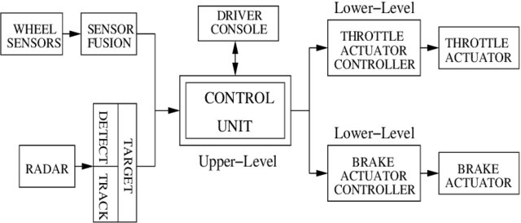
Motivation – Why modeling is important?
Event based activation
Various periods of activation
Multiple Sensors
Shared data
Multiple
Tasks

Slide 5
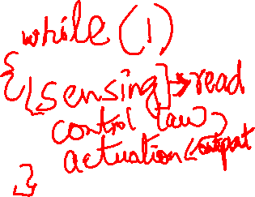
Preliminary Notions
What is a Task?
a piece of code that implements a system functionality
can have multiple inputs and outputs
can be activated by events (e.g., user command or an interrupt) or by time (e.g., by periodic timer interrupt)
Tasks can usually share data, communicate with each other and perform i/o operations.

Slide 6



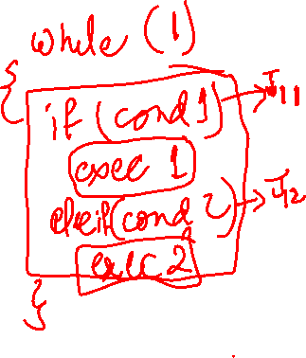





Preliminary Notions
Job
An instance of a task that has arrived at the system
$$J_{1,1}$$
$$J_{1,2}$$
$$J_{1,3}$$
$$J_{1,4}$$
…
Task 1
$$J_{2,1}$$
$$J_{2,2}$$
$$J_{2,3}$$
$$J_{2,4}$$
…
Task 2

Slide 7

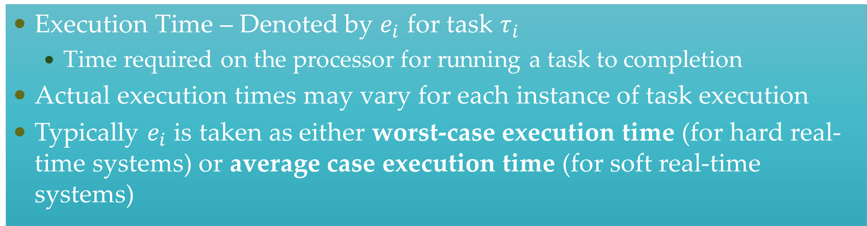



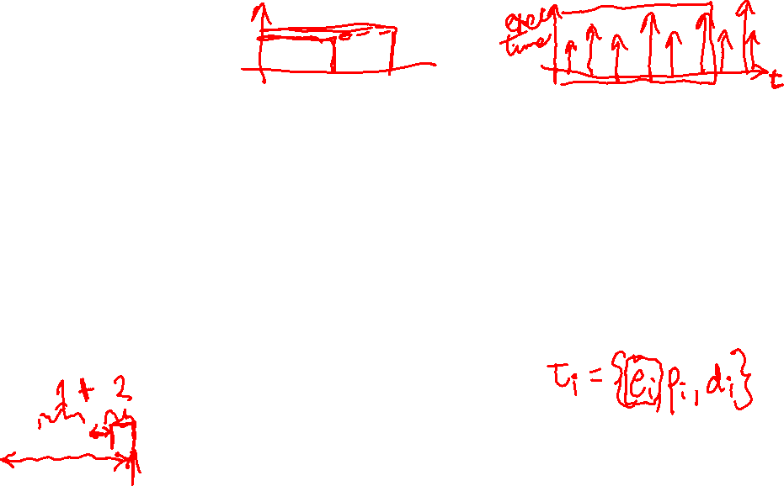
Preliminary Notions
Execution Time – Denoted by $e_{i}$ for task $τ_{i}$
Time required on the processor for running a task to completion
Actual execution times may vary for each instance of task execution
Typically $e_{i}$ is taken as either worst-case execution time (for hard real-time systems) or average case execution time (for soft real-time systems)
$$J_{1,1}$$
$$J_{1,2}$$
$$J_{1,3}$$
$$J_{1,4}$$
…
Task 1

Slide 8
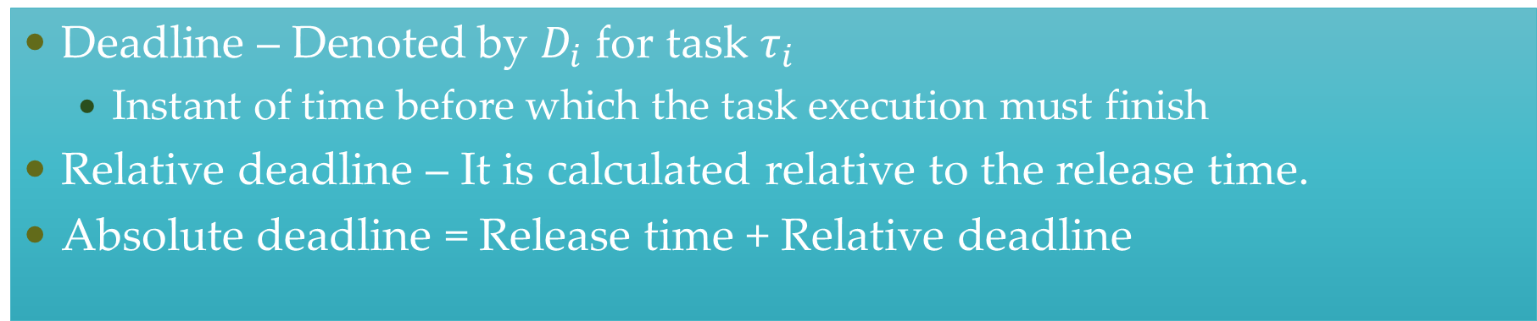



Preliminary Notions
Deadline – Denoted by $D_{i}$ for task $τ_{i}$
Instant of time before which the task execution must finish
Relative deadline – It is calculated relative to the release time.
Absolute deadline = Release time + Relative deadline
$$J_{1,1}$$
$$J_{1,2}$$
$$J_{1,3}$$
Relative deadline = 80
Absolute deadline = 90
…
Relative
deadline
Task 1
10
90

Slide 9

Modeling Real-Time System
Application/ Workload modeled as task graph
Scheduling and Resource Access control algorithms
Resource Model

Slide 10
Application/Task Model

Slide 11



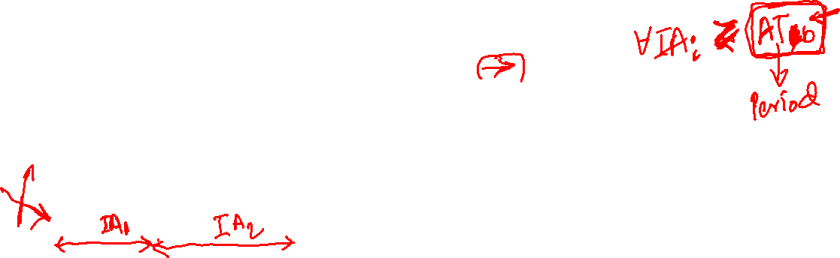





Activation Pattern of Tasks
Periodic
Single rate (all tasks have same period)
Multi rate (tasks have different periods)
Aperiodic
Bounded arrival time (sporadic)
Unbounded arrival time (event based activation)
$$J_{2,1}$$
$$J_{2,2}$$
$$J_{2,3}$$
$$J_{2,4}$$
…
Aperiodic
task
$$J_{1,1}$$
$$J_{1,2}$$
$$J_{1,3}$$
$$J_{1,4}$$
…
Periodic
task

Slide 12
Periodic
Each task/group of tasks executes/execute repeatedly with a particular period
Allows static analysis techniques
Widely used in real-time systems

Slide 13
Aperiodic
Activated by events
Workload is dynamic (cannot be predicted)

Slide 14
Sporadic
Task whose next activation time is lower bounded by a value called minimum inter arrival time (also called period)

Slide 15
Questions?

