Slide 1

Lecture 4- Introduction to Scheduling
Deepak Gangadharan

Slide 2
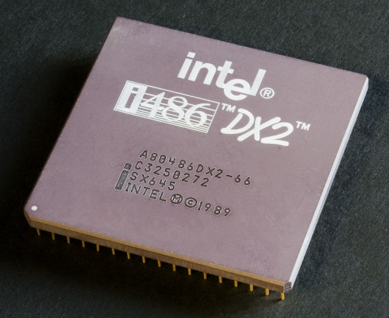
Online Scheduling
In a system, more than one task can be simultaneously active, but only one can be in execution or running.
A task is said to be ready if it is active and not in execution or suspension.
Online Scheduler
Processor
Task Activation
(release)
Ready Queue
dispatch
Task Completion
Pending Queue
Scheduling Algorithm
preemption
or suspension
This Photo by Unknown Author is licensed under CC BY-SA

Slide 3
Online Scheduling
Ready tasks are kept in a ready queue and managed by a scheduling algorithm.
The scheduling algorithm selects a task in the queue and assigns the processor to it.
Online Scheduler
Processor
Task Activation
(release)
Ready Queue
dispatch
Task Completion
Pending Queue
Scheduling Algorithm
preemption
or suspension
This Photo by Unknown Author is licensed under CC BY-SA

Slide 4
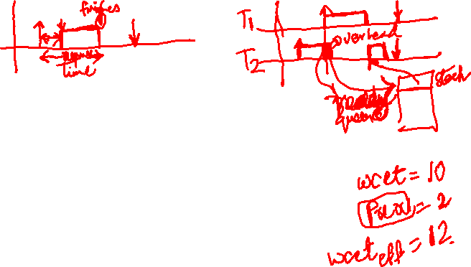
Preemption
Online Scheduler
Processor
Task Activation
(release)
Ready Queue
dispatch
Task Completion
Pending Queue
Scheduling Algorithm
preemption
or suspension
A kernel mechanism that allows the execution of a task to be stopped and execution of a more important task to be started.
Preempted task goes into the ready queue.
Enhances concurrency and reduces response times of high priority tasks.
Can be disabled (completely or temporarily) to ensure consistency of some critical operations.

Slide 5
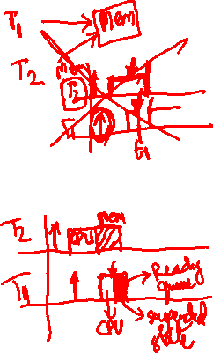
Suspension
Online Scheduler
Processor
Task Activation
(release)
Ready Queue
dispatch
Task Completion
Pending Queue
Scheduling Algorithm
preemption
or suspension
Occurs when a task decides to suspend itself by using delay() instruction or if it waits for a resource which is being used by another task.
Suspended task goes into pending queue.

Slide 6
Task States
BLOCKING
signal
wait/suspension
dispatch
activation
READY
RUNNING
termination
preemption
Active

Slide 7

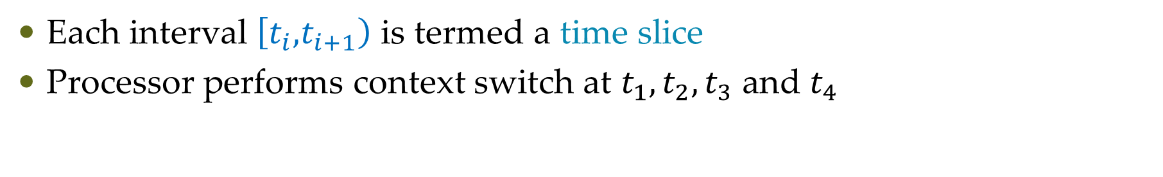
Recap: Schedule
Source: http://www.st.ewi.tudelft.nl/mitra/teaching/rts/2019/files/lect02-online-scheduling.pdf
Each interval $\left[t_{i},\right.\left.t_{i+1}\right)$ is termed a time slice
Processor performs context switch at $t_{1},t_{2},t_{3}$ and $t_{4}$

Slide 8
Preemptive Scheduling
Source: http://www.st.ewi.tudelft.nl/mitra/teaching/rts/2019/files/lect02-online-scheduling.pdf

Slide 9
Task State Transition in Preemptive Scheduling
Source: http://www.st.ewi.tudelft.nl/mitra/teaching/rts/2019/files/lect02-online-scheduling.pdf

Slide 10
Well known Scheduling Algorithms
First-in-First-out scheduling (FIFO)
Same as first-come-first-serve (FCFS) algorithm
Round Robin
Shortest-job first
Earliest Deadline First (EDF)
Fixed-priority Scheduling (FP)

Slide 11
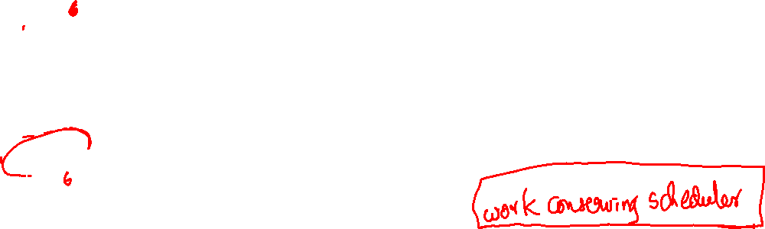
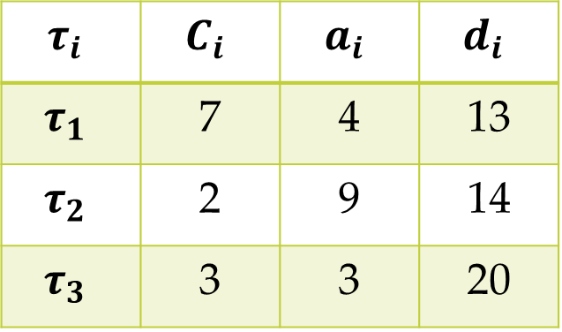



Example: FIFO
$$τ_{i}$$ | $$C_{i}$$ | $$a_{i}$$ | $$d_{i}$$
$$τ_{1}$$ | 7 | 4 | 13
$$τ_{2}$$ | 2 | 9 | 14
$$τ_{3}$$ | 3 | 3 | 20
$$τ_{1}$$
4
13
Deadline violation
$$τ_{2}$$
9
14
$$τ_{3}$$
3
20

Slide 12


Question: Is preemptive better than non-preemptive scheduling?
Preemptive Scheduling
Minimum makespan of non-preemptive scheduling is 4/3 times the minimum makespan of preemptive when pre-emption is allowed and for 2 processors
$J_{5}$ is released at 4, all others are released at 0
Non-Preemptive Scheduling

Slide 13
Questions?

