Slide 1

Lecture 6- Commonly used Scheduling Techniques (Chapter 4)
Deepak Gangadharan

Slide 2
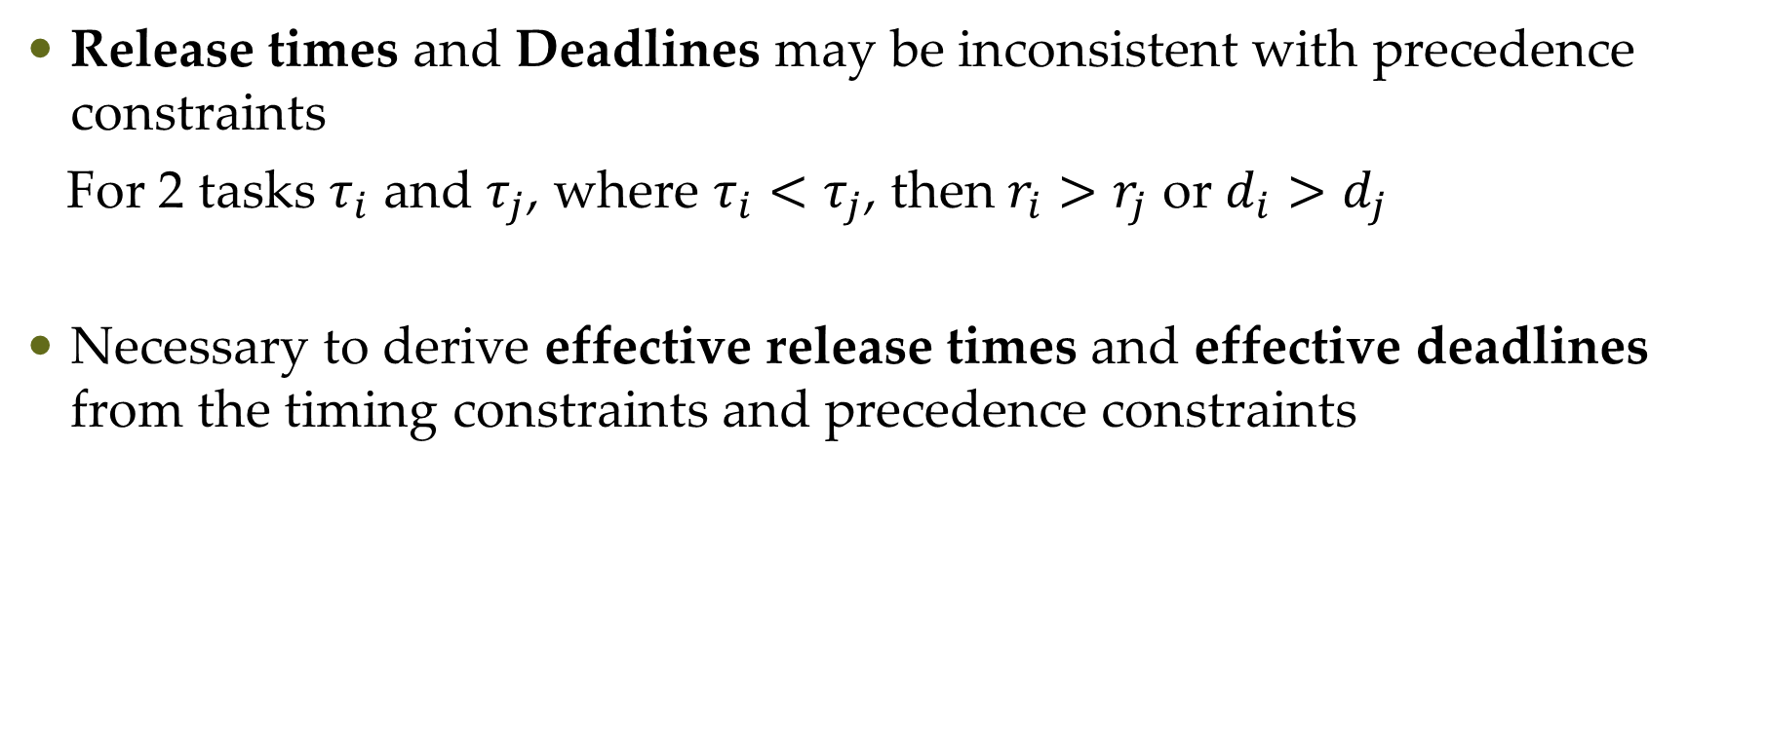
Effective Release Times and Deadlines
Release times and Deadlines may be inconsistent with precedence constraints
For 2 tasks $τ_{i}$ and $τ_{j}$, where $τ_{i}<τ_{j}$, then $r_{i}>r_{j}$ or $d_{i}>d_{j}$
Necessary to derive effective release times and effective deadlines from the timing constraints and precedence constraints

Slide 3
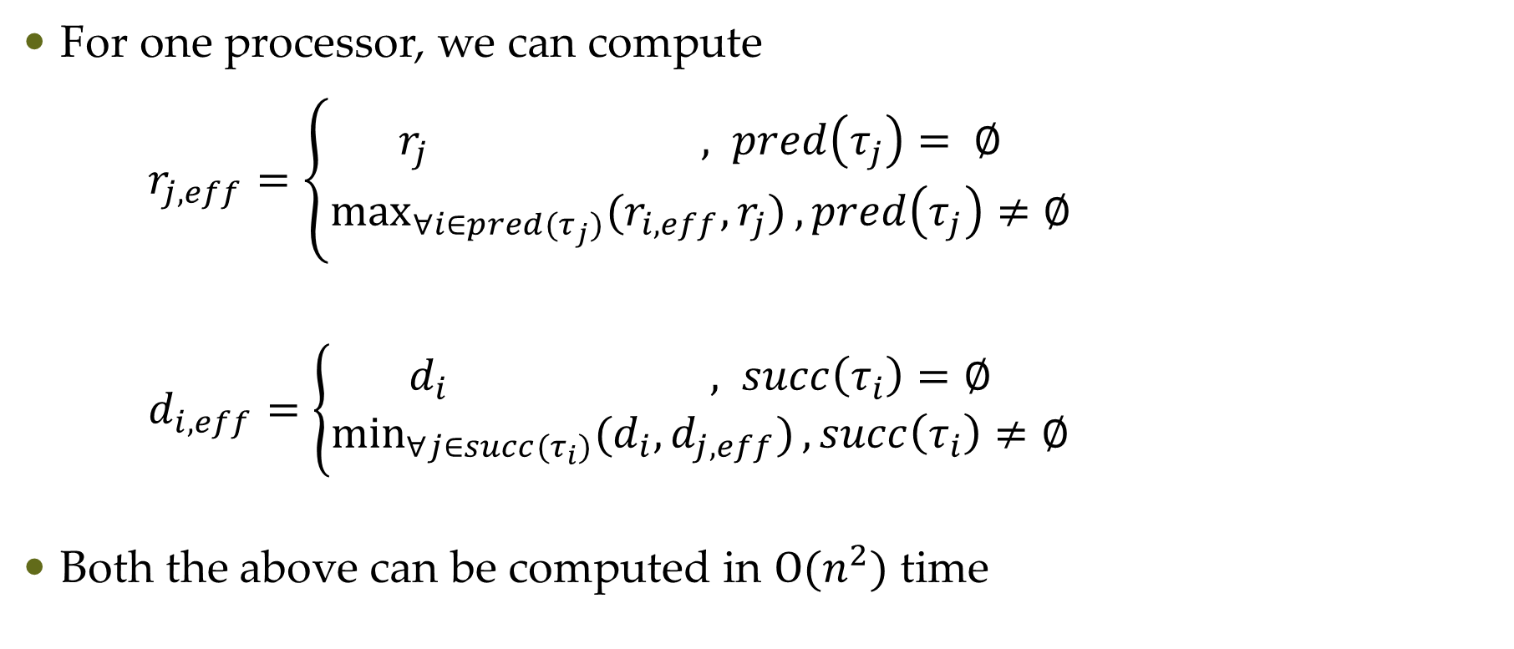
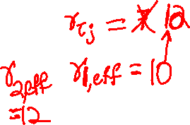
Effective Release Times and Deadlines
For one processor, we can compute
$r_{j,eff}=\left\{\begin{aligned}r_{j} , pred\left(τ_{j}\right)= ∅ \\ &\max_{∀i∈pred(τ_{j})}{{(r}_{i,eff},r_{j})},pred\left(τ_{j}\right)≠∅\end{aligned}\right.$
$d_{i,eff}=\left\{\begin{aligned}d_{i} , succ\left(τ_{i}\right)=∅ \\ &\min_{∀j∈succ(τ_{i})}{(d_{i},d_{j,eff})},succ\left(τ_{i}\right)≠∅\end{aligned}\right.$
Both the above can be computed in $Ο(n^{2})$ time

Slide 4
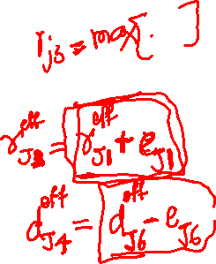
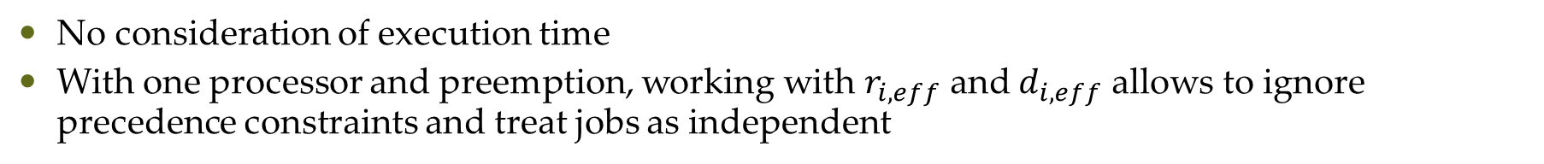
Effective Release Times and Deadlines
(2,8)
(2,8)
(4,9)
(4,20)
(2,)
(2,)
(4,)
(4,)
(0,)
(2,)
(6,)
(0,7)
(2,8)
(6,21)
No consideration of execution time
With one processor and preemption, working with $r_{i,eff}$ and $d_{i,eff}$ allows to ignore precedence constraints and treat jobs as independent

Slide 5
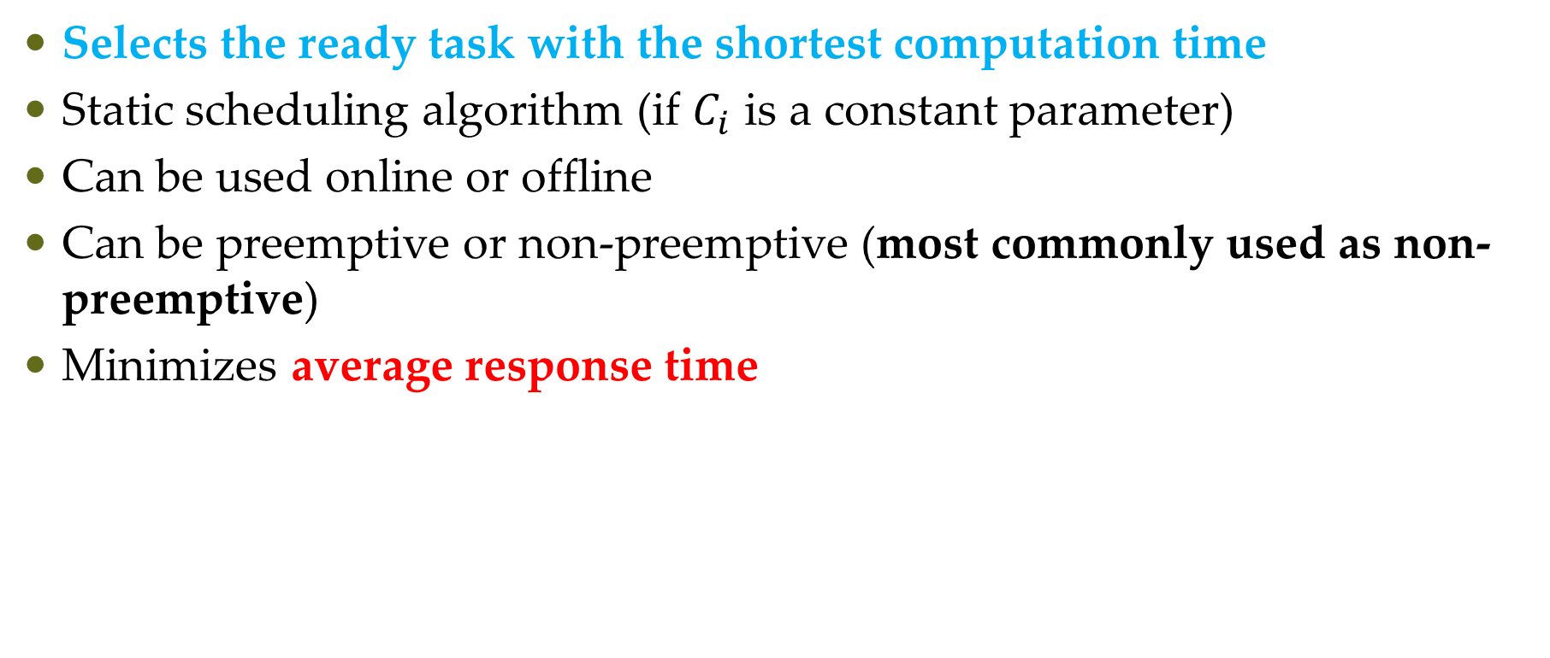
Shortest Job First (SJF) scheduling
Selects the ready task with the shortest computation time
Static scheduling algorithm (if $C_{i}$ is a constant parameter)
Can be used online or offline
Can be preemptive or non-preemptive (most commonly used as non-preemptive)
Minimizes average response time

Slide 6
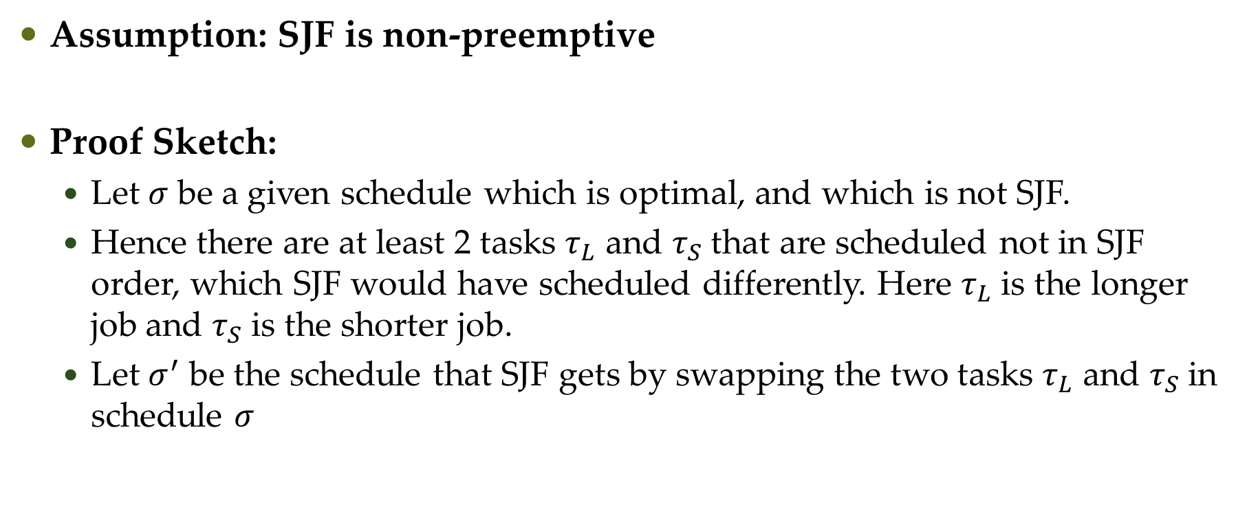
Optimality of SJF
Assumption: SJF is non-preemptive
Proof Sketch:
Let $σ$ be a given schedule which is optimal, and which is not SJF.
Hence there are at least 2 tasks $τ_{L}$ and $τ_{S}$ that are scheduled not in SJF order, which SJF would have scheduled differently. Here $τ_{L}$ is the longer job and $τ_{S}$ is the shorter job.
Let $σ^{′}$ be the schedule that SJF gets by swapping the two tasks $τ_{L}$ and $τ_{S}$ in schedule $σ$

Slide 7
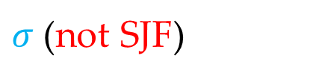

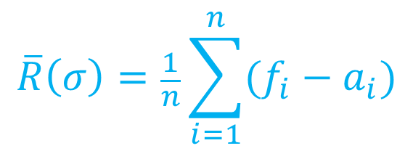









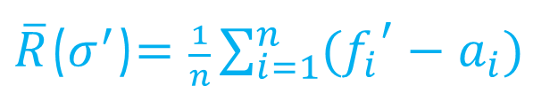

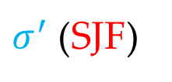

Optimality of SJF
Average Response Time
$$\overline{R}\left(σ\right)=\frac{1}{n}\sum_{i=1}^{n}{(f_{i}−a_{i})}$$
$$τ_{L}$$
$$τ_{S}$$
$σ$ (not SJF)
0
$$t$$
$$f_{L}$$
$$f_{S}$$
$$t_{end}$$
$$τ_{S}$$
$$τ_{L}$$
$σ^{′}$ (SJF)
$\overline{R}$($σ^{′}$)$=\frac{1}{n}\sum_{i=1}^{n}{({f_{i}}^{′}−a_{i})}$
0
$$t$$
$$f_{S}^{′}$$
$$f_{L}^{′}$$
$$t_{end}$$
To prove optimality, we need to show
$\overline{R}\text{(}σ^{′}\text{)}≤\overline{R}\left(σ\right)$
Source: http://www.st.ewi.tudelft.nl/mitra/teaching/rts/2019/files/lect03-scheduling-aperiodic.pdf

Slide 8
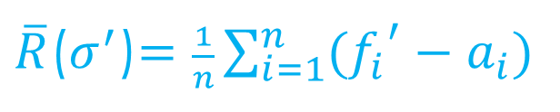




Optimality of SJF
Average Response Time
$$\overline{R}\left(σ\right)=\frac{1}{n}\sum_{i=1}^{n}{(f_{i}−a_{i})}$$
$$τ_{L}$$
$$τ_{S}$$
$σ$ (not SJF)
0
$$t$$
$$f_{L}$$
$$f_{S}$$
$$t_{end}$$
$$τ_{S}$$
$$τ_{L}$$
$σ^{′}$ (SJF)
$\overline{R}$($σ^{′}$)$=\frac{1}{n}\sum_{i=1}^{n}{({f_{i}}^{′}−a_{i})}$
0
$$t$$
$$f_{S}^{′}$$
$$f_{L}^{′}$$
$$t_{end}$$
$$f_{S}^{′}<f_{L}$$
$$f_{S}^{′}+f_{L}^{′}<f_{L}+f_{S}$$
$$f_{L}^{′}=f_{S}$$
$\overline{R}$($σ^{′}$)$=\frac{1}{n}\sum_{i=1}^{n}{\left({f_{i}}^{′}−a_{i}\right)≤\frac{1}{n}\sum_{i=1}^{n}{\left(f_{i}−a_{i}\right)}=\overline{R}\left(σ\right)}$
Source: http://www.st.ewi.tudelft.nl/mitra/teaching/rts/2019/files/lect03-scheduling-aperiodic.pdf

Slide 9
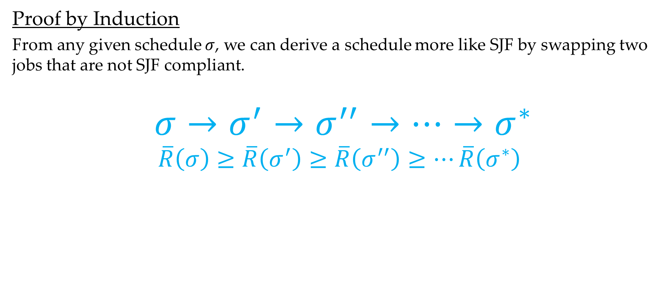
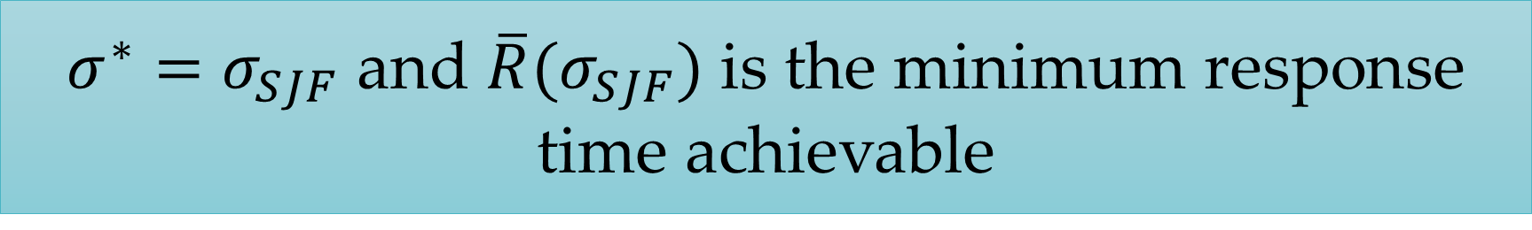
Optimality of SJF
Proof by Induction
From any given schedule $σ$, we can derive a schedule more like SJF by swapping two jobs that are not SJF compliant.
$$σ→σ^{′}→σ^{′′}→⋯→σ^{∗}$$
$$\overline{R}\left(σ\right)≥\overline{R}\left(σ^{′}\right)≥\overline{R}\left(σ^{′′}\right)≥⋯\overline{R}\left(σ^{∗}\right)$$
$σ^{∗}=σ_{SJF}$ and $\overline{R}(σ_{SJF})$ is the minimum response time achievable
Source: http://www.st.ewi.tudelft.nl/mitra/teaching/rts/2019/files/lect03-scheduling-aperiodic.pdf

Slide 10
Challenges in Validating Timing Constraints for Priority-Driven Systems
Priority-driven algorithms are easy to implement
Run-time overhead to maintain a priority queue is small
But not used much in hard real-time systems, especially safety-critical systems because behavior is non-deterministic when job parameters vary
Difficult to validate the deadline of all jobs, when job parameters vary

Slide 11
Challenges in Validating Timing Constraints for Priority-Driven Systems

Slide 12
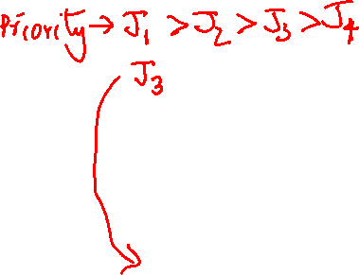
Challenges in Validating Timing Constraints for Priority-Driven Systems

Slide 13
Challenges in Validating Timing Constraints for Priority-Driven Systems

Slide 14
Questions?

