Slide 1

Lecture 8: Clock-Driven Scheduling (Chapter 5)
Deepak Gangadharan

Slide 2
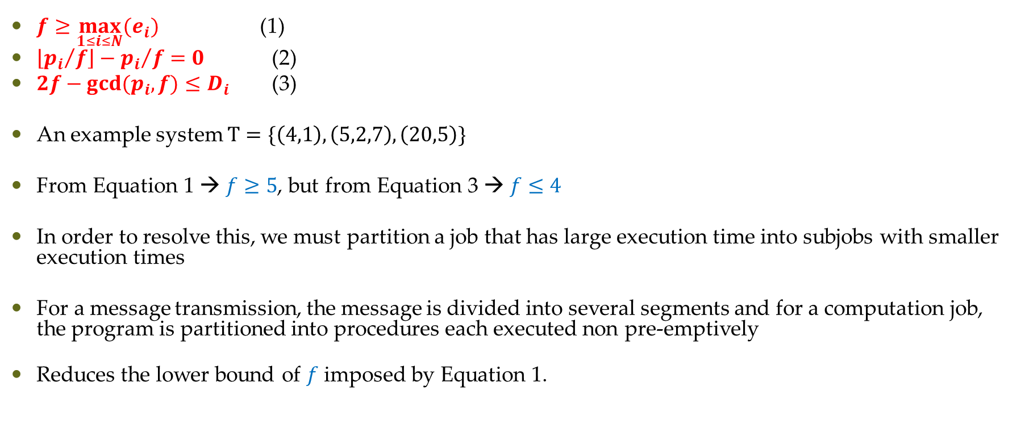
Job Slices
$f≥\max_{1≤i≤N}{{(e}_{i})}$ (1)
$\left\lfloor {p_{i}}/f\right\rfloor −{p_{i}}/f=0$ (2)
$2f−gcd(p_{i},f)≤D_{i}$ (3)
An example system $Τ=\{\left(4,1\right),\left(5,2,7\right),\left(20,5\right)\}$
From Equation 1 → $f≥5$, but from Equation 3 → $f≤4$
In order to resolve this, we must partition a job that has large execution time into subjobs with smaller execution times
For a message transmission, the message is divided into several segments and for a computation job, the program is partitioned into procedures each executed non pre-emptively
Reduces the lower bound of $f$ imposed by Equation 1.

Slide 3
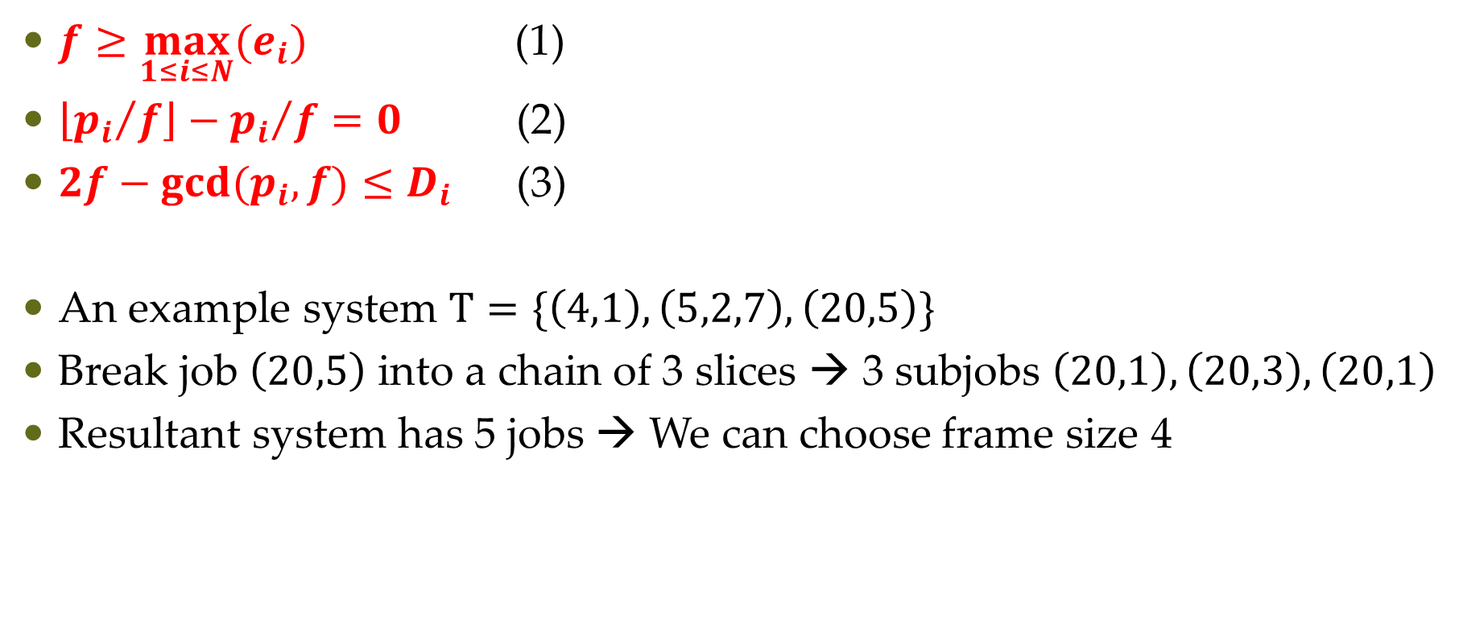
Job Slices
$f≥\max_{1≤i≤N}{{(e}_{i})}$ (1)
$\left\lfloor {p_{i}}/f\right\rfloor −{p_{i}}/f=0$ (2)
$2f−gcd(p_{i},f)≤D_{i}$ (3)
An example system $Τ=\{\left(4,1\right),\left(5,2,7\right),\left(20,5\right)\}$
Break job $\left(20,5\right)$ into a chain of 3 slices → 3 subjobs $\left(20,1\right),\left(20,3\right),\left(20,1\right)$
Resultant system has 5 jobs → We can choose frame size 4

Slide 4
Constructing a Cyclic Schedule
Three kinds of design decisions
choosing a frame size
partitioning jobs into slices
placing slices in the frames
Typically the above decisions cannot be made independently
More the number of slices, more is the context switch or communication overhead

Slide 5
Cyclic Executives
In earlier clock driven scheduler, scheduling decisions are made at task boundaries
We need to make decisions at frame boundaries → Cyclic executive achieves this

Slide 6
Improving the Average Response Time of Aperiodic Jobs
Not considered the performance of the scheduler in terms of aperiodic jobs
Scheduled in background after all the job slices with hard deadlines are completed in each frame
No advantage in completing a job with hard deadline early
Better to improve/minimize the (average) response time of aperiodic job while ensuring hard deadlines are met as aperiodic jobs are released in response to some event

Slide 7
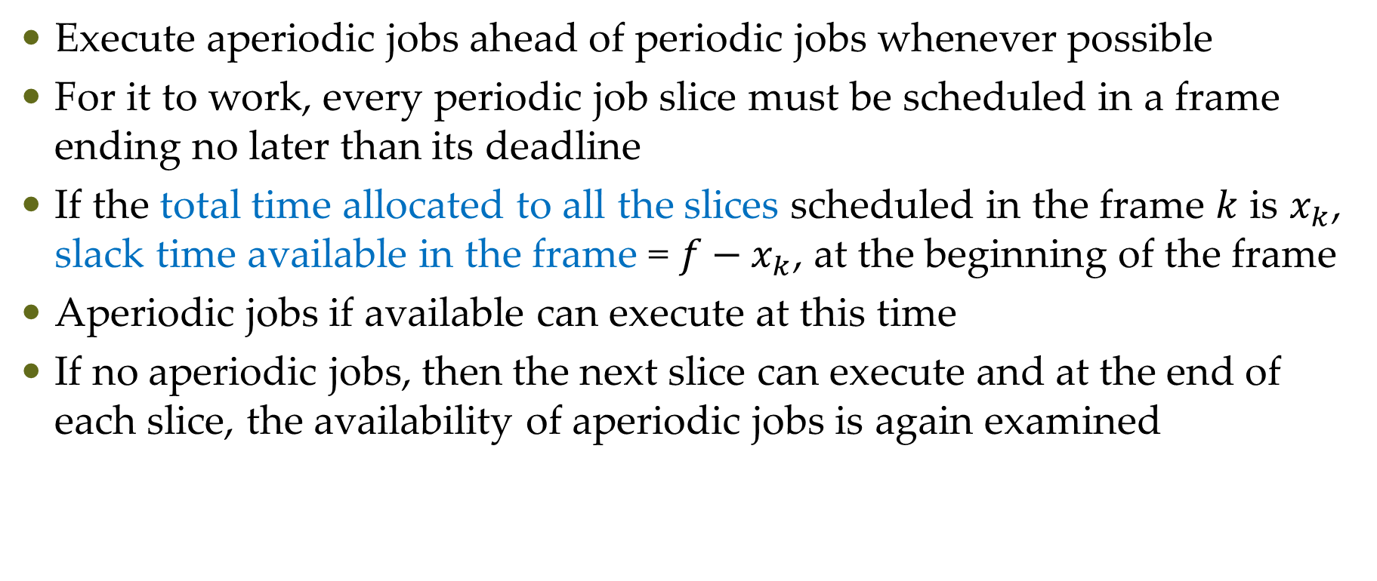
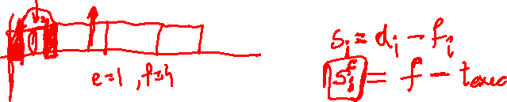
Slack Stealing
Execute aperiodic jobs ahead of periodic jobs whenever possible
For it to work, every periodic job slice must be scheduled in a frame ending no later than its deadline
If the total time allocated to all the slices scheduled in the frame $k$ is $x_{k}$, slack time available in the frame = $f−x_{k}$, at the beginning of the frame
Aperiodic jobs if available can execute at this time
If no aperiodic jobs, then the next slice can execute and at the end of each slice, the availability of aperiodic jobs is again examined

Slide 8

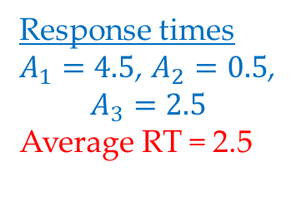
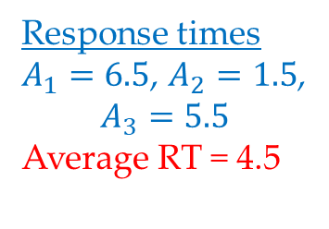
Slack Stealing
Response times $A_{1}=6.5$, $A_{2}=1.5$, $$A_{3}=5.5$$ Average RT = 4.5
Response times $A_{1}=4.5$, $A_{2}=0.5$, $$A_{3}=2.5$$ Average RT = 2.5

Slide 9
Implementation of Slack Stealing
Initial amount of slack in each frame precomputed and stored in table along with the cyclic schedule
Cyclic executive needs to keep track of available slack and keep updating it
Can be done using a timer, which is set to the initial available slack time
Aperiodic job pre-empted by the cyclic executive, whenever the timer expires and lets the next job slice to execute
Practical only when the temporal parameters of periodic tasks are in the order of hundreds of milliseconds or seconds

Slide 10
Practical Considerations – Handling Frame Overruns
Reasons for frame overruns
Execution time of a job is input data dependent – can become unexpectedly large for some rare combinations of input values
A transient hardware fault in the system may cause some jobs to execute longer than expected
A software flaw that was undetected during debugging and testing
Handling method depends on the application and the reason for overrun

Slide 11
Practical Considerations – Handling Frame Overruns
Methods to handle overruns
Simply abort the overrun job at the beginning of the next frame and log the termination. Can be later handled using some recovery mechanism if necessary. Better for applications where late results are not useful.
Premature termination may put the system into inconsistent state. Actions required to recover may be costly. Preempted immediately if not in a critical section or as soon as it exits the critical section.
Allow the execution of the violating job. Start of next frame and job slices is delayed. Good only if occasional late completion of a periodic job is acceptable

Slide 12
Questions?

