Slide 1

Lecture 15: Scheduling Aperiodic and Sporadic Jobs (Chapter 7)
Deepak Gangadharan

Slide 2
Priority Queues maintained by OS
Periodic tasks are scheduled using some priority-driven algorithm
Ready periodic jobs are placed in the periodic task queue, ordered by their priorities
Each accepted sporadic job is assigned a priority and is placed in a priority queue, which may or may not be the same as the periodic task queue
Each new aperiodic job is placed in the aperiodic job queue
New sporadic jobs are inserted into a waiting queue and waits for acceptance

Slide 3
Problem Solutions Considered
Acceptance tests for newly arrived sporadic jobs and how to schedule the accepted sporadic jobs
Acceptance test makes sure that the periodic tasks and previously accepted sporadic jobs do not miss deadlines
How to schedule aperiodic tasks as soon as possible without causing periodic tasks and accepted sporadic jobs to miss their deadlines
An aperiodic job scheduling algorithm is optimal if it either minimizes the response time of aperiodic job at the head of the queue or the average response time of all the aperiodic jobs
Scheduling algorithm for sporadic jobs is optimal if it accepts each sporadic job and schedules it on time iff the new job can be correctly scheduled to complete in time by some means

Slide 4
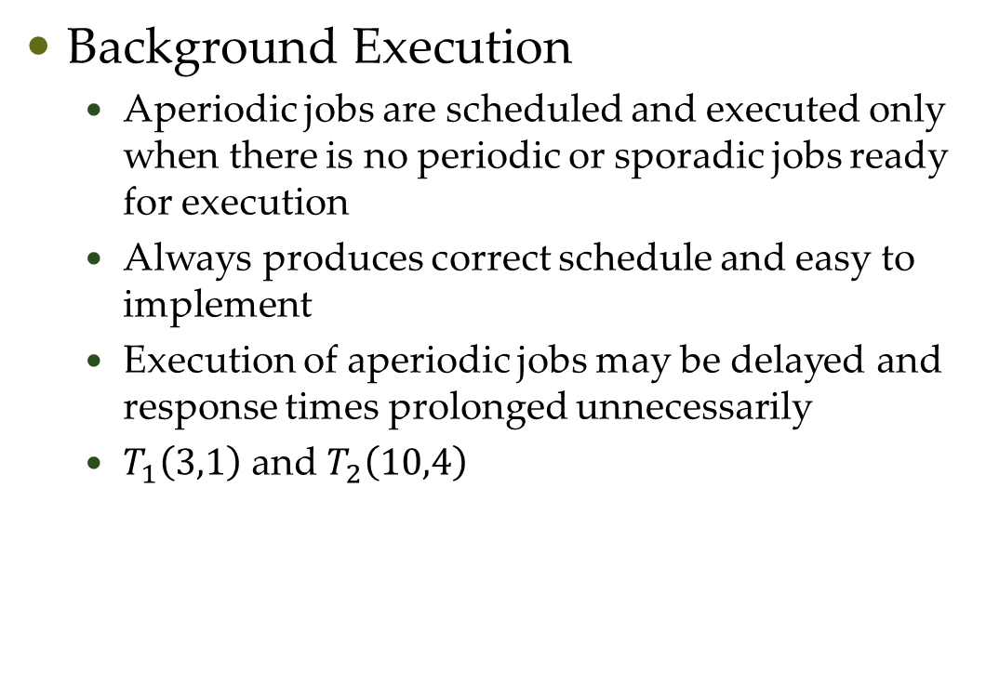
Aperiodic Scheduling: Commonly used Approaches
Background Execution
Aperiodic jobs are scheduled and executed only when there is no periodic or sporadic jobs ready for execution
Always produces correct schedule and easy to implement
Execution of aperiodic jobs may be delayed and response times prolonged unnecessarily
$T_{1}\left(3,1\right)$ and $T_{2}\left(10,4\right)$
Response time = 7.7

Slide 5
Questions?

