Slide 1

Lecture 16: Scheduling Aperiodic and Sporadic Jobs (Chapter 7)
Deepak Gangadharan

Slide 2
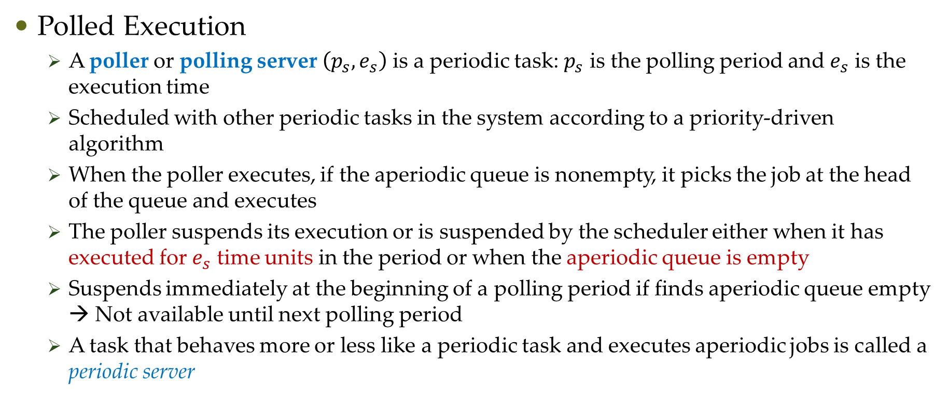
Aperiodic Scheduling: Commonly used Approaches
Polled Execution
A poller or polling server $\left(p_{s},e_{s}\right)$ is a periodic task: $p_{s}$ is the polling period and $e_{s}$ is the execution time
Scheduled with other periodic tasks in the system according to a priority-driven algorithm
When the poller executes, if the aperiodic queue is nonempty, it picks the job at the head of the queue and executes
The poller suspends its execution or is suspended by the scheduler either when it has executed for $e_{s}$ time units in the period or when the aperiodic queue is empty
Suspends immediately at the beginning of a polling period if finds aperiodic queue empty → Not available until next polling period
A task that behaves more or less like a periodic task and executes aperiodic jobs is called a periodic server

Slide 3
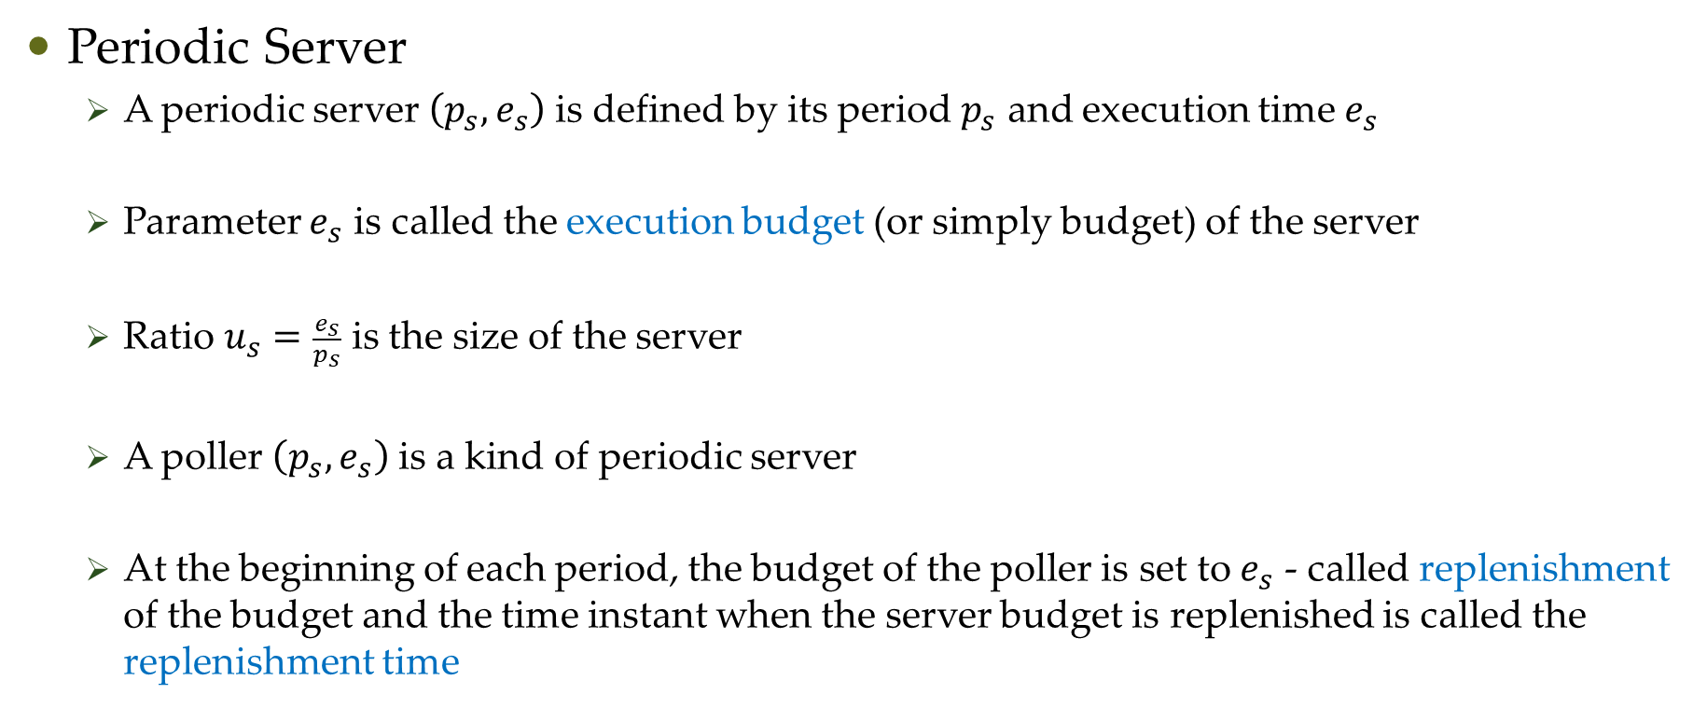
Aperiodic Scheduling: Commonly used Approaches
Periodic Server
A periodic server $\left(p_{s},e_{s}\right)$ is defined by its period $p_{s}$ and execution time $e_{s}$
Parameter $e_{s}$ is called the execution budget (or simply budget) of the server
Ratio $u_{s}=\frac{e_{s}}{p_{s}}$ is the size of the server
A poller $\left(p_{s},e_{s}\right)$ is a kind of periodic server
At the beginning of each period, the budget of the poller is set to $e_{s}$ - called replenishment of the budget and the time instant when the server budget is replenished is called the replenishment time

Slide 4
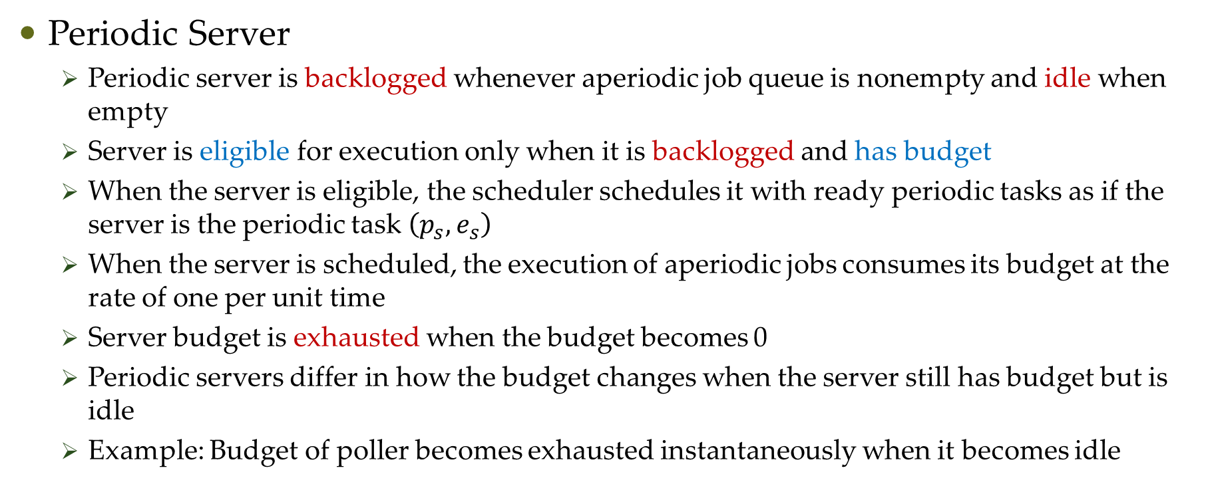
Aperiodic Scheduling: Commonly used Approaches
Periodic Server
Periodic server is backlogged whenever aperiodic job queue is nonempty and idle when empty
Server is eligible for execution only when it is backlogged and has budget
When the server is eligible, the scheduler schedules it with ready periodic tasks as if the server is the periodic task $\left(p_{s},e_{s}\right)$
When the server is scheduled, the execution of aperiodic jobs consumes its budget at the rate of one per unit time
Server budget is exhausted when the budget becomes 0
Periodic servers differ in how the budget changes when the server still has budget but is idle
Example: Budget of poller becomes exhausted instantaneously when it becomes idle

Slide 5
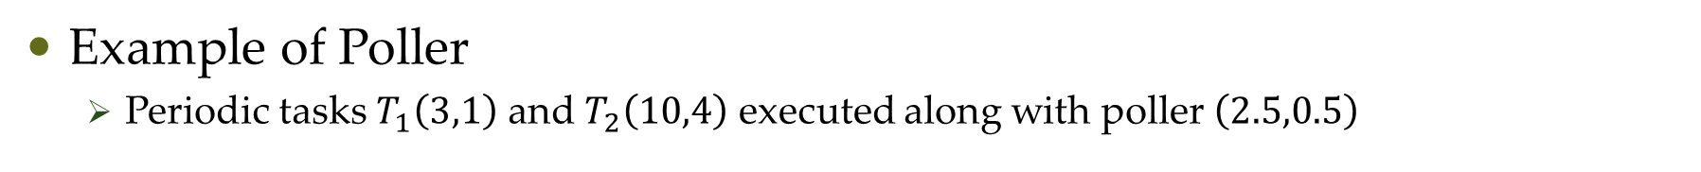
Aperiodic Scheduling: Commonly used Approaches
Example of Poller
Periodic tasks $T_{1}\left(3,1\right)$ and $T_{2}\left(10,4\right)$ executed along with poller $\left(2.5,0.5\right)$
server idle →
budget consumed
Aperiodic job must wait for the next poller period
Can poller preserve the execution budget?

Slide 6
Aperiodic Scheduling: Commonly used Approaches
Bandwidth-Preserving Server
They are periodic servers
Each type defined by their consumption and replenishment rules
Consumption rules: Conditions under which the budget is preserved and consumed
Replenishment rules: When and by how much the budget is replenished

Slide 7
Aperiodic Scheduling: Commonly used Approaches
Bandwidth-Preserving Server (BPS) (Assumptions)
Backlogged BPS is ready for execution when it has budget
Scheduler keeps track of the server budget and suspends the server when it is exhausted or the server becomes idle and moves the server back to the ready queue once replenishment occurs if the server is backlogged at the time
Server suspends itself when it becomes idle and the scheduler puts the server back into ready queue when it becomes backlogged again and if it has budget

Slide 8

Deferrable Server
Simplest of BPS
Execution budget of a deferrable server with period $p_{s}$ and execution budget $e_{s}$ replenished periodically with period $p_{s}$
When no aperiodic job ready, it preserves the budget

Slide 9
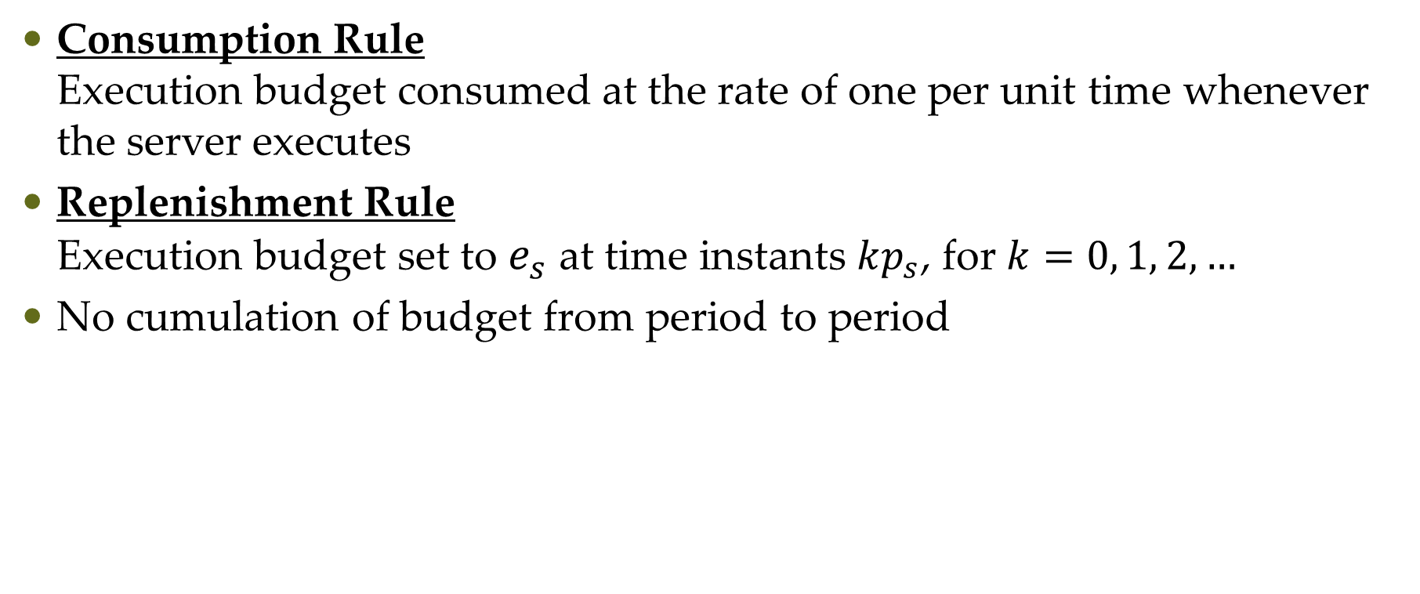
Operations of Deferrable Servers
Consumption Rule Execution budget consumed at the rate of one per unit time whenever the server executes
Replenishment Rule Execution budget set to $e_{s}$ at time instants $kp_{s}$, for $k=0, 1, 2, …$
No cumulation of budget from period to period

Slide 10
Operations of Deferrable Servers
Rate Monotonic Schedule
t = 0 Server given 1 unit of budget. Budget stays till time 2.8 when A arrives. Server executes and budget decreases as it executes.
t = 3 Immediately before the budget is 0.8, but it is lost at time 3. A new budget is acquired at time 3 and server continues to execute.
t = 4 Budget is exhausted and server is suspended
t = 6 Budget is replenished and server resumes execution of A
t = 6.5 A completes execution. Server suspends and holds the remaining budget until t = 9

Slide 11
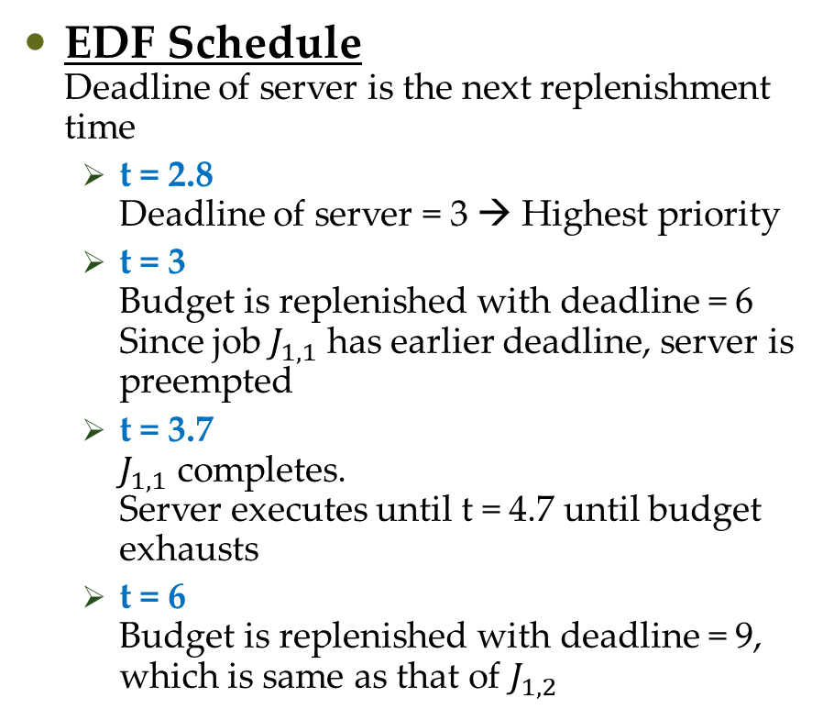

Operations of Deferrable Servers
EDF Schedule Deadline of server is the next replenishment time
t = 2.8 Deadline of server = 3 → Highest priority
t = 3 Budget is replenished with deadline = 6 Since job $J_{1,1}$ has earlier deadline, server is preempted
t = 3.7 $J_{1,1}$ completes. Server executes until t = 4.7 until budget exhausts
t = 6 Budget is replenished with deadline = 9, which is same as that of $J_{1,2}$
$T_{1}\left(2,3.5,1.5\right)$, $T_{2}\left(6.5,0.5\right)$, $T_{DS}=(3,1)$

Slide 12
Questions?

