Slide 1

Lecture 17: Scheduling Aperiodic and Sporadic Jobs (Chapter 7)
Deepak Gangadharan

Slide 2
Schedulability of FP Systems with Deferrable Server
Can we improve the response time of the aperiodic job by increasing the execution budget of the server?
Example: Can we make it 1.5 instead of 1?

Slide 3
Schedulability of FP Systems with Deferrable Server
Factor Limiting the budget of a deferrable server
Is the deferrable server (3,1.5) feasible?
Turns out task (3.5,1.5) will not be feasible if the budget of deferrable server is made more than 1

Slide 4
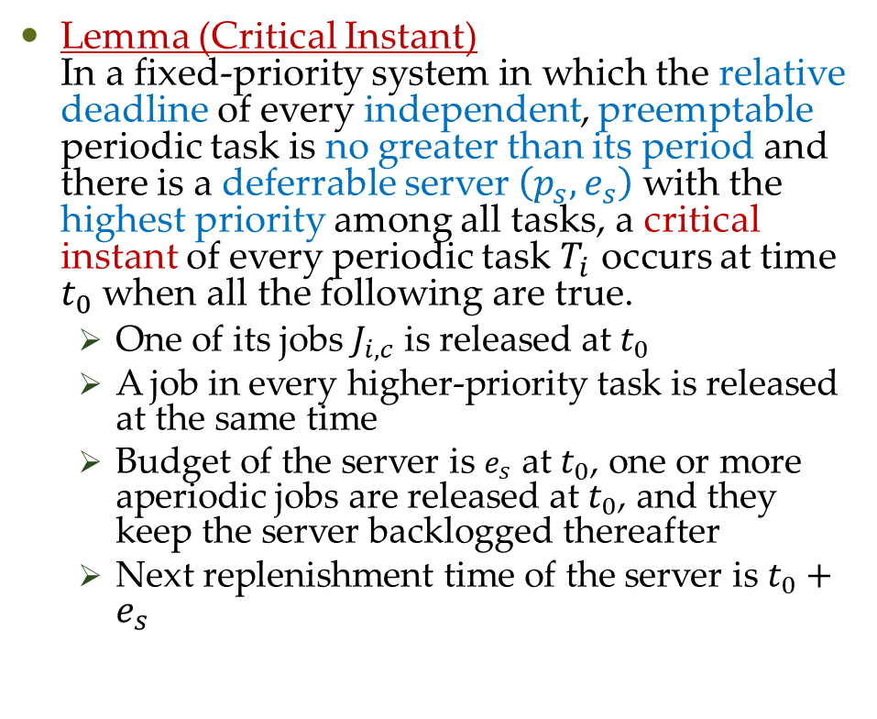
Schedulability of FP Systems with Deferrable Server
Lemma (Critical Instant) In a fixed-priority system in which the relative deadline of every independent, preemptable periodic task is no greater than its period and there is a deferrable server $\left(p_{s},e_{s}\right)$ with the highest priority among all tasks, a critical instant of every periodic task $T_{i}$ occurs at time $t_{0}$ when all the following are true.
One of its jobs $J_{i,c}$ is released at $t_{0}$
A job in every higher-priority task is released at the same time
Budget of the server is $e_{s}$ at $t_{0}$, one or more aperiodic jobs are released at $t_{0}$, and they keep the server backlogged thereafter
Next replenishment time of the server is $t_{0}+e_{s}$

Slide 5
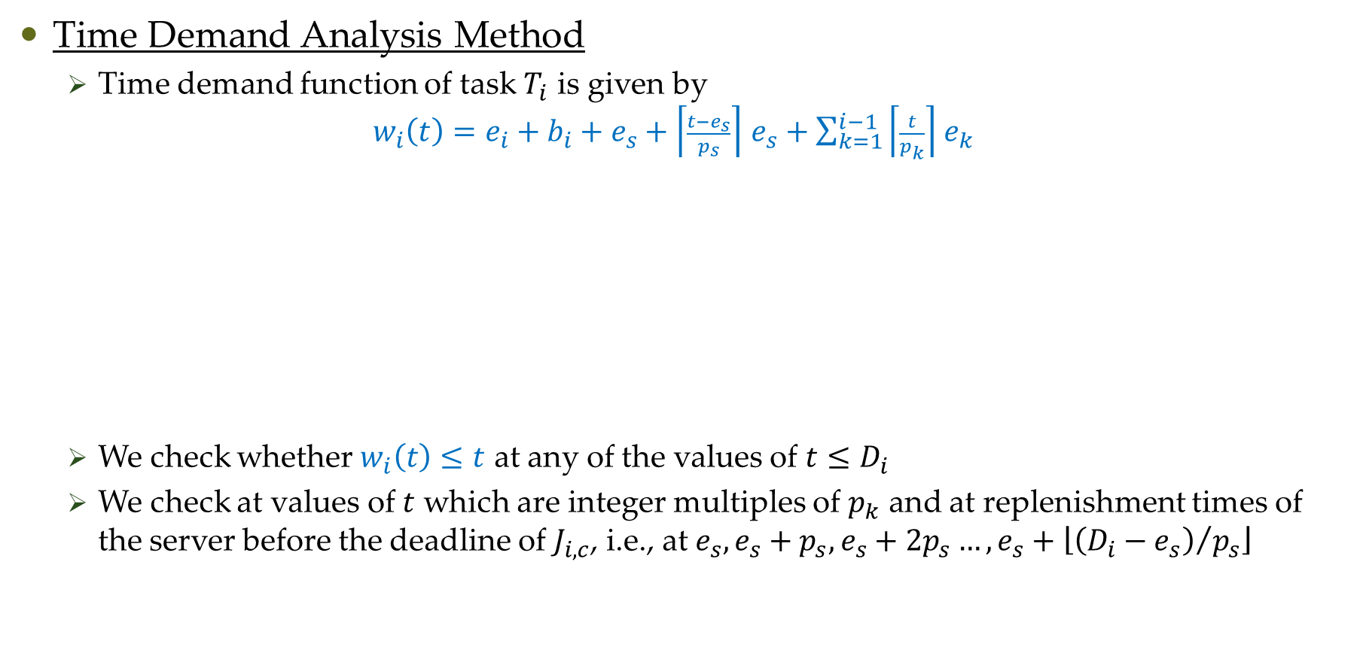
Schedulability of FP Systems with Deferrable Server
Time Demand Analysis Method
Time demand function of task $T_{i}$ is given by $w_{i}\left(t\right)=e_{i}+b_{i}+e_{s}+\left\lceil \frac{t−e_{s}}{p_{s}}\right\rceil$ $e_{s}+\sum_{k=1}^{i−1}{\left\lceil \frac{t}{p_{k}}\right\rceil }$ $e_{k}$
We check whether $w_{i}\left(t\right)≤t$ at any of the values of $t≤D_{i}$
We check at values of $t$ which are integer multiples of $p_{k}$ and at replenishment times of the server before the deadline of $J_{i,c}$, i.e., at $e_{s}, e_{s}+p_{s}, e_{s}+2p_{s}…, e_{s}+\left\lfloor {\left(D_{i}−e_{s}\right)}/{p_{s}}\right\rfloor$
Maximum amount of
processor time demanded
by server at time t
Blocking time of
non-premptive low
priority tasks

Slide 6
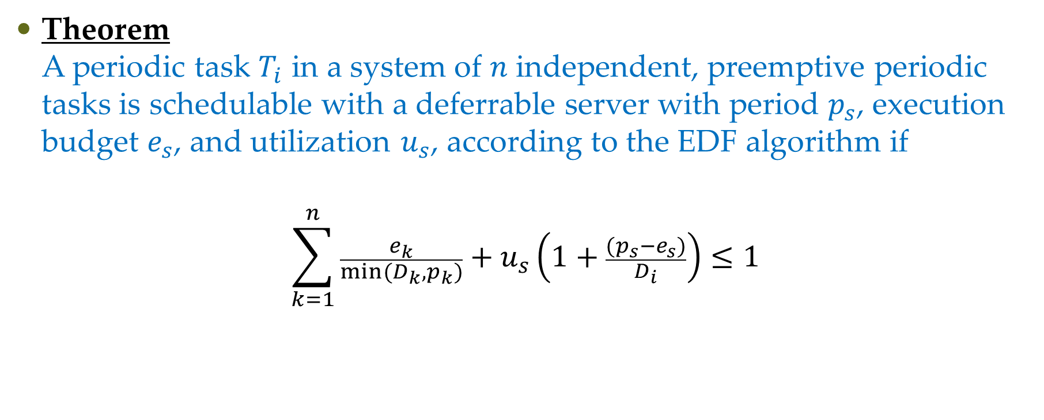
Schedulability of Deadline-Driven Systems with Deferrable Server
Theorem A periodic task $T_{i}$ in a system of $n$ independent, preemptive periodic tasks is schedulable with a deferrable server with period $p_{s}$, execution budget $e_{s}$, and utilization $u_{s}$, according to the EDF algorithm if
$$\sum_{k=1}^{n}{\frac{e_{k}}{min⁡(D_{k},p_{k})}}+u_{s}\left(1+\frac{(p_{s}−e_{s})}{D_{i}}\right)≤1$$

Slide 7
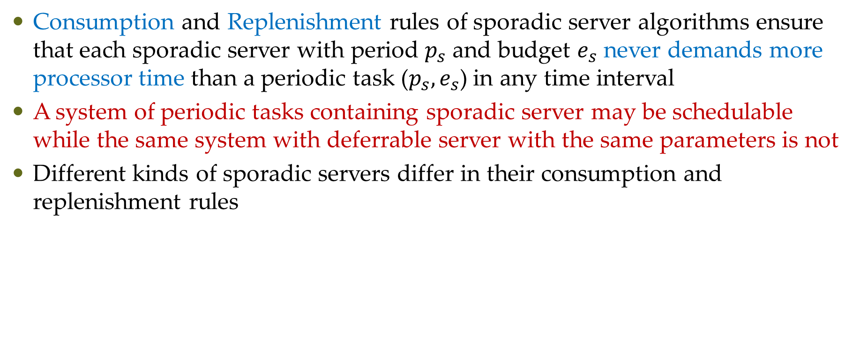
Sporadic Server
Consumption and Replenishment rules of sporadic server algorithms ensure that each sporadic server with period $p_{s}$ and budget $e_{s}$ never demands more processor time than a periodic task ($p_{s},e_{s}$) in any time interval
A system of periodic tasks containing sporadic server may be schedulable while the same system with deferrable server with the same parameters is not
Different kinds of sporadic servers differ in their consumption and replenishment rules

Slide 8
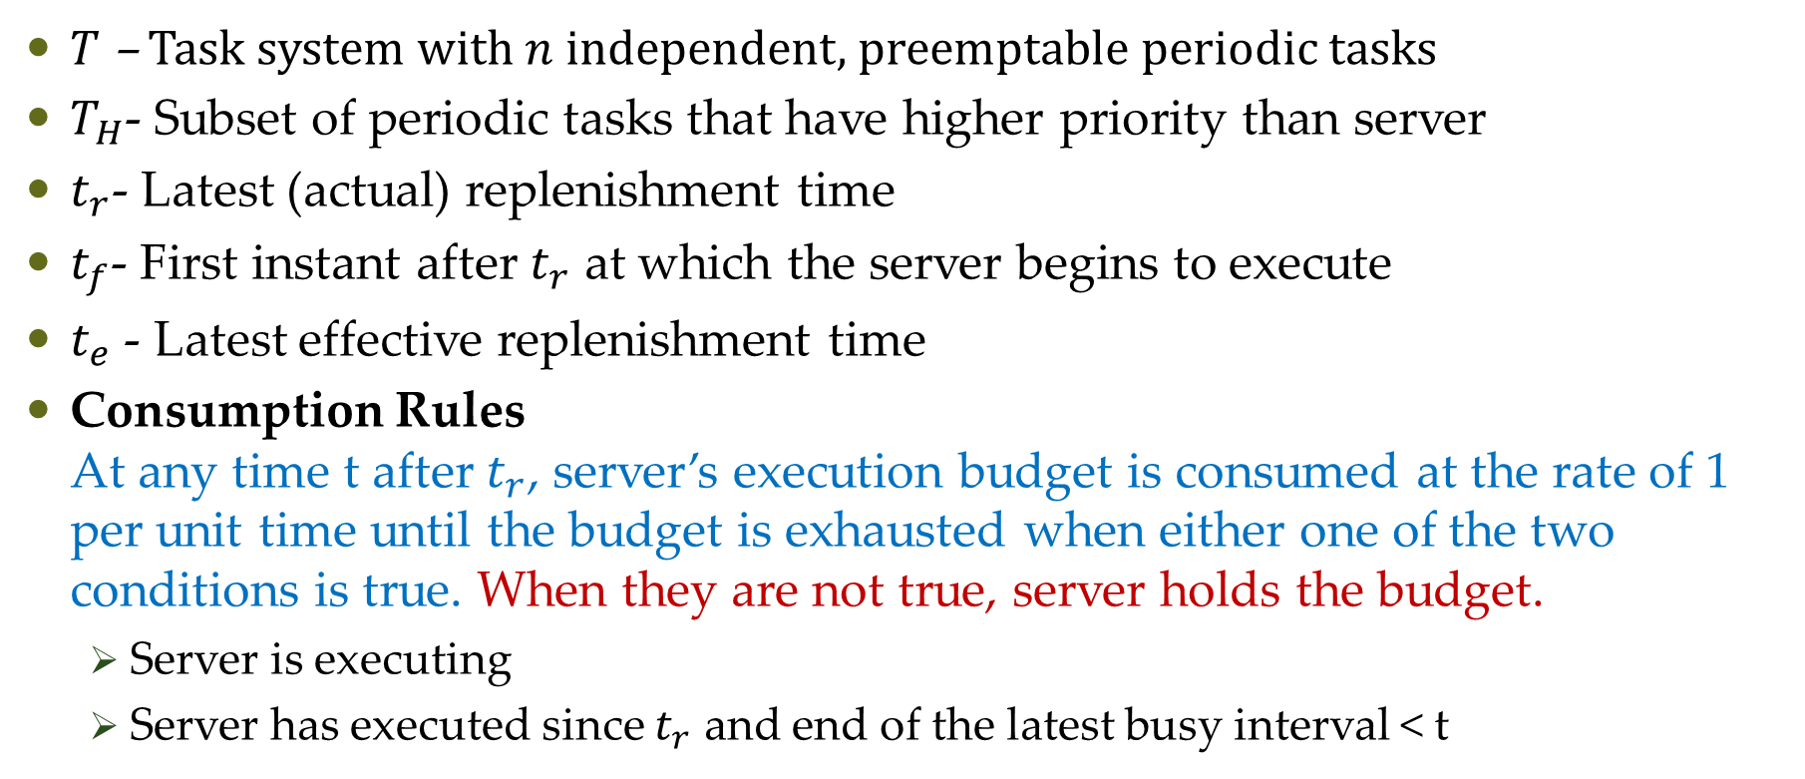
Simple Sporadic Server
$T$ – Task system with $n$ independent, preemptable periodic tasks
$T_{H}$- Subset of periodic tasks that have higher priority than server
$t_{r}$- Latest (actual) replenishment time
$t_{f}$- First instant after $t_{r}$ at which the server begins to execute
$t_{e}$ - Latest effective replenishment time
Consumption Rules At any time t after $t_{r}$, server’s execution budget is consumed at the rate of 1 per unit time until the budget is exhausted when either one of the two conditions is true. When they are not true, server holds the budget.
Server is executing
Server has executed since $t_{r}$ and end of the latest busy interval < t

Slide 9
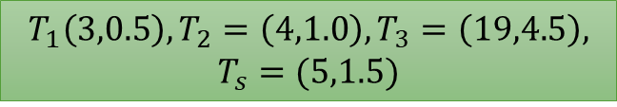
Simple Sporadic Server
$$T_{1}\left(3,0.5\right),T_{2}=\left(4,1.0\right),T_{3}=\left(19,4.5\right),$$
$$T_{s}=(5,1.5)$$
R2
R3b

Slide 10
Questions?

