Slide 1

Lecture 18: Scheduling Aperiodic and Sporadic Jobs (Chapter 7)
Deepak Gangadharan

Slide 2
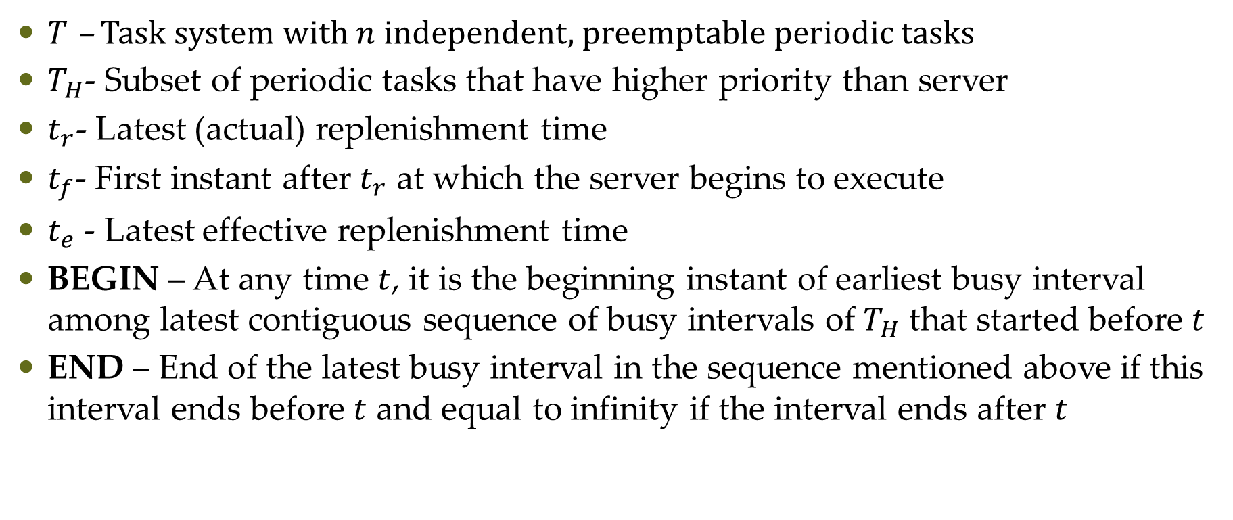
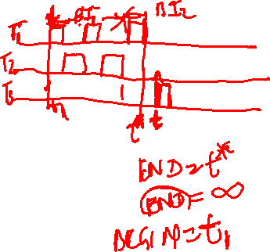
Sporadic Server in FP Systems
$T$ – Task system with $n$ independent, preemptable periodic tasks
$T_{H}$- Subset of periodic tasks that have higher priority than server
$t_{r}$- Latest (actual) replenishment time
$t_{f}$- First instant after $t_{r}$ at which the server begins to execute
$t_{e}$ - Latest effective replenishment time
BEGIN – At any time $t$, it is the beginning instant of earliest busy interval among latest contiguous sequence of busy intervals of $T_{H}$ that started before $t$
END – End of the latest busy interval in the sequence mentioned above if this interval ends before $t$ and equal to infinity if the interval ends after $t$

Slide 3
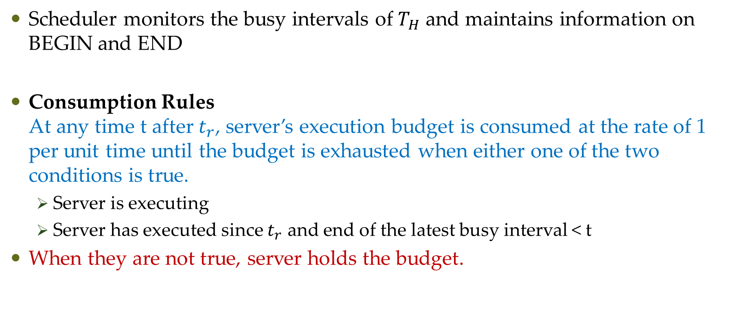
Simple Sporadic Server
Scheduler monitors the busy intervals of $T_{H}$ and maintains information on BEGIN and END
Consumption Rules At any time t after $t_{r}$, server’s execution budget is consumed at the rate of 1 per unit time until the budget is exhausted when either one of the two conditions is true.
Server is executing
Server has executed since $t_{r}$ and end of the latest busy interval < t
When they are not true, server holds the budget.

Slide 4
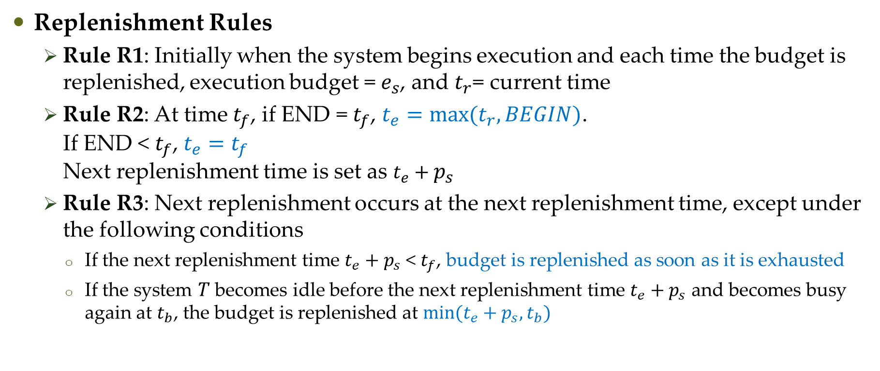
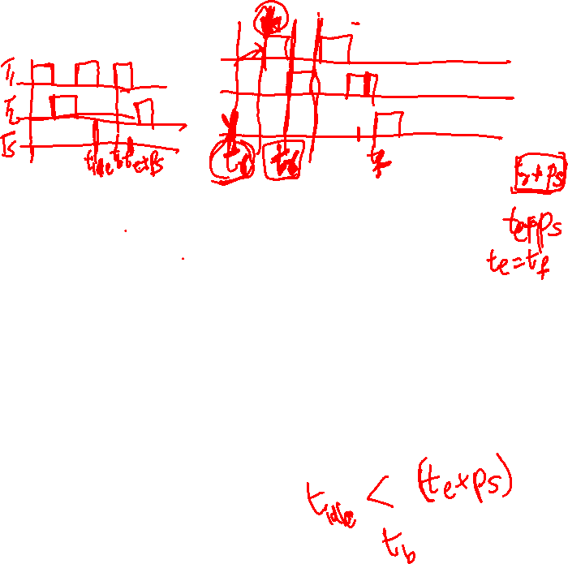
Simple Sporadic Server
Replenishment Rules
Rule R1: Initially when the system begins execution and each time the budget is replenished, execution budget = $e_{s}$, and $t_{r}$= current time
Rule R2: At time $t_{f}$, if END = $t_{f}$, $t_{e}=max⁡(t_{r},BEGIN)$. If END < $t_{f}$, $t_{e}=t_{f}$ Next replenishment time is set as $t_{e}+p_{s}$
Rule R3: Next replenishment occurs at the next replenishment time, except under the following conditions
If the next replenishment time $t_{e}+p_{s}$ < $t_{f}$, budget is replenished as soon as it is exhausted
If the system $T$ becomes idle before the next replenishment time $t_{e}+p_{s}$ and becomes busy again at $t_{b}$, the budget is replenished at $min⁡(t_{e}+p_{s},t_{b})$

Slide 5
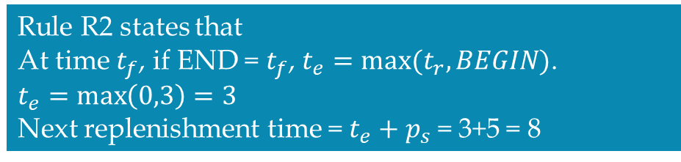
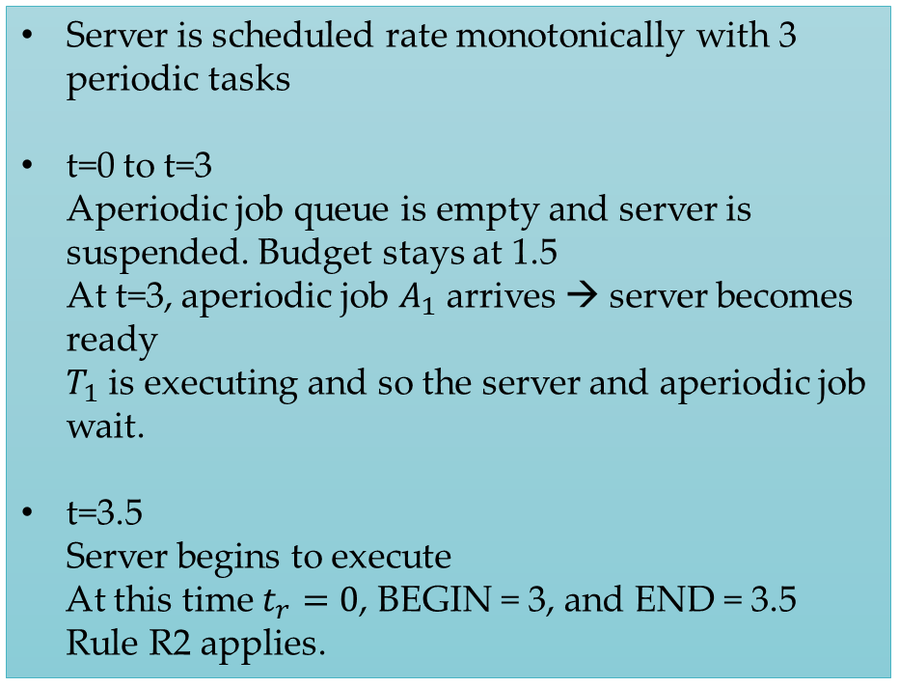
Simple Sporadic Server
$$T_{1}\left(3,0.5\right),T_{2}=\left(4,1.0\right),T_{3}=\left(19,4.5\right),T_{s}=(5,1.5)$$
Server is scheduled rate monotonically with 3 periodic tasks
t=0 to t=3 Aperiodic job queue is empty and server is suspended. Budget stays at 1.5 At t=3, aperiodic job $A_{1}$ arrives → server becomes ready $T_{1}$ is executing and so the server and aperiodic job wait.
t=3.5
Server begins to execute At this time $t_{r}=0$, BEGIN = 3, and END = 3.5
Rule R2 applies.
Rule R2 states that At time $t_{f}$, if END = $t_{f}$, $t_{e}=max⁡(t_{r},BEGIN)$.
$t_{e}=\max\left(0,3\right)=3$
Next replenishment time = $t_{e}+p_{s}$ = 3+5 = 8

Slide 6
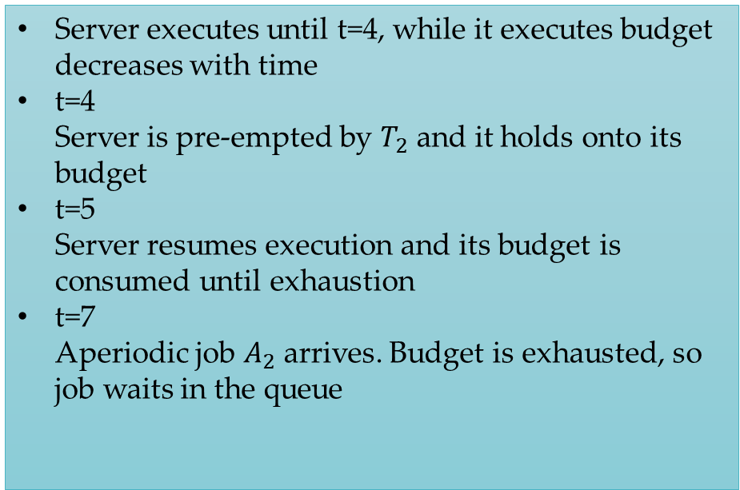
Simple Sporadic Server
$$T_{1}\left(3,0.5\right),T_{2}=\left(4,1.0\right),T_{3}=\left(19,4.5\right),T_{s}=(5,1.5)$$
Server executes until t=4, while it executes budget decreases with time
t=4 Server is pre-empted by $T_{2}$ and it holds onto its budget
t=5 Server resumes execution and its budget is consumed until exhaustion
t=7 Aperiodic job $A_{2}$ arrives. Budget is exhausted, so job waits in the queue

Slide 7
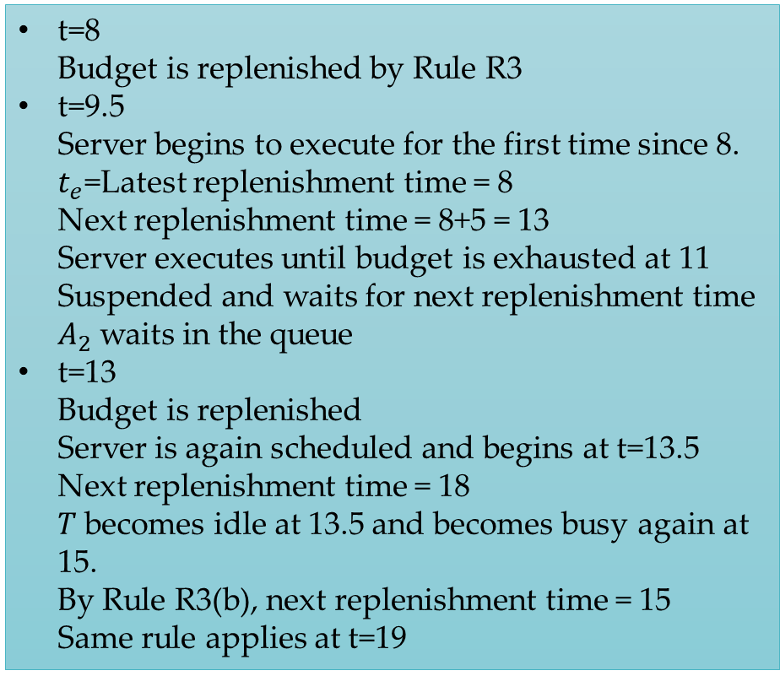
Simple Sporadic Server
$$T_{1}\left(3,0.5\right),T_{2}=\left(4,1.0\right),T_{3}=\left(19,4.5\right),T_{s}=(5,1.5)$$
t=8 Budget is replenished by Rule R3
t=9.5 Server begins to execute for the first time since 8. $t_{e}$=Latest replenishment time = 8 Next replenishment time = 8+5 = 13 Server executes until budget is exhausted at 11 Suspended and waits for next replenishment time $A_{2}$ waits in the queue
t=13 Budget is replenished Server is again scheduled and begins at t=13.5 Next replenishment time = 18 $T$ becomes idle at 13.5 and becomes busy again at 15. By Rule R3(b), next replenishment time = 15 Same rule applies at t=19

Slide 8
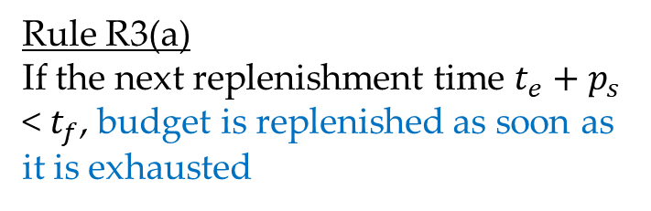
Simple Sporadic Server
Rule R3(a) If the next replenishment time $t_{e}+p_{s}$ < $t_{f}$, budget is replenished as soon as it is exhausted

Slide 9
Questions?

