Slide 1

Lecture 19: Scheduling Aperiodic and Sporadic Jobs (Chapter 7)
Deepak Gangadharan

Slide 2

Constant Utilization Server
Belongs to a class of algorithms emulating Generalized Processor Sharing (GPS) algorithm
GPS gives each server infinitesimally small time slice of length proportional to the server size
Each server maintained and scheduled according to this algorithm offers timing isolation to tasks executed by it

Slide 3
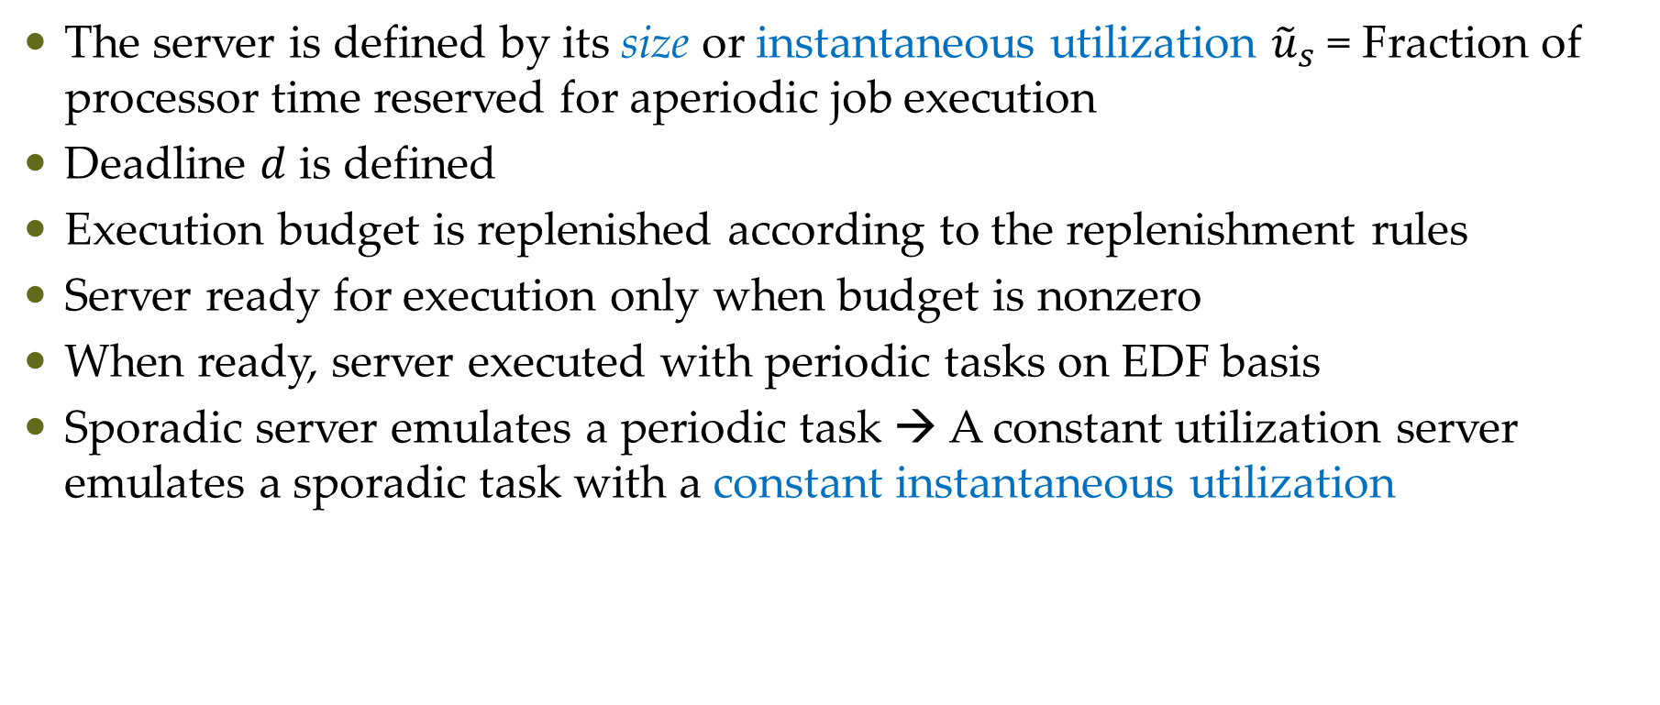
Constant Utilization Server
The server is defined by its size or instantaneous utilization ${\tilde{u}}_{s}$ = Fraction of processor time reserved for aperiodic job execution
Deadline $d$ is defined
Execution budget is replenished according to the replenishment rules
Server ready for execution only when budget is nonzero
When ready, server executed with periodic tasks on EDF basis
Sporadic server emulates a periodic task → A constant utilization server emulates a sporadic task with a constant instantaneous utilization

Slide 4
Consumption Rule
Consumption Rule of constant utilization server, total bandwidth server or weighted fair-queueing server is simple – A server consumes the budget only when it executes
Does not have a budget when there is no aperiodic job ready
No problem of dealing with chunks of budget

Slide 5
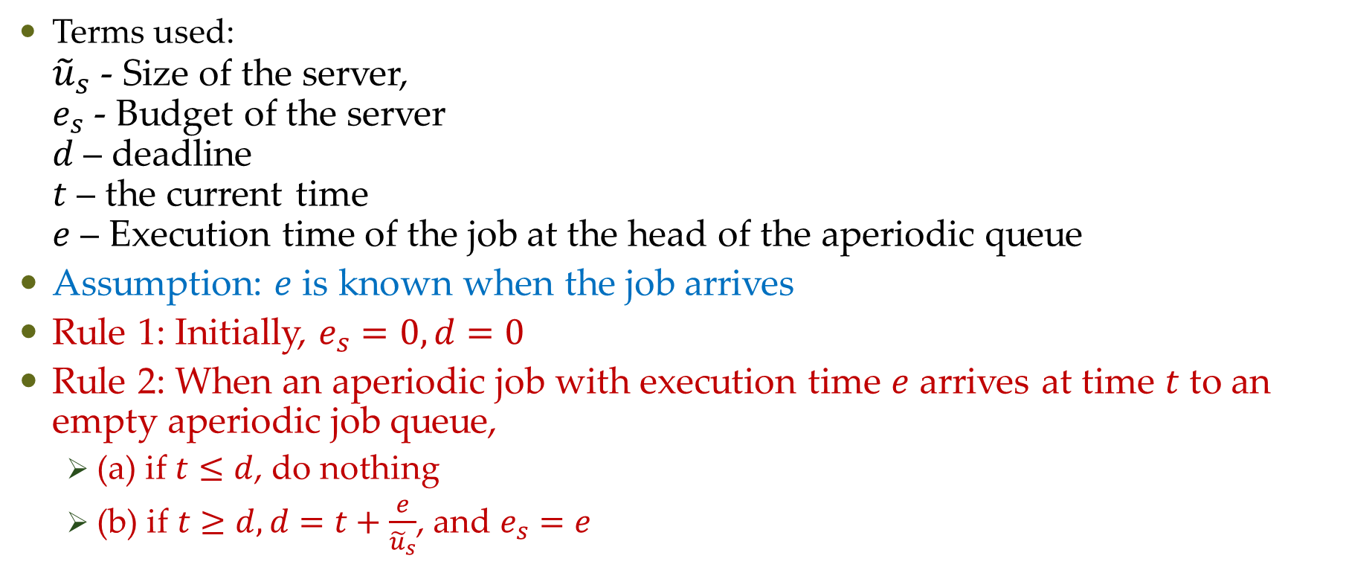
Replenishment Rule
Terms used: ${\tilde{u}}_{s}$ - Size of the server, $e_{s}$ - Budget of the server $d$ – deadline $t$ – the current time $e$ – Execution time of the job at the head of the aperiodic queue
Assumption: $e$ is known when the job arrives
Rule 1: Initially, $e_{s}=0,d=0$
Rule 2: When an aperiodic job with execution time $e$ arrives at time $t$ to an empty aperiodic job queue,
(a) if $t≤d$, do nothing
(b) if $t≥d, d=t+\frac{e}{{\tilde{u}}_{s}}$, and $e_{s}=e$

Slide 6
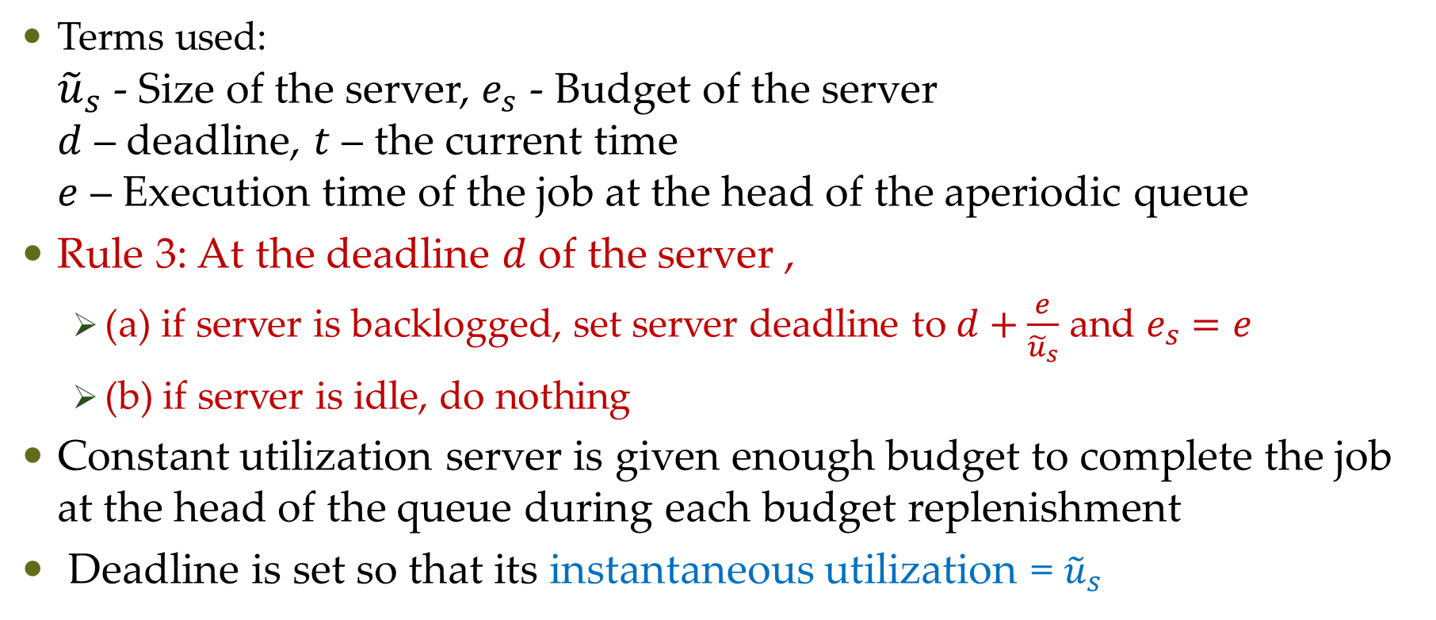
Replenishment Rule
Terms used: ${\tilde{u}}_{s}$ - Size of the server, $e_{s}$ - Budget of the server $d$ – deadline, $t$ – the current time $e$ – Execution time of the job at the head of the aperiodic queue
Rule 3: At the deadline $d$ of the server ,
(a) if server is backlogged, set server deadline to $d+\frac{e}{{\tilde{u}}_{s}}$ and $e_{s}=e$
(b) if server is idle, do nothing
Constant utilization server is given enough budget to complete the job at the head of the queue during each budget replenishment
Deadline is set so that its instantaneous utilization = ${\tilde{u}}_{s}$

Slide 7
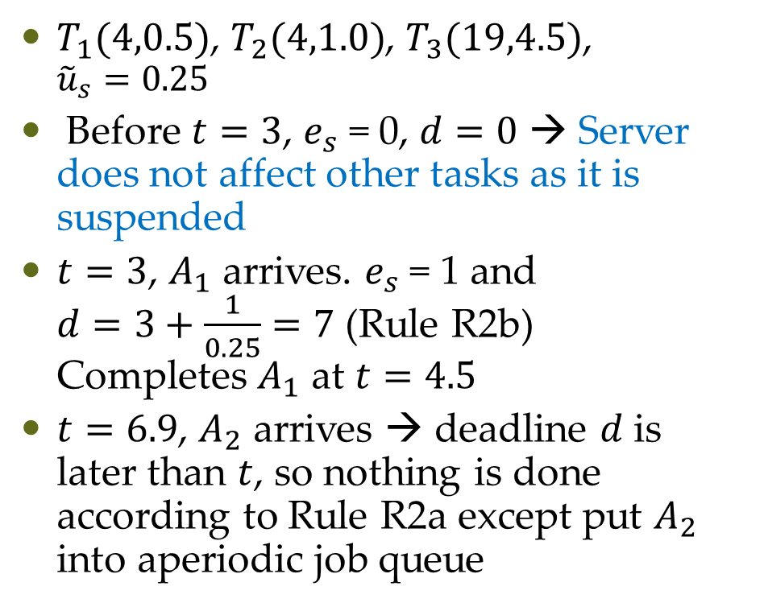
Constant Utilization Server - Example
$T_{1}(4,0.5)$, $T_{2}(4,1.0)$, $T_{3}(19,4.5)$, ${\tilde{u}}_{s}=0.25$
Before $t=3$, $e_{s}$ = 0, $d=0$ → Server does not affect other tasks as it is suspended
$t=3$, $A_{1}$ arrives. $e_{s}$ = 1 and $d=3+\frac{1}{0.25}=7$ (Rule R2b) Completes $A_{1}$ at $t=4.5$
$t=6.9$, $A_{2}$ arrives → deadline $d$ is later than $t$, so nothing is done according to Rule R2a except put $A_{2}$ into aperiodic job queue

Slide 8
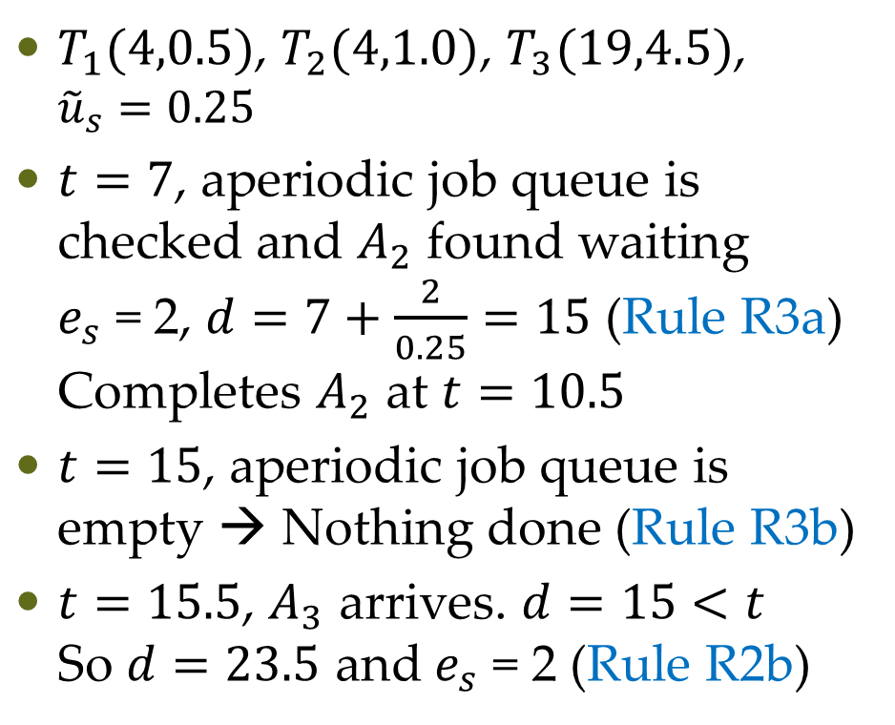
Constant Utilization Server - Example
$T_{1}(4,0.5)$, $T_{2}(4,1.0)$, $T_{3}(19,4.5)$, ${\tilde{u}}_{s}=0.25$
$t=7$, aperiodic job queue is checked and $A_{2}$ found waiting $e_{s}$ = 2, $d=7+\frac{2}{0.25}=15$ (Rule R3a) Completes $A_{2}$ at $t=10.5$
$t=15$, aperiodic job queue is empty → Nothing done (Rule R3b)
$t=15.5$, $A_{3}$ arrives. $d=15<t$ So $d=23.5$ and $e_{s}$ = 2 (Rule R2b)

Slide 9
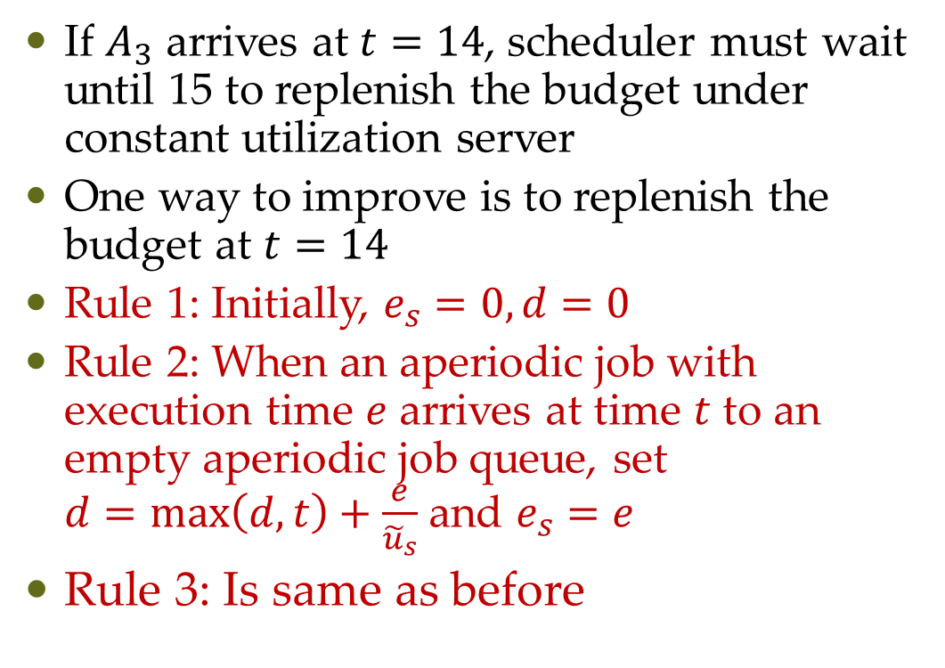
Total Bandwidth Server Algorithm
If $A_{3}$ arrives at $t=14$, scheduler must wait until 15 to replenish the budget under constant utilization server
One way to improve is to replenish the budget at $t=14$
Rule 1: Initially, $e_{s}=0,d=0$
Rule 2: When an aperiodic job with execution time $e$ arrives at time $t$ to an empty aperiodic job queue, set $d=\max\left(d,t\right)+\frac{e}{{\tilde{u}}_{s}}$ and $e_{s}=e$
Rule 3: Is same as before

Slide 10
Questions?

