Slide 1

Lecture 20: Resource Access Control
Deepak Gangadharan

Slide 2
Agenda
Effect of Resource Contention on the execution behaviour and schedulability of jobs
Effect of Resource Access-Control Protocols over resource contention
Considerations
Focus on priority-driven systems
No problem with clock-driven systems as resource contention avoided by scheduling jobs according to a cyclic schedule → resource access of jobs are serialized

Slide 3
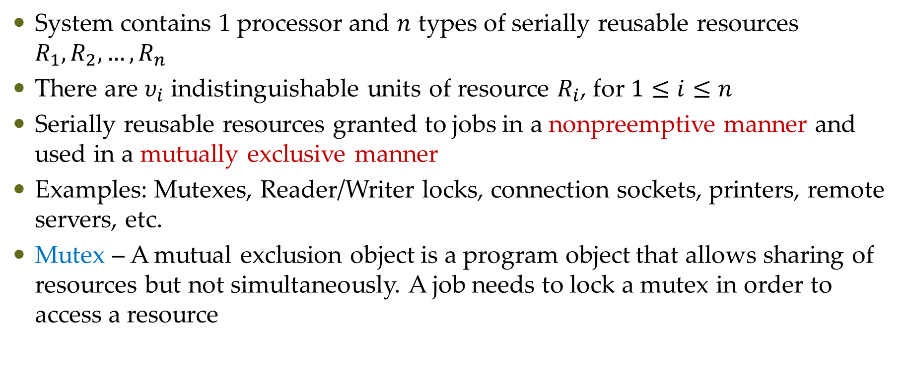
Assumptions on Resources and Usage
System contains 1 processor and $n$ types of serially reusable resources $R_{1}, R_{2},…,R_{n}$
There are $υ_{i}$ indistinguishable units of resource $R_{i}$, for $1≤i≤n$
Serially reusable resources granted to jobs in a nonpreemptive manner and used in a mutually exclusive manner
Examples: Mutexes, Reader/Writer locks, connection sockets, printers, remote servers, etc.
Mutex – A mutual exclusion object is a program object that allows sharing of resources but not simultaneously. A job needs to lock a mutex in order to access a resource

Slide 4
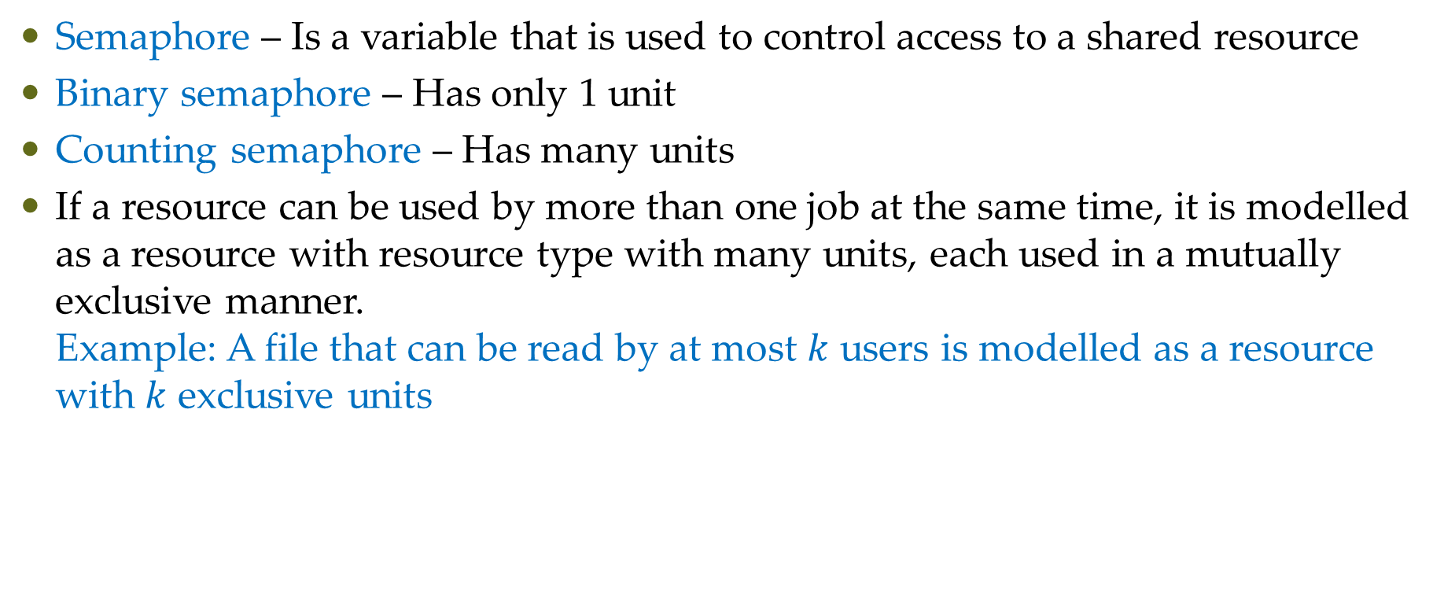
Assumptions on Resources and Usage
Semaphore – Is a variable that is used to control access to a shared resource
Binary semaphore – Has only 1 unit
Counting semaphore – Has many units
If a resource can be used by more than one job at the same time, it is modelled as a resource with resource type with many units, each used in a mutually exclusive manner. Example: A file that can be read by at most $k$ users is modelled as a resource with $k$ exclusive units

Slide 5
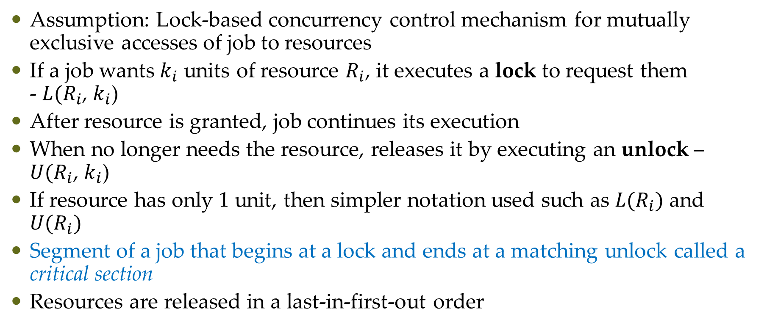
Enforcement of Mutual Exclusion and Critical Sections
Assumption: Lock-based concurrency control mechanism for mutually exclusive accesses of job to resources
If a job wants $k_{i}$ units of resource $R_{i}$, it executes a lock to request them - $L(R_{i}$, $k_{i}$)
After resource is granted, job continues its execution
When no longer needs the resource, releases it by executing an unlock – $U(R_{i}$, $k_{i}$)
If resource has only 1 unit, then simpler notation used such as $L(R_{i})$ and $U(R_{i})$
Segment of a job that begins at a lock and ends at a matching unlock called a critical section
Resources are released in a last-in-first-out order

Slide 6
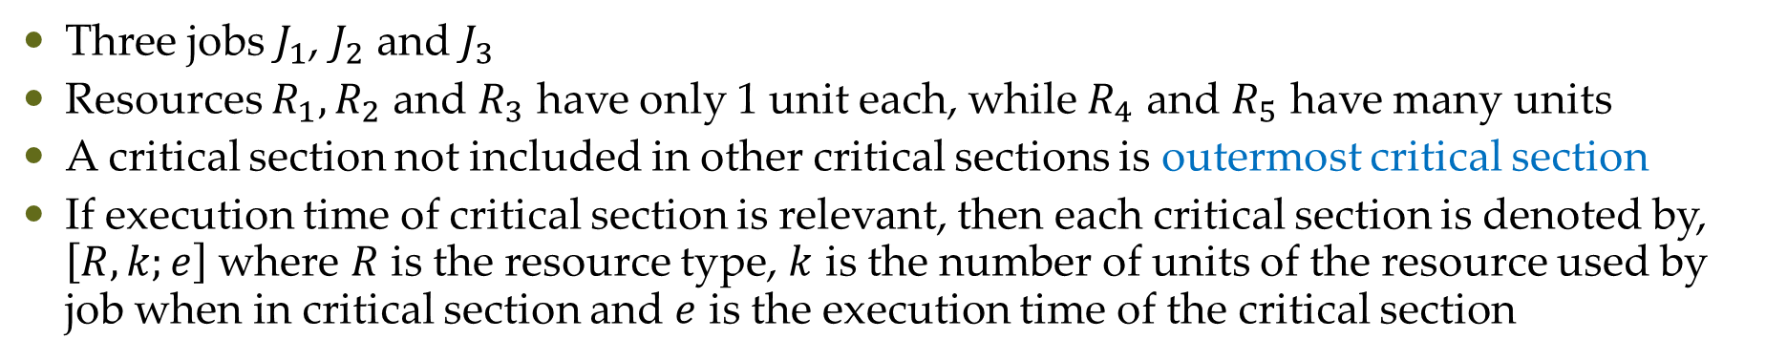
Enforcement of Mutual Exclusion and Critical Sections
Three jobs $J_{1}$, $J_{2}$ and $J_{3}$
Resources $R_{1}, R_{2}$ and $R_{3}$ have only 1 unit each, while $R_{4}$ and $R_{5}$ have many units
A critical section not included in other critical sections is outermost critical section
If execution time of critical section is relevant, then each critical section is denoted by, $\left[R, k;e\right]$ where $R$ is the resource type, $k$ is the number of units of the resource used by job when in critical section and $e$ is the execution time of the critical section

Slide 7
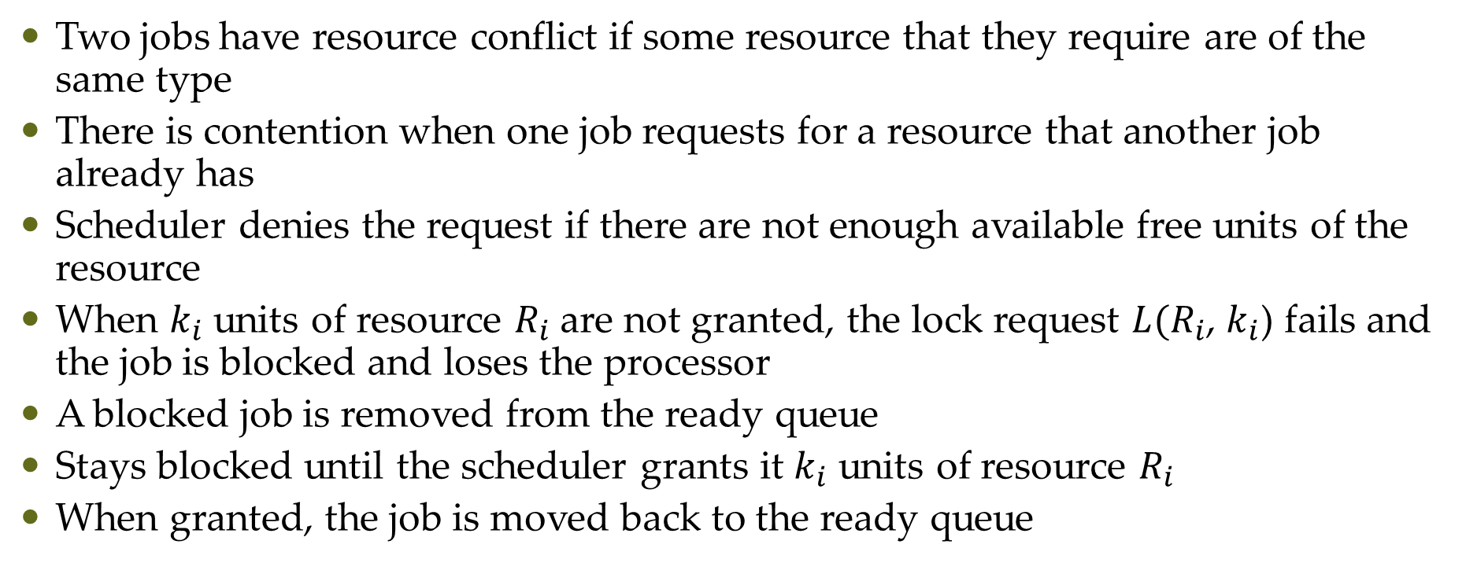
Resource Conflicts and Blocking
Two jobs have resource conflict if some resource that they require are of the same type
There is contention when one job requests for a resource that another job already has
Scheduler denies the request if there are not enough available free units of the resource
When $k_{i}$ units of resource $R_{i}$are not granted, the lock request $L(R_{i}$, $k_{i}$) fails and the job is blocked and loses the processor
A blocked job is removed from the ready queue
Stays blocked until the scheduler grants it $k_{i}$ units of resource $R_{i}$
When granted, the job is moved back to the ready queue

Slide 8
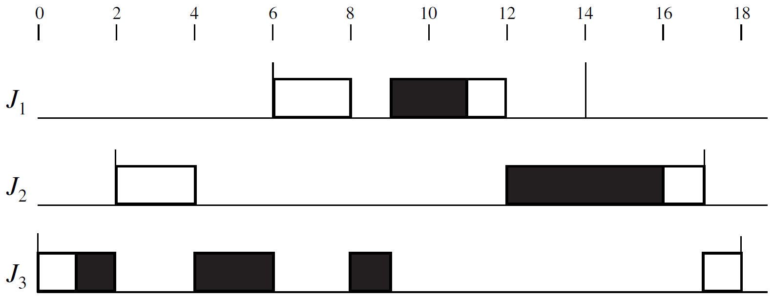
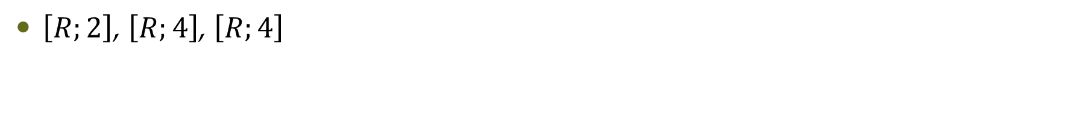
Resource Conflicts and Blocking
$\left[R;2\right]$, $\left[R;4\right]$, $\left[R;4\right]$

Slide 9
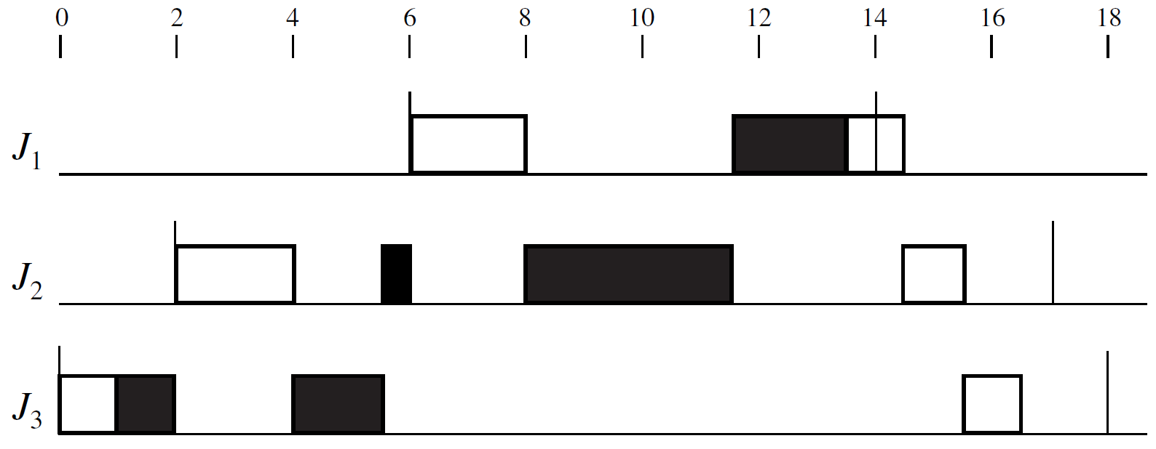
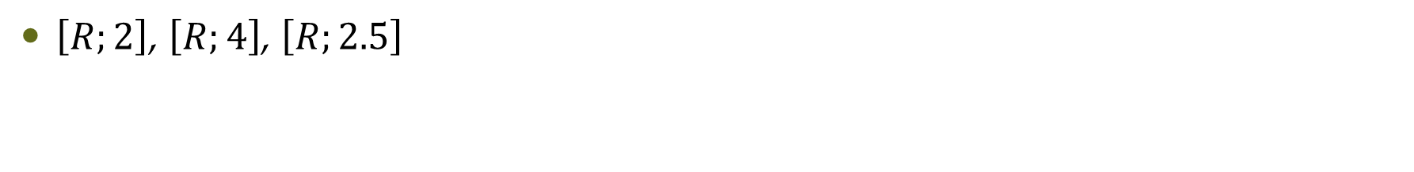
Timing Anomaly
$\left[R;2\right]$, $\left[R;4\right]$, $\left[R;2.5\right]$

Slide 10
Questions?

