Slide 1

Lecture 21: Resource Access Control
Deepak Gangadharan

Slide 2
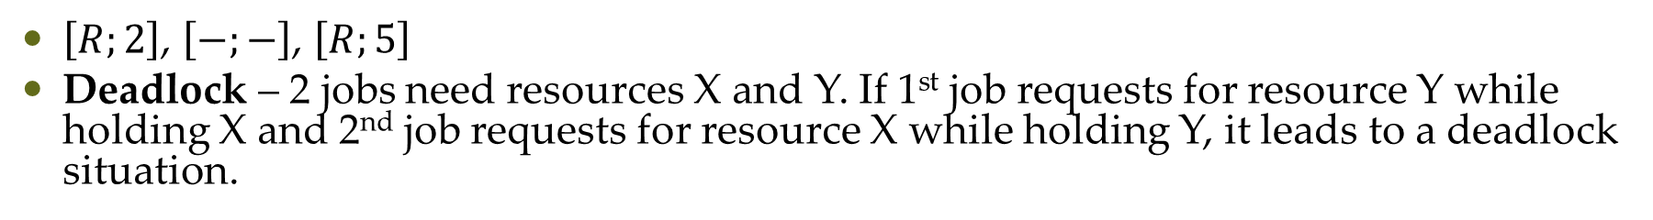
Uncontrolled Priority Inversion and Deadlocks
$\left[R;2\right]$, $\left[−;−\right]$, $\left[R;5\right]$
Deadlock – 2 jobs need resources X and Y. If 1st job requests for resource Y while holding X and 2nd job requests for resource X while holding Y, it leads to a deadlock situation.
A resource access control protocol cannot eliminate priority inversion and anomalous behaviour → A good protocol can only control priority inversion (bound blocking time of every job) and prevent deadlocks

Slide 3
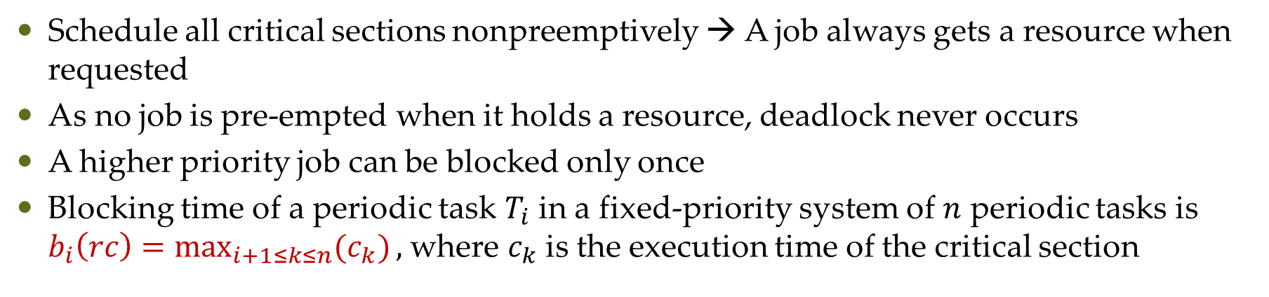
Nonpreemptive Critical Section (NPCS) Protocol
Schedule all critical sections nonpreemptively → A job always gets a resource when requested
As no job is pre-empted when it holds a resource, deadlock never occurs
A higher priority job can be blocked only once
Blocking time of a periodic task $T_{i}$ in a fixed-priority system of $n$ periodic tasks is $b_{i}\left(rc\right)=\max_{i+1≤k≤n}{(c_{k})},$ where $c_{k}$ is the execution time of the critical section

Slide 4
Nonpreemptive Critical Section (NPCS) Protocol
Advantages
Simplicity
No prior knowledge of resource requirements of jobs required
Simple to implement and can be used in both fixed-priority and dynamic-priority systems
Good protocol when all the critical sections are short
Disadvantages
Every job can be blocked by every lower priority job that needs a resource even when there is no resource conflict

Slide 5
Basic Priority-Inheritance Protocol
Only considers a special case of resources with 1 unit
Advantages
Also a simple protocol
Works with any preemptive, priority-driven scheduling algorithm
Does not require prior knowledge on resource requirements of jobs
When there is no deadlock, ensures that no job is blocked for an indefinite time
Disadvantages
Does not prevent deadlock

Slide 6

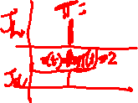
Basic Priority-Inheritance Protocol - Preliminaries
Assigned Priority: Priority assigned to a job according to the scheduling algorithm
At any time $t$, each ready job $J_{l}$ is scheduled and executes at its current priority $π_{l}(t)$, which may differ from its assigned priority and may vary with time
The current priority $π_{l}(t)$ of a job $J_{l}$ may be raised to the higher priority $π_{h}(t)$ of another job $J_{h}$ → $J_{l}$ inherits the priority of higher priority job $J_{h}$ and executes at inherited priority $π_{h}(t)$

Slide 7
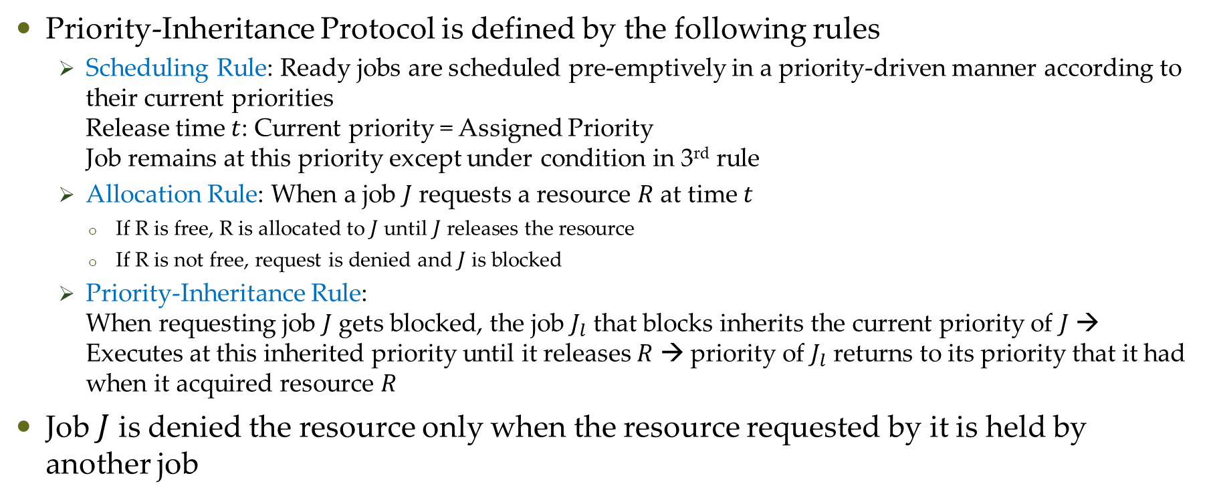
Basic Priority-Inheritance Protocol - Definition
Priority-Inheritance Protocol is defined by the following rules
Scheduling Rule: Ready jobs are scheduled pre-emptively in a priority-driven manner according to their current priorities Release time $t$: Current priority = Assigned Priority Job remains at this priority except under condition in 3rd rule
Allocation Rule: When a job $J$ requests a resource $R$ at time $t$
If R is free, R is allocated to $J$ until $J$ releases the resource
If R is not free, request is denied and $J$ is blocked
Priority-Inheritance Rule: When requesting job $J$ gets blocked, the job $J_{l}$ that blocks inherits the current priority of $J$ → Executes at this inherited priority until it releases $R$ → priority of $J_{l}$ returns to its priority that it had when it acquired resource $R$
Job $J$ is denied the resource only when the resource requested by it is held by another job

Slide 8
Basic Priority-Inheritance Protocol - Example
Priority Inheritance

Slide 9
Basic Priority-Inheritance Protocol – Complex Example

Slide 10
Questions?

